Slide 1

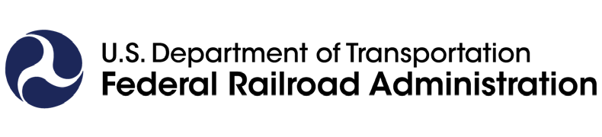
RAIL
MOVING AMERICA FORWARD
FRA 101: Our Mission, Work, and Structure
October 12, 2023

Slide 2
History and Mission

Slide 3
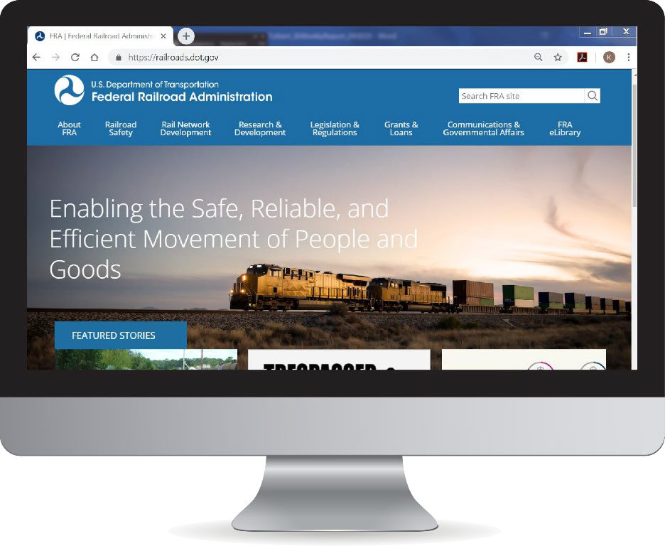
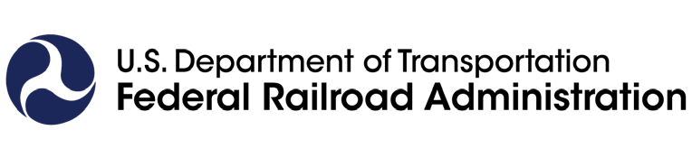
We Are FRA
History:
Created by the Department of Transportation Act of 1966; one of ten agencies within DOT concerned with intermodal transportation
Mission:
The Federal Railroad Administration's (FRA) mission is to enable the safe, reliable, and efficient movement of people and goods for a strong America now and in the future.
Vision: RAIL – Moving America Forward
FRA accomplishes this mission primarily through:
Carrying out a robust railroad safety enforcement, oversight, and technical assistance program
Managing Federal investments in freight and passenger rail across the country
Research and development of new technologies and operating practices

Slide 4
Structure and Organization

Slide 5
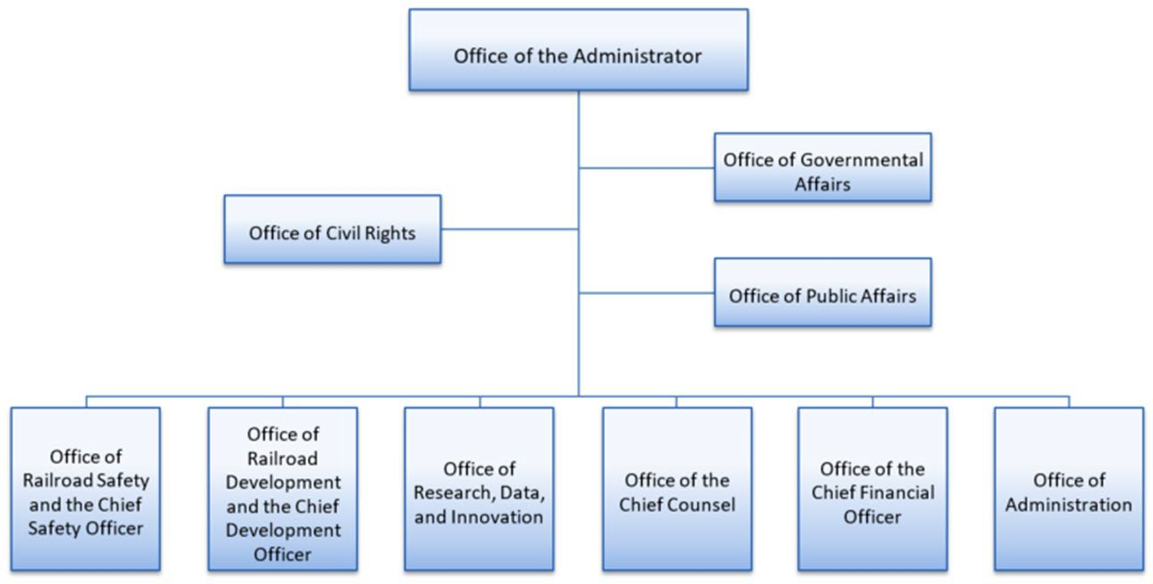
FRA Offices
FRA is organized into seven primary offices that collaborate to support our mission and uphold DOT’s strategic priorities:
1,117 employees as of March 23, 2024

Slide 6
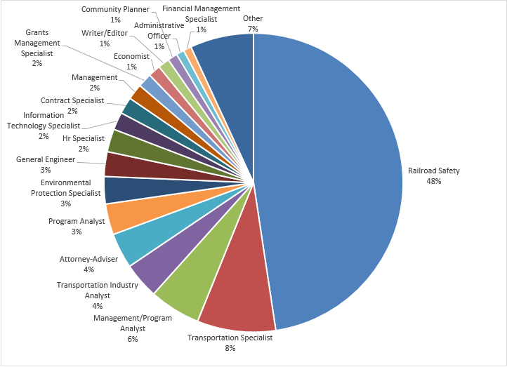
Who We Are - Updated
At the end of FY 2023, FRA’s workforce totaled 1,047 employees on board.
48% of FRA’s workforce is in the Railroad Safety series (GS 2121)
RRS is FRA’s largest program office, with 61% of the workforce
Employees work in every state except Alaska and Hawaii

Slide 7
Industry Overview

Slide 8
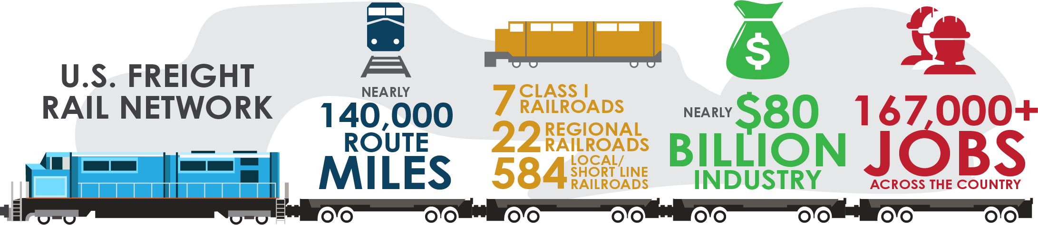
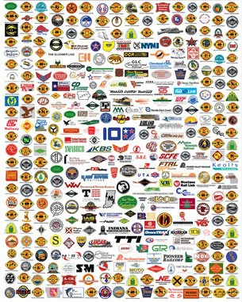






Overview of U.S. Freight Rail Network
6
Class II & III Railroads
Class I Railroads
11
8

Slide 9
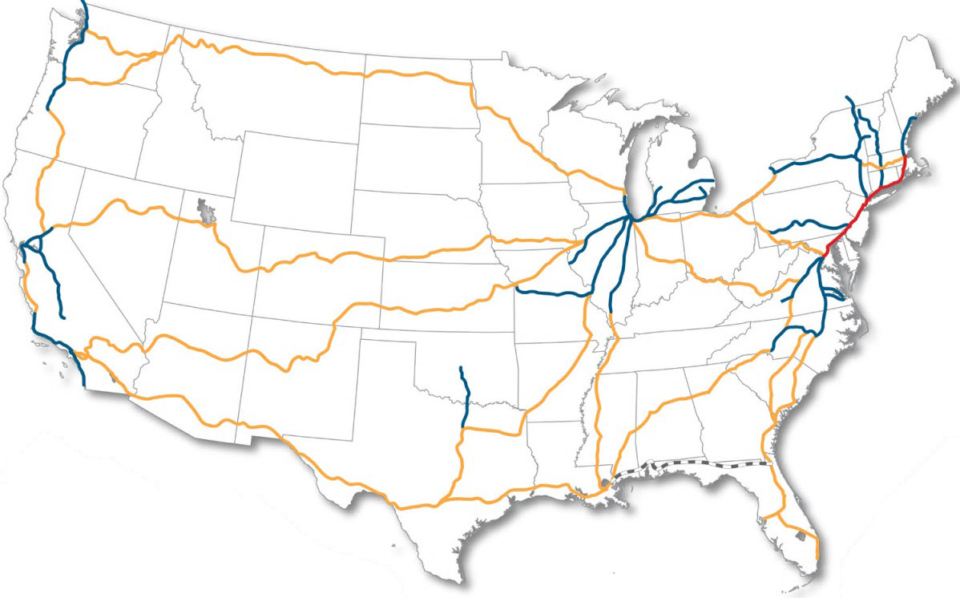
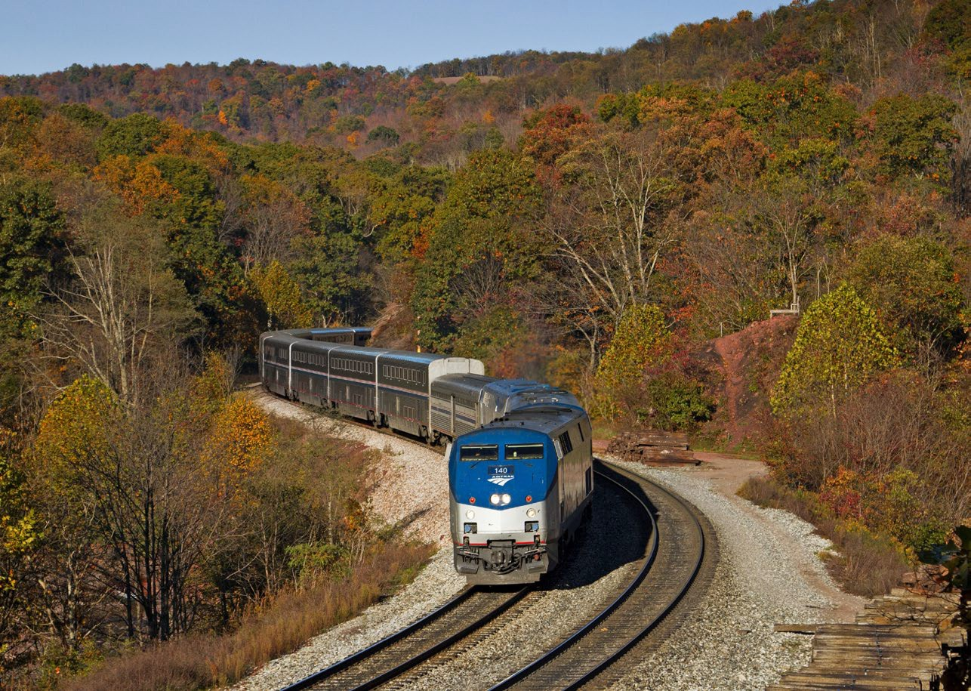

Overview of Amtrak Passenger Rail Network
12.1M
Passenger Trips on
the Northeast
12.5M
Passenger Trips on
State Supported
3.9M
Passenger Trips
on Long Distance
28.6M
Total
Passenger Trips on
Corridor (NEC)*
Routes*
Routes*
Network*
Amtrak’s Rail Network
Northeast Corridor State Supported Long Distance Suspended service
*FY23 Ridership Data

Slide 10
Safety

Slide 11
Railroad Safety Technical Disciplines
More than 350 Federal safety inspectors specialize in one of six technical disciplines focusing on compliance and enforcement.
Highway-Rail Grade Crossing Safety and Trespass Prevention
Signal, Train Control, and Crossings (ST&C)
Motive Power and Equipment
Operating Practices
Hazardous Materials
Track
FRA also employs specialists, engineers, analysts, and managers with expertise in areas such as PTC, passenger rail, human performance, alcohol and drug programs, tank car quality assurance, rail and infrastructure integrity, bridge safety, occupational health, radioactive materials, and railroad management.
33 states and the District of Columbia participate in the State Safety Program; about 220 state inspectors contribute more than 15,000 inspection days and nearly 19,000 inspections.

Slide 12
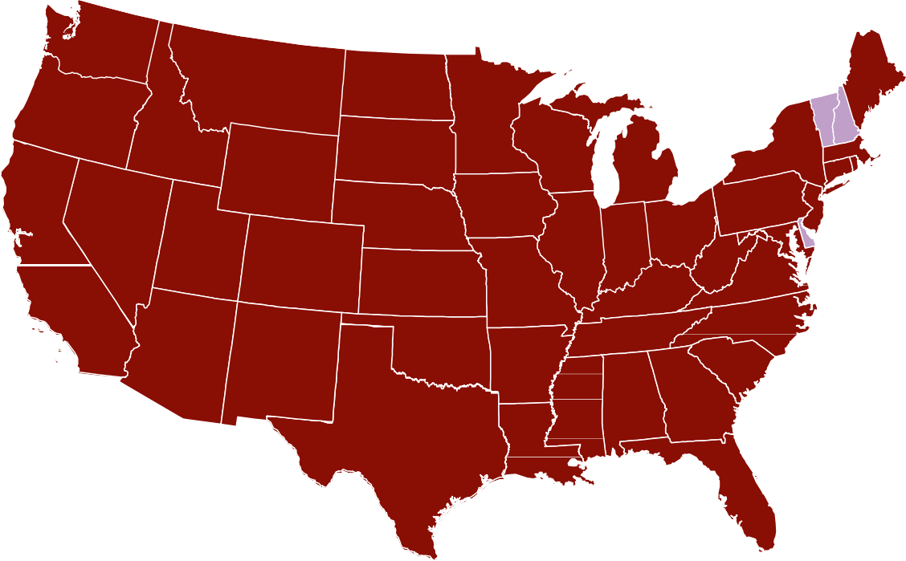









FRA Safety Management Teams
FRA Safety Management Teams are assigned to a single railroad or group of railroads.
District 8 Vancouver, WA SMT 8: Short lines West
District 1 Cambridge, MA SMT 1: Amtrak, Commuters East
Develop and manage senior-level relationships with railroads, associations, and labor organizations.
Understand the structure, safety culture, operations, infrastructure, and territory of their railroads.
Work with railroads to improve rail safety and outcomes.
District 4 Chicago, IL
SMT 4: CN, CPKC
District 2 Wilmington, DE SMT 2: Short Lines East
District 7 Sacramento, CA SMT 7: Commuters West
District 6 Kansas City, MO SMT 6: UP
Headquarters Washington, DC
District 3 Atlanta, GA SMT 3: NS
District 5 Fort Worth, TX SMT 5: BNSF
District 9 Jacksonville, FL SMT 9: CSX

Slide 13
Railroad Development

Slide 14
BIL | FRA Advance Appropriations
[ ADVANCE APPROPRIATIONS ]
From FY22-FY26
$66B
in total
funding
Consolidated Rail Infrastructure and Safety Improvements (CRISI)
Federal-State
Partnership (FSP) for Intercity Passenger Rail
Railroad Crossing Elimination (RCE)
Restoration & Enhancement
Amtrak
[ ADVANCE APPROPRIATIONS ]
[ ADVANCE APPROPRIATIONS ]
[ ADVANCE APPROPRIATIONS ]
[ ADVANCE APPROPRIATIONS ]
[ ADVANCE APPROPRIATIONS ]
$22B
$5B
$3B
$36B
$250M

Slide 15
Summary Table of FRA Grant Programs Under BIL
Programs | Purpose | Advanced Appropriations | Additional Authorized Over Five Years | Total
Consolidated Rail Infrastructure and Safety Improvements (CRISI) | To fund projects that improve the safety, efficiency, or reliability of intercity passenger and freight rail. | $5 billion ($1 billion annually) | $5 billion ($1 billion annually) | $10 billion
Railroad Crossing Elimination (New) | To promote highway-rail or pathway-rail grade crossing improvement projects that focus on improving the safety and mobility of people and goods. | $3 billion ($600 million annually) | $2.5 billion ($500 million annually) | $5.5 billion
Federal-State Partnership for Intercity Passenger Rail (Significantly Changed) | To fund capital projects that reduce the state of good repair backlog, improve performance, or expand or establish new intercity passenger rail service, including privately operated intercity passenger rail service if an eligible applicant is involved. | $36 billion ($7.2 billion annually) | $7.5 billion ($1.5 billion annually) | $43.5 billion
Restoration & Enhancement | To provide operating assistance to initiate, restore, or enhance intercity passenger rail service. | $250 million ($50 million annually from Amtrak National Network fund) | $250 million ($50 million annually) | $500 million
Interstate Rail Compacts (New) | This program will provide funding for interstate rail compacts' administrative costs and railroad systems planning, promotion of intercity passenger rail operations, and the preparation of grant applications. | $15 million ($3 million annually from Amtrak National Network fund) | $15 million ($3 million annually) | $30 million

Slide 16
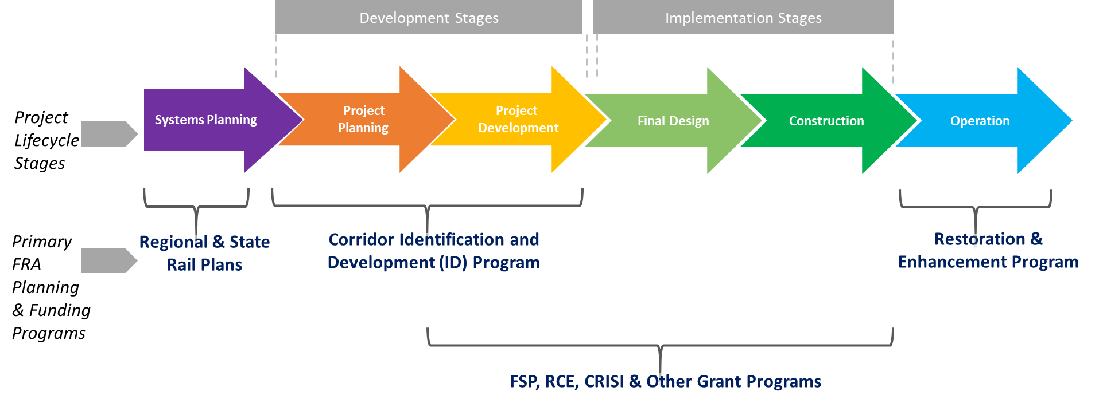
FRA Project Lifecycle and Program Framework

Slide 17
Amtrak

Slide 18

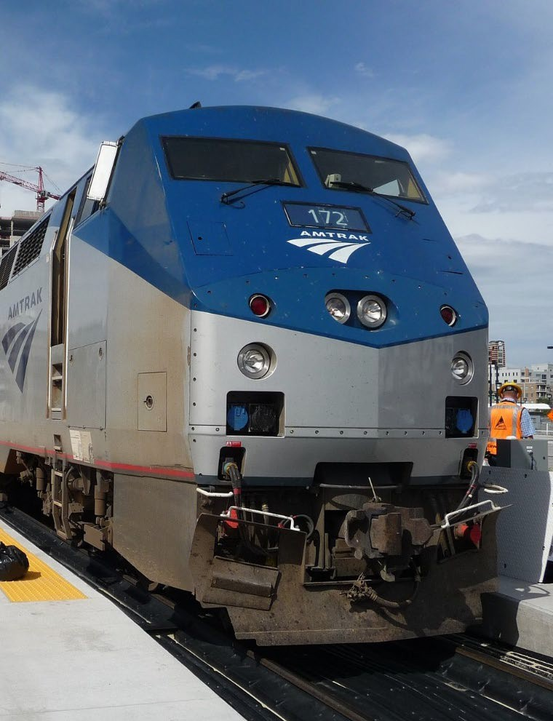
FRA’s Role in Amtrak Passenger Service
Amtrak is congressionally chartered by the Rail Passenger Service Act of 1970.
A for-profit corporation, independent for purposes of day-to-day operations; the Federal government exercises long-term control.
Reliant, in part, on annual federal and state appropriations.
Amtrak operates a nationwide passenger rail network, including:
High-speed, high-frequency Northeast Corridor (NEC) services.
State-supported short-distance corridor service in heavily populated regions.
Long-distance services connecting rural areas and distant population centers.

Slide 19
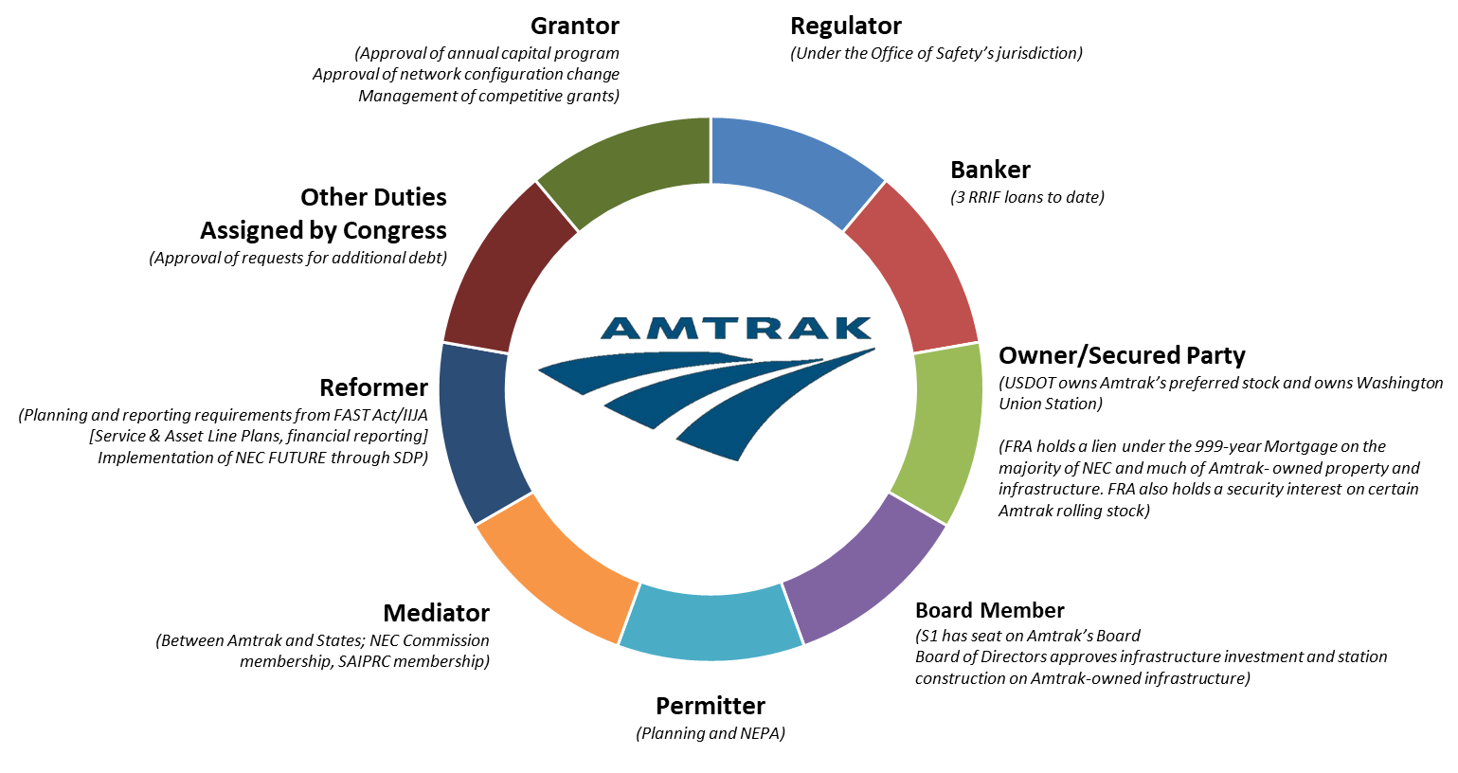
FRA’s Role in Amtrak Passenger Service

Slide 20
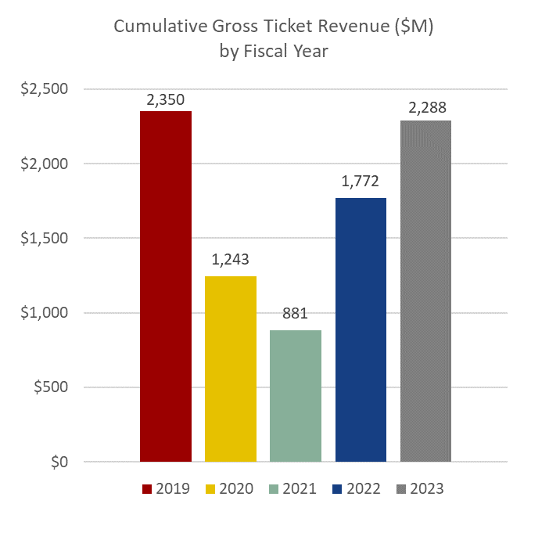
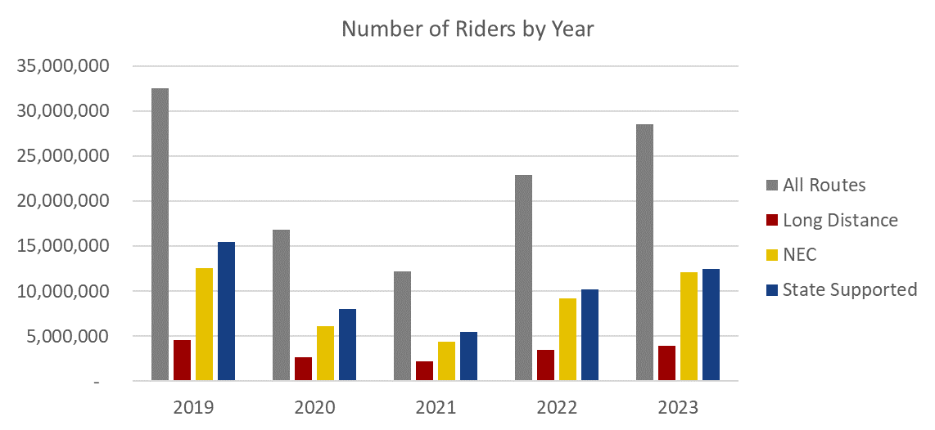
Amtrak Performance
Amtrak FY23 Ridership & Ticket Revenue
Amtrak’s ridership and ticket revenue surpassed FY22 results but fell short of surpassing 2019 results.
In FY23, ridership peaked in July at 2.76 million riders. This is more than 90% of the pre-pandemic peak ridership measured in July 2019 at 2.97 million riders.
Data Source: Amtrak Performance Dashboard
Data Source: Amtrak Performance Dashboard
Notes:
*Note: FY21 Ticket Revenue is unavailable in the Amtrak Performance Dashboard for August and September '21.

Slide 21
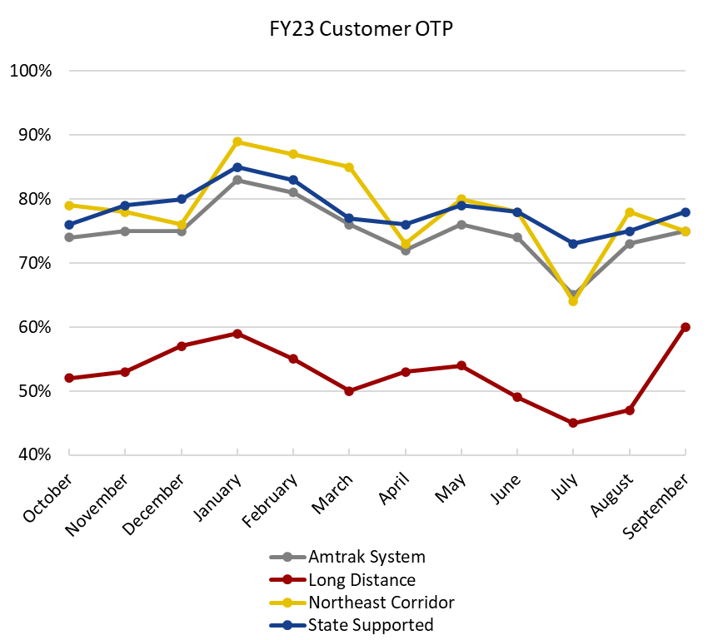
Amtrak Performance
OTP & FRA Quarterly Reporting
At the system-level FY23 Customer OTP was comparable to FY22.
  Long Distance Service Customer OTP showed improvements over FY22. FY22 experienced four months of Customer OTP below 40%.
In FY23, FRA published quarterly reports on Metrics and Standards, including OTP for all Amtrak routes and trains.
In July, STB began their investigation into poor performance along the entire Sunset Limited Route, of which UP hosts around 90%.
Data Source: Amtrak Monthly Performance Report

Slide 22
FRA Appropriations Accounts Overview

Slide 23
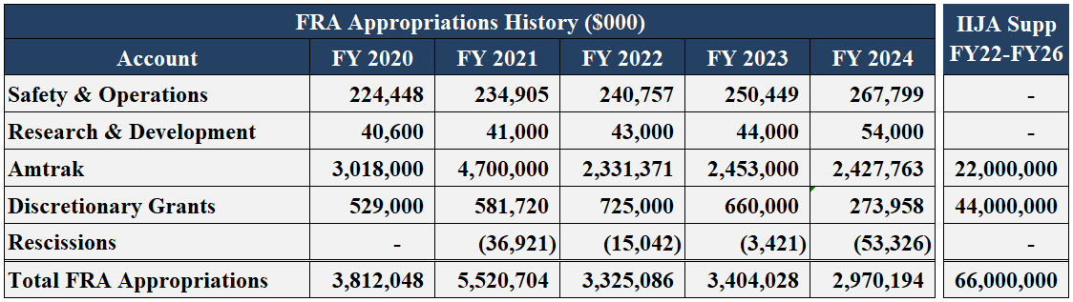
Accounts Overview
Safety & Operations
Research & Development
FRA administers four primary groups of funding accounts
Following significant funding increases for rail under the 2009 Recovery Act (ARRA) and FY10 appropriations, FRA’s budget averaged between $1.6B-$1.7B annually until FY17, when Congress began appropriating funds for FRA’s FAST Act grant programs
Amtrak Grants
Discretionary Grants
In addition to FRA’s traditional annual budget/appropriations, the IIJA provides $13.2 billion each year in supplemental advance appropriations from FY22-FY26

Slide 24
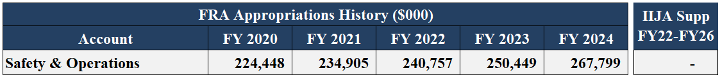
Accounts Overview – S&O
Safety & Operations
85% of S&O funding is dedicated to core mission support activities and fixed costs (salaries, rent, Working Capital Fund, travel/fleet, etc.). Funding also supports several discrete railroad safety programs, such as the Automated Track Inspection Program, Confidential Close Call Reporting System, and grade crossing/trespass prevention activities
Research & Development
Payroll is the largest S&O spend category, accounting for more than 60% of the budget
Amtrak Grants
Since FY17, Congress has directed FRA to allocate specific S&O amounts to a number of FRA’s safety programs. FY24 congressional directives include:
Automated Track Inspection Program (ATIP, not less than $18M)
Confidential Close Call Reporting System (C3RS, up to $4.5M)
Highway-Rail Grade Crossing Safety (up to $3.25M)
Trespasser Prevention (up to $3M)
Grant/Project Development Technical Assistance (up to $0.5M)
Positive Train Control (up to $1M)
Discretionary Grants

Slide 25
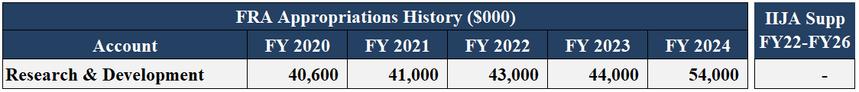
Accounts Overview – R&D
Safety & Operations
FRA’s R&D program provides the scientific and engineering foundation for the agency’s safety enforcement, oversight, and regulatory efforts
Research & Development
FRA R&D also advances transformative, next-generation safety technologies and human factors research that spurs innovation, efficiency gains, and safer operating practices across the railroad industry
Amtrak Grants
The program is also expanding climate and resiliency research, including the efficacy of clean fuels and advanced motive power technologies to improve energy efficiency and reduce emissions of rail transportation
IIJA specified two new set-asides within the R&D program:
Discretionary Grants
Up to $3M annually for building repair and rehabilitation at FRA’s Transportation Technology Center in Pueblo, CO
Up to 10% of funds to establish and maintain a Rail R&D Center of Excellence with institutions of higher learning

Slide 26
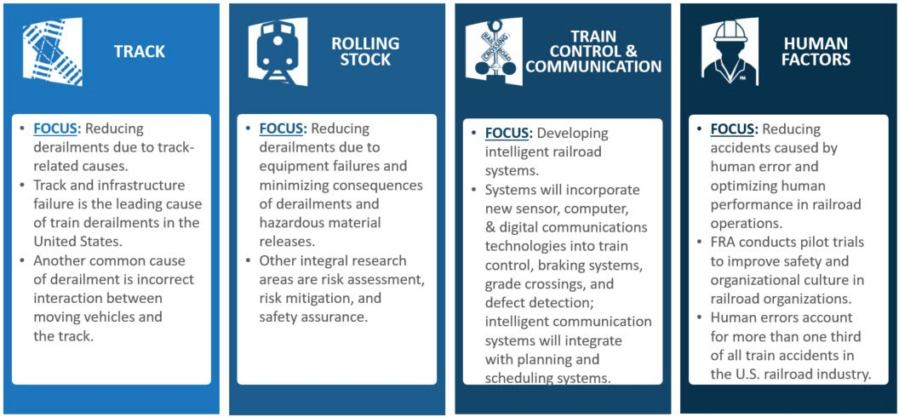
Accounts Overview – R&D Research Programs
Safety & Operations
Research & Development
Amtrak Grants
Discretionary Grants

Slide 27
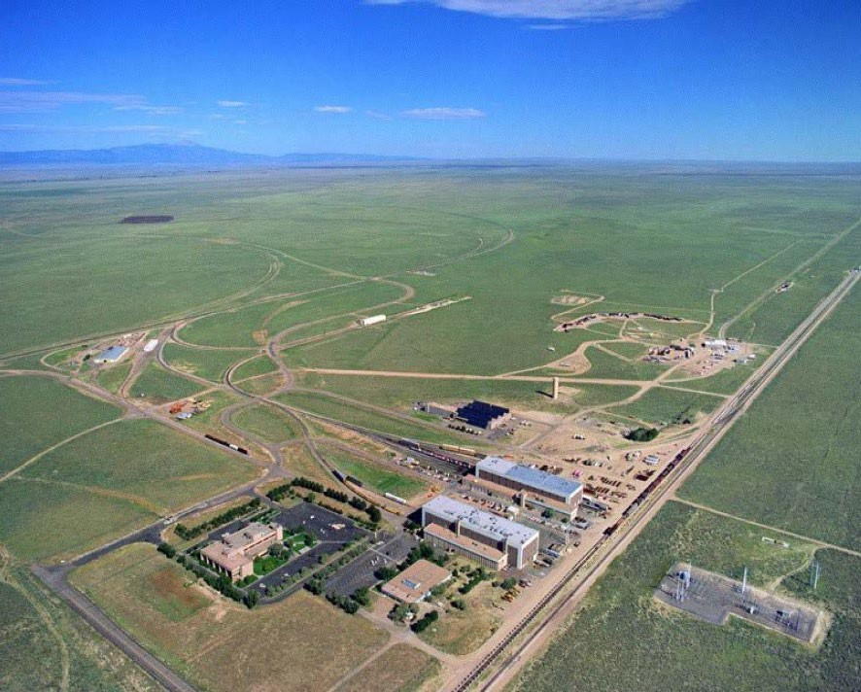
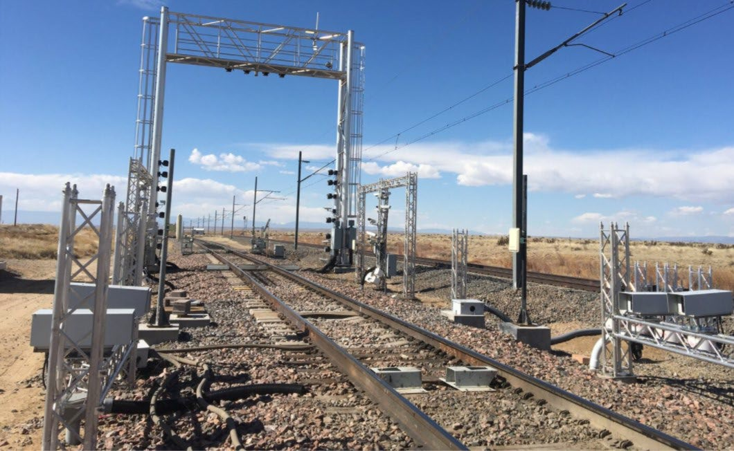
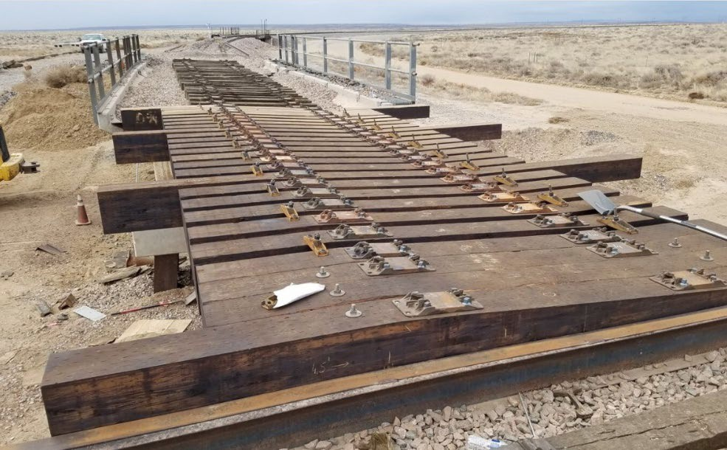
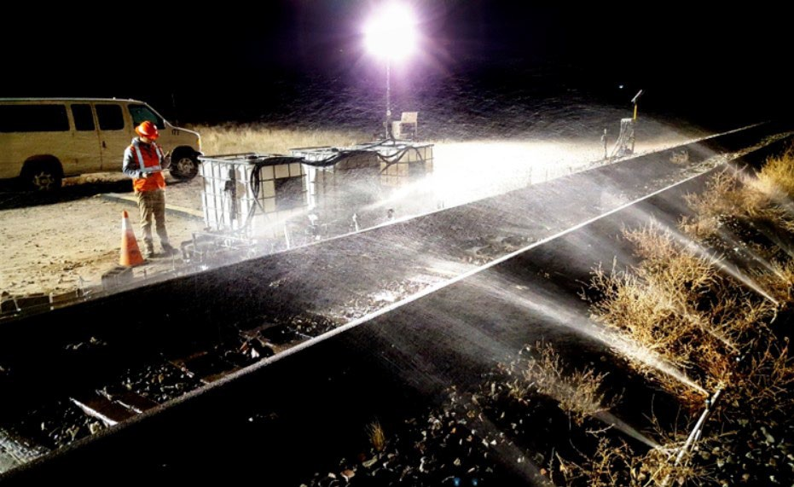
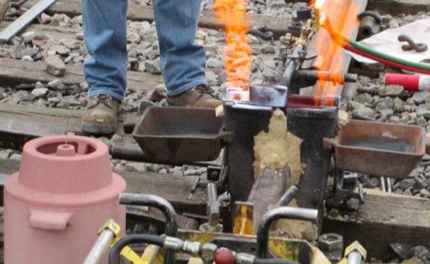
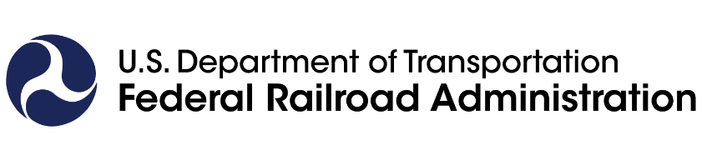
Transportation Technology Center (TTC)
FRA’s Transportation Technology Center in Pueblo, Colorado has played an important part in research, development, and testing of rail infrastructure and equipment

Slide 28
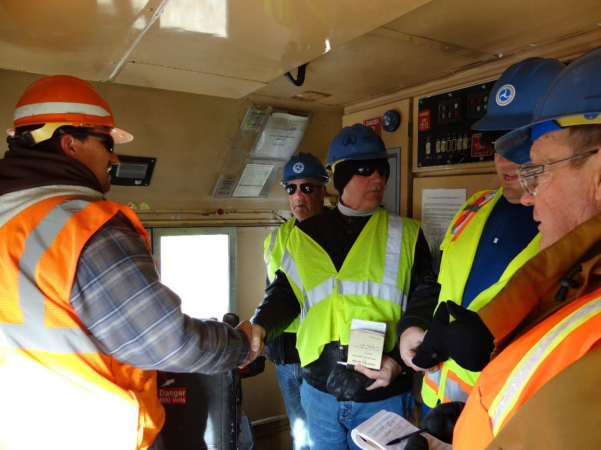
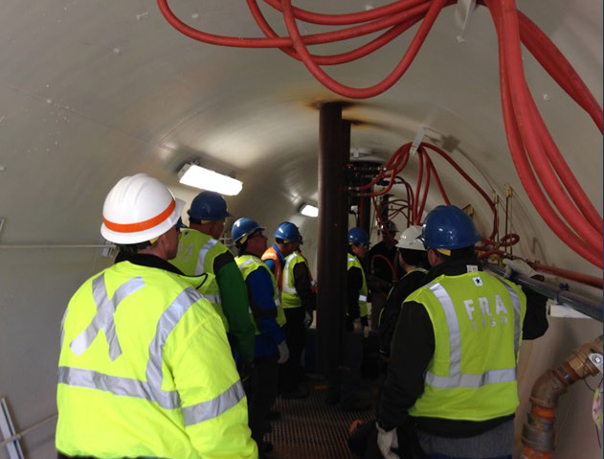
FRA’s Training Role at the TTC: Unequaled Hands-On Employee Training
FRA utilizes TTC for technical training of Office of Railroad Safety field inspectors and specialists.
TTC offers hands-on training with practical exercises. Students learn in an environment the same as their work environment, applying new skills right outside the classroom.
  Field Inspectors learn on actual equipment with real defects.
  Students investigate mock accidents to learn investigation skills.
  Positive Train Control (PTC) skills are taught on locomotive simulators and on actual PTC locomotives.
FRA partners with the Transportation Safety Administration (TSA) Surface Operations to maintain two shared classrooms.
  TSA trains surface inspectors to search actual rail cars and to identify evidence that a derailment is vandalism or sabotage.
TTC offers more than 75 week-long courses per year and trains nearly a thousand students each year.

Slide 29
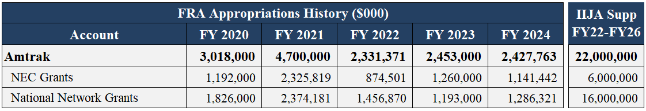

Accounts Overview – Amtrak
Safety & Operations
Research & Development
Until FY03, FRA largely served as a pass-through entity for Amtrak funding
From FY06 to FY16, Amtrak received one appropriation for operating assistance and one appropriation for capital projects and debt service
Amtrak Grants
The FAST Act created a new account structure and reporting requirements to eliminate the cross subsidization of NEC surpluses to losses in other Amtrak service lines and increase transparency on the use of Amtrak funds; FAST Act account structure first funded in FY17
Discretionary Grants

Slide 30
Accounts Overview – Amtrak
Safety & Operations
Amtrak’s annual grant supports Amtrak’s base operating, capital, and debt service needs
A robust base Amtrak appropriation is required to support Amtrak’s operating needs on the National Network, maintain existing infrastructure and equipment, and continue addressing the programmatic capital renewal backlog on the NEC
Research & Development
Amtrak Grants
IIJA delineates clear purposes for the $22B in direct Amtrak funding:
Replace aging rolling stock/related facilities
Eliminate SOGR backlog on Amtrak-owned sole benefit NEC assets
Eliminate SOGR backlog on Amtrak-owned National Network assets
Eliminate backlog of Amtrak support assets (e.g. reservations, security, training, IT)
Eliminate ADA stations backlog
Advance NEC capital renewal backlog projects
  However, IIJA funding alone will not eliminate this programmatic backlog
Discretionary Grants

Slide 31
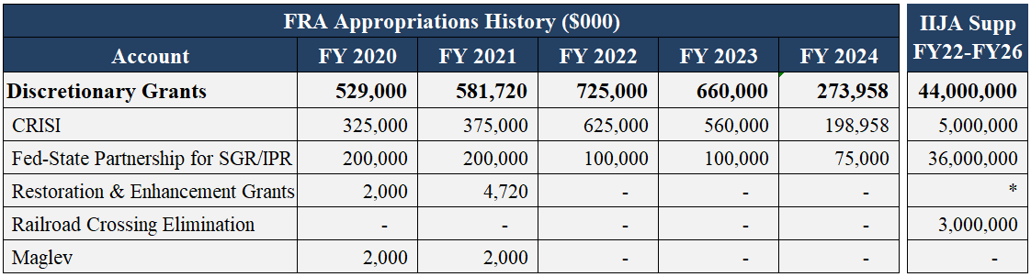
Accounts Overview – Discretionary Grants
Safety & Operations
F
A
A _{C}
S _{T} T
Research & Development
The appropriations provided for the FAST Act programs—which were reauthorized in IIJA—represent the most consistent commitment by Congress for discretionary rail grants since 3R Act/4R Act deregulation
Amtrak Grants
In addition to significantly expanding FRA’s grant portfolio, these programs broadened the pool of eligible recipients, which has resulted in significant investment directly to short line railroads through the CRISI program
Renewed interest and pursuit of remaining SAFETEA-LU maglev funds by the private sector, including hyperloop firms, led to new maglev appropriations to FRA in recent years (including $5M set-asides in CRISI in FY22 and FY23 annual funding)
Discretionary Grants
*$50M provided per year for Restoration & Enhancement grants as a set aside from the $16B provided to Amtrak's National Network account.

Slide 32
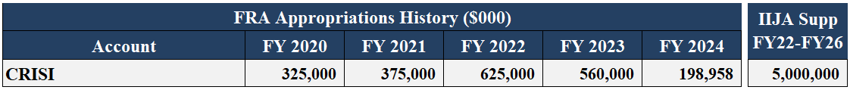

Accounts Overview – Consolidated Rail Infrastructure & Safety Improvements (CRISI)
Safety & Operations
CRISI supports a wide range of projects to improve the safety, efficiency, and/or reliability of intercity passenger and freight rail systems
Research & Development
Eligible recipients include state and local governments, Class II/III railroads, Amtrak and other intercity passenger rail operators, Indian Tribes, TRB, UTCs, and rail labor orgs
20% non-Federal match (preference for 50%) and at least 25% of funding reserved for rural areas
Amtrak Grants
Historically FRA’s most-oversubscribed program
FY23 annual set-asides included:
>$150M for new intercity passenger rail routes
>$25M for trespass prevention
$5M for maglev
$5M for workforce development
$30.4M for congressionally directed spending
Only FY24 set-aside was $98.9M for congressionally directed spending
Discretionary Grants
31

Slide 33
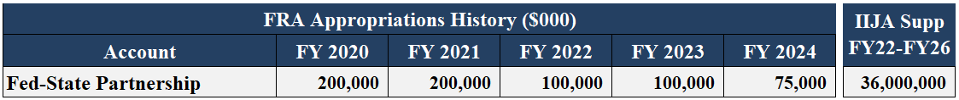
Accounts Overview – Federal State Partnership (FSP) for Intercity Passenger Rail
Safety & Operations
IIJA renamed and expanded the Partnership program, to more broadly support intercity passenger rail projects across the country and enable previously ineligible planning and project development activities to be funded.
Research & Development
Eligible recipients include state and local governments, Amtrak, and Indian Tribes
20% non-Federal match and 5% set-aside for planning related to the IIJA Corridor Identification and Development (Corridor ID) planning process
Amtrak Grants
IIJA reauthorization and the supplemental advance appropriations established different criteria, processes, funding allocations for NEC vs. non-NEC projects (i.e. National):
  Supplemental provides up to $24B for NEC and $12B for National; annual authorization requires no less than 45% of funding for each
  NEC project selections driven by a new NEC Project Inventory; National project selections will eventually provide preference for projects developed through Corridor ID
Discretionary Grants
Program allows for Letters of Intent and new Phased Funding Agreements to make contingent commitments and help more efficiently implement largescale projects

Slide 34
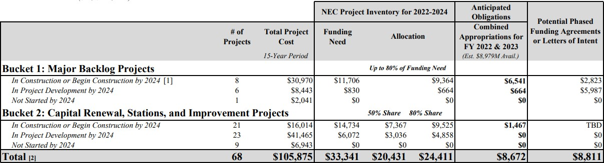
Accounts Overview – Federal State Partnership for Intercity Passenger Rail
Safety & Operations
NEC Project Purposes:
Major state of good repair projects
Improvement projects to increase capacity and service performance (including station redevelopment and expansion)
Programmatic capital renewal backlog
Planning, engineering, and environmental prerequisites
Research & Development
NEC Planning Process:
Amtrak Grants
First NEC Project Inventory published November 14, 2022
Informed by extensive collaboration with NEC Commission
Identifies and allocates funding for NEC projects, prioritizing major backlog projects
Discretionary Grants

Slide 35
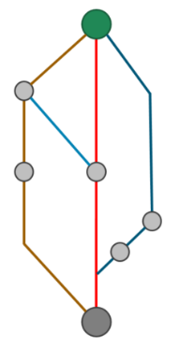
Accounts Overview – Federal State Partnership for Intercity Passenger Rail
Safety & Operations
National Project Purposes:
Initiating intercity passenger rail service on new or restored corridors
Improvements in frequencies and trip times on existing State-Supported and Long-Distance services
New and improved stations
Planning, engineering, and environmental prerequisites
Research & Development
National Planning Process:
Amtrak Grants
Corridor ID planning process is intended to establish a pipeline of intercity passenger rail corridors and projects for development
Corridor sponsors selected under the program will partner with FRA to prepare a Service Development Plan for their selected corridor and advance capital projects
Discretionary Grants

Slide 36
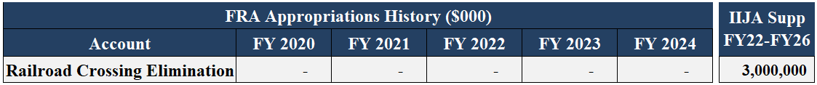
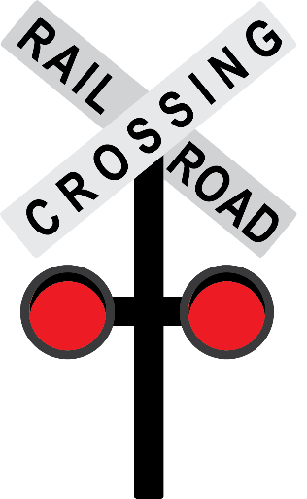
Accounts Overview – Railroad Crossing Elimination
Safety & Operations
New program under IIJA to fund highway-rail or pathway-rail grade crossing improvement projects that focus on improving the safety and mobility of people and goods
Research & Development
Eligible recipients include state and local governments, Indian Tribes, public port authorities, and MPOs
20% non-Federal match, minimum award of $1M, at least 20% of funding reserved for rural areas or Tribal lands, at least 3% for planning, and 0.25% for safety information and education programs
Amtrak Grants
Not more than 20% of funds can be awarded to a single state
Discretionary Grants
Program provides opportunity fund complex grade separations and corridor-wide safety solutions that are difficult to fund under other Federal grant programs

Slide 37
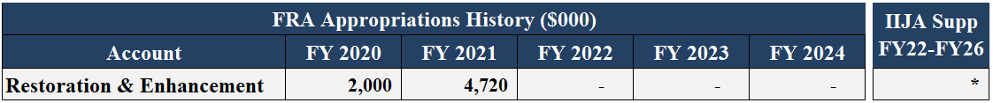
Accounts Overview – Restoration & Enhancement Grants
Safety & Operations
Provides operating assistance grants to initiate, restore, or enhance intercity passenger rail services
Eligible recipients include state and local governments, Amtrak and other intercity passenger rail operators, and Indian Tribes
Research & Development
Grantees may receive up to six years of operating assistance for a route and no more than six grants may be active under the program simultaneously
Amtrak Grants
The non-Federal match increases from 10 percent in the first year of the grant to 70 percent in the sixth and final year of the grant
R&E grants will complement the new and expanded intercity passenger rail services
funded under IIJA by offsetting the operating subsidy requirements of new services
Discretionary Grants
As the ridership and revenue base of these services grow, the R&E support is phased out over six years
*$50M provided per year for Restoration & Enhancement grants as a set aside from the $16B provided to Amtrak's National Network account.

Slide 38


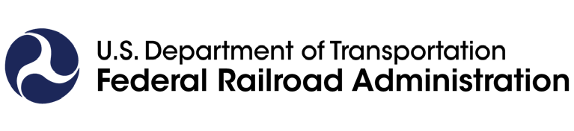
QUESTIONS?

