Slide 1
Post-Accident Training
Part 219
Subpart C Testing Requirements
Revised: January 1, 2025
This is a tool to assist railroads and contractors in providing the required minimum FRA post-accident training for supervisors responsible for regulated service employees per Part 219.11 (g).
Notes:
This is a tool to assist railroads and contractors in providing the required FRA post-accident training for supervisors responsible for regulated service employees per Part 219.11 (g). The requirement is to provide training on the qualifying criteria for FRA post-accident testing, and the role of the supervisor in post-accident collections.
Note that in addition to this training on post-accident testing, railroads and regulated contractors are also required to provide training on signs & symptoms of alcohol & drug influence, intoxication and misuse.

Slide 2
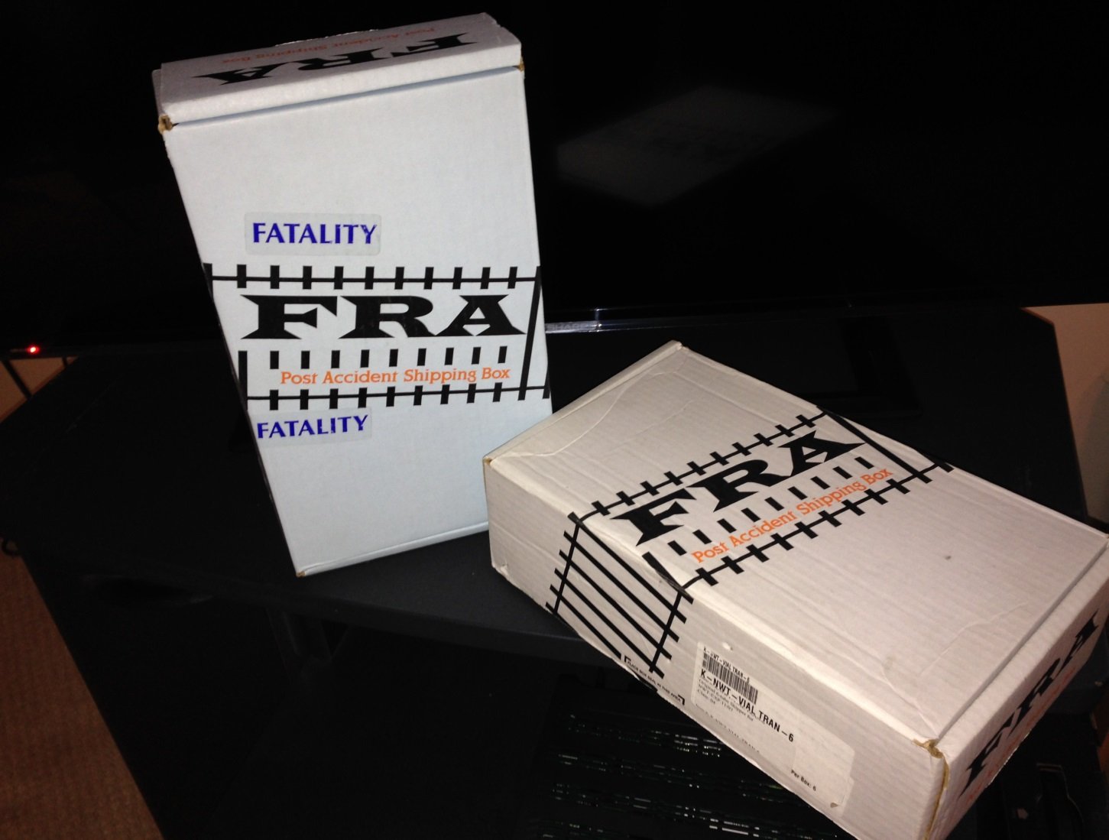
Post-Accident Tox Boxes
Notes:
When you have a qualifying post-accident event, determine which box - either the standard box, post-mortem box or both - your railroad and contractors will use to collect urine and blood specimens. Standard Tox Box is white in color and used for surviving employees to be tested. Blue Tox box is used for fatalities that are required to be tested. The railroads will be responsible for maintaining a supply of post-accident toxicological boxes for their and contractors’ usage and ensure distribution as needed.

Slide 3
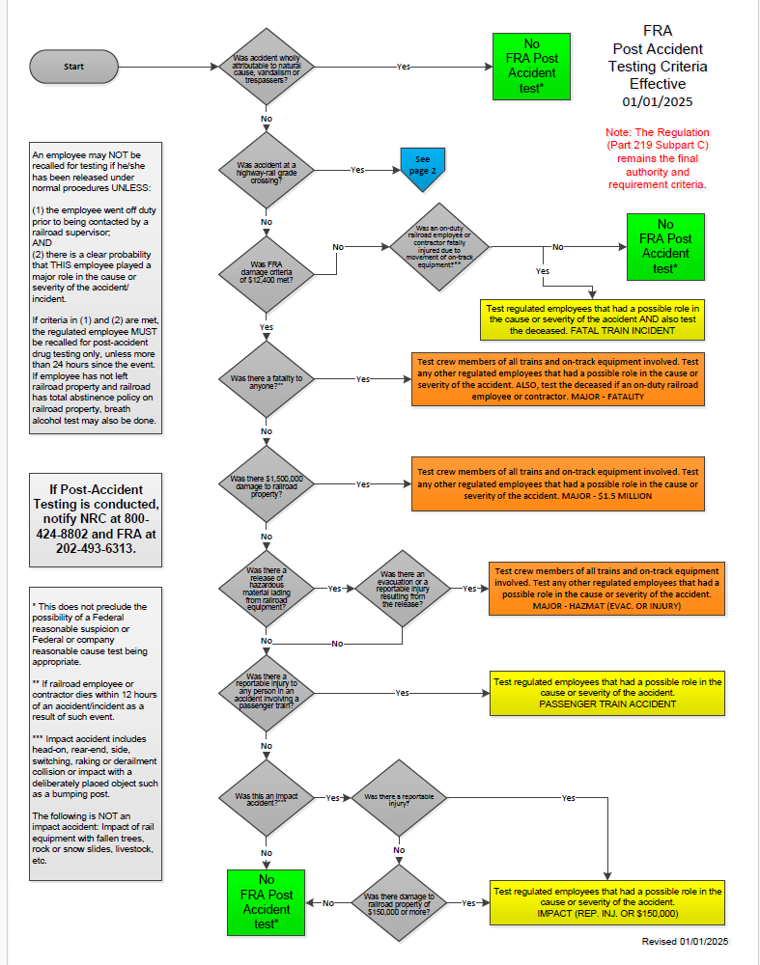
Notes:
Your guide to successful Post Accident Testing. This is page one of the new FRA Post Accident Testing Chart revised January 1, 2025.

Slide 4
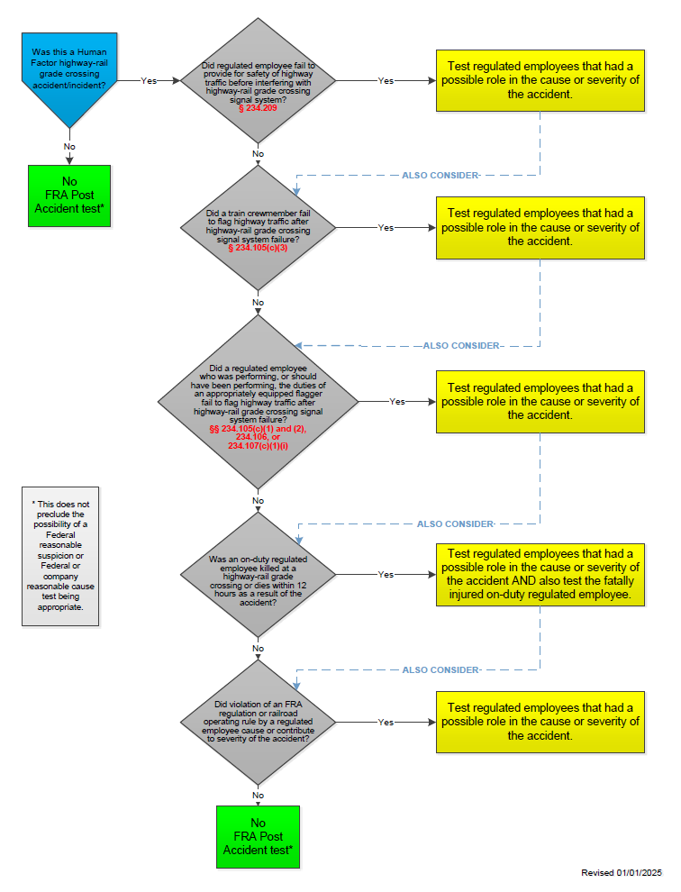
Notes:
This is page two of the FRA Post Accident Testing Chart dealing with the testing requirements regarding Human-Factor Highway-Rail Grade Crossing Accident/Incidents.

Slide 5
Post-Accident Qualifying Events
Major Train Accident
Impact Accident
Passenger Train Accident
Fatal Train Incident
Human-Factor Highway-Rail Grade Crossing Accident/Incidents
All have to first meet the $12,400 monetary reporting threshold except for which type?
Notes:
Answer: Fatal Train incident or Human-Factor Highway-Rail Grade Crossing Accident/Incidents
Note: The FRA monetary reporting threshold sometime changes and FRA issues a Notice reflecting any change in threshold amounts prior to January 1st each year. Currently the FRA monetary reporting threshold is $12,400.

Slide 6
Post-Accident Testing Exceptions
Exceptions from testing:
Highway/rail grade crossing accident unless it meets the Human Factor criteria set forth above in 219.201(a)(5)(i-v).
Wholly natural-caused accident or incident (flood, tornado, etc.)
Wholly caused by vandalism or trespasser(s)
Is a sun kink of wholly natural cause?
Notes:
Answer: No, in almost every case there has been recent track repair which may have contributed to the sun-kink (MOW possible cause or severity). There may also be cases where a heat order should have been issued and wasn’t (MOW and/or Dispatch possible cause or severity); or a heat order was issued and not complied with by the crew (T&E possible cause or severity).
Even in cases of washouts due to excessive rain, the railroad needs to determine if special track inspections were conducted per the track regulations (MOW possible cause) or was there a dispatcher error (Dispatch possible cause) regarding warning or speed restriction or train crew compliance with such (T&E possible cause).

Slide 7
Highway/Rail Grade Crossing Accident Exception
One rationale for this exception is that a heavy train operating at high speeds requires a long stopping distance that would not allow the crew sufficient time to avoid an accident by the time the motor vehicle is spotted on the railroad tracks.
The second rationale is that motor vehicle operators cause the vast majority of these accidents since the train has the right of way over motor vehicles at public crossings.
In the case of a mechanical employee struck by a hump yard switching crew while backing his pickup truck onto a yard crossing, this exception would not apply, and consideration should be made as to whether this was a qualifying post-accident testing event.
Notes:
Human-factor highway-rail grade crossing accident/incident

Slide 8
Post-Accident Qualifying Events
Major Train Accident - Rail equipment accident $12,400+ that involves one or more of these:
Fatality of an on-duty railroad employee or regulated contractor; or
Release of hazmat lading with an
  Evacuation; or
  Reportable injury from hazmat;
$1.5 Million+ railroad property damage
Notes:
The $12,400 amount is the current (2025) FRA Part 225 Monetary Threshold Reporting dollar amount and could change for each calendar year.
We get a few of these definitions from Part 219, but others come from Part 225 (Accident/Incident Reporting) and its supplementary FRA Guide for Preparing Accident/Incident Reports.
For example, let’s look at the definition of Train Accident which means a rail equipment accident. Rail equipment accidents are collisions, derailments, fires, explosions, acts of God, & other events involving the operation of on-track equipment (standing or moving).
Includes damage to track, track structures, on-track equipment, signals, or roadbed.
ON-TRACK EQUIPMENT: Note that the FRA Guide for Preparing Accident/Incident Reports defines on-track equipment to include an equipment consist (train, locomotive, cut of cars, or a single car not coupled to another car or locomotive), locomotive, motorcar, train, yard switching train, or work train. These definitions include a track motorcar, hi-rail vehicle, push car, crane, ballast tamping machine.

Slide 9
Evacuation
An evacuation is the relocation of people to a safe area to avoid exposure. It is normally initiated by local authorities, usually by the responding fire or police department, and may be either a mandatory or voluntary evacuation.
Notes:
Homeowners and businesses evacuating an area without being directed to do so, would not meet the criteria for a post-accident test.

Slide 10
Fuel Oil Spill
A fuel oil spill from the fuel tank of a locomotive, although a hazardous material, is not considered hazmat “lading” since the fuel tank is part of the locomotive. Nor would it be considered a release of hazmat lading if a fuel tender car(s), connected to the locomotive (as part of the locomotive consist) would spill fuel oil.
However, if a fuel tender car is not part of a locomotive consist, any fuel oil spill would be considered hazmat lading.
Notes:
Part 219 Interpretation

Slide 11
Post-Accident Qualifying Events
Impact Accident – Rail equipment accident $12,400+ resulting in:
A reportable injury; or
$150,000 railroad property damage
Includes head-on, rear-end, side, switching, raking or side collision or impact with bumping post
Doesn’t include impact of rail equipment with fallen trees, rock or snow slides, livestock, etc.
Notes:
Definition of an Impact accident.
A head-on or rear-end collision between on-track equipment;
A side collision, derailment collision, raking collision, switching collision, or “other impact accident,” as defined by this section;
Impact with a deliberately-placed obstruction, such as a bumping post (but not a derail); or
Impact between on-track equipment and any railroad equipment fouling the track, such as an impact between a train and the boom of an off-rail vehicle.
The definition of “impact accident” does not include an impact with naturally-occurring obstructions such as fallen trees, rock or snow slides, livestock, etc.

Slide 12
Post-Accident Qualifying Events
Passenger Train Accident – Rail equipment accident $12,400+
Involving a passenger train:
  In revenue service
  Intercity, commuter or other short-haul, or excursion service
  With a reportable injury to any person in the accident (employee, passenger, bystander, etc.)
Notes:
Means a train transporting persons (other than employees, contractors, or persons riding equipment to observe or monitor railroad operations) in intercity passenger service, commuter or other short-haul service, or for excursion or recreational purposes.

Slide 13
Post-Accident Qualifying Events
Fatal Train Incident - Any train incident that involves a fatality (within 12 hours) to any on-duty railroad employee (or regulated service contractor)
Involving the operation of on-track equipment
Regulated or non-regulated employee
No railroad property damage threshold
Fatality cannot be excluded from testing
Notes:
A Train Incident means an event involving the movement of railroad on-track equipment that results in a casualty, but in which railroad property damage does not exceed $12,400.
If an employee dies within 12 hours of a qualifying event, the remains must be tested. 219.11 (f).

Slide 14
Highway-Rail Grade Crossing Accident/Incident
Exceptions:
No test may be required in the case of a collision between railroad rolling stock (including any on-track equipment) and a motor vehicle or other highway conveyance at a rail/highway grade crossing, unless it meets the criteria set forth above in 219.201(a)(5)(i-v).

Slide 15
Human-factor highway-rail grade crossing accident/incident
A regulated employee who interfered with the normal functioning of a grade crossing signal system;
A train crewmember who was, or who should have been flagging highway traffic due to an activation failure of the grade crossing system;
A regulated employee who was performing or should have been performing the duties of an appropriately equipped flagger due to an activation failure, partial activation or false activation of the grade crossing signal system;
A fatality to any regulated employee performing duties for the railroad;
A regulated employee who violated an FRA regulation or railroad operating rule and whose actions may have played a role in the cause or severity of the accident/incident
219.201(a)(5)(i-v)
Notes:
If there is a fatality of any on-duty regulated employee or regulated service contractor (within 12 hours) as result of a Highway-Rail Grade Crossing Accident/Incident, the fatally injured regulated employee must be tested regardless of fault.
Does not have to meet the $12,400 monetary reporting threshold.
Note: More than one of the 5 subcategories outlined within 219.201(a)(5)(i-v) could require regulated employees to be post-accident tested.

Slide 16
Post Accident Qualifying Events
If an impact accident, passenger train accident, or fatal train incident also meet the criteria for a “Major Train Accident” you must classify the event as a Major Train Accident
Why is this so important?
Notes:
It’s important because there are higher standards for a Major Train Accident. As we’ll see in our next discussion on “which crewmembers to test” there is no provision for excluding crew members of all trains and on-track equipment from testing for a Major Train Accident.

Slide 17
Which Crewmembers to Test?
MUST test crew members of all trains and on-track equipment for a:
Major Train Accident (regardless of fault)
MUST exclude crew members of all trains and on-track equipment if clear they did not cause or contribute to the accident for:
Impact Accident
Passenger Train Accident
Fatal Train Incident (except fatality)
Human Factor Highway-Rail Grade Crossing Accident/Incident
Notes:
After you decide that you have a qualifying event, the next decision is who to test.
For a Major Train Accident, you don’t have to make that decision, because you test all crew members of all trains and on-track equipment .
For the last 4 qualifying events, a regulated employee must be excluded from testing if the railroad representative can immediately determine, on the basis of specific information, that the employee had no role in the cause(s) or severity of the accident/incident.

Slide 18
Other Regulated Employees to Test
For all 5 qualifying events:
In any case where an operator, dispatcher, signal maintainer, roadway worker or other regulated employee (or regulated service contractor) is directly and contemporaneously involved in the circumstances of the accident/incident
He or she must be post-accident tested (if they appear to be at fault)

Slide 19
Event Determination
If an accident/incident falls into more than one category of events, testing will be conducted pursuant to the criteria for the higher testing category. For example, if a collision occurs with $1.5 Million in property damage, testing will be conducted for a “Major Train Accident,” rather than for an “Impact Accident.” Therefore, all crewmembers would be required to be tested.

Slide 20
Group Quiz
A train runs an absolute stop signal and hits the rear-end of standing on-track equipment, resulting in a fatality to a crew-member of the on-track equipment and $13,000 property damage.
What type of event is this and who should be tested?
Notes:
This is a Major Train Accident, and all crew members of the train and on-track equipment involved should be tested, including the fatality.
In addition, the railroad should determine if other regulated employees such as a train dispatcher, signalman or other roadway worker may be involved.

Slide 21
Group Quiz
Two hi-rail vehicles collide with damage estimated at $15,000, and a reportable injury to the trackman who exceeded his track & time limits. The signal maintainer (in regulated service) on the other hi-rail operated by a regulated service employee is not at fault.
Is this a qualifying event?
If so, who should be tested?
Notes:
Yes, this is an Impact Accident because we have a rail equipment accident that’s over the $12,400 monetary threshold, with a reportable injury.
In addition to meeting the monetary threshold along with the injury, with the roadway worker being a regulated employee they must be tested because he/she played a role in the cause or severity of the accident. The signal maintainer would not be tested if he/she had no role in the cause or severity of the accident, and in this case, it appears he did not. Therefore, the signalman should be excluded from testing.
Of course, if a dispatcher had a role in the accident, he or she should be tested.

Slide 22
Deadhead Crew
If a crew is deadheading on a train that is involved in a qualifying accident/incident, the deadheading crewmembers would not be tested, unless they actually performed hours of service by taking over the duties of a crewmember.
Notes:
Part 219 Interpretation since August 02, 1985.

Slide 23
Remaining Available
Involved regulated employees must be kept on duty until a testing determination is made
If an employee fails to remain available (AWOL), it is considered a refusal
However, the railroad should still try to contact the AWOL employee for testing
Notes:
219.11(b)(3) applies to failure to remain available.

Slide 24
Remaining Available
The initial estimated damages for a derailment are $700,000 & you release the train crew to go home. An hour later, the mechanical people change their estimate and say that the damages are now going to be $1.5 Million. Can you recall the crew for post-accident testing?
Notes:
No, once you made the determination and have released the train crew from duty and they have left the property you may not recall them.

Slide 25
Subpart C—Post-Accident Toxicological Testing - RECALL
A railroad must immediately recall and place on duty a regulated employee for post-accident drug testing.
See next slide…

Slide 26
Subpart C—Post-Accident Toxicological Testing
A railroad must immediately recall and place on duty a regulated employee for post-accident drug testing, if –
The employee could not be retained in duty status because the employee went off duty under normal railroad procedures before being contacted by a railroad supervisor and instructed to remain on duty pending completion of the required determinations (e.g., in the case of a dispatcher or signal maintainer remote from the scene of an accident who was unaware of the occurrence at the time he or she went off duty); and
Notes:
§ 219.203(e) Except as otherwise provided for in paragraph (e)(2) of this section, a regulated employee may not be recalled for testing under this subpart if that employee has been released from duty under the normal procedures of the railroad.
An employee who has been transported to receive medical care is considered to be on-duty for purposes of PAT testing. A railroad may also PAT test an employee who has failed to remain available for PAT testing as required.

Slide 27
Subpart C—Post-Accident Toxicological Testing
If the criteria in paragraph 219.203(e)(2)(i)&(ii) of this section are met, a regulated employee must be recalled for post-accident drug testing regardless of whether the qualifying event happened or did not happen during the employee’s tour of duty as per 219.203(e)(3).
However, an employee may not be recalled for testing if more than 24 hours have passed since the qualifying event. An employee who has been recalled must be placed on duty for the purpose of accomplishing the required post-accident drug testing.

Slide 28
Subpart C—Post-Accident Toxicological Testing
Urine and blood specimens must be collected from an employee who is recalled for testing in accordance with this section.
If the employee left railroad property before being recalled, however, the specimens must be tested for drugs only.
A railroad is prohibited from requiring a recalled employee to provide breath specimens for alcohol testing, unless the regulated employee has remained on railroad property since the time of the qualifying event and the railroad has a company policy completely prohibiting the use of alcohol on railroad property.
Notes:
219.203(e)(4)

Slide 29
Subpart C—Post-Accident Toxicological Testing
A railroad must document its attempts to contact an employee subject to the recall provisions of this section.
If a railroad is unable, as a result of the non-cooperation of an employee or for any other reason, to obtain specimen(s) from an employee subject to mandatory recall within the 24-hour period after a qualifying event and to submit specimen(s) to FRA as required by this subpart, the railroad must contact FRA and prepare a concise narrative report according to the requirements of paragraph 219.203(d)(1) of this section.
The report must also document the railroad’s good faith attempts to contact and recall the employee.
Notes:
219.203(e)(5)

Slide 30
Subpart C—Post-Accident Toxicological Testing
Place of specimen collection. With the exception of Federal breath testing for alcohol (when conducted as authorized under this subpart), an employee must be transported to an independent medical facility for specimen collection.
In all cases, blood may be drawn only by a qualified medical professional or by a qualified technician subject to the supervision of a qualified medical professional (e.g., a phlebotomist).
A collector contracted by a railroad or medical facility may collect and/or assist in the collection of specimens at the medical facility if the medical facility does not object and the collector is qualified to do so.

Slide 31

Employee’s Consent
Remember that:
For FRA post-accident tests only, an employee may be required to sign a consent form, as long as it doesn’t waive liability
A regulated employee has consented to testing by performance of regulated service duties per 219.11(a)
A railroad employee, regulated service contractor or Volunteer (including a non-regulated service employee per 219.11(f)) who performs service for a railroad has consented to post-accident testing if he or she dies as a result of a qualifying accident or incident within 12 hours of the event
Notes:
219.11(b)(1) - Each regulated employee must participate in such testing, as required under the conditions set forth in this part by a representative of the railroad or employing contractor.

Slide 32
Post-Accident Tox Boxes
Notes:
Make sure tox boxes are up-to-date with blood tubes, testing forms, instructions and shipping labels in each shipping box. When updating blood tubes, the expiration date labels on outside of the box should also be updated. If your blood tubes are out of date, please contact Sandra Volante at sandra.volante@dot.gov and Kevin Breen at kevin.breen@dot.gov for assistance.
DO NOT PLACE ANY LABEL OVER TOX BOX NUMBER ON THE OUTSIDE OF THE BOX.
The expiration date refers to BLOOD TUBES ONLY.

Slide 33
Prepare in Advance
Current Blood Tubes & Shipping Label:
Make sure blood tubes inside tox box are not expired!
  - If expired, email Sandra Volante at sandra.volante@dot.gov and Kevin Breen at kevin.breen@dot.gov and provide name and mailing address of your railroad (must be a physical mailing address that can receive FedEx packages)
If you have a qualifying event and tubes are expired, ask the hospital to replace them with their own gray-top blood tubes (which is preferred)
Make sure you have the Chesapeake Toxicology Resources shipping label for their testing lab in Frederick, MD
Notes:
Each individual kit should contain two blood tubes with expiration date of January 31, 2026.
Send your email request to sandra.volante@dot.gov or kevin.breen@dot.gov if the railroad needs updated blood tubes.

Slide 34
Prepare in Advance
Review Instructions Inside Tox Box:
There are instruction sheets for -
  Employees to be tested (3 copies)
  Railroad representative
  Blood collector
  Urine collector
Notes:
Ensure that each employee and collector receives their copy. Discussion of the materials with the employees and collectors will help expedite the process.

Slide 35
Prepare in Advance
Review Testing Forms Inside Tox Box:
One Form F 6180.73 (Form 73) to be completed by railroad representative (know the name, address & phone of your Medical Review Officer)
Three Form F 6180.74 (Form 74) forms – 1 for each employee tested to be completed by the blood & urine collectors
Notes:
Revision date on Form F 6180.73 (Form 73) is (06-17).
Revision date on Form F 6180.74 (Form 74) is (06-17).

Slide 36
Timely Collection
FRA expects post-accident collections to be collected within 4 hours but are required to be completed regardless of time or hours of service of the employees
If not completed within 4 hours, railroad must prepare & maintain a “why not” record and must submit to FRA Drug and Alcohol Program Manager Jerry Powers at Gerald.Powers@dot.gov
Notes:
The critical element is that the railroad must implement this process so that the testing decisions & arrangements for travel and testing are accomplished within four hours of the accident’s occurrence or from when the railroad was notified.
FRA understands that the railroads have to work with the independent medical facilities to prioritize this collection requirement.
219.203(d) - If a test required by this section is not administered within four hours following the accident or incident, the railroad must prepare and maintain on file a record stating the reasons the test was not promptly administered. Records must be submitted to FRA Drug and Alcohol Program Manager Jerry Powers/FRA Drug & Alcohol team.

Slide 37
Timely Collection
Any violation for non-compliance with speed of testing requirements will be from FRA’s assessment of the railroad’s action/inaction and level of effort in getting the employee to the medical facility.
If the railroad representative makes a timely decision on who to test and uses diligence in coaxing the medical facility into doing the testing, FRA may not penalize the railroad.

Slide 38
Medical Treatment
If an employee needs medical attention, treatment takes priority & should not be delayed to collect the FRA required specimen.

Slide 39
Post-Accident Collections
Transport employees (surviving) & have Independent Medical Facility collect:
Blood (two tubes)
Urine (split specimen)
Follow instructions in the tox box!
A Federal breath test is optional if it doesn’t delay collection of blood & urine
Put copy of breath alcohol testing form in tox box

Slide 40
Where to Collect Post-Accident Specimens
Must be Collected at An Independent Medical Facility:
- Hospital - check those in your area to see if they are willing to do these collections
- Clinic - sometimes best option
- Laboratory
- Physician’s office
Notes:
You should contact Medical facilities in close proximity to your railroad operation and make arrangements for completion of FRA Post-Accident Testing. You should develop and maintain a current list of these facilities easily accessed by your management personnel.

Slide 41
Where to Collect Post-Accident Specimens
You cannot have your normal collector come out to the railroad office to collect post-accident specimens, but they can assist at the medical facility if there are no objections by the medical facility
Blood must be collected by a phlebotomist or person with extensive experience with the drawing of blood
Medical personnel at facility don’t have to be Part 40 certified collectors
Notes:
Does not have to be an accredited licensed phlebotomist, but at a minimum must be a person with extensive experience with the drawing of blood.

Slide 42
Post-Accident Tox Box
Notes:
Make sure you have a record of all your boxes and can identify each box number.

Slide 43
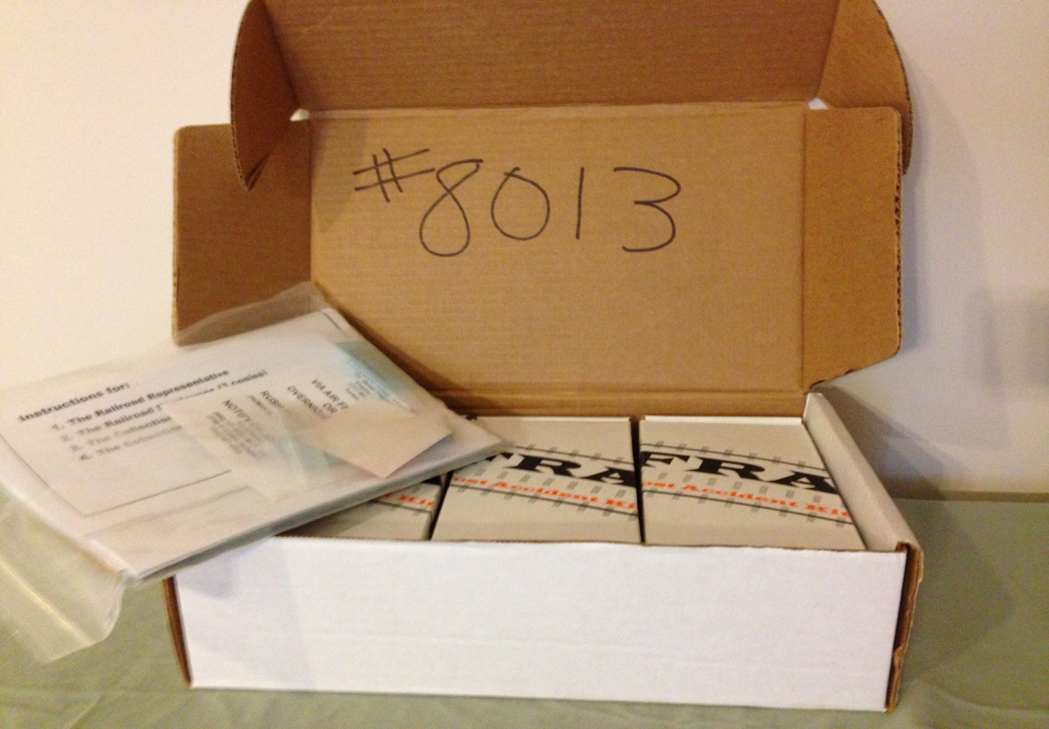
Post-Accident Tox Boxes
Notes:
Numbers on the outside of boxes often fade or a label peels or another label is placed over the box number causing confusion of inventory. A good practice is to write the box number on the inside of lid with a permanent marker.

Slide 44
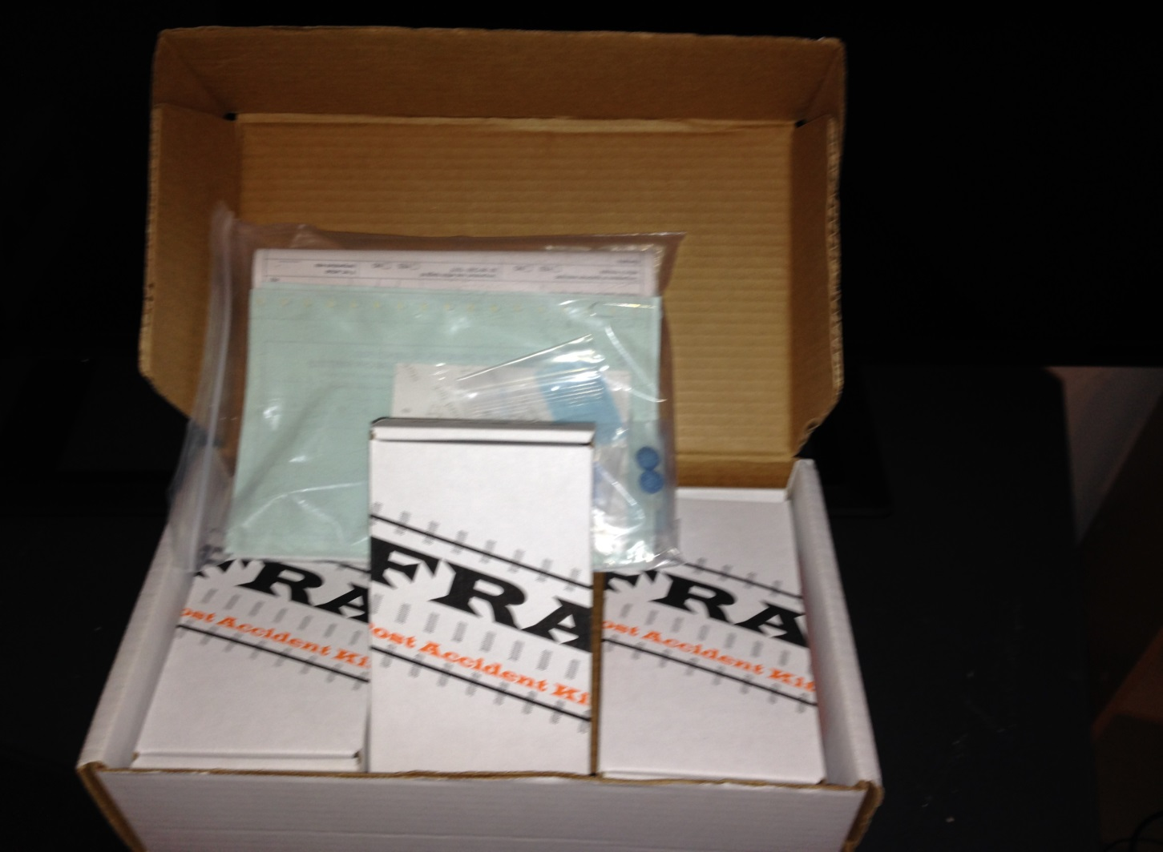
Standard Post-Accident Tox Box
Notes:
When opening the standard tox box you should find three smaller kits, for testing up to three surviving individuals and one plastic bag containing: one Form 73 with revision date of June 2017, three Form 74’s with revision date of June 2017, three packs of two bluing tablets, a red security seal and a mailing label for shipment to Chesapeake Toxicology Resources located in Frederick, MD.
The plastic zip-lock bag should not be discarded after removing contents for use during the collection, and upon completion of all forms related with the testing event, the forms should be placed back into the plastic bag, and plastic bag placed into the shipping box for transport to Chesapeake Toxicology Resources.

Slide 45
Standard Post-Accident Tox Box
Standard Post-Accident Tox Box:
All railroads should have at least one standard tox box
  Each standard tox box has 3 kits inside to collect from 3 employees
Notes:
Contact Sandra Volante at sandra.volante@dot.gov and Kevin Breen at kevin.breen@dot.gov for an order form or information on ordering tox boxes.

Slide 46
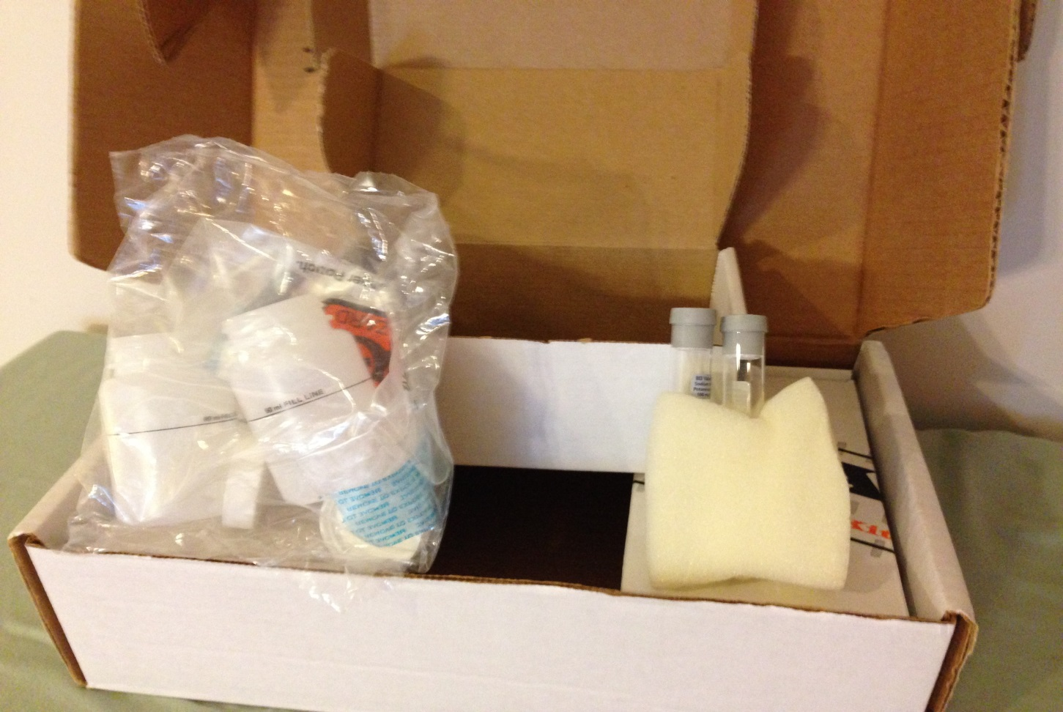
Standard Post-Accident Tox Box
Notes:
Each one of the three individual kits should have two blood tubes with expiration dates of 1/31/26, and a sealed bag which includes a collection cup and two split urine specimen shipping containers.

Slide 47
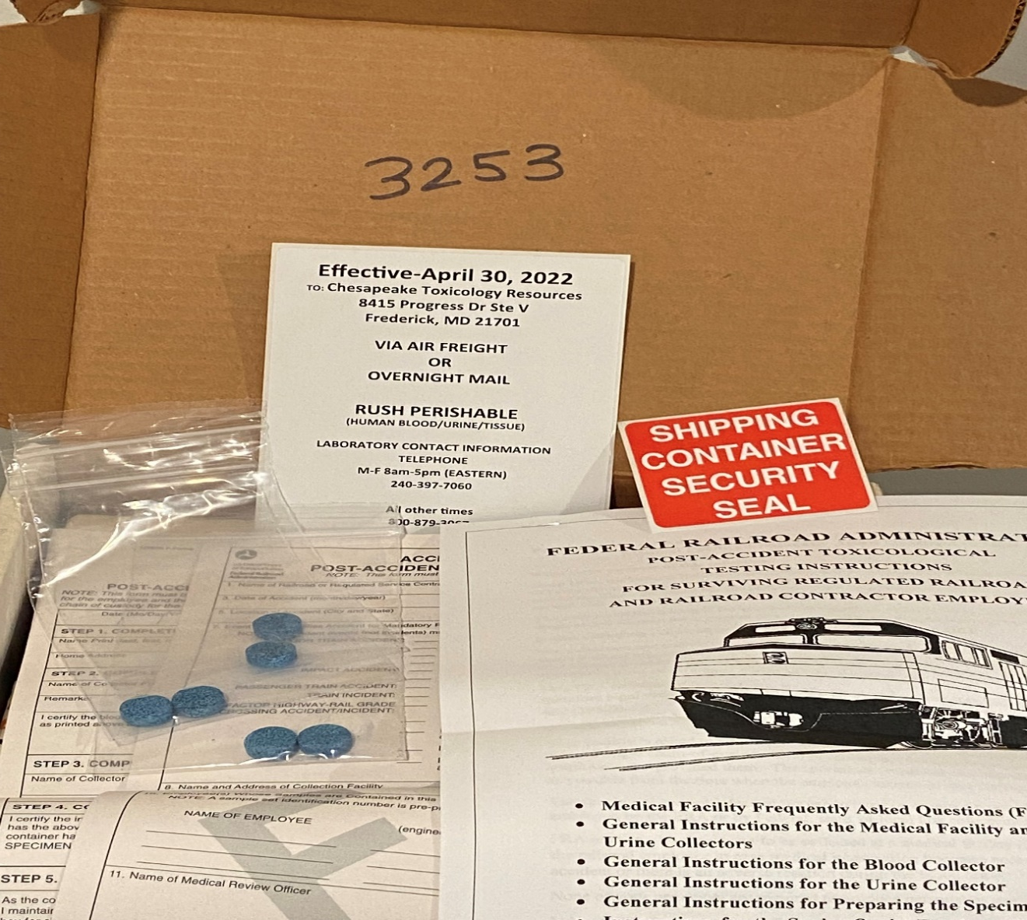
Standard Post-Accident Tox Box
Notes:
EFFECTIVE – April 30, 2022
FRA’s Present Contracted Post-Accident Testing Lab:
Chesapeake Toxicology Resources
8415 Progress Dr.
Ste V
Frederick, MD 21701
Phone: 240-397-7060 (M-F 8am-5pm Eastern Time)
Other: 800-879-3067 (All other times)

Slide 48
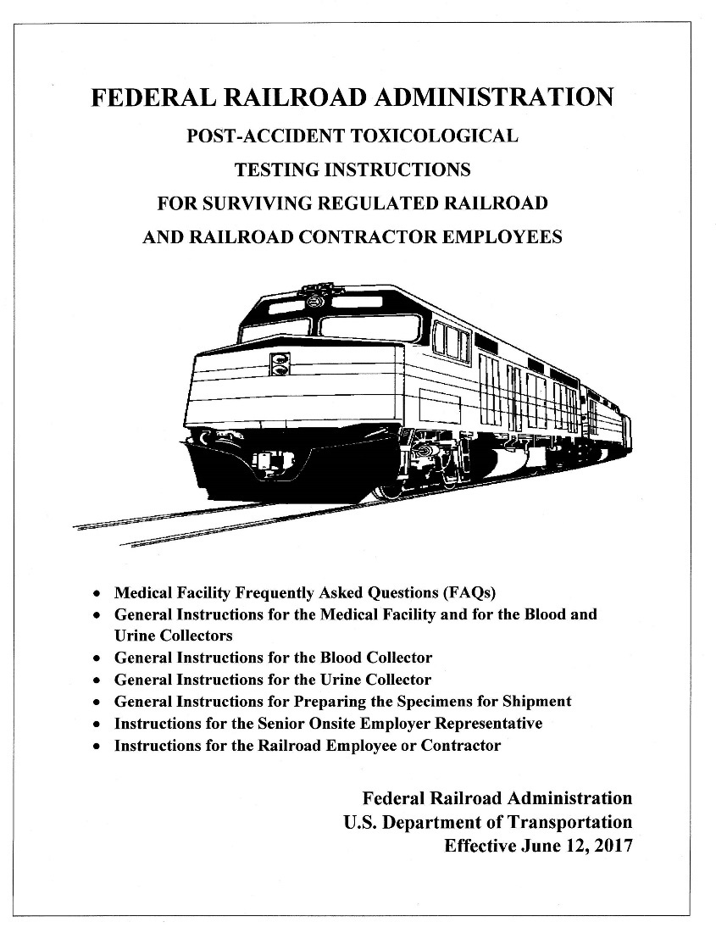
Standard Post-Accident Tox Box Instructions
Notes:
The first and most important document in the tox box is the instructions revised June 12, 2017. Please review this document before beginning collection process.
Suggestion: Something you want to consider is to conduct tabletop exercises with your managers during training.

Slide 49
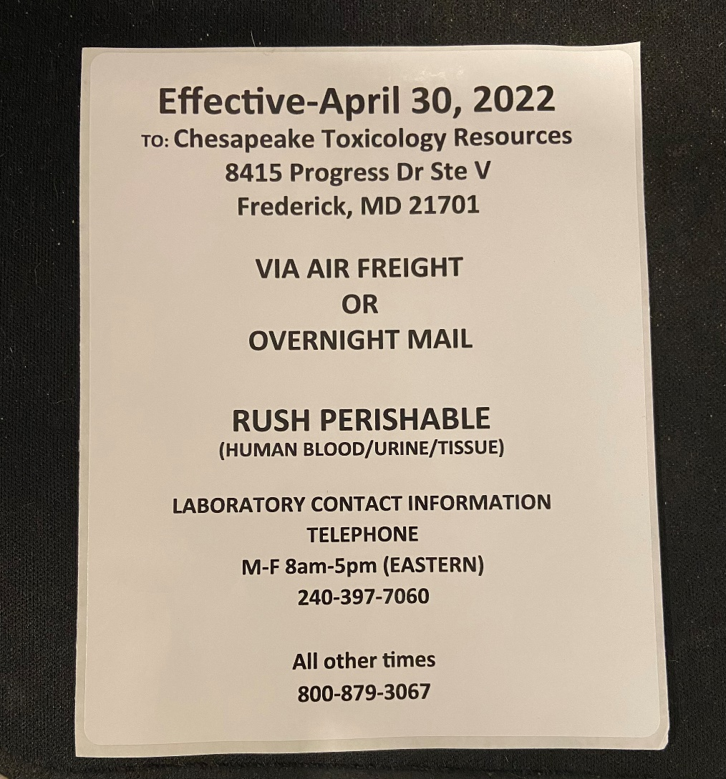
Current Post-Accident Shipping Label
Notes:
EFFECTIVE – April 30, 2022
FRA’s Current Contracted Post-Accident Testing Lab:
Chesapeake Toxicology Resources
8415 Progress Dr.
Ste V
Frederick, MD 21701
Phone: 240-397-7060 (M-F 8am-5pm Eastern Time)
Other: 800-879-3067 (All other times)

Slide 50
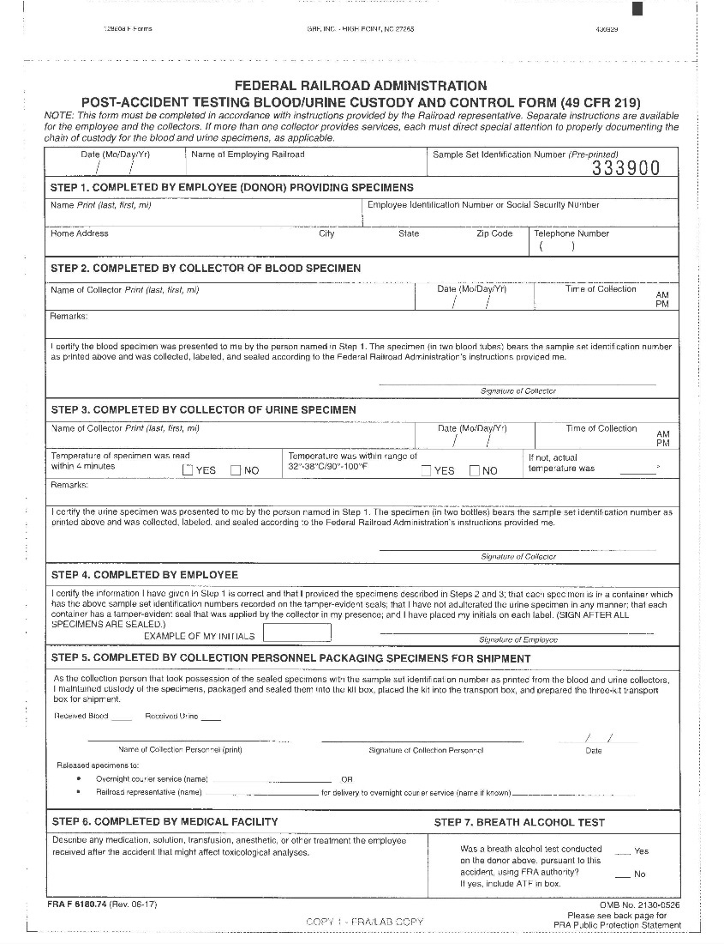
Standard Post-Accident Tox Box
Form F6180.74 (Rev. 06-17)
Notes:
A Form 74, revised 06-17 is used to document collection of blood and urine for each surviving employees only.
The railroad supervisor can provide oversight, but the form must only be completed by collection personnel. Corrections on this document should be initialed.

Slide 51
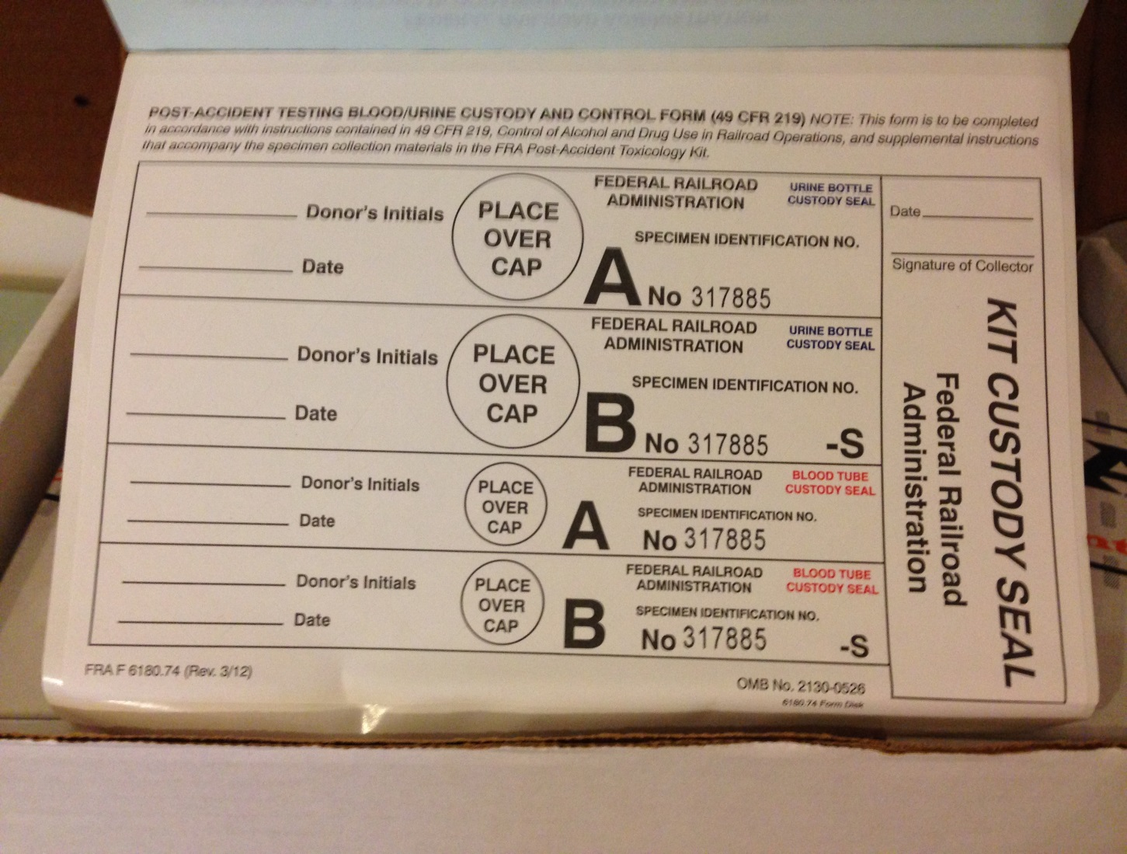
Standard Post-Accident Tox Box
Notes:
The last page of Form 74 has labels for two blood tubes, two urine specimen shipping containers and custody seal for each smaller individual kit. All three of the smaller kits (even if unused) should be placed back into the larger standard box for shipment to Chesapeake Toxicology Resources. Once a tox box is used in a post-accident collection, the lab will automatically send a replacement tox box to the DER.

Slide 52
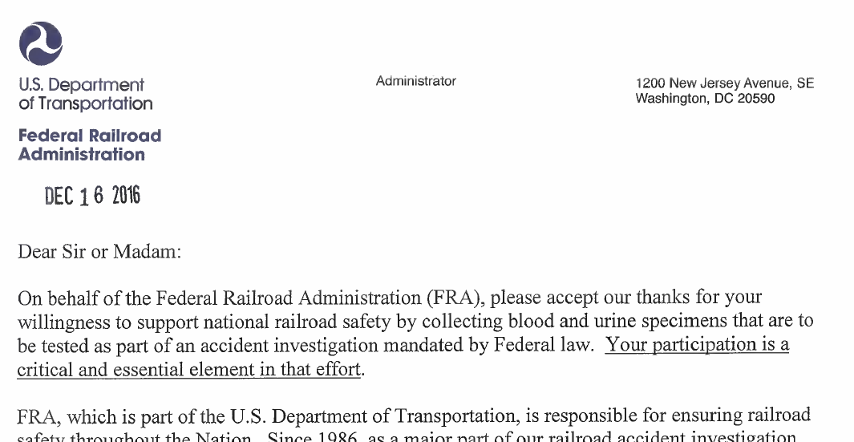
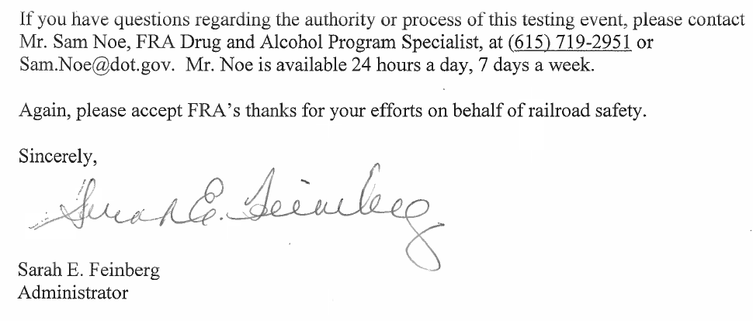
Letter Included in PATT Boxes
Notes:
FRA Letter to be provided to Medical facilities.

Slide 53
Clarification for FRA Post-Accident Testing
Under 219.11(a), an employee is deemed to have consented to FRA testing by the act of performing regulated service for a railroad. A conscious employee may not refuse to provide urine from his/her catheter bag.

Slide 54
Clarification for FRA Post-Accident Testing
An employee, whether conscious or unconscious, may not be catheterized solely for the purpose of providing an FRA specimen.

Slide 55
Clarification for FRA Post-Accident Testing
Urine may be collected from an employee who has been catheterized for medical purposes, whether conscious or unconscious, for FRA Post-Accident Part 219 Subpart C testing only.
Notes:
Because Part 40 applies to FRA reasonable suspicion/cause testing but does not apply to FRA post-accident testing (see 40.1(c)), FRA does not prohibit the taking of urine from an unconscious employee for a Part 219 Subpart C post-accident test, who has already been catheterized for medical purposes.

Slide 56
Clarification for FRA Post-Accident Testing
Blood may also be taken from an injured employee, whether conscious or unconscious, subject to a physician’s determination that drawing the required amount of blood for FRA Post-Accident Part 219 Subpart C testing is consistent with the employee’s health (see 219.203(h)).
Notes:
Remember blood is only allowed to be collected for Part 219 Subpart C Post Accident testing. No other FRA tests require a blood collection.

Slide 57
Standard Post-Accident Tox Box
Notes:
All completed paperwork (including any ATF’s conducted for breath testing) should be placed into the plastic bag and placed in the larger box before sealing with the red seal. If the box has already been sealed, do not break the red seal and open box to place the documents inside. Just mail the documents separately by express courier directly to Chesapeake Toxicology Resources. A good practice would be to scan and email the collection forms left out of the sealed box to Sandra Volante at sandra.volante@dot.gov.

Slide 58
Completing and Preparing the Collection for Shipment
The person preparing the specimens for shipment can be either the blood or urine collector, or another member of the medical staff (it cannot be a railroad representative). This person is responsible for carefully packaging the specimens for shipment, sealing the individual collection kits and the FRA Post Accident Shipping Box, and transferring Shipping Box to the onsite railroad representative or directly to the overnight courier.
Once all the collections are complete, skip to STEP 5 where medical facility personnel will initiate chain-of-custody by showing receipt of the urine and blood specimens. Perform this step only when you have custody of both the blood and urine specimens or when all collections of the individual’s available fluids has been completed.
Step 5 should be completed by collector or medical facility personnel.
Notes:
The railroad representative does not sign or complete any part of the Form 74.
The railroad is responsible for arranging shipment of specimens to the FRA laboratory, so the railroad representative will need to provide the collection facility representative the details on how to complete Step 5 of the CCF.
The railroad representative must provide their name and name of overnight courier service (i.e. UPS, FedEX, DHL, etc.) to medical personnel to list on Form 74, in Step 5, if the railroad representative will be taking possession of the box for shipment.

Slide 59
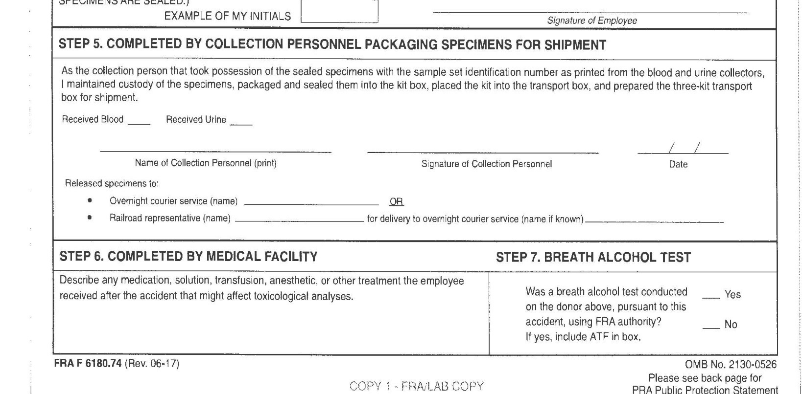
Post Accident Form 74 – Step 5
Notes:
Step 5 is completed and signed by Medical personnel. The railroad supervisor does not sign Form 74. Form 74 was revised to clarify that Medical Personnel should sign this section.

Slide 60
Sealing the Tox Box
Once specimens are collected and sealed, the railroad representative may advise medical facility personnel in making sure the correct forms are included in the tox box (FRA & Lab copies)
Send the MRO copy to your railroad’s MRO
Keep the employer copy
Give each employee their copy
IF THE HOSPITAL HAS ALREADY SEALED THE TOX BOX, DON’T BREAK THE SEAL
Email the FRA copy to Sandra Volante at sandra.volante@dot.gov and Kevin Breen at kevin.breen@dot.gov
Notes:
The collection personnel should include paperwork along with specimens and should place the red seal on the box.

Slide 61
Transporting to Lab
After sealing the tox box with the red security seal, apply Chesapeake Toxicology Resources shipping label, place tox box in overnight courier shipping envelope, attach courier address labels, and ask medical facility to ensure it goes out ASAP
If week-end service is not available, ask the medical facility to refrigerate, but railroad must check to make sure it got picked up
Notes:
Railroad must use due diligence to ensure that each tox box is transported to the FRA laboratory without any delay. Must be shipped within 72 hours of the event.

Slide 62
Transporting to Lab
If the medical facility is not willing to ship, then the railroad representative must take possession of the tox box (and refrigerate as necessary) and send via overnight courier ASAP
Supervisor should keep his/her own record of the chain of custody if they took possession of the tox box

Slide 63
Chesapeake Toxicology Resources
FRA’s Present Contracted Post-Accident Testing Lab:
EFFECTIVE – April 30, 2022
Chesapeake Toxicology Resources
8415 Progress Dr.
Ste V
Frederick, MD 21701
Phone: 240-397-7060 (M-F 8am-5pm Eastern Time)
Other: 800-879-3067 (All other times)
Notes:
FRA is still finding improper shipping labels for FRA’s laboratory during inspections.

Slide 64
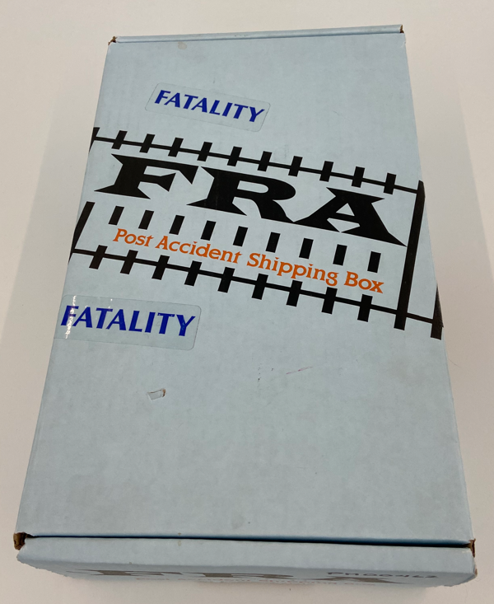
Post-Mortem Post-Accident Tox Box
Notes:
When you have a qualifying post-accident event inclusive of a fatality, you will utilize the Post-Mortem tox box (Blue in color).

Slide 65
Post-Mortem Post-Accident Tox Boxes
Fatality (Post-Mortem) Tox Box:
Notify the NRC at 800-424-0201(preferred) or 800-424-8802 if you have a qualifying fatality event
- Involving the operation of on-track equipment
If you don’t have a fatality box, FRA will either overnight the tox box to the medical examiner/coroner, or
The railroad can borrow one from a neighboring railroad (Note: if the railroad “borrows” a tox box from another railroad, please let FRA know to ensure the replacement tox box is sent to the correct railroad.)
Small railroads cannot order a fatality tox box
Notes:
Use overnight courier service, not U.S. mail.

Slide 66
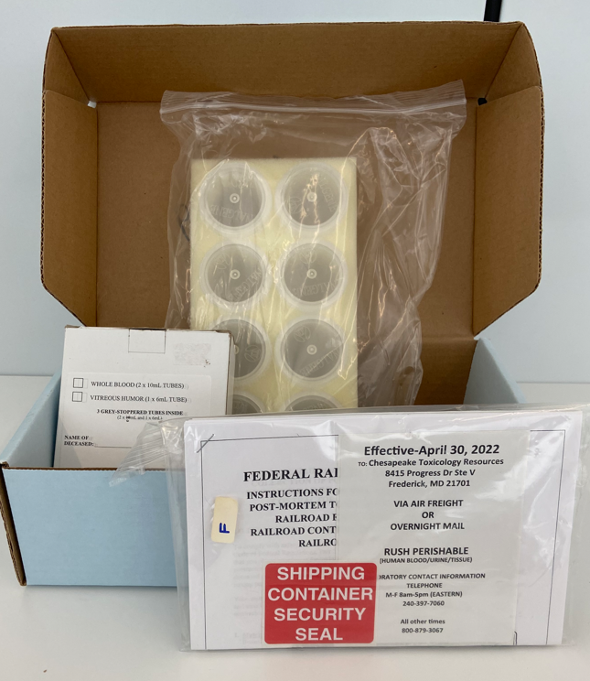
Post-Mortem Post-Accident Tox Box
Notes:
This post-mortem kit is for a single fatality. The kit contains three 6 mL blood tubes (two for blood and one for vitreous fluid) with expiration date of 1/31/26, a sealed bag with eight tissue specimen containers and one plastic bag, a Chesapeake Toxicology Resources mailing label, a red security seal, and one Form F 6180.73 (Form 73) and one Form F 6180.75 (Form 75).

Slide 67
Post-Mortem Post-Accident Tox Boxes
Fatality (Post-Mortem) Tox Box:
Tissue, in addition to urine and blood specimens, is collected by medical examiner/coroner (Forms 73 and 75)
Railroad representative completes Form 73 and medical examiner/coroner completes Form 75
Box is light blue in color (only distributed to the larger railroads)
Notes:
The railroad must complete and provide required copies of Form 73 to the medical examiner/coroner for inclusion inside of the kit sent to FRA’s laboratory.
Don’t forget to retain the railroad’s copies of the Forms 73 and 75.

Slide 68
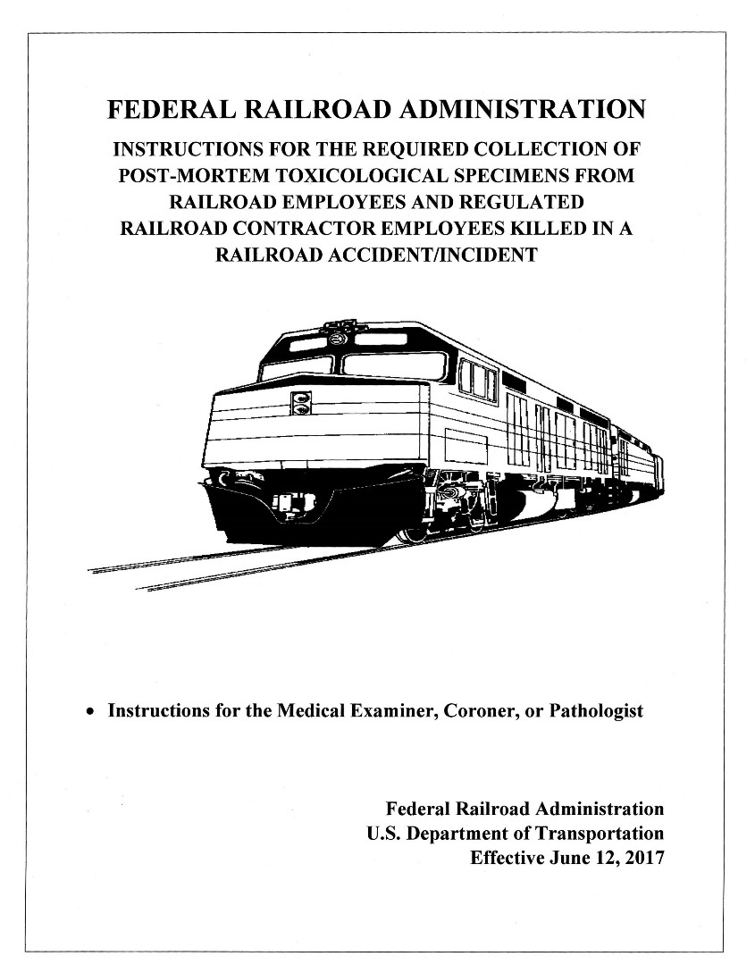
Post-Accident Post-Mortem
Tox Box Instructions
Notes:
Again, the post-mortem instructions included in the post-mortem kit should be self-explanatory to the medical examiner/coroner.

Slide 69
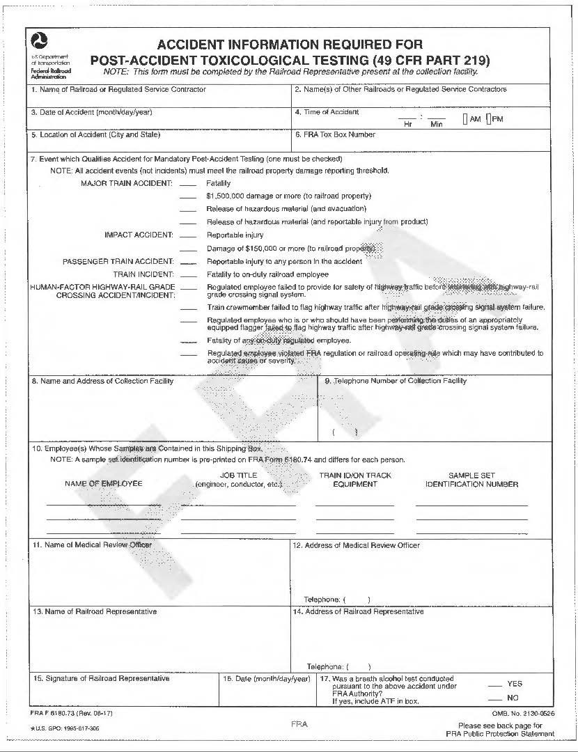
Post-Mortem Post-Accident Tox Boxes
Form F6180.73 (Rev. 06-17)
Notes:
For the Post-Mortem Post-Accident Tox Box, a Form F6180.73 (Rev. 06-17) must be completed and is the only form in the post-mortem tox box that the railroad supervisor needs to complete or sign. Corrections on this document should be initialed.
The railroad must complete and provide required copies of Form 73 to the medical examiner/coroner for inclusion inside of the kit sent to the FRA’s laboratory.

Slide 70
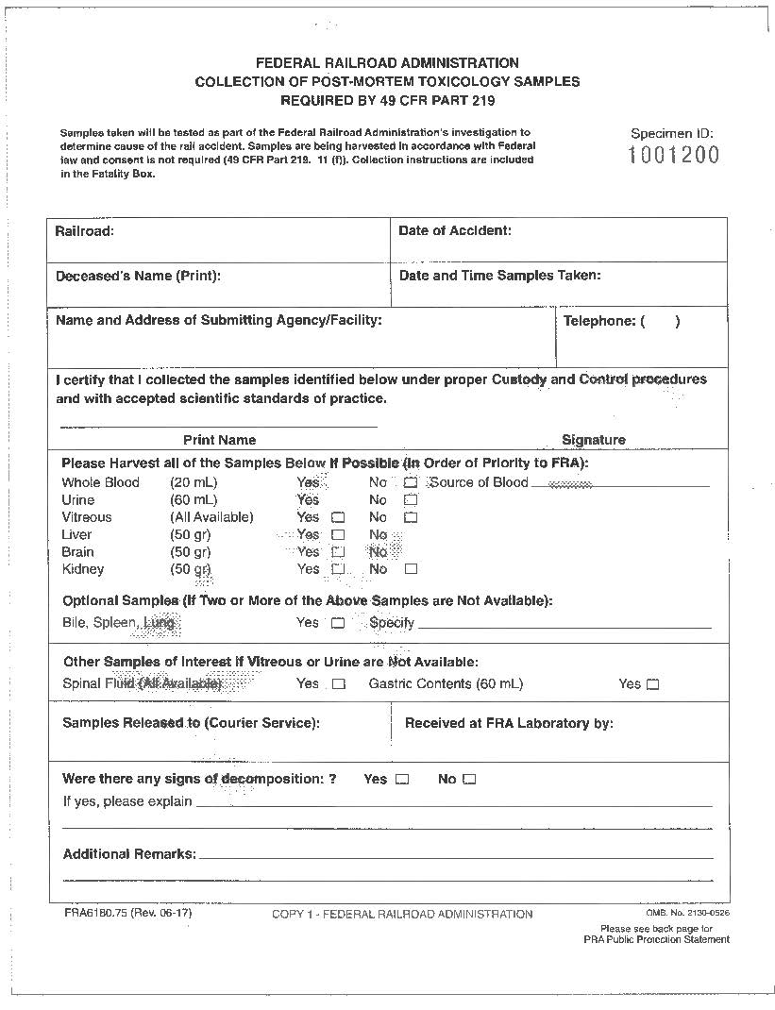
Post-Mortem Post-Accident Tox Box
Form F6180.75 (Rev. 06-17)
Notes:
This is a copy of FRA Form F6180.75 (Rev. 06-17) to be completed by the Medical Examiner, Coroner, or Pathologist. FRA requests them to harvest whole blood 20 mL, urine 60mL, vitreous fluid (all available in remaining 6 mL tube), liver, brain and kidney. If these specimens are not available, alternative specimens are bile, spleen, lung, spinal fluid, and gastric contents.
Note: FRA regulations neither require nor authorize a railroad representative to witness or be present when specimens are being harvested from fatally injured employees. The railroad representative’s role is limited to accepting the sealed fatality box from the medical examiner or coroner’s office and arranging shipment of the sealed box to FRA’s testing laboratory.

Slide 71
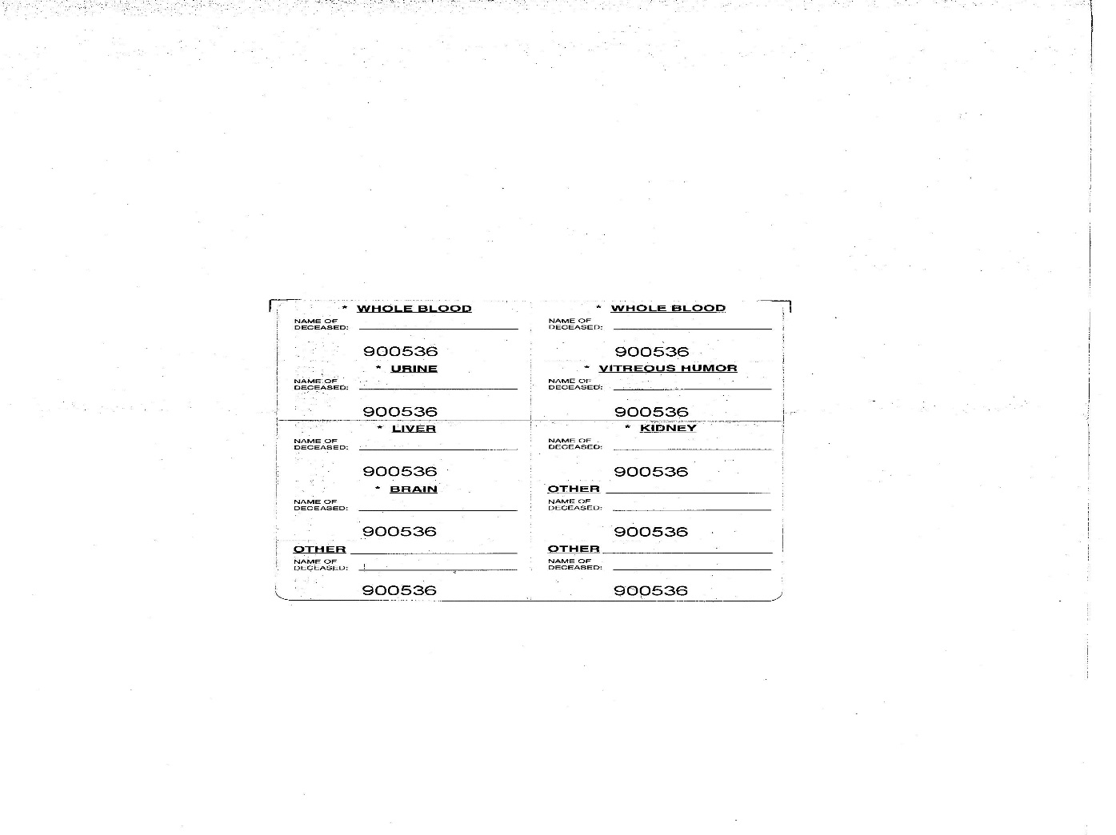
Post-Mortem Post-Accident Tox Box
Notes:
Eight peel-off specimen labels are on the last page of each Form 75 for use by the medical examiner/coroner.

Slide 72
Chesapeake Toxicology Resources
EFFECTIVE – April 30, 2022
FRA’s Contracted Post-Accident Testing Lab:
Chesapeake Toxicology Resources
8415 Progress Dr.
Ste V
Frederick, MD 21701
Phone: 240-397-7060 (M-F 8am-5pm Eastern Time)
Other: 800-879-3067 (All other times)

Slide 73
Group Quiz
A train runs past a stop signal indication and hits the rear-end of a standing train, resulting in a fatality to a crew-member and $400,000 property damage.
What type of event is this and who should be tested?
Notes:
Answer: This is a Major Train Accident due to damages exceeding $12,400 with a fatality to a on-duty railroad employee or regulated service contractor. Therefore, all crewmembers of both trains should be tested, including the fatality.
In addition, the railroad should determine if other regulated employees such as a train dispatcher, roadway worker or signalman may have played a role in the cause or severity of the accident.

Slide 74
Group Quiz
Two hi-rail vehicles collide with damage estimated at $9,000, and a reportable injury to the roadway worker who exceeded his track and time limits. The signal maintainer on the other hi-rail is not at fault.
Is this a qualifying event?
If so, who should be tested?
Notes:
No, this is not considered an Impact Accident requiring post-accident testing because we have a rail equipment accident that’s not over the $12,400 monetary threshold, even with a reportable injury.

Slide 75
FRA Notification of Event
Railroad must telephone FRA at 202-493-6313 and talk to Jerry Powers or leave a message to include:
  Name of railroad
  Accident date, time and location
  Type of event (e.g., Impact with $150,000)
  Number of employees tested
You may call Melissa Van Dermeir at 612-720-9491 instead of Jerry – particularly if you have questions
Must also call Nat’l Response Center at 800-424-0201 (preferred) or 800-424-8802 to report that post-accident testing was done
Notes:
After you’ve made your testing determination, the next step is to let Sandra Volante or Kevin Breen know that specimens are en route so they can contact Chesapeake Toxicology Resources, FRA’s contracted post-accident testing lab.

Slide 76
Current Post-Accident Testing Panel
Current Panel (Blood, Urine, and Tissue in Fatalities):
  Marijuana
  Cocaine
  Amphetamines (amphetamine, methamphetamine, MDMA and analogues)
  Opioids (codeine, morphine, heroin, 6-acetylmorphine)
  PCP
  Benzodiazepines (9 substances)
  Barbiturates (5 substances)
  Alcohol
Includes Part 40
Panel
Notes:
FRA post-accident samples (urine, blood, and tissue) are screened using an immunoassay or another appropriate screening technology.
Samples that screen positive for drugs are confirmed using gas chromatography/mass spectrometry (GC/MS) or liquid chromatography/tandem mass spectrometry (LC-MS/MS). Samples that screen positive for alcohol are confirmed using head-space GC.
The FRA post-accident testing program uses cutoffs that are often quite different (and usually much lower) than those employed in most workplace drug and alcohol testing programs.
All screening is performed with the urine sample except for Alcohol which is tested using blood in post-accident. Any urine which screens presumptively positive are confirmed using both the urine and blood samples.

Slide 77
Post-Accident Testing Panel
Synthetic Opiates:
- hydrocodone Vicodin/Lortab/Lorcet
- oxycodone Oxycontin/Percocet
- hydromorphone Dilaudid
- oxymorphone Numorphan
- methadone Dolophine
- propoxyphene Darvon/Darvocet
- fentanyl Sublimaze
- tramadol Ultram
Notes:
Note: FRA added tramadol to testing panel effective July 7, 2015.
Under our regulations FRA can test for additional drugs and drug categories as it deems necessary.

Slide 78
Post-Accident Test Results
FRA Lab will overnight the test results to the railroad’s MRO & to FRA
Lab will mail results directly to the employee
If positive, the MRO will interview the surviving employees to check for a legitimate explanation (e.g., prescription medication or medical administration)
MRO will report test results to the railroad’s Designated Employer Representative (DER)
Keep checking with your MRO for the test results
Notes:
The MRO has no role with positives from fatally injured employees.

Slide 79
FRA Contacts
Gerald “Jerry” Powers, Drug & Alcohol Program Manager,
gerald.powers@dot.gov
202-493-6313
Melissa Van Dermeir, Drug and Alcohol Program Specialist
melissa.vandermeir@dot.gov
312-720-9491
Sandra Volante, Drug and Alcohol Program Specialist
sandra.volante@dot.gov
682-351-3428
Kevin Breen, Program Management Analyst
Kevin.breen@dot.gov
202-536-6644

Slide 80
FRA Post-Accident Toxicological Smart Phone Application
As part of FRA’s drug and alcohol testing program, certain accidents/incident are subject to Part 49 CFR 219, Subpart C Post Accident Testing requirements.
In order, for railroad managers and their regulated contractors to make more rapid FRA Post Accident testing determinations, FRA has developed a smart phone application (app) for use on both Apple and Android devices.
The FRA PATT app is a tool that is available to all railroad and contractor employees to help them understand FRA’s Post Accident requirements.

Slide 81
FRA Post-Accident Toxicological Smart Phone Application
Part 219 Subpart C defines the train accident/incident thresholds that require testing. This post-accident testing helps FRA accident investigators determine whether the use of drugs and alcohol by involved railroad employees or contractors may have contributed to the cause or severity of a particular accident.
The goal of this application is to aid regulated employers (railroad or contractor) in determining whether a rule-triggering post-accident testing event has occurred as well as who to test; and that the decision to test is made quickly after reasonable inquiry and good faith judgment by an on-site supervisor

Slide 82

FRA Post-Accident Toxicological Smart Phone Application
Blood and urine collections from surviving employees/contractors must be completed within for (4) hours of the accident with the proper supplies and forms; and blood, urine, and tissue collections from fatally injured personnel must be completed as soon as practicable.
In addition, this application is likewise intended to protect employees from inadvertent incursions upon their right-to-privacy represented by tests performed erroneously.
You can upload the application to your Apple or Android device:

Slide 83





RAIL– Moving America Forward
Visit us at:
www.fra.dot.gov

