Slide 1

SharedUse Web-Based Screening Tool – Overview and Demonstration

Slide 2
Overview
General Description of the SU tool
  Helps State DOTs develop preliminary capital improvement plans for intercity passenger rail projects
Step-by-step demonstration
  Input requirements and model output
  Contact Karen McClure
  karen.mcclure@dot.gov

Slide 3
Introduction to the Share-Use tool
Web-based tool for shared-use rail corridor feasibility screening analysis
Track tool – visualization, data entry and integration
User-friendly train data and operating plan development
Analysis engine
  Simulation and conflict identifier modes
  Deadlock-free dispatching
  Train performance algorithm
Rich array of result charts and reports

Slide 4
The Problem
Planning of new passenger rail services on shared-use corridor proceeds slowly
Key issue: promoting a constructive dialogue with the owning freight railroad
Railroads are not obligated to
  support the planning efforts of a State DOT
  educate the DOT regarding operational challenges in a corridor
SU assists the DOT in engaging in an informed dialogue

Slide 5
What question does SU address?
SU is a tool that supports preliminary planning – plan development and refinement
SU addresses the question:
  Does the plan meet feasibility criteria
    Operational
    Financial
  If the answer is “yes”, then the plan warrants further study

Slide 6
Elements of a plan
New Service
  Existing traffic with planned growth, and new passenger service
Modifications to infrastructure
  New meet-pass facilities (sidings, double-track, crossovers, etc.)
  Estimated costs of the above

Slide 7
Using SU to refine a plan
Develop baseline and “do minimum” cases
SU conflict identifier assists in locating places to add meet-pass infrastructure
“Build” case is the plan for new service with improvements – which needs to meet feasibility criteria

Slide 8
Operational feasibility screening criteria
Passenger trains operate without significant delay
Freight operations are unimpeded in the corridor (i.e., no worsening of average speeds)

Slide 9
Financial feasibility screening criteria
What SU does not do:
  Forecast demand
  Detailed capital planning
SU’s financial feasibility is driven by assumptions re average number of passengers / train
Financial feasibility based on estimated capital cost per trip

Slide 10
Approach to Screening of SU Corirdors
Data requirements
Evaluation process
Key metrics
Notes:
These are the three elements of the approach to analysis and screening. Let me start with the last. SU evaluates a plan for proposed new service and infrastructure improvements. Key metrics for feasibility screening need to demonstrate that passenger trains can operate in the corridor without delay, and that freight operations are, essentially, unaffected. So, in brief summary, we are looking at delay and average speeds before and after new service and improvements.

Slide 11
Data Requirements
Assumption: no or minimal cooperation with railroad at initial stage
Data requirements
  Preliminary – general description of corridor, system entry/exit points, stations
  Infrastructure – track, switches, elevations, headings, speed restrictions, ancillary features
  Traffic – trains, their consists and schedules; traffic control features
Notes:
These are the essentials that are required for conducting an analysis. The assumption means that the tool will not necessarily rely on data provided by the railroad.

Slide 12
Public and Other Sources
  Public
    USDOT FRA GIS 1:100000 Rail Network database (BTS)
    USDOT FRA Highway-Rail Grade Crossing Inventory
    Google Earth™
  Other
    Railroad employee timetable
    Passenger train timetables
    Railroad websites (equipment information)
Notes:
Let me add to this list of others – track charts. These may be readily available and we’ll use these as the main source of infrastructure data for the sample analysis we’ll conduct later today.

Slide 13
Evaluation Process – Workflows Overview
Step 1
Step 3
Step 4
Step 2
Prepare “Do Nothing” baseline and evaluate
Prepare “Do Minimum” case
Evaluate and mitigate – prepare “Build Case”
Evaluate “Build Case”
Notes:
These are four main steps of the evaluation process. The baseline replicates current conditions. “Do minimum” include the minimal improvements required to enable passenger service (i.e., automatic switches). The “Build Case” includes those improvements that will be necessary to support the proposed new service in the corridor. In the interest of saving time, I won’t walk through the following four slides that show each of these steps in detail.

Slide 14
Workflows – Step 1
Prepare “Do Nothing” Baseline and Evaluate
Develop data
Rail infrastructure
Simulate baseline conditions
Freight and passenger trains and schedule
Other required
Report results
Stringline chart
Delay metrics by train and type
Run simulation for typical operating day
Authorities chart
Notes:
Establish and document baseline conditions in the corridor.
Baseline conditions will be used to assess the impact on freight operations in the corridor.

Slide 15
Workflows – Step 2
Prepare “Do Minimum Case”
Add features
Minimally required
Estimate costs
E.g., automatic switches
E.g., upgrade sidings to allow overtakes
Estimate costs of “Do Minimum” improvements
Notes:
Modify the baseline conditions
Bring the corridor to minimum operational standard that can accommodate new passenger service

Slide 16
Workflows – Step 3
Evaluate and Mitigate – Prepare Build Case
Develop Data
Schedules for new passenger service
Identify & Mitigate Conflicts
Modify freight schedules for shared use
Test Adequacy
Run conflict identifier analysis on new infrastructure
Run conflict identifier analysis
Modify infrastructure data and estimate costs
If conflicts mitigated, then done
Else, add mitigating infrastructure, test again – Build case completed
Notes:
Run conflict identifier analysis with “do minimum” case.
Add infrastructure to mitigate conflicts.
The revised system is the “build case” for feasibility screening.

Slide 17
Workflows – Step 4
Evaluate Build Case
Run Simulation
Run simulation with Build Case and New Services Schedule
Feasibility Targets Met?
Yes, feasibility screening passed
No -
Review results
More mitigation not possible → reject
More mitigation possible → mitigate and re-evaluate
Notes:
Run simulation and test if feasibility targets are met.
If yes, then the Build Case passes screening and warrants further consideration
If no, see if further mitigation can refine the build cases so it passes screening

Slide 18
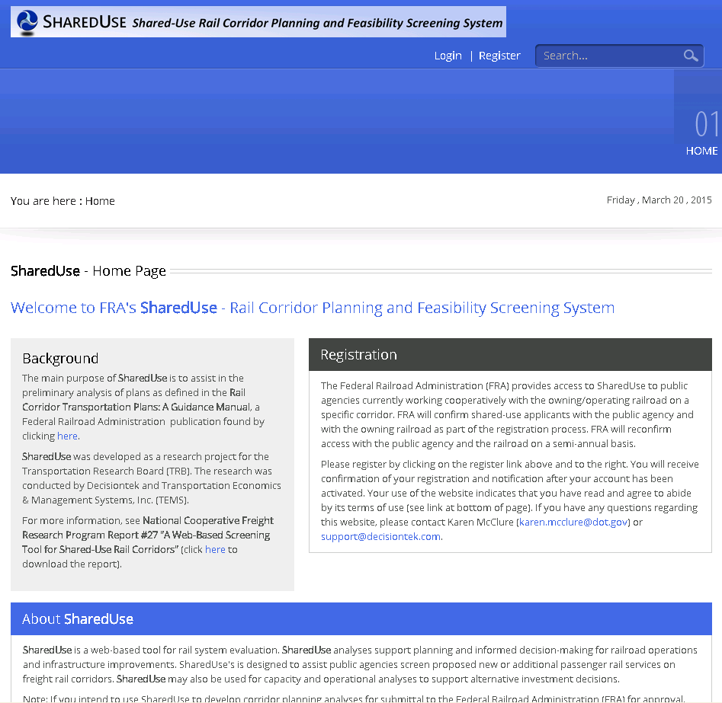
Home Page
Notes:
The important thing to note on the home page is the login and register link.

Slide 19
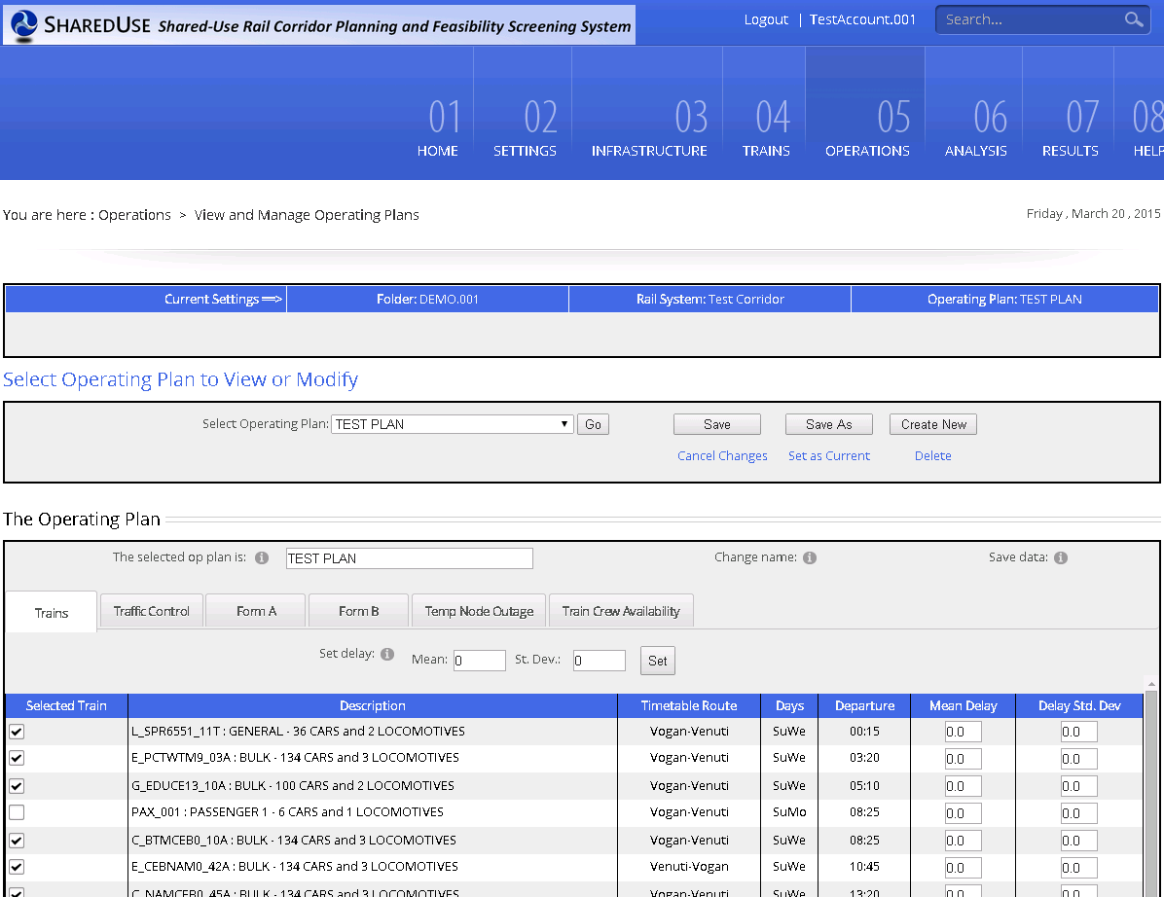
Page Structure
Navigation menu and fixed features
Page content
Notes:
The top of the page is constant, and the content portion is changes with each page

Slide 20
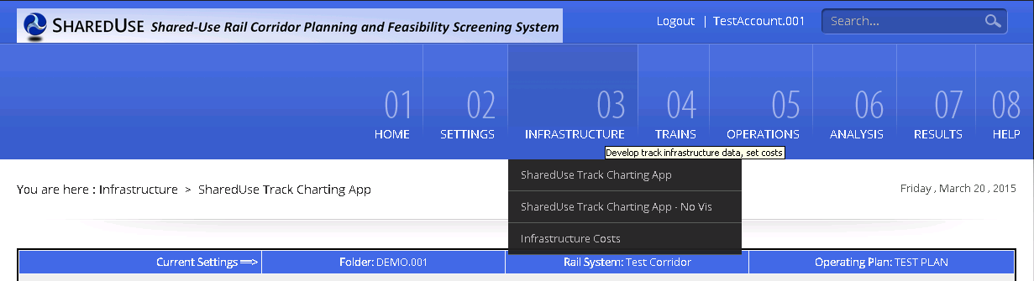
Main Menu and Page Features
Status bar
Main menu
Breadcrumb
Notes:
A few more of the page’s features.

Slide 21
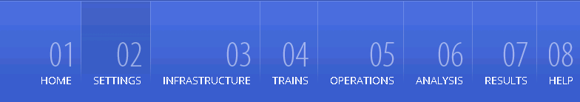
Settings

Slide 22
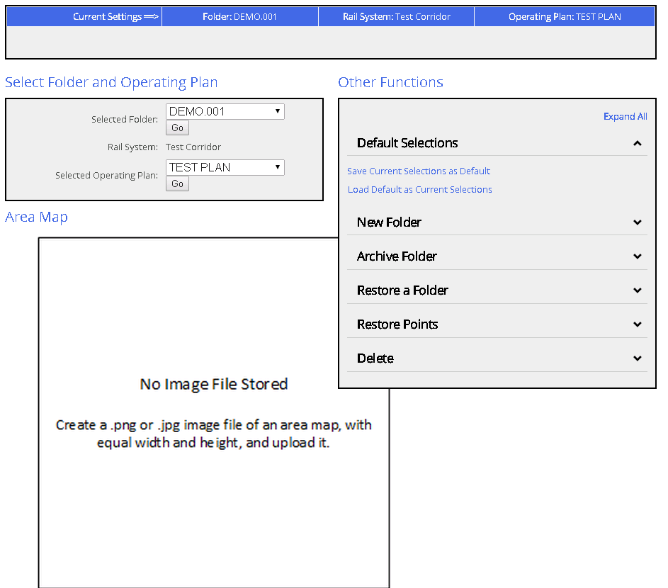
Settings page
Op plan selector
Map or image
Folder selector
Other functions (next slide)
Notes:
Settings page includes controls for selection, archiving and restoring and control points.
The left side of the screen focuses on selecting your folder and operating plan.

Slide 23
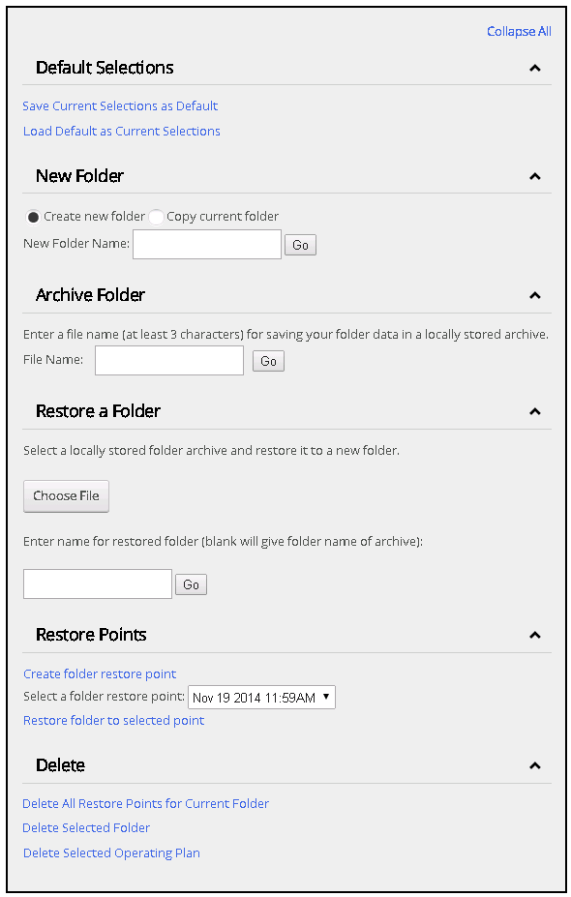
Settings Page – Other functions
Defaults
New folder
Archive
Restore folder
Restore points
Delete
Notes:
When you develop an analysis, you’ll make use of these features for backing up your work and managing your analysis.

Slide 24

Infrastructure

Slide 25
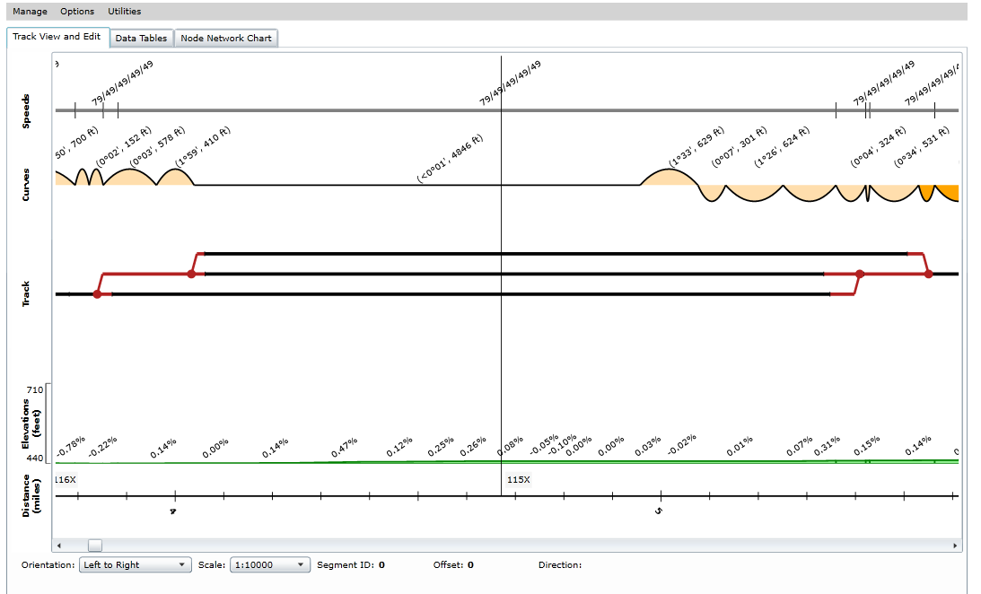
Infrastructure – Track Charting App
Speed restrictions
Curves / Headings
Track (red is interlocking or fouling link)
Grades / Elevations
Milepost marker
Running distance
Notes:
The track chart app is where you’ll spend a lot of the time developing an analysis. The tool is meant to resemble an actual track chart. You interact directly with the chart to modify your data.

Slide 26
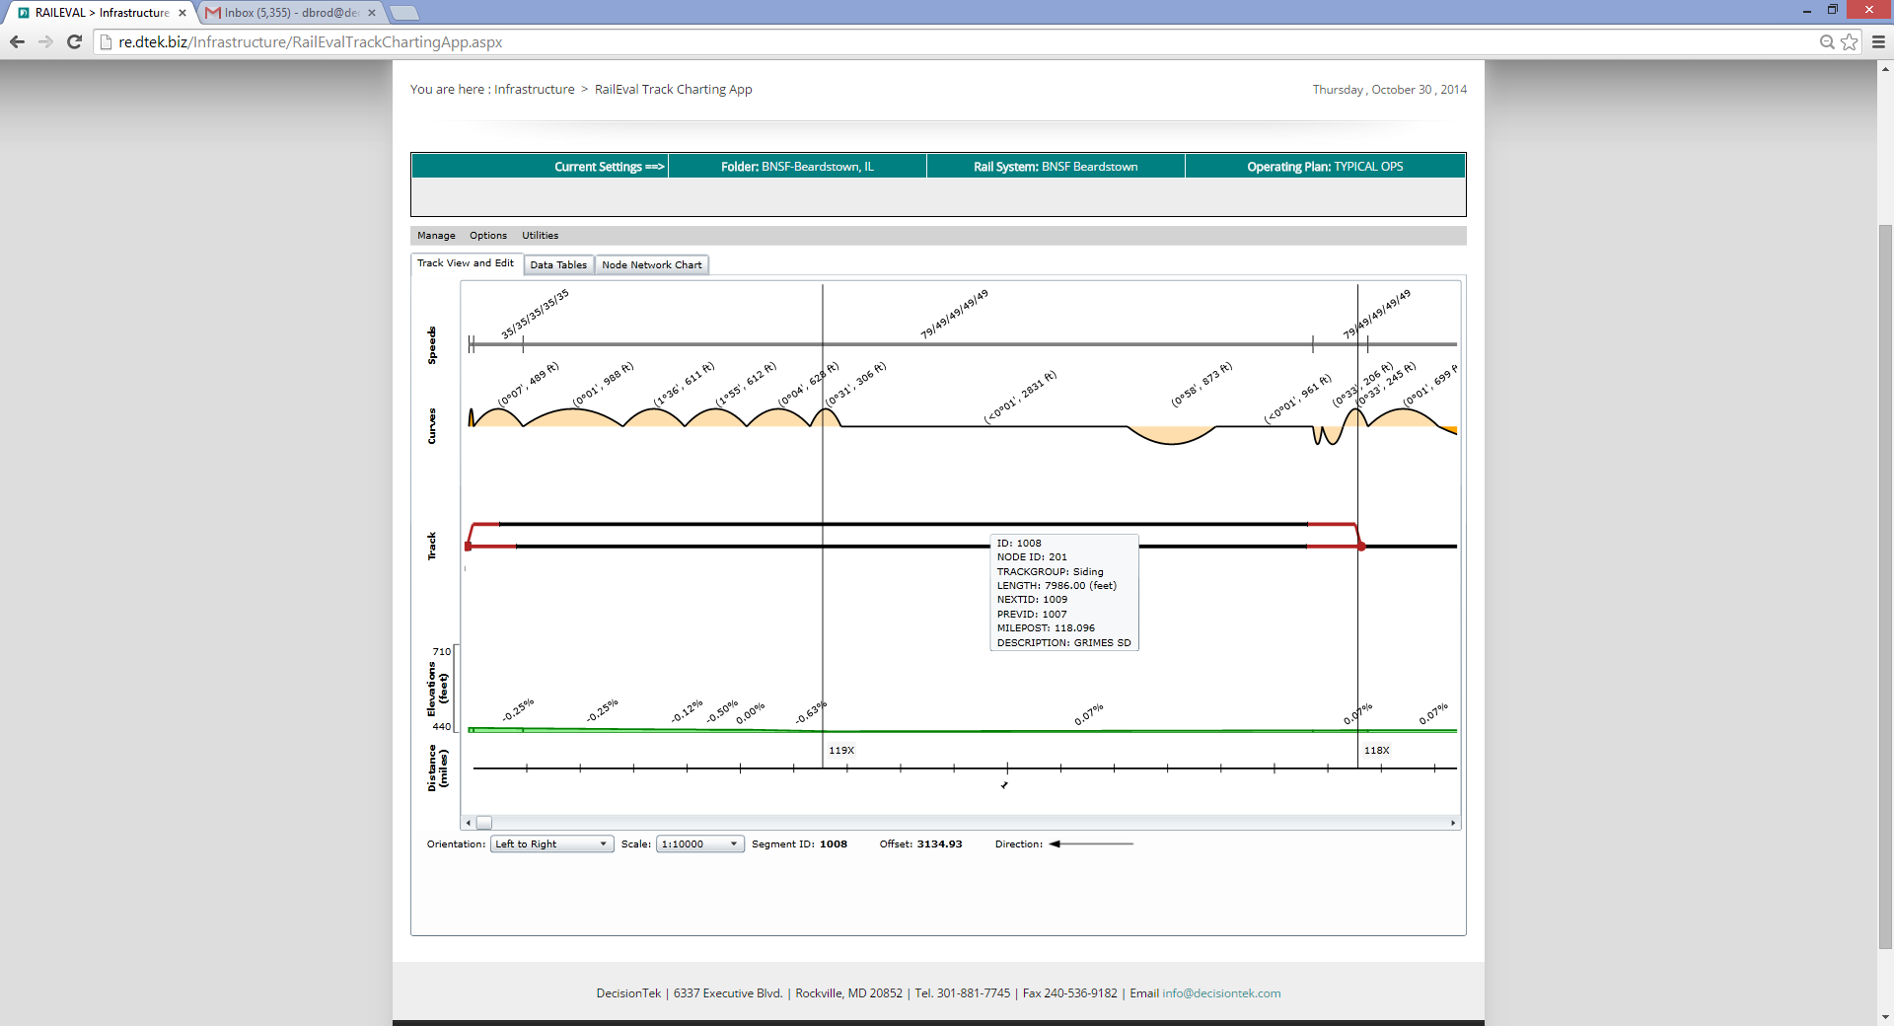
Infrastructure – tooltip detail
Direction of inc. milepost
Distance from start of segment

Slide 27
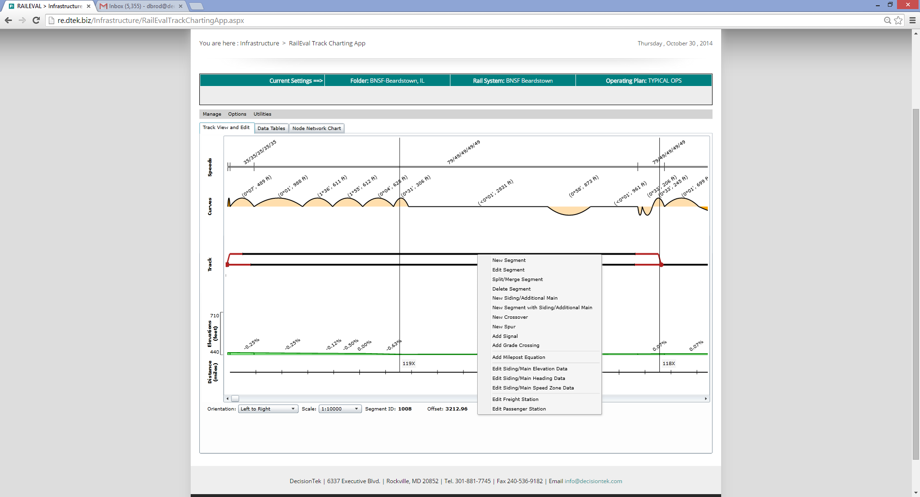
Infrastructure – context menu

Slide 28
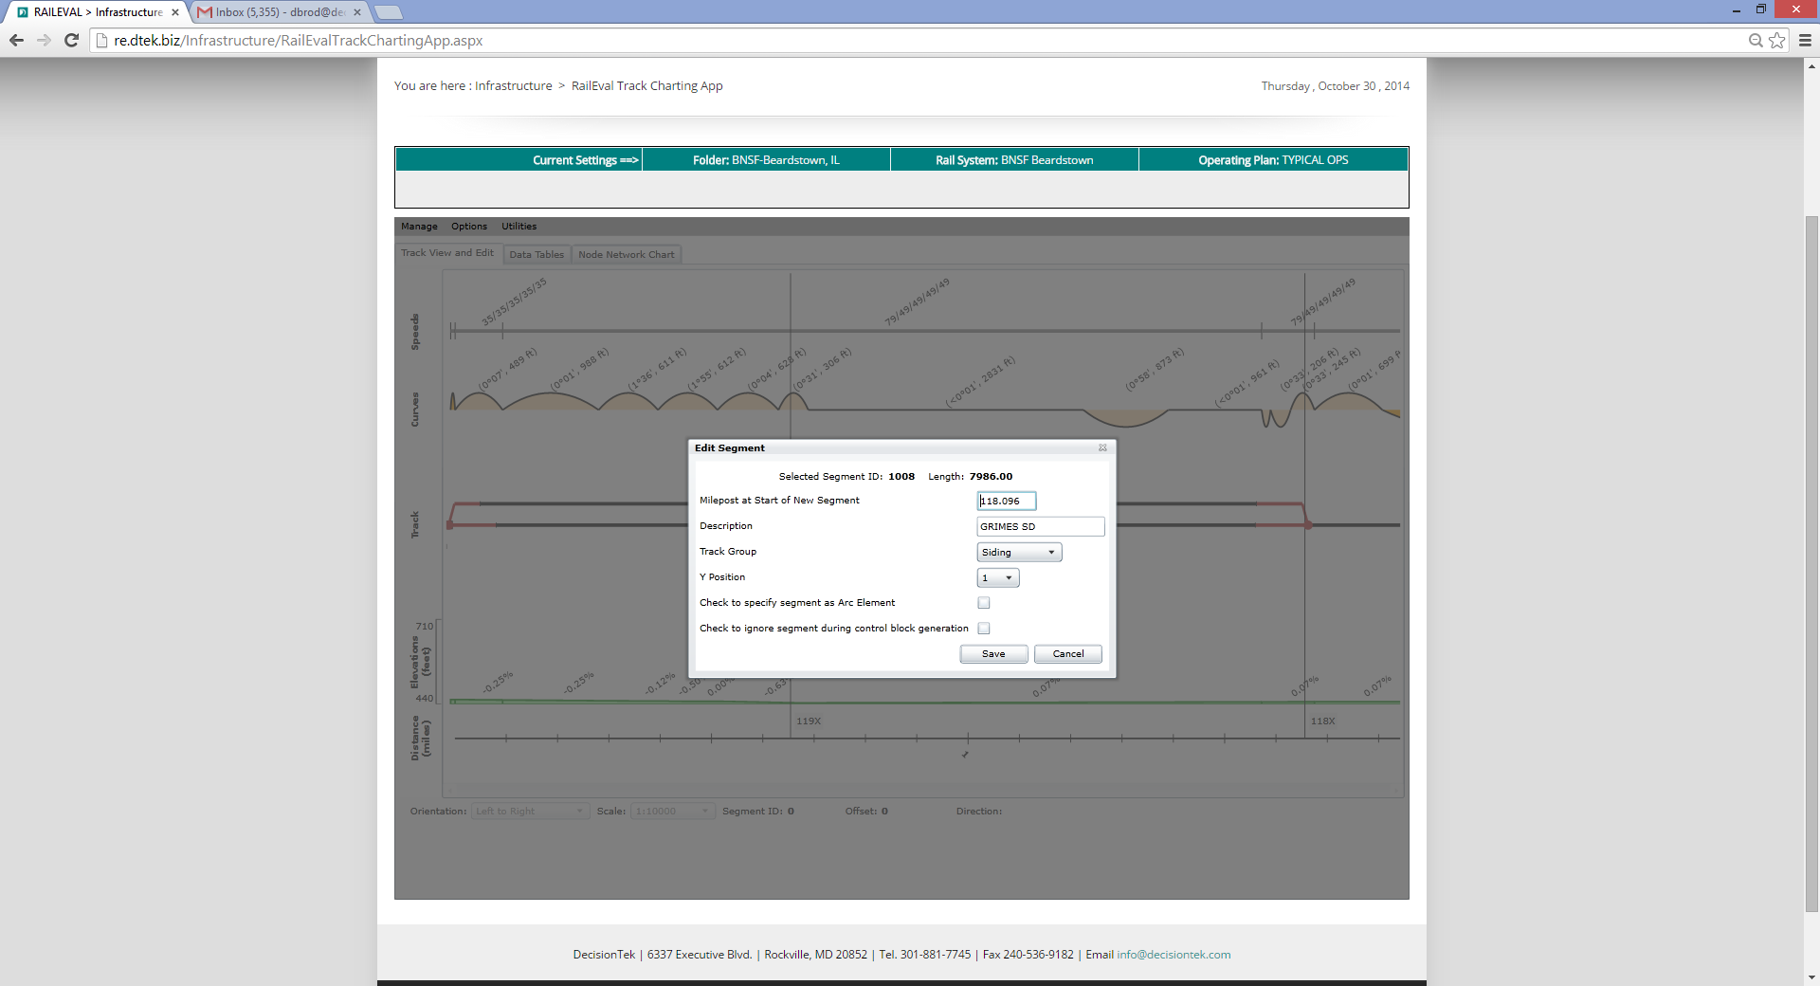
Infrastructure – edit segment form

Slide 29
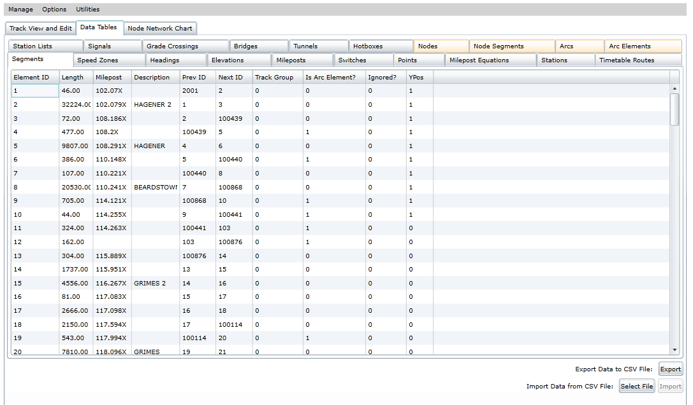
Infrastructure – data tables
Notes:
In many cases, you’ll want to develop your data in a spreadsheet and upload them directly into the tool.

Slide 30
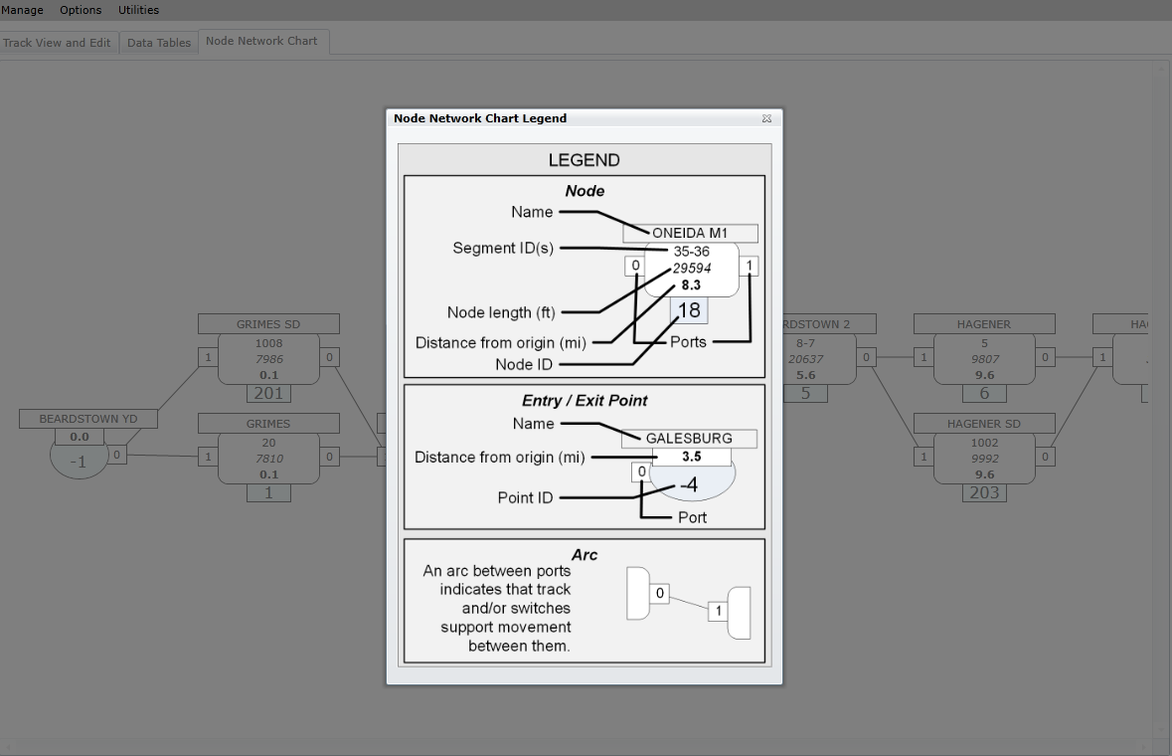
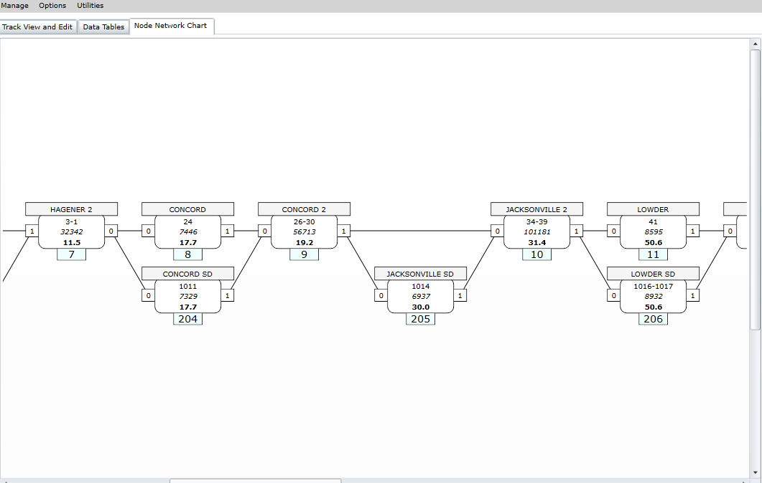
Infrastructure – Node network (traffic control blocks
Milepost equation
Shorter siding

Slide 31
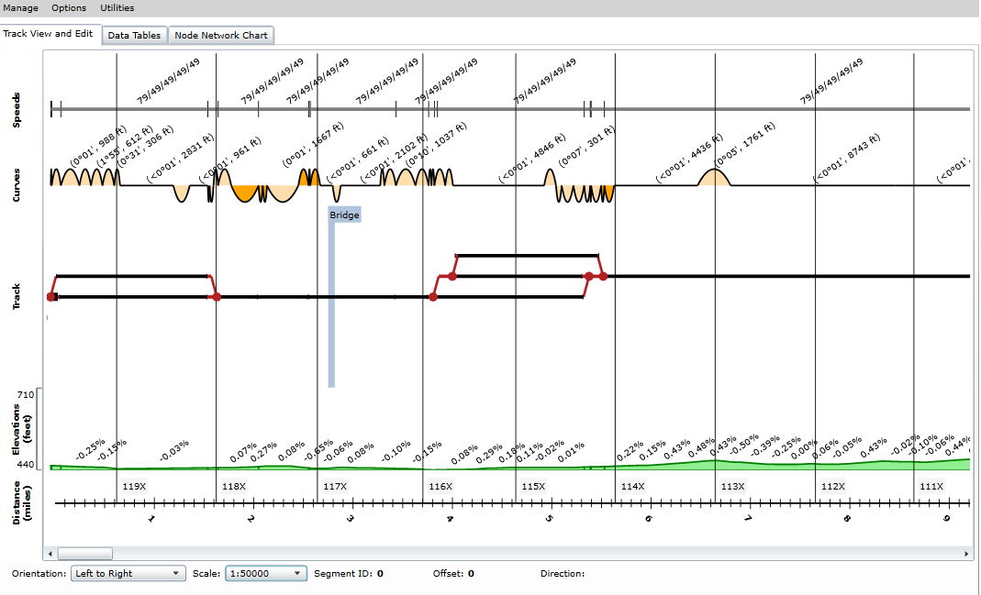
Infrastructure – Track Chart App (zoom)

Slide 32
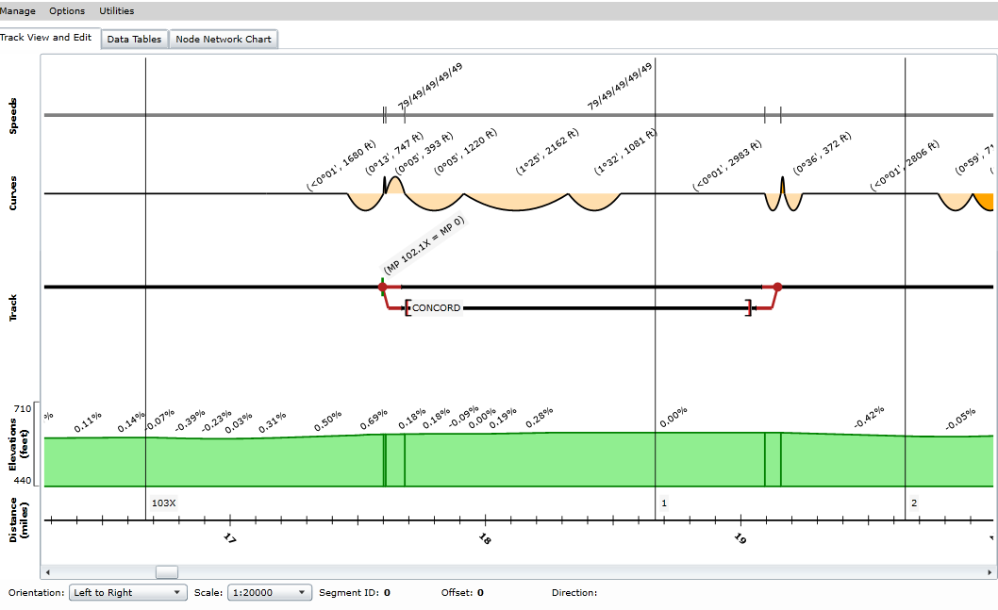
Infrastructure – Milepost equation

Slide 33
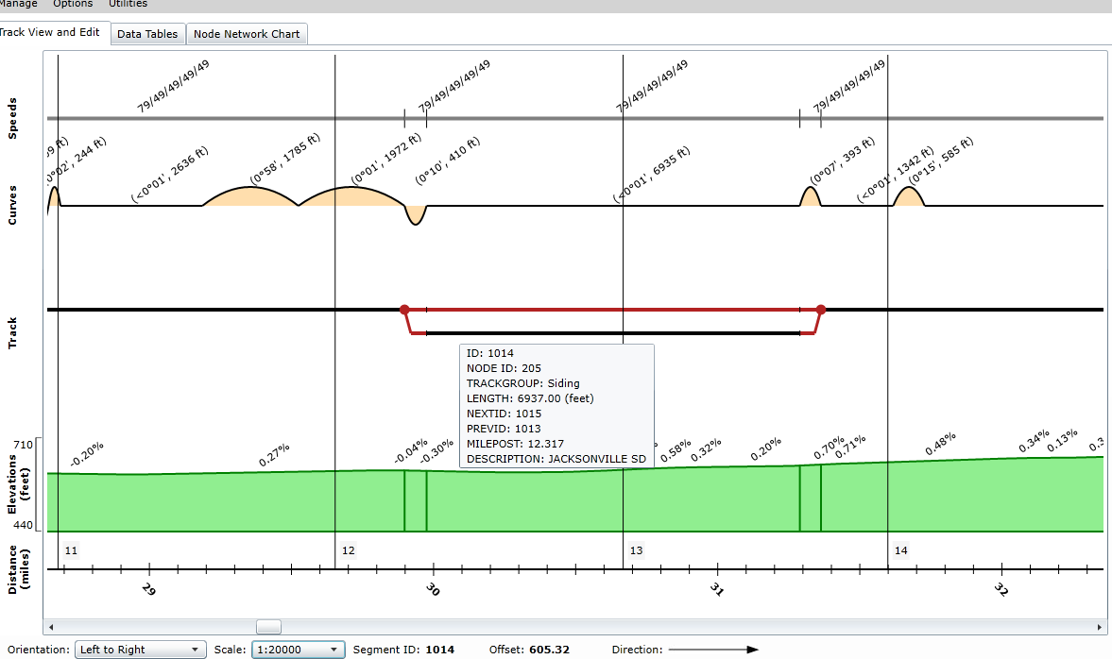
Infrastructure – shorter siding

Slide 34
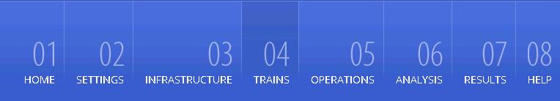
Trains

Slide 35
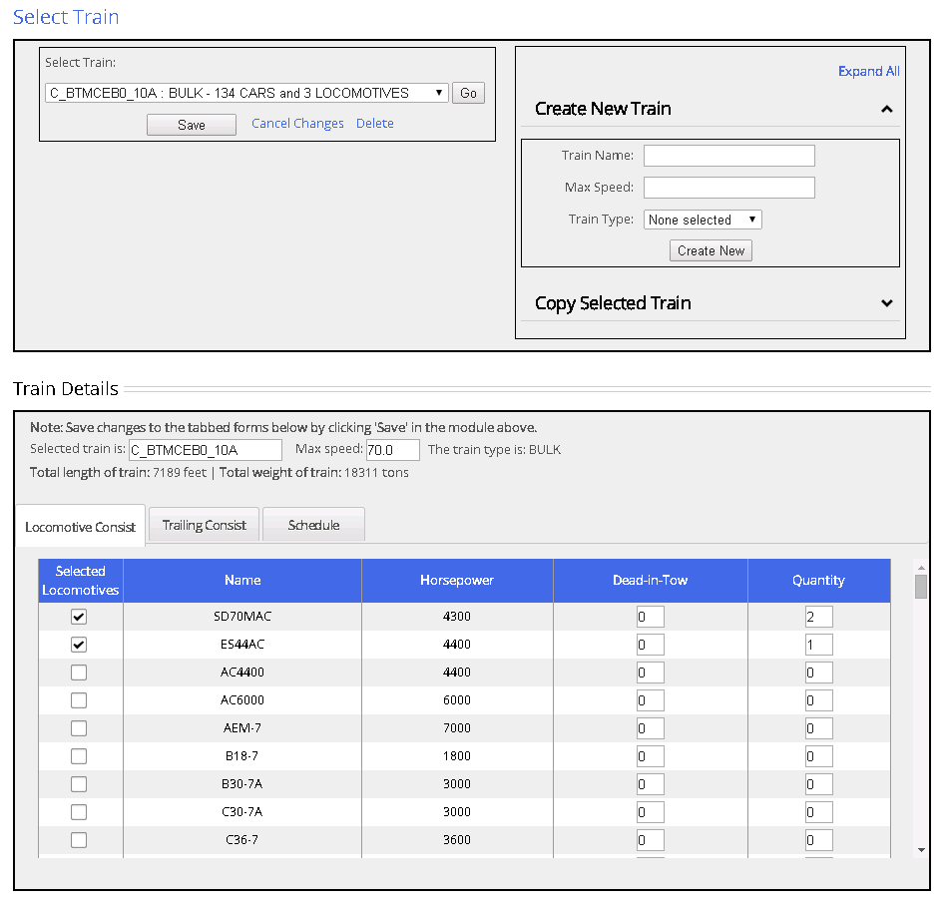
Trains – Locomotive consist

Slide 36
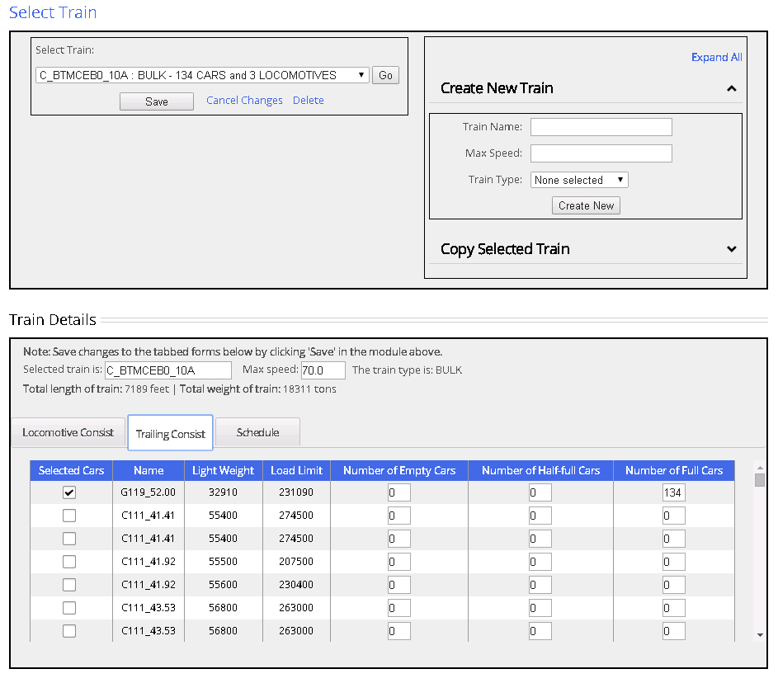
Trains – trailing consist

Slide 37
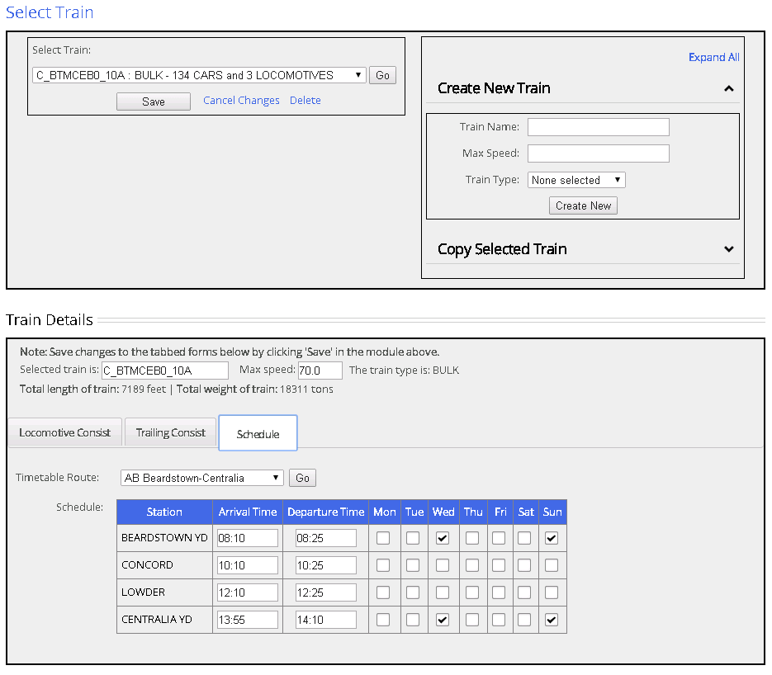
Trains - schedule

Slide 38
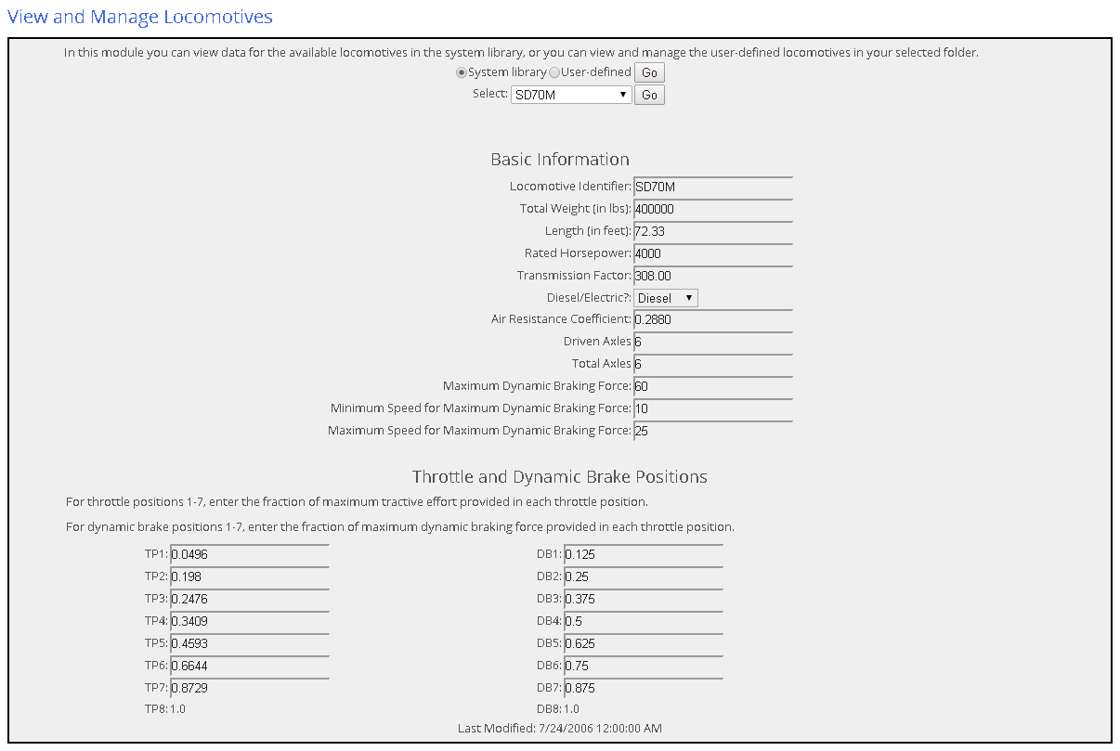
Trains – locomotive data

Slide 39
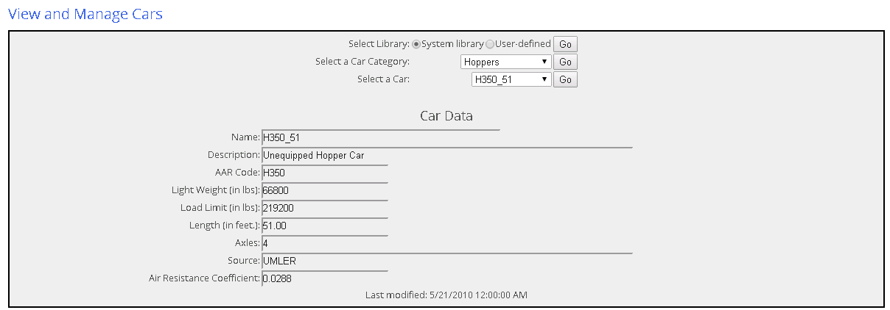
Trains – Car data

Slide 40

Operations

Slide 41
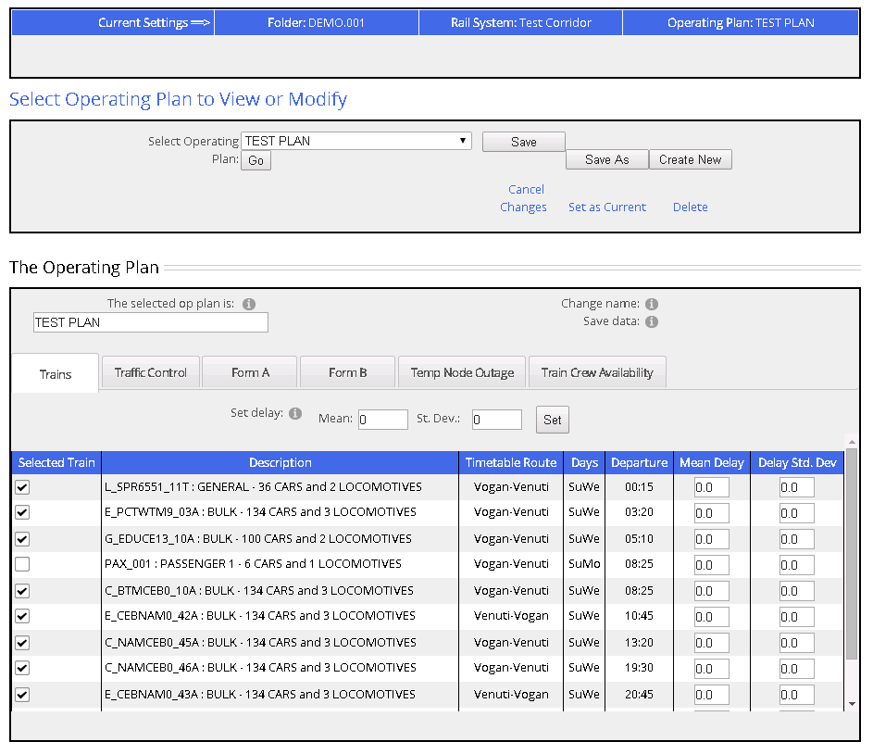
Operations – selecting trains

Slide 42

Analysis

Slide 43
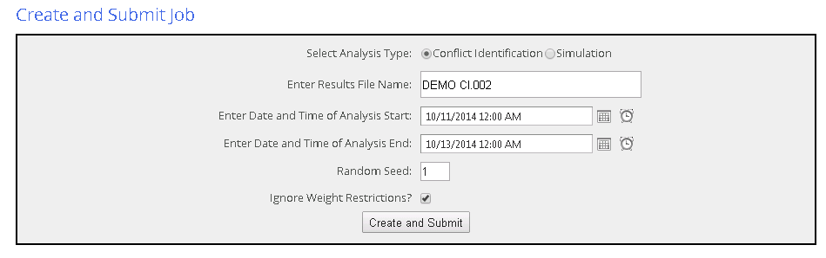
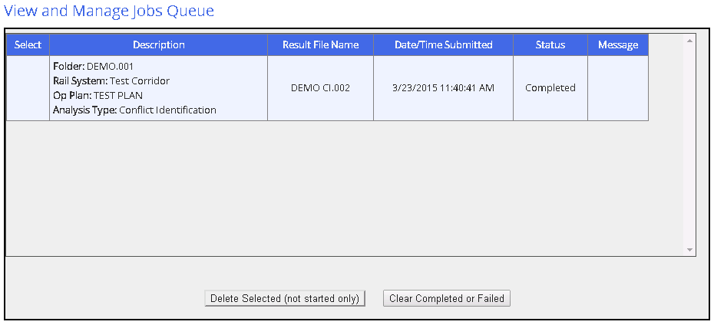
Analysis – Create and Submit Jobs

Slide 44

Results

Slide 45
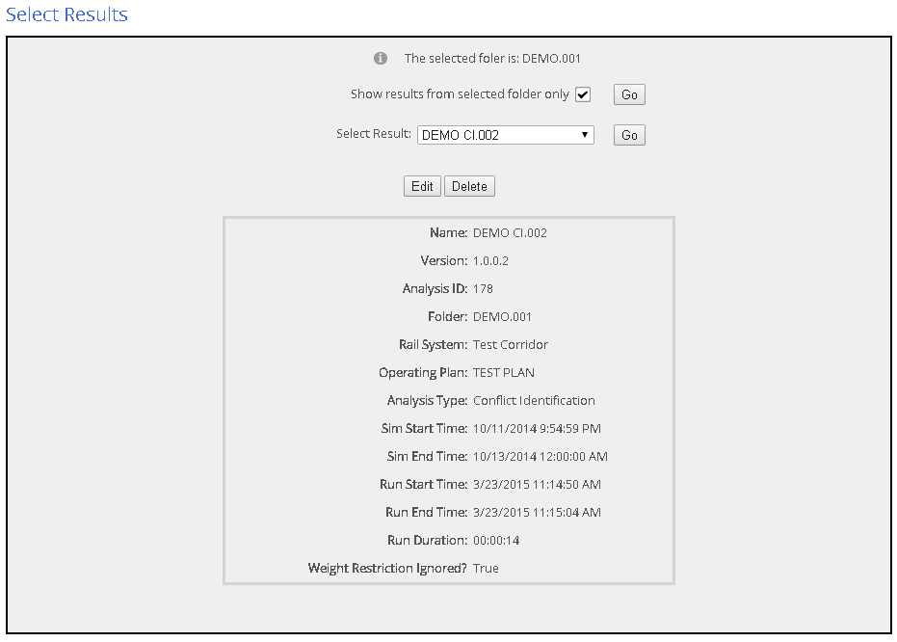
Select Results

Slide 46
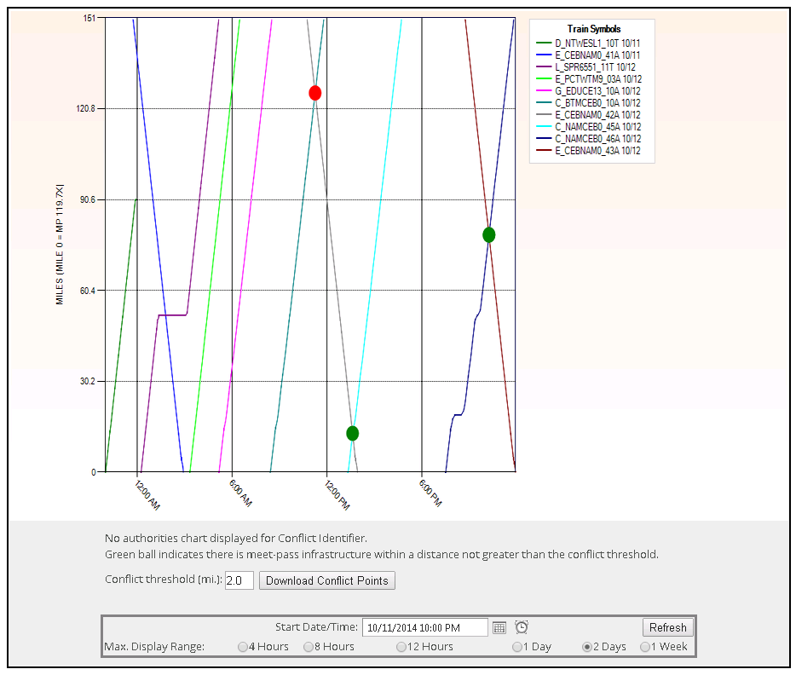
Results – Stringline with Conflict Identifier

Slide 47
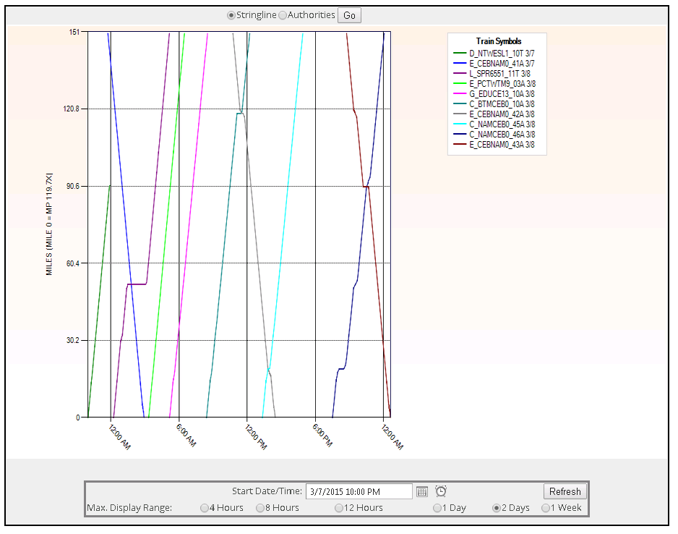
Results – Stringline chart

Slide 48
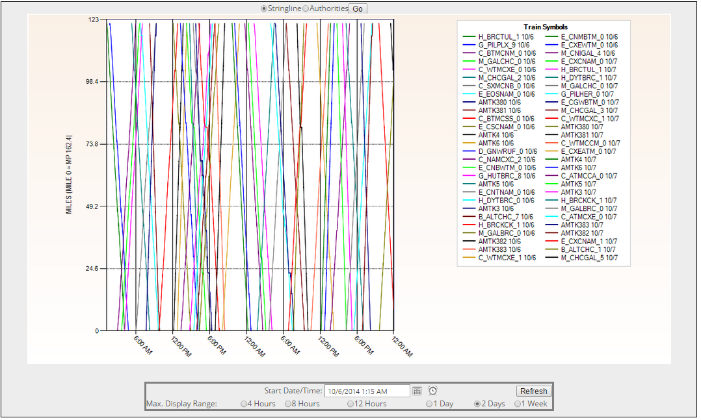
Results – Stringline chart
Double-track, 30 trains per day
Zoom (next slide)

Slide 49
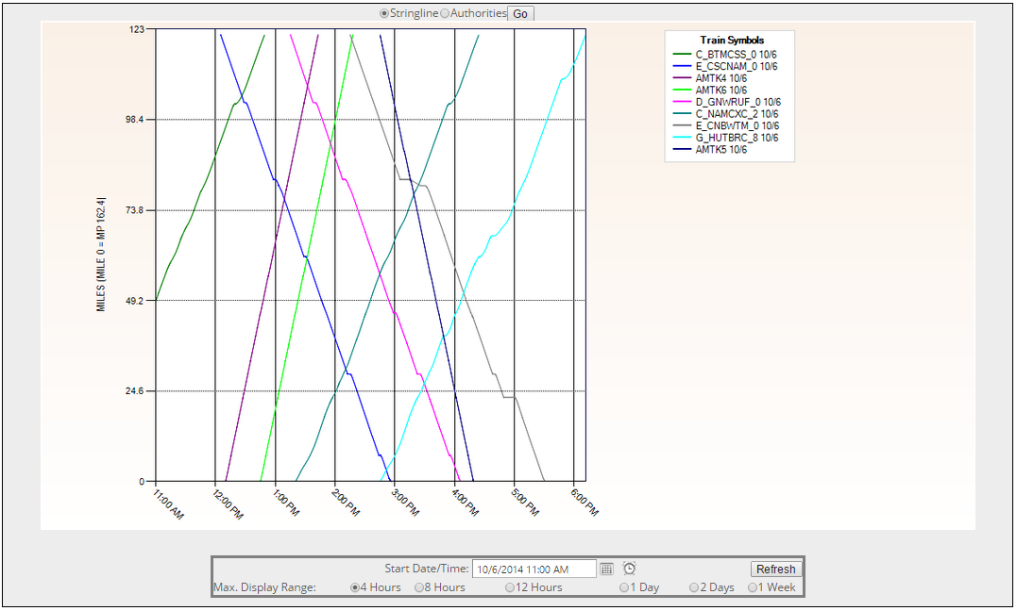
Results – Stringline chart
Double-track, 30 trains per day (with zoom)
Overtake and meet

Slide 50
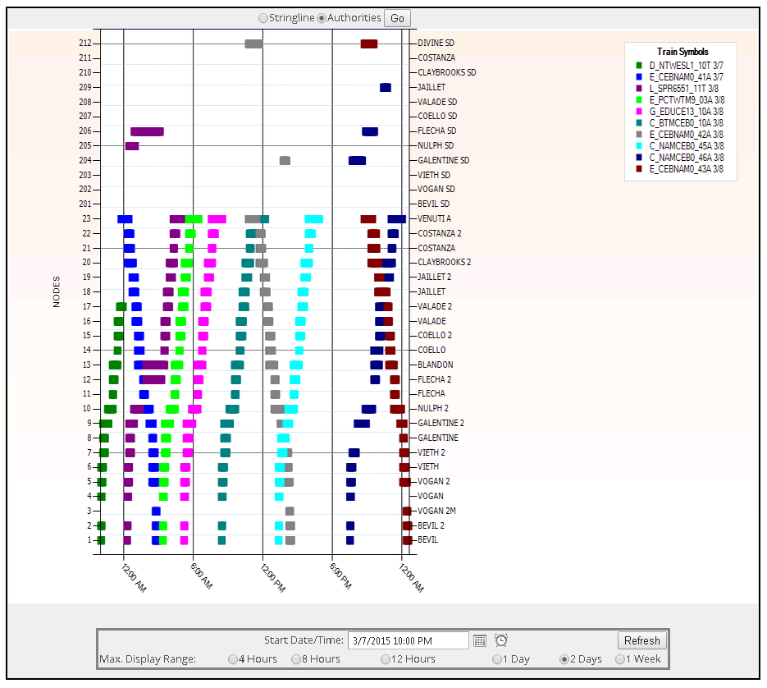
Results – Authorities Chart

Slide 51
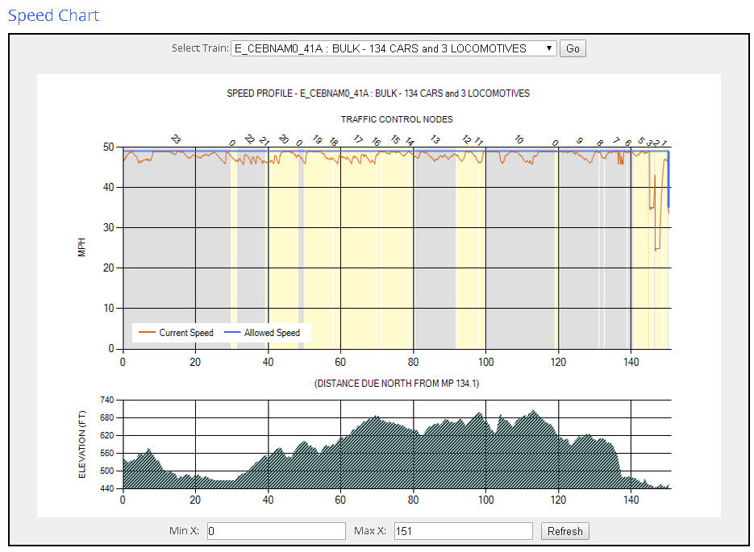
Results – Speed profile

Slide 52
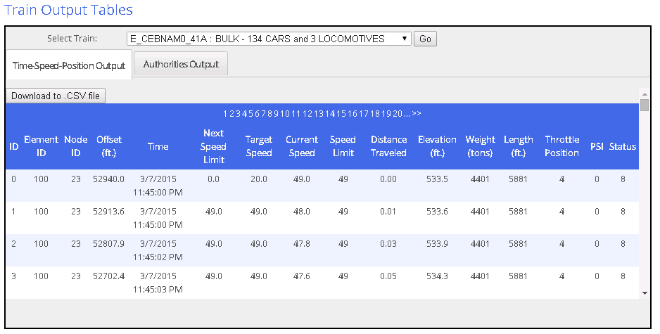
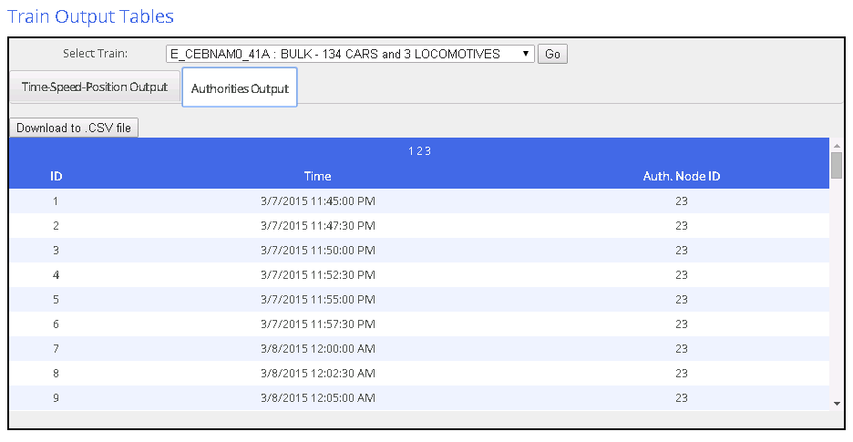
Results – Simulation Output Tables

Slide 53
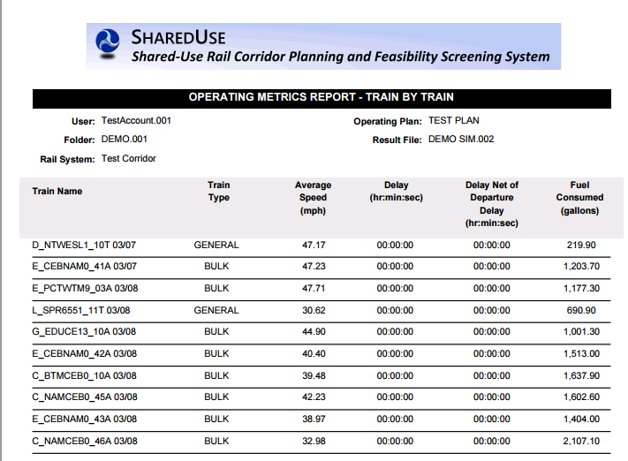
Results – Operating metrics

Slide 54
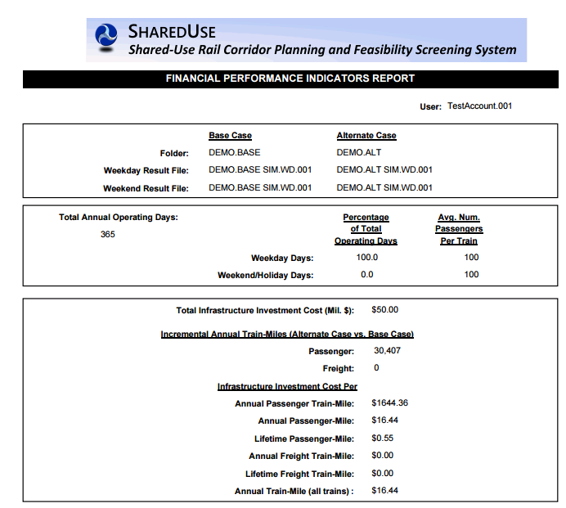
Results – Financial metrics
Notes:
The indicators of financial performance compare simulation result files from two folders representing the Base Case and the Alternate Case.
- The Base Case folder has rail system infrastructure data prior to implementing planned investments for increased capacity. The two selected result files from the Base Case folder represent simulations of: 1) typical weekday operations, and 2) typical weekend/holiday operations.
- The Alternate Case folder has rail system infrastructure data after implementing planned investments for increased capacity. The two selected result files from the Alternate Case represent simulations of operations on typical weekday and weekend/holiday, however, with modified service that the investments were intended to accommodate. You need to specify the investment costs required for the rail system improvements in the Alternate Case folder (see the Infrastructure>Infrastructure Costs page).
The indicators calculate the incremental annual train-miles (i.e., Alternate Case vs. Base Case) with breakouts for freight and passenger. The financial performance indicators show the investment cost per incremental annual train-miles - freight, passenger and total

