Slide 1
Track Recurrency 2016

Slide 2
COURSE OVERVIEW
Emergency Response Guide
Adjacent Track Protection Review
PDF Violation Report Compilation Review
Ballast - Technical Bulletin
General Manual Review
TTCi Field Exercise Mini-Sessions

Slide 3
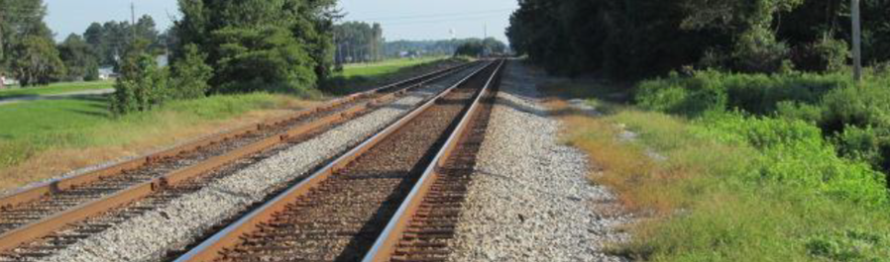
Adjacent Track Protection
214.336
Track Recurrency 2016

Slide 4
What Happened?
As a result of this rule, changes were made to three existing Subparts of the Roadway Workplace Safety Regulation; 214.7, 214.315 and 214.335 and a new rule, 214.336 was added.
214.7 was amended by adding introductory text.
214.315(a) changed to provide additional information in the job briefing. The subsection was re-written to include adjacent track discussion in the job briefing.
214.335 changed the heading and paragraph (c) was removed.

Slide 5
214.7
Intro text: ‘‘Unless otherwise provided, as used in this part-’’ prior to the list of definitions. This change is necessary for two reasons:
  to clarify that the definitions apply to part 214 and not necessarily to other parts of the CFR; and
  to ensure that the addition of similar definitions (‘‘adjacent track’’ and ‘‘adjacent controlled track’’) that are applicable only to § 214.336 do not conflict in any way with the same terms in this ‘‘general definitions’’ section.
Note: the definition of ‘‘adjacent tracks’’ still applies to any other sections in Part 214, unless otherwise provided in the section the term is used.

Slide 6
214.315(a)
OTS Job Briefings
When an employer assigns a duty to a roadway worker that calls for that employee to foul a track, the employer shall provide the employee with an OTS job briefing which includes at a minimum, the following:
  Information on the means by which on-track safety is to be provided for each track identified to be fouled;
  Instruction on each on-track safety procedure to be followed;
  Information about any adjacent tracks, on-track safety for such tracks, if required by this subpart or deemed necessary by the roadway worker in charge, and identification of any roadway maintenance machines that will foul such tracks; and
  A discussion of the nature of the work to be performed and the characteristics of the work location to ensure compliance with this subpart.

Slide 7
214.335
214.335 received a heading change to add the word “general” to now read:
214.335 On-track safety procedures for roadway work groups, general.
Paragraph (c) of 213.335 “Roadway work groups engaged in large-scale maintenance or construction shall be provided with train approach warning in accordance with 214.327 for movements on adjacent tracks that are not included within working limits” was removed.

Slide 8
214.336
Adjacent Track Protection
Initially published to become effective November 30, 2011.
In response to the petitions for reconsideration, FRA delayed the effective date until July 1, 2013, and requested comments on the petitions.
The November 2011 final rule was amended to clarify certain sections and the rule made effective July 1, 2014. The two final rules were not consolidated into one and reference must be made to the revisions contained in the 2014 final rule to ensure proper application.

Slide 9
Adj. Trk. Protection
Definitions
The definitions as used in this section play a large part in the understanding and application of the rule and must be considered when making an assessment of the proper application of the rule.
Remember, definitions in this section (214.336) apply ONLY in this section!

Slide 10
Adj. Trk. Protection
Definitions
From 214.7
Fouling a track - the placement of an individual or an item of equipment in such proximity to a track that the individual or equipment could be struck by a moving train or on-track equipment, or in any case is within four feet of the field side of the near running rail.

Slide 11
Adj. Trk. Protection
Definitions
From 214.336(a)(3)
Occupied track means a track on which on-track, self-propelled equipment or coupled equipment is authorized or permitted to be located while engaged in a common task with a roadway work group with at least one of the roadway workers on the ground.

Slide 12

Adj. Trk. Protection
Definitions
From 214.336(a)(3)
Adjacent controlled track means a controlled track whose track center is spaced 19 feet or less from the track center of the occupied track.
The occupied track can be controlled or non-controlled.
OCCUPIED TRACK
19 feet or less
CONTROLLED TRACK

Slide 13
Adj. Trk. Protection
Definitions
From 214.336(a)(3)
Adjacent track means a controlled or non-controlled track whose track center is spaced less than 25 feet from the track center of the occupied track.
Less than 25 feet

Slide 14
Adj. Trk. Protection
Definitions
From 214.336(a)(3)
Minor correction means one or more repairs of a minor nature, including, but not limited to, welding, spiking, anchoring, hand tamping, and joint bolt replacement, that are accomplished with hand tools or handheld, hand supported, or hand-guided power tools. The term does not include machine spiking, machine tamping, or any similarly distracting repair.

Slide 15
Adj. Trk. Protection
Definitions
From 214.336(a)(3)
Inter-track barrier means a continuous barrier of a permanent or semi-permanent nature that spans the entire work area, that is at least four feet in height, and that is of sufficient strength to prevent a roadway worker from fouling the adjacent track.

Slide 16
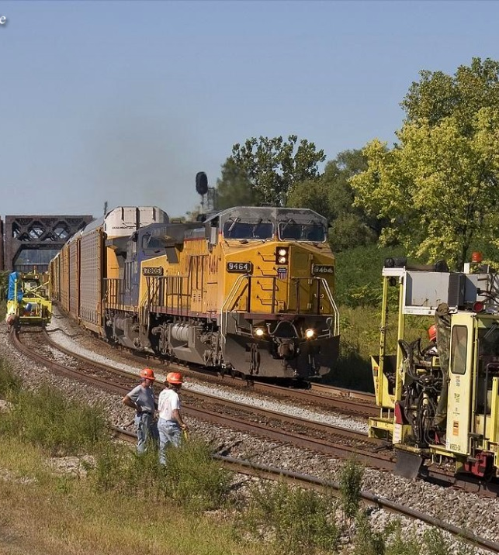
Is Adjacent Track Protection Required?
Ask first: Is Adjacent track protection required?
Then: What procedures must be followed?

Slide 17
214.336 Adjacent Track Protection - Application
Do you have an adjacent controlled track within 19 feet?
Is there On-track self-propelled or coupled equipment on the occupied track?
Is there one or more roadway workers on the ground engaged in a common task with this equipment?
Is the work other than inspection or minor correction being performed? (or one of the other exceptions: mechanics, centenary tower car, ATIP, etc.)
If you answer no to ANY of these questions, 214.336 does not apply.

Slide 18
214.336 (a) Procedures; General
Procedures; general
  General Rule
    Except as provided in paragraph (e) of this section, on-track safety is required for each adjacent controlled track when a roadway work group with at least one of the roadway workers on the ground is engaged in a common task with on-track, self-propelled equipment or coupled equipment on an occupied track. The required on-track safety shall be established through § 214.319 (Working limits, generally) or § 214.329 (Train approach warning provided by watchmen/lookouts) and as more specifically described in this section.

Slide 19
214.336 (a) Procedures; General
Procedures; general
  Special circumstance arising in territories with at least three tracks, if an occupied track is between two adjacent controlled tracks.
    If an occupied track is between two adjacent tracks and concurrent movements are authorized with one of those movements at speeds greater than 25F/40P, the more restrictive procedure in paragraph (b) applies.
(summarized)

Slide 20
214.336(E) Exceptions!!!!!
Exceptions to the rules:
No adjacent track protection is needed when a work group is exclusively performing one or more of the following three activities:
(summarized)

Slide 21
214.336(e) Exceptions
Exceptions to the rules
No Adjacent Track Protection is needed when:
  On-ground work performed on a side of the occupied track meeting specified condition(s).
    Working on the side of track away from the move or with an inter-track barrier
  Maintenance or repairs performed either alongside, or within the perimeter of, a roadway maintenance machine or coupled equipment on the occupied track.
    The machine physically limits you from getting to the other track
  Work activities involving certain equipment and purposes.
    Inspection and minor repair
(summarized)

Slide 22
214.336(e) Exceptions
(e)(1)
(e) Exceptions (1) On-ground work performed on a side of the
occupied track meeting specified condition(s).
A work group with all of its on-ground workers (other than those working under another exception in this paragraph) performing work while exclusively positioned on a side of the occupied track as follows:
  The side with no adjacent track
  The side with one or more adjacent tracks, the closest of which has working limits on it and no movements permitted
  The side with one or more adjacent tracks, provided that there is an inter-track barrier before the next track.
(summarized)

Slide 23




214.336(e) Exceptions
(e)(1)(i)
Work can continue on the side with no adjacent track…
And No adjacent track protection is needed

Slide 24

214.336(e) Exceptions
(e)(1)(ii)
Work can continue on the side with one or more adjacent tracks, the closest of which has working limits on it and no movements permitted
And No adjacent track protection is needed

Slide 25


214.336(e) Exceptions
(e)(1)(iii)
Work can continue on the side with one or more adjacent tracks, provided that there is an inter-track barrier before the next track
And No adjacent track protection is needed
Side B
Side “A2”
Side “A1”
Inter-track barrier

Slide 26
214.336(e) Exceptions
Exceptions to the rules
No Adjacent Track Protection is needed when:
  On-ground work performed on a side of the occupied track meeting specified condition(s).
    Working on the side of track away from the move or with an inter-track barrier
  Maintenance or repairs performed either alongside, or within the perimeter of, a roadway maintenance machine or coupled equipment on the occupied track.
    The machine physically limits you from getting to the other track
  Work activities involving certain equipment and purposes.
    Inspection and minor repair
(summarized)

Slide 27
214.336(e) Exceptions
(e)(2)
(e) (2) Maintenance or repairs performed either alongside, or within the perimeter of, a roadway maintenance machine or coupled equipment on the occupied track.
No Adjacent Track Protection is needed when:
Roadway worker(s) perform maintenance or repairs alongside an RMM or coupled equipment, provided that such machine or equipment would effectively prevent the worker from fouling the adjacent controlled track on the other side of such equipment, and that such maintenance or repairs are performed while positioned on a side of the occupied track as described in paragraph (e)(1)
(summarized)
Notes:
Fueling, replacing grinder wheels,

Slide 28
214.336(e) Exceptions
(e)(2)
(e) (2) Maintenance or repairs performed either alongside, or within the perimeter of, a roadway maintenance machine or coupled equipment on the occupied track.
No Adjacent Track Protection is needed when:
Roadway worker(s) on or under an RMM or coupled equipment perform maintenance or repairs within the perimeter of the machine or equipment, provided that no part of their person breaks the plane of the rail of the occupied track except when toward one of the sides of the occupied track as described in paragraph (e)(1). A boom or other equipment extending beyond the body of an RMM or coupled equipment toward an adjacent controlled track is not considered to be within the perimeter of the machine.
(summarized)

Slide 29
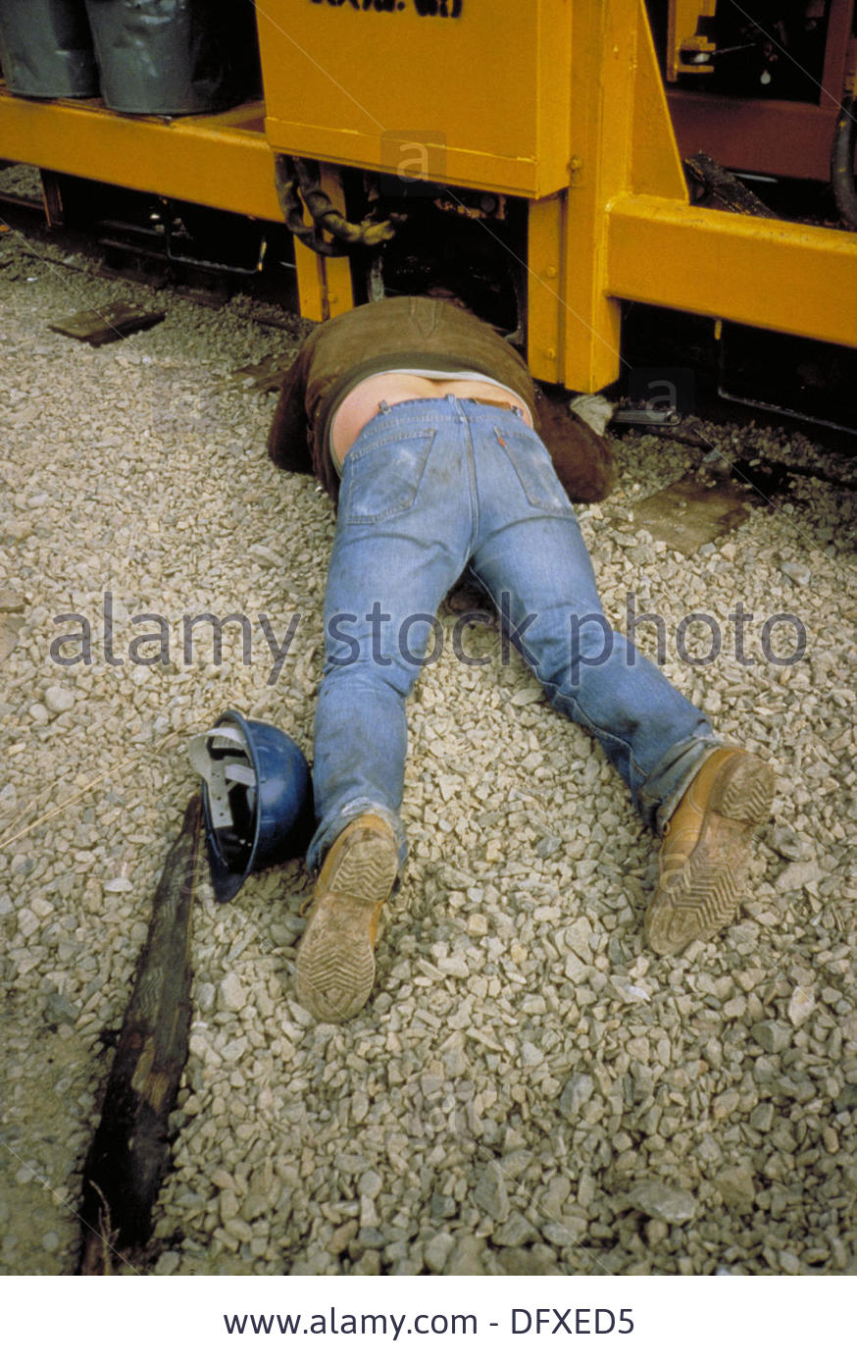
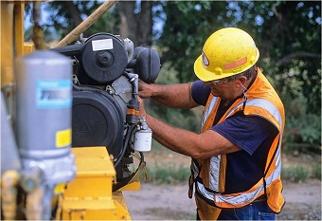
214.336(e) Exceptions
(e)(2)(i)&(ii)
No adjacent track protection is needed for mechanic:
  Alongside machine (with machine between them and adjacent track)
  Under or on machine if they don’t
  break the plane of the rail on the
  live track side

Slide 30
214.336(e) Exceptions
Exceptions to the rules
No Adjacent Track Protection is needed when:
  On-ground work performed on a side of the occupied track meeting specified condition(s).
    Working on the side of track away from the move or with an inter-track barrier
  Maintenance or repairs performed either alongside, or within the perimeter of, a roadway maintenance machine or coupled equipment on the occupied track.
    The machine physically limits you from getting to the other track
  Work activities involving certain equipment and purposes.
    Hirails and inspection/ minor repair; ATIP; catenary tower cars
(summarized)

Slide 31
214.336(e) Exceptions
(e)(3)
(e) (3) Work activities involving certain equipment and purposes.
No Adjacent Track Protection is needed when:
On-ground roadway worker(s) engaged in a common task on an occupied track with on-track, self-propelled equipment or coupled equipment consisting exclusively of the following:
  A hirail or other railbound vehicle being used for inspection or minor correction.
    ‣ No coupled equipment ‣ Multiple vehicles must have job briefing
  An automated inspection vehicle
  A catenary maintenance tower car when on the on-ground workers are between the rails and solely there to apply and remove grounds.
(summarized)

Slide 32
Adj. Trk. Protection
Definitions
From 214.336(a)(3)
Minor correction means one or more repairs of a minor nature, including, but not limited to, welding, spiking, anchoring, hand tamping, and joint bolt replacement, that are accomplished with hand tools or handheld, hand supported, or hand-guided power tools. The term does not include machine spiking, machine tamping, or any similarly distracting repair.

Slide 33
214.336(e) Exceptions
(e)(3)
(e)(3) (continued)
… If such a roadway work group (‘‘excepted group’’) is authorized to operate on the same occupied track and within the working limits of a separate roadway work group performing work that is subject to the requirements of this section (‘‘non-excepted group’’) or vice versa, the groups must conduct an on-track safety job briefing to determine if adjacent-controlled-track on-track safety is necessary for the excepted group.
If an excepted work group and non-excepted work group occupy the same limits → Have a job briefing.
(summarized)

Slide 34
214.336(e) Exceptions
(e)(3)
(e)(3) (continued)
Such determination shall be made by the RWIC of the working limits;
if the groups are in such proximity where the ability of the roadway workers in the excepted group to hear or see approaching trains and other on-track equipment is impaired by background noise, lights, sight obstructions or any other physical conditions caused by equipment,
  then this exception does not apply, and adjacent track protection must be provided to both groups.
(summarized)

Slide 35
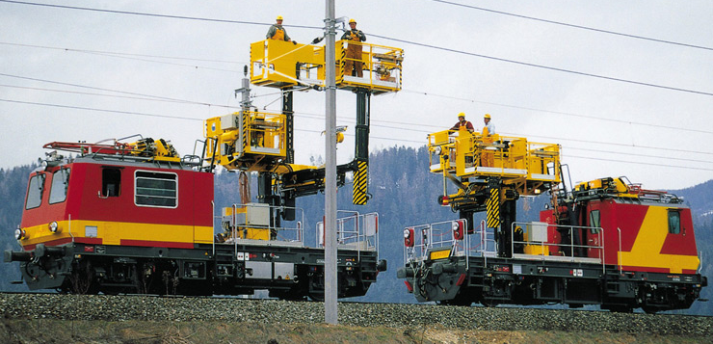
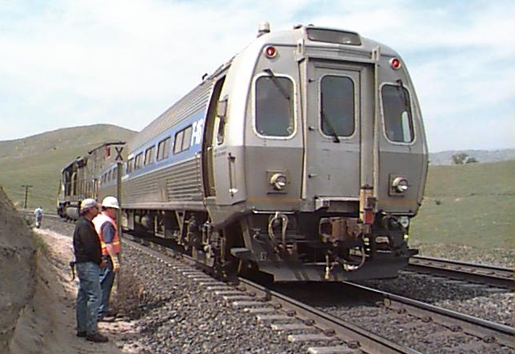
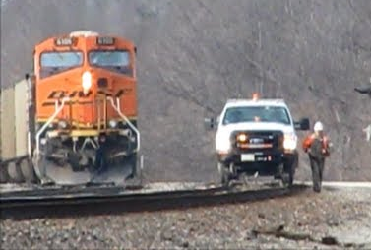
214.336(e) Exceptions
(e)(3)
No Adjacent Track Protection is needed for: (with lots of fine print)
(summarized)

Slide 36
Is Adjacent Track Protection Required?
Ask first: Is Adjacent track protection required?
Then: What procedures must be followed?

Slide 37
214.336 (B) Procedures For Passing Speeds Over 25F/40P
Procedures for moves over 25F/40P
  If a train or other on-track equipment is authorized to move on an adjacent controlled track at a speed greater than 25 mph, or at a speed greater than 40 mph for a passenger train or other passenger on-track equipment movement, each roadway worker in the roadway work group that is affected by such movement must comply with the following procedures:

Slide 38
214.336 (B) Procedures For Passing Speeds Over 25F/40P
Procedures for moves over 25F/40P
  Ceasing Work
    Except for the work activities as described in paragraph (e) of this section, each affected roadway worker shall as described in Table 1:
    Cease all on-ground work and equipment movement on or between the rails of the occupied track or on one or both sides of the occupied track
    Occupy a predetermined place of safety upon notification or warning of movement on the adjacent controlled track.
(summarized)

Slide 39
214.336 (B) Procedures For Passing Speeds Over 25F/40P
Procedures for moves over 25F/40P
  Resuming Work
    Work may be resumed after the trailing-end of all trains or other on-track equipment has passed and remains ahead of the roadway worker
    If the train or other on-track equipment stops before its trailing-end passes the roadway worker, work may resume only:
      train approach warning has been established on the adjacent controlled track, or
      The RWIC has established that further movements shall be made only as permitted by the RWIC
(summarized)

Slide 40
214.336 (B) Procedures For Passing Speeds Over 25F/40P
Upon movement notification or warning for Track 1
at speeds greater than 25F/40P,
Cease ALL work and movements; Occupy a PPOS
Track 2 - Side “B”
ALL WORK STOPS
ALL MOVES STOPS
ALL MOVES STOPS
ALL MOVES STOPS
ALL WORK STOPS
Side “A”
Track 1 - Working limits or Train Approach Warning

Slide 41
214.336(c) Procedures For Passing Speeds 25F/40P or Less
Procedures for 25F/40P or less
  If a movement is authorized on adjacent controlled track at 25F/40P or less, each roadway worker of the roadway work group affected by the movement must comply with paragraph (b) of this section except:
  Equipment movement may continue on the occupied track
  On-ground work may continue between the rails (doesn’t break the plane) of the occupied track when not within 25’ (ahead or behind) of on-track, self-propelled equipment or coupled equipment on the occupied track
The only change in procedures when moves
are above or below the speed threshold.
(summarized)

Slide 42
214.336(c) Procedures For Passing Speeds 25F/40P or Less
Upon movement notification or warning for No. 1 less than 25F/40P,
Cease Work & Occupy a PPOS (with 2 exceptions)
Track 2 - Side “B”
Not less than 25’
25F/40P or less
Not less than 25’
25F/40P or less
Side “A”
Track 1 - Working limits or Train Approach Warning
On-ground work performed exclusively between the rails of the may continue, provided that no on-ground work is performed within the areas 25’ in front of or behind any on-track equipment.
Equipment movements on the rails of the occupied track may continue

Slide 43
214.336 Adjacent Track Protection
Congratulations!!!! You now know the bulk of the rule.
Moves over 25F/40P →
Moves 25F/40P or less →
Additional rules for 3+ tracks (don’t worry, we’ll get there!)
Cease all work and moves on occupied track
Occupy a PPOS
Same Except:
Moves may continue
On ground work may continue if >25’ from the machines

Slide 44
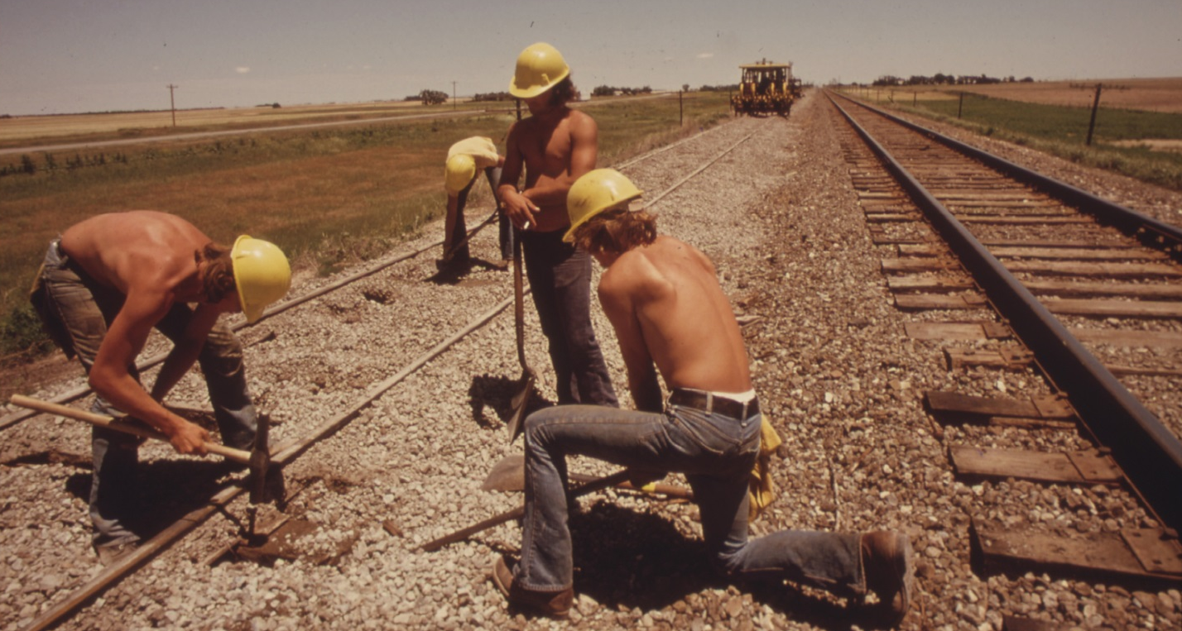
214.336(d) Discretion of roadway worker in charge
Nothing in this subpart prohibits the roadway worker in charge from establishing on-track safety on one or more adjacent tracks as he or she deems necessary consistent with both the purpose and requirements of this subpart.

Slide 45
214.336(E) Exceptions!!!!!
Exceptions to the rules:
No adjacent track protection is needed when a work group is exclusively performing one or more of the following three activities:
(summarized)

Slide 46
214.336(e) Exceptions
Exceptions to the rules
No Adjacent Track Protection is needed when:
  On-ground work performed on a side of the occupied track meeting specified condition(s).
    Working on the side of track away from the move or with an inter-track barrier
  Maintenance or repairs performed either alongside, or within the perimeter of, a roadway maintenance machine or coupled equipment on the occupied track.
    The machine physically limits you from getting to the other track
  Work activities involving certain equipment and purposes.
    Inspection and minor repair
(summarized)

Slide 47
214.336(f) Components of RRMs Fouling Adjacent Tracks
Except as provided for in 214.341(c), a component of an RMM shall not foul an adjacent controlled track unless working limits have been established on the adjacent controlled-track and there are no movements permitted by the RWIC that would affect any of the roadway workers engaged in a common task with such machine.
214.341(c) Components of RMMs shall be kept clear of passing trains. Where operating conditions permit RMMs to be < 4’ from an adjacent track, the OTS program of the railroad shall include instructions necessary to provide adequate clearance between the RMM and passing trains.
(summarized)

Slide 48
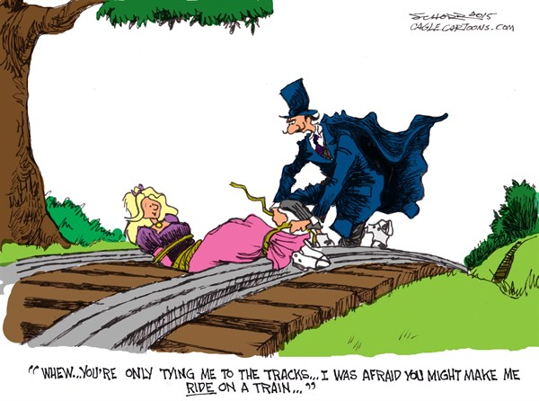
Examples

Slide 49
Example 1
“Side A”
Occupied Track
“Side B”
“Side A” of the Occupied Track – the side from the vertical plane of the near running rail of the occupied track extending outward through to the fouling space of the adjacent controlled track (“No. 1” Track) |  | On or Between the Rails of the Occupied Track (“No. 2” Track) where On-Track Safety is Established through working Limits | “Side B” of the Occupied Track – either (1) the side with no adjacent track or (2) the side from the vertical plane of the near running rail of the occupied track extending outward through to the fouling space of the adjacent controlled track (“No. 3” Track)
Method of On-Track Safety on Side A | Requirements | Requirements | Requirements | Method of On-Track Safety on Side B
Working Limits or Train Approach Warning | Upon receiving a notification or warning for movement(s) (“movement notification or warning”) for No. 1, cease work and occupy a predetermined place of safety (“PPOS”)¹. | Upon movement notification or warning for No. 1, cease work and occupy a PPOS, except work may continue during movement(s) on No. 1 auth’d at 25 mph or less(or 40 mph or less for passenger train movements) if maintain 25’ spacing² | Work³ is not required to cease during movements on No. 1 | Not Applicable (N/A) because there is no adjacent track

Slide 50
Example 1 –
If passing at Over 25F/40P
Notification for movement on Track 1 at greater than 25F/40P
“Side B”: Work may continue
Occupied Track: Cease all work and movements; Occupy a PPOS
“Side B”
ALL WORK STOPS
ALL MOVES STOPS
ALL MOVES STOPS
ALL MOVES STOPS
ALL WORK STOPS
“Side A”
Track 1 - Working limits or Train Approach Warning
“Side A”: Cease all work and movements; Occupy a PPOS

Slide 51
Example 1 –
If passing at 25F/40P or Less
Notification for movement on Track 1 at 25F/40P or less
“Side B”: Work may continue
Occupied Track: Cease work & Occupy a PPOS; except
Moves may continue;
Work may continue if >25’ from equipment;
“Side B”
At Least 25’
At Least 25’
At Least 25’
At Least 25’
“Side A”
Track 1 - Working limits or Train Approach Warning
“Side A”: Cease work;
Occupy a PPOS

Slide 52
Example 2
“Side A”
Occupied Track
“Side B”
“Side A” of the Occupied Track – the side from the vertical plane of the near running rail of the occupied track extending outward through to the fouling space of the adjacent controlled track (“No. 1” Track) |  | On or Between the Rails of the Occupied Track (“No. 2” Track) where On-Track Safety is Established through working Limits | “Side B” of the Occupied Track – either (1) the side with no adjacent track or (2) the side from the vertical plane of the near running rail of the occupied track extending outward through to the fouling space of the adjacent controlled track (“No. 3” Track)
Method of On-Track Safety on Side A | Requirements | Requirements | Requirements | Method of On-Track Safety on Side B
Working Limits | Upon movement notification for No. 1, cease work and occupy a PPOS. Work³ is not required to cease during movement(s) on No. 3. | Upon movement notification for No. 1 or No. 3, cease work and occupy a PPOS, except work may continue during movement(s) on No. 1 or No. 3 auth’d. at 25 mph or less (or at 40 mph or less for passenger train movements) if maintain 25′ spacing². | Upon movement notification for No. 3, cease work and occupy a PPOS. Work³ is not required to cease during movement(s) on No. 1. | Working limits.

Slide 53
Example 2
Single Move at 25F/40P or Less
Notification for movement on Track 1 at 25F/40P or less
“Side B”: Work may continue
Occupied Track: Cease work & Occupy a PPOS; except
Moves may continue;
Work may continue if >25’ from equipment;
Track 3 - Working Limits
“Side B”
At Least 25’
At Least 25’
At Least 25’
At Least 25’
“Side A”
Track 1 - Working limits
“Side A”: Cease work;
Occupy a PPOS

Slide 54

Example 2
Double Move at 25F/40P or Less
Notification for movement on Track 1 & 3 at 25F/40P or less
“Side B”: Cease work & Occupy PPOS
Occupied Track: Cease work & Occupy a PPOS; except
Moves may continue;
Work may continue if >25’ from equipment;
Track 3 Working Limits
“Side B”
At Least 25’
At Least 25’
At Least 25’
At Least 25’
“Side A”
Track 1 - Working limits
“Side A”: Cease work;
Occupy a PPOS

Slide 55
Example 3
“Side A”
Occupied Track
“Side B”
“Side A” of the Occupied Track – the side from the vertical plane of the near running rail of the occupied track extending outward through to the fouling space of the adjacent controlled track (“No. 1” Track) |  | On or Between the Rails of the Occupied Track (“No. 2” Track) where On-Track Safety is Established through working Limits | “Side B” of the Occupied Track – either (1) the side with no adjacent track or (2) the side from the vertical plane of the near running rail of the occupied track extending outward through to the fouling space of the adjacent controlled track (“No. 3” Track)
Method of On-Track Safety on Side A | Requirements | Requirements | Requirements | Method of On-Track Safety on Side B
Working Limits | Upon movement notification for No. 1, cease work and occupy a PPOS. Work³ is not required to cease during movement(s) on No. 3. | Upon movement notification for No. 1 or No. 3, cease work and occupy a PPOS, except work may continue during movement(s) on No. 1 or No. 3 auth’d. at 25 mph or less (or at 40 mph or less for passenger train movements) if maintain 25′ spacing². | Upon movement warning for No. 3 or notification for No. 1, cease work and occupy a PPOS. | Train Approach Warning

Slide 56

Example 3 - Move on Trk 1
25F/40P or Less
Notification for movement on Track 1 at 25F/40P or less
“Side B”: Cease work & Occupy PPOS
Occupied Track: Cease work & Occupy a PPOS; except
Moves may continue;
Work may continue if >25’ from equipment;
Track 3 - Train Approach Warning
“Side B”
At Least 25’
At Least 25’
“Side A”
Track 1 - Working limits
“Side A”: Cease work;
Occupy a PPOS

Slide 57

Example 3 - Move on Trk 3
25F/40P or Less
Notification for movement on Track 3 at 25F/40P or less
“Side B”: Cease work & Occupy PPOS
Occupied Track: Cease work & Occupy a PPOS; except
Moves may continue;
Work may continue if >25’ from equipment;
Track 3 - Train Approach Warning
“Side B”
At Least 25’
At Least 25’
“Side A”
Track 1 - Working limits
“Side A”: Work may Continue

Slide 58

Example 3 - Move on Trk 3
25F/40P or Less, 19-25’ Centers
Notification for movement on Track 3 at 25F/40P or less
“Side B”: Cease work & Occupy PPOS
Occupied Track: Cease work & Occupy a PPOS; except
Moves may continue;
Work may continue if >25’ from equipment;
Track 3 - Train Approach Warning
No. 3 Foul Zone
“Side B”
Possible PPOS for “Side B”
“Side A”
A Least 25’
Track 1 - Working limits
“Side A”: Cease work; Occupy PPOS
FRA Technical Training Material is Intended for Internal Instructional Purposes Only.
Do not distribute outside FRA or State Agency pursuant to 49 CFR Part 212.
58

Slide 59
Example 4
“Side A”
Occupied Track
“Side B”
“Side A” of the Occupied Track – the side from the vertical plane of the near running rail of the occupied track extending outward through to the fouling space of the adjacent controlled track (“No. 1” Track) |  | On or Between the Rails of the Occupied Track (“No. 2” Track) where On-Track Safety is Established through working Limits | “Side B” of the Occupied Track – either (1) the side with no adjacent track or (2) the side from the vertical plane of the near running rail of the occupied track extending outward through to the fouling space of the adjacent controlled track (“No. 3” Track)
Method of On-Track Safety on Side A | Requirements | Requirements | Requirements | Method of On-Track Safety on Side B
Train Approach Warning | Upon movement warning for No. 1 or No. 3, cease work and occupy a PPOS. | Upon movement warning for No. 1 or No. 3, cease work and occupy a PPOS, except work may continue during movement(s) on No. 1 or No. 3 auth’d. at 25 mph or less (or at 40 mph or less for passenger train movements) if maintain 25′ spacing². | Upon movement warning for No. 3 or No. 1, cease work and occupy a PPOS. | Train Approach Warning

Slide 60


Example 4 – Move on Either Track at 25F/40P or Less
Notification for movement on Track 3 at 25F/40P or less
“Side B”: Cease work & Occupy PPOS
Occupied Track: Cease work & Occupy a PPOS; except
Moves may continue;
Work may continue if >25’ from equipment;
Track 3 - Train Approach Warning
“Side B”
At Least 25’
At Least 25’
“Side A”
Track 1 - Train Approach Warning
“Side A”: Cease work;
Occupy a PPOS

Slide 61
Example 5
“Side A”
Occupied Track
“Side B”
“Side A” of the occupied track – the side from the vertical plane of the near running rail of the occupied track extending outward through to the fouling space of the adjacent controlled track (“No. 1”Track” or No. 1) |  | On or Between the Rails of the occupied track (“No. 2” Track or “number 2”) where On-Track Safety is Established through working Limits | “Side B” of the Occupied Track – either (1) the side with no adjacent track or (2) the side from the vertical plane of the near running rail of the occupied track extending outward through to the fouling space of the adjacent controlled track (“No. 3 Track” or “number 3”)
Method of On-Track Safety on Side A | Requirements | Requirements | Requirements | Method of On-Track Safety on Side B
None, but with inter-track barrier. | Work is prohibited on No. 1 and up to barrier (‘‘Side A1’’). Work is not required to cease btwn. barrier and near running rail of occupied track (‘‘Side A2’’) during movement(s) on No. 1. | Work is not required to cease during movement(s) on No. 1. | Work is not required to cease during movement(s) on No. 1. | N/A, because there is no adjacent track.

Slide 62
Example 5 – Inter-track Barrier
Notification for movement on Track 1 at any speed
“Side B”: Work may Continue; No Restrictions
Occupied Track: Work may Continue; No Restrictions
“Side A2”: Work may Continue; No Restrictions
“Side B”
“Side A2”
“Side A1”
Inter-track barrier
Track 1 – No OTS
“Side A1”: Work is Prohibited

Slide 63
Example 6
“Side A”
Occupied Track
“Side B”
“Side A” of the occupied track – the side from the vertical plane of the near running rail of the occupied track extending outward through to the fouling space of the adjacent controlled track (“No. 1”Track” or No. 1) |  | On or Between the Rails of the occupied track (“No. 2” Track or “number 2”) where On-Track Safety is Established through working Limits | “Side B” of the Occupied Track – either (1) the side with no adjacent track or (2) the side from the vertical plane of the near running rail of the occupied track extending outward through to the fouling space of the adjacent controlled track (“No. 3 Track” or “number 3”)
Method of On-Track Safety on Side A | Requirements | Requirements | Requirements | Method of On-Track Safety on Side B
None, but with inter-track barrier. | Work is prohibited on Side A1. Work 3 is not required to cease on Side A2 during movement(s) on No. 1 or No. 3. | Work is not required to cease during movement(s) on No. 1. | Upon movement notification or warning for No. 3, cease work and occupy a PPOS. Work 3 is not required to cease during movement(s) on No. 1. | Working limits or train approach warning.

Slide 64

Example 6 – Triple Track with Single Inter-track barrier
Notification for movement on Track 3 at 25F/40P or less
“Side B”: Cease work; Occupy a PPOS
Occupied Track: Cease work & Occupy a PPOS; except
Moves may continue;
Work may continue if >25’ from equipment;
“Side A2”: Work may Continue; No Restrictions
Track 3 - Working Limits or Train Approach Warning
“Side B”
At Least 25’
At Least 25’
At Least 25’
At Least 25’
“Side A2”
“Side A1”
Track 1 – No OTS
“Side A1”: Work is Prohibited

Slide 65
Is Adjacent Track Protection Required?
Ask first: Is Adjacent track protection required?
Then: What procedures must be followed?

Slide 66
214.336 Adjacent Track Protection - Application
Do you have an adjacent controlled track within 19 feet?
Is there On-track self-propelled or coupled equipment on the occupied track?
Is there one or more roadway workers on the ground engaged in a common task with this equipment?
Is the work other than inspection or minor correction being performed? (or one of the other exceptions: mechanics, centenary tower car, ATIP, etc.)
If you answer no to ANY of these questions, 214.336 does not apply.

Slide 67
Adjacent Track Protection
214.336
Module Complete!
Track Recurrency 2016

Slide 68
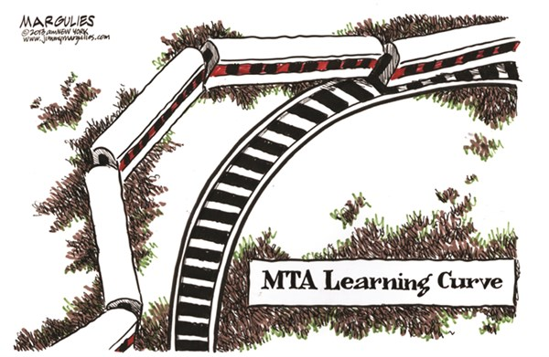
M-o-W Learning Curve

Slide 69
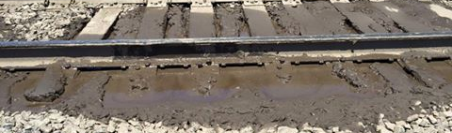
Ballast
Technical Bulletin
Track Recurrency 2016

Slide 70
Objectives
Understand the four functions of ballast that must be met.
Understand the current guidance concerning 213.103 – Ballast.

Slide 71
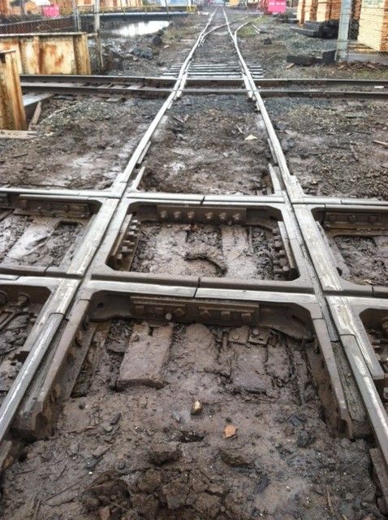
Ballast Requirements
213.103 A-D
Ballast Must:
Transmit and distribute loads, AND
Restrain track in all directions under loads, AND
Provide adequate drainage, AND
Maintain proper cross level, surface, and alinement

Slide 72
Technical Bulletin
TB-14-01
What is a Technical Bulletin?
Included in your supplements folder!

Slide 73
TB-14-01
Highlights
Ballast can be made of anything as long as it meets the performance standard (four functions from 213.103)
Look for other degrading components and geometry to see if ballast is performing its four functions
Consider safety and risk. Consult with specialist before writing defects/violations in class 1 track
Definition of a ‘geometry condition’

Slide 74
TB-14-01
Highlights
Take into account geometry and other aggravating factors when considering enforcement actions
  Track Speeds
  Traffic Density
  Passenger/Hazmat/STRACNET?
  Rate of degradation
  Tie conditions
  Location in relation to switches, joints, bridges
  Standing Water

Slide 75
Ballast Standard
Discussion Points
Is there a length requirement?
Is there a profile or crosslevel requirement?
What issues are you seeing in your areas?
Can you write fouled ballast in class 1 track?
  Should you? When would you? When wouldn’t you?

Slide 76
Fouled Ballast
Technical Bulletin
Module Complete!
Track Recurrency 2016

