Slide 1
Track Fundamentals Phase One

Slide 2
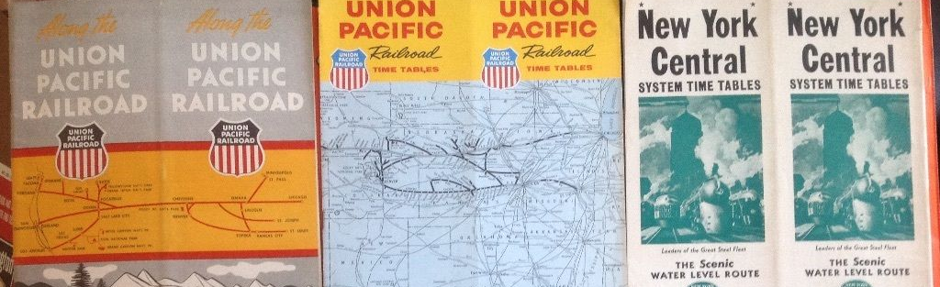
Reading timetables

Slide 3
MODULE PURPOSE
This module teaches each participant to read and interpret railroad timetables and track charts profiles.
The ability to use these documents is essential in track inspections and accident investigations when identifying specific railroad site locations.

Slide 4
MODULE OBJECTIVES
At the completion of this module participants will be able to:
Navigate a railroad timetable and identify and interpret information relevant during an inspection or investigation.
Navigate a railroad track chart/profile and identify and interpret information relevant during an inspection or investigation

Slide 5
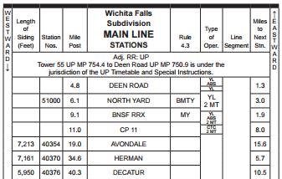
Timetables

Slide 6
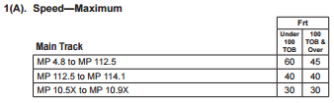
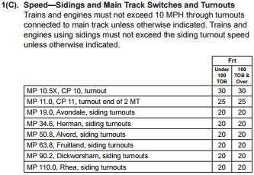
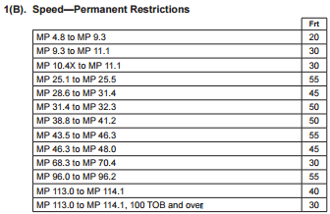

Timetables
Speeds

Slide 7
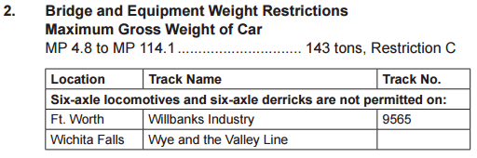
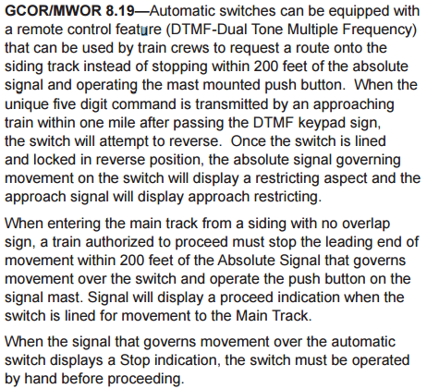
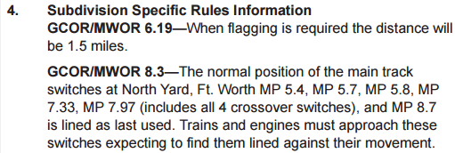
Timetable - Equipment Restrictions, Subdivision Rules

Slide 8
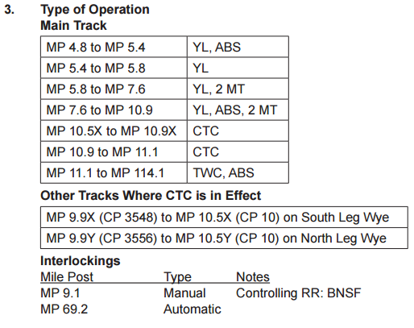
Timetables
Type of Operation

Slide 9
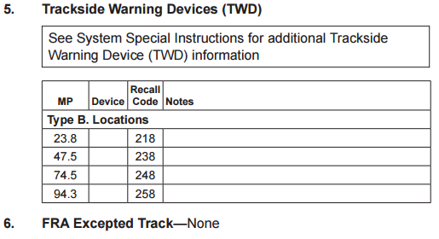
Timetables – Wayside Detectors & Excepted Track

Slide 10
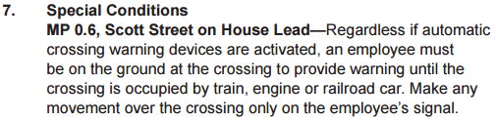
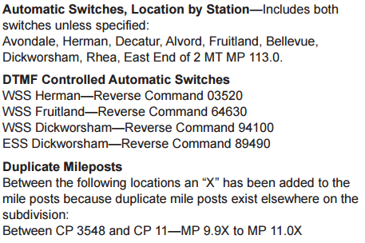
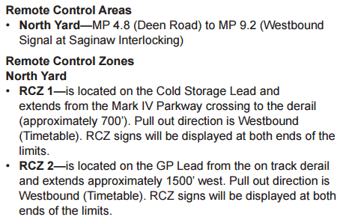
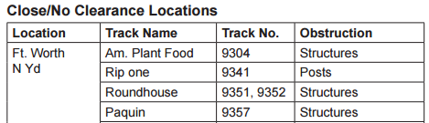
Timetables
Special Conditions

Slide 11
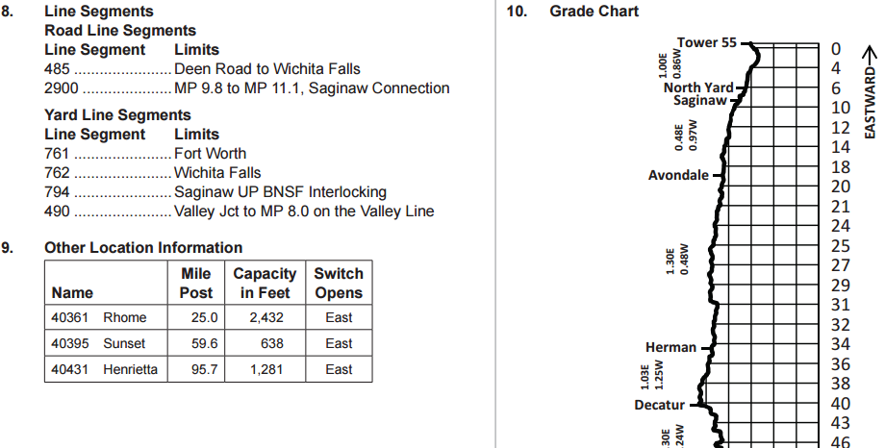
Timetables
Special Conditions

Slide 12
PRACTICAL EXERCISE
Open the folder named “Practical Exercise One”
Here you will find a UP Timetable for use in the exercise
  You will also find a UP SSI and GCOR if they help you
Write your answer on the sheet provided
This is an individual exercise
We will review the answers as a group

Slide 13
Practical Exercise #1
What is the name of timetable?
What is the timetable number?
What is the effective date of the timetable?

Slide 14
Practical Exercise #1
Turn to the Craig Subdivision
What is the timetable direction traveling from Craig toward Ute Jct.?
A train on the siding at Empire wishes to proceed West to Axial. The train will need to get a Track Warrant between Station Empire and MP ??? to reach the loop track at Axial?

Slide 15
Practical Exercise #1
What is the milepost at west Dorsey?
Where is CP DS184?
How many stations are between MP 1 and MP 25?

Slide 16
Practical Exercise #1
What is the capacity of the siding at empire?
What is the method of operation between Evans and Dorsey?
What is the maximum authorized speed between West Dawson and East Dorsey?

Slide 17
Practical Exercise #1
List the excepted tracks?
What is the maximum authorized speed in the Steamboat Siding?

Slide 18
Practical Exercise #1
Turn to the Greeley Subdivision
Are there any RCL Areas on the Main Track? If so, where?

Slide 19
Practical Exercise #1
While inspecting you find 1-7/8” of crosslevel at MP 52.2. What slow order, if any, should the RR place?
(Tangent Track)
Class of Track -> | 1 | 2 | 3 | 4 | 5
Deviation from zero crosslevel | 3” | 2” | 1-3/4” | 1-1/4” | 1”

Slide 20

ANSWERS
What is the name of timetable?
What is the timetable number?
What is the effective date of the timetable?

Slide 21
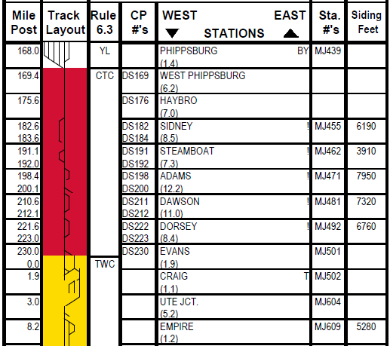
Practical Exercise #1
What is the timetable direction traveling from Craig toward Ute Jct.?

Slide 22

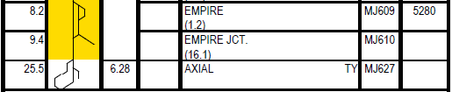
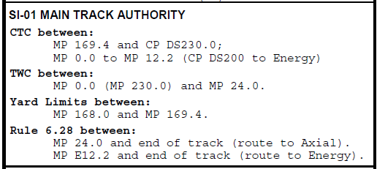
ANSWERS
A train on the siding at Empire wishes to proceed West to Axial. The train will need to get a Track Warrant between Station Empire and MP ___ to reach the loop track at Axial?
Milepost 24.0

Slide 23
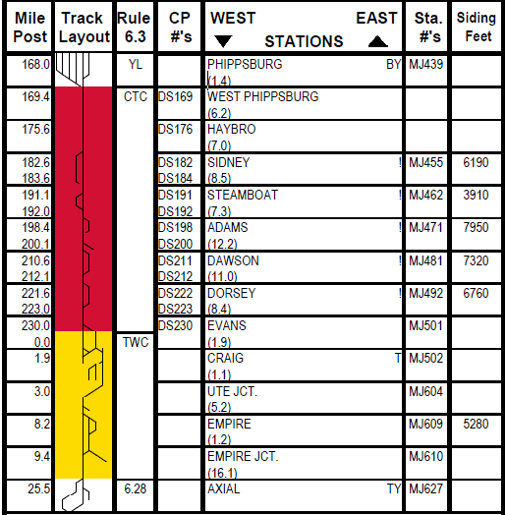
ANSWERS
What is the milepost at west Dorsey?
Where is CP DS184?
How many stations are between MP 1 and MP 25?
MP 223.0
West Sidney
MP 183.6
1
2
3
4

Slide 24
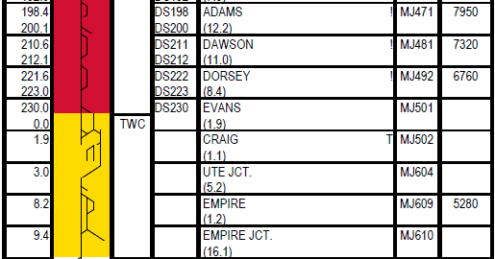
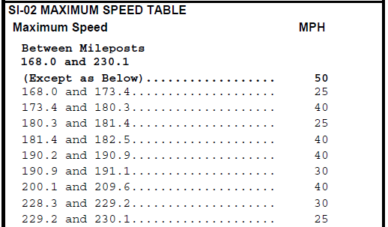
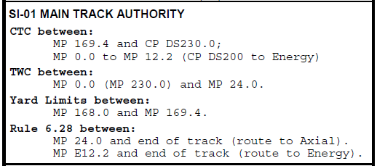
Practical Exercise #1
What is the capacity of the siding at empire?
What is the method of operation between Evans and Dorsey?
What is the maximum authorized speed between West Dawson and East Dorsey?
5280 Feet
CTC
50 MPH
No restriction between 209.6 and 228.3 so…

Slide 25
Practical Exercise #1
List the excepted tracks?
No Excepted Tracks

Slide 26
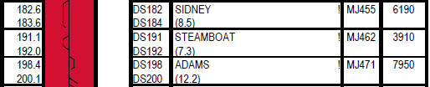

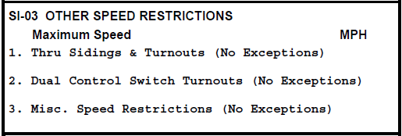
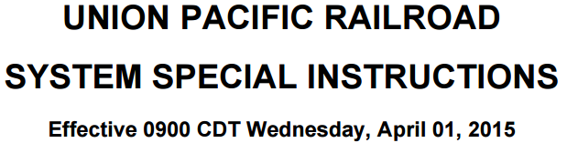

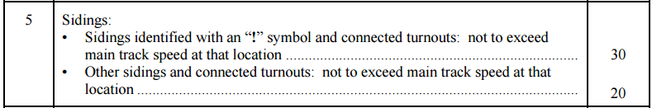
Practical Exercise #1
What is the maximum authorized speed in the Steamboat Siding?
30 MPH

Slide 27
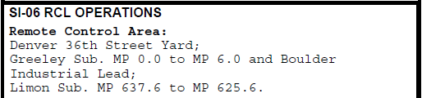
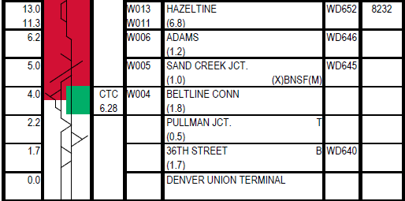
Practical Exercise #1
Greeley Subdivision
Are there any RCL Areas on the Main Track? If so, where?

Slide 28
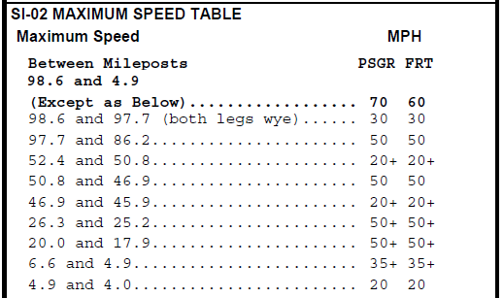
Practical Exercise #1
While inspecting you find 1-7/8” of profile at MP 52.2. What slow order, if any, should the RR place?
A 25/30 MPH
Slow Order
20+
25/30 MPH
Class of Track -> | 1 | 2 | 3 | 4 | 5
Deviation from zero crosslevel | 3” | 2” | 1-3/4” | 1-1/4” | 1”
So What is the Maximum Authorized Speed at MP 52.2?
60/70 MPH

Slide 29
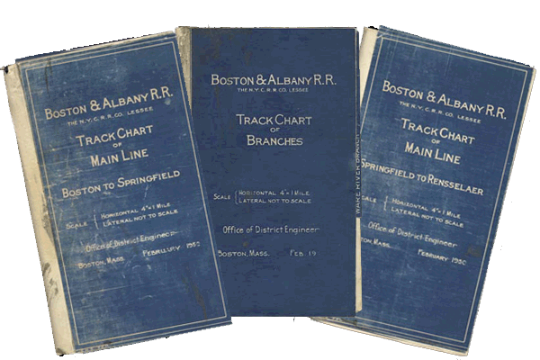
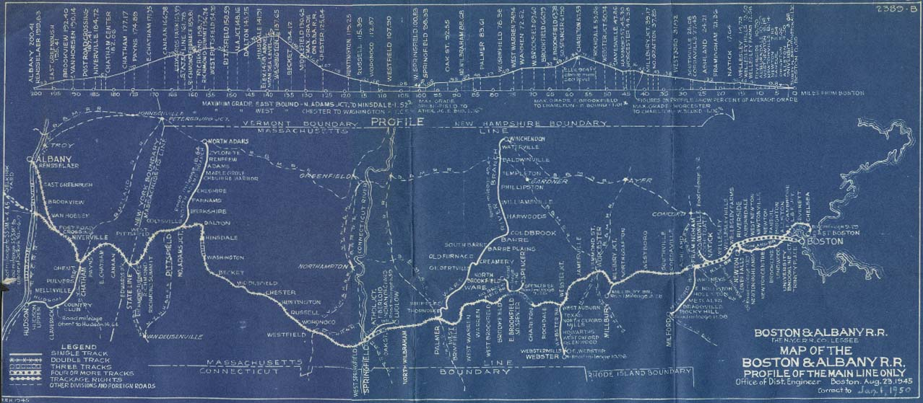
Track Charts/profiles

Slide 30
Track Charts/Profiles
An invaluable tool to our department
Contain a wealth of information
  Track Layout
  Curve Data
  Track Speeds
  Turnout Locations
  Crossing Locations w/ DOT
  Overheads/Underpasses
  Signal Locations
  Bridge Locations/Data
  Grade

Slide 31
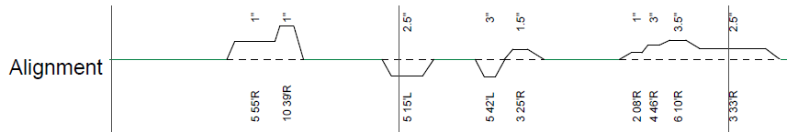

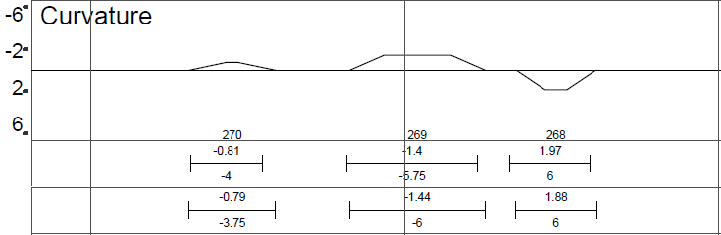
Track Charts/Profiles

Slide 32
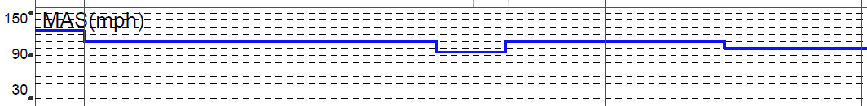
Track Charts/Profiles

Slide 33
PRACTICAL EXERCISE #2
Open the folder named “Practical Exercise Two”
Here you will find:
  A C&O Railroad, Peninsula Subdivision Track Chart
  UP Black Butte Subdivision Track Chart
Write your answer on the sheet provided
This is an individual exercise
We will review the answers as a group

Slide 34
Practical Exercise #2
Using the C&O – Peninsula Track Chart
What direction are you traveling if you are heading in the direction of increasing mileposts?
How many main track turnouts are there between MP 19 and MP 29?

Slide 35
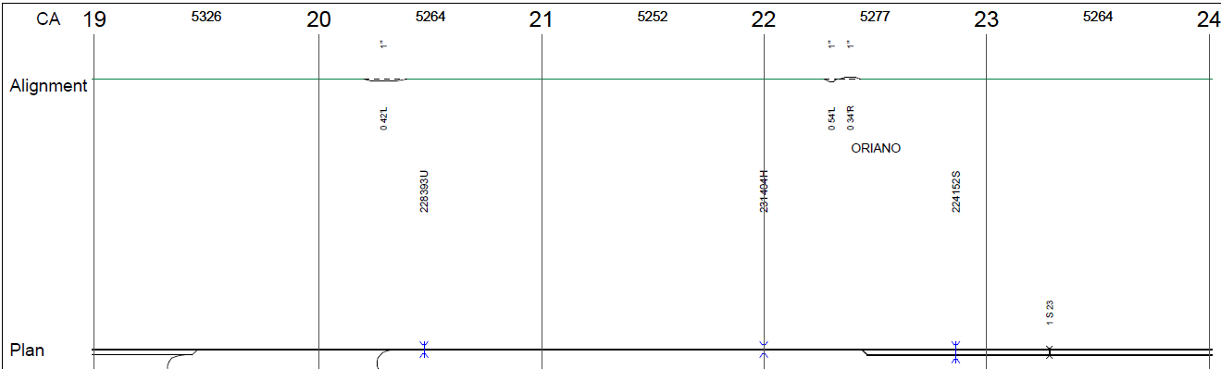
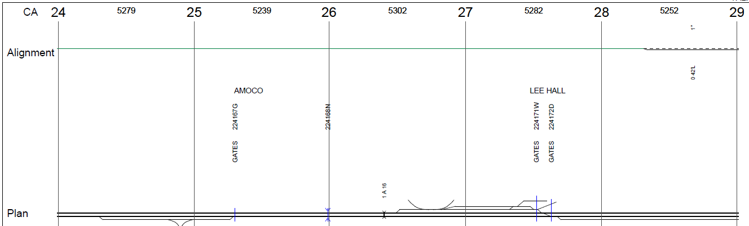
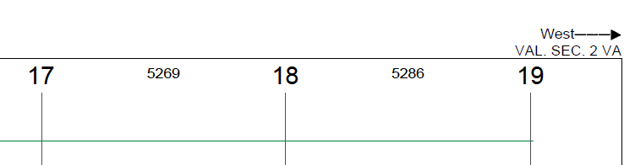
Practical Exercise #2
Using the C&O – Peninsula Track Chart
What direction are you traveling if you are heading in the direction of increasing mileposts?
How many main track turnouts are there between MP 19 and MP 29?
WEST
1
2
6
3
7
8
4
5
9
10
TEN

Slide 36
Practical Exercise #2
Using the C&O – Peninsula Track Chart
How many road crossings are between MP 54 and MP 59?
How many are public crossings?
What crossing protection is in place at the first private road West of Landings Road?

Slide 37
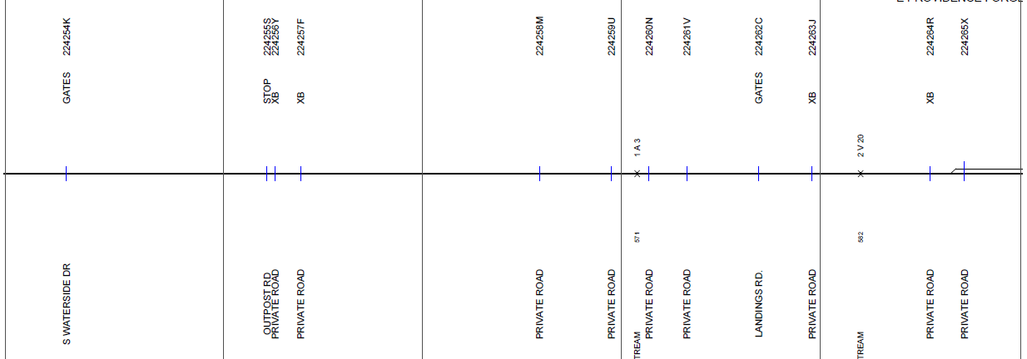
Practical Exercise #2
12 Road Crossings
3 Public
Using the C&O – Peninsula Track Chart
How many road crossings are between MP 54 and MP 59?
How many are public crossings?
What crossing protection is in place at the first private road West of Landings Road?
Crossbucks

Slide 38
Practical Exercise #2
Using the C&O – Peninsula Track Chart
What is located just east of MP 81?
What is the exact milepost location of this feature? Any other pertinent information?

Slide 39
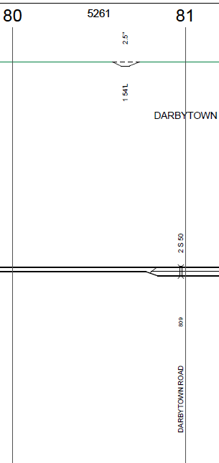
Practical Exercise #2
Using the C&O – Peninsula Track Chart
What is located just east of MP 81?
What is the exact milepost location of this feature? Any other pertinent information?
Overpass @ MP 80.9
Over Darbytown Road

Slide 40
Practical Exercise #2
Using the UP – Black Butte Track Chart
What is the steepest grade between MP 330 and MP 331?
What is located near MP 343.5? List any pertinent details.
List all the wayside detectors between MP 324 and MP 330?

Slide 41

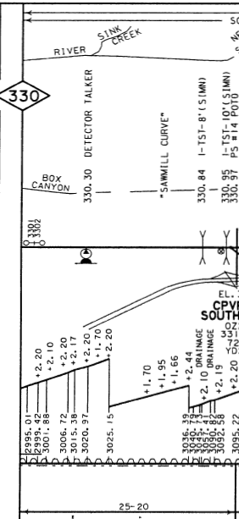
Practical Exercise #2
MP 324.2 Dragger
  Talk on Defect Only
MP 326.5 Dragger
  Talk on Defect Only
MP 327.3 Dragger and
  High Wide – Talker
MP329.1 Dragger
  Talk on Defect Only
Using the UP – Black Butte Track Chart
What is the steepest grade between MP 330 and MP 331?
What is located near MP 343.5? List any pertinent details.
List all the wayside detectors between MP 324 and MP 330?
2.44%
Twin Overhead Viaducts
MP 343.51 & MO 343.55
Over I-5, Each 60’ wide

Slide 42
Practical Exercise #2
Using the UP – Black Butte Track Chart
Traveling from MP 346 to MP 347, list the details of the three curves you will traverse?
For the middle curve, when was the rail last laid and what size is it?

Slide 43
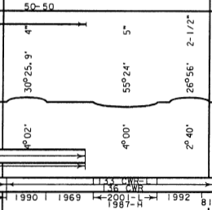
Practical Exercise #2
Using the UP – Black Butte Track Chart
Traveling from MP 346 to MP 347, list the details of the three curves you will traverse?
For the middle curve, when was the rail last laid and what size is it?

Slide 44
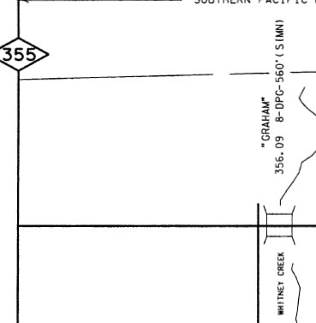
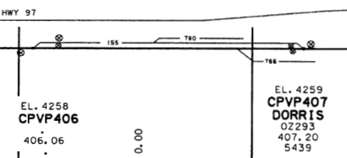

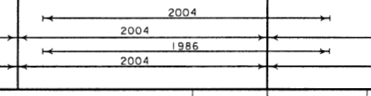
Practical Exercise #2
Using the UP – Black Butte Track Chart
What is located at MP 356.09? List the pertinent details?
When was the last tie gang on the siding at Dorris (CPVP406 to CPVP407?)

Slide 45
Federal Railroad Administration
Track Safety Standards Part 213
Subparts A - F

Slide 46
Presentation Notes
This presentation is intended to provide guidance in broad terms. It is not intended to serve as a complete explanation of the regulations or as a substitute for application of the regulations to specific facts.
With the exception of definitions, each section shown in this presentation are brief summaries of the regulation text. User must consult the complete regulation documentation when necessary.

Slide 47

Presentation Notes
49 CFR Part 213
Track Safety Standards; Improving Rail Integrity; Final Rule
This Presentation contains the Amendments to the Track Safety Standards as published in the Federal Register - January 24, 2014 (V0l. 79, Vol 16).

Slide 48
Part 213 - Track Safety Standards
SUBPART – A GENERAL
§ 213.1 Scope of Part
§ 213.3 Application
§ 213.4 Excepted Track
§ 213.5 Responsibility for Compliance
§ 213.7 Designation of Qualified Persons to Supervise
Certain Renewals and Inspect Track
§ 213.9 Classes of Track: Operating Speed Limits
§ 213.11 Restoration or Renewal Under Traffic Conditions
§ 213.13 Measuring Track Under Load
§ 213.14 Application of Requirements to Curved Tracks NEW
§ 213.15 Penalties
§ 213.17 Waivers
§ 213.19 Information Collection
Notes:
TABLE of CONTENTS - Items in RED are new 2013/2014 changes

Slide 49
§ 213.1 Scope
This part prescribes minimum safety requirements for railroad track that is part of the general railroad system of transportation. In general, the requirements prescribed in this part apply to specific track conditions existing in isolation. Therefore, a combination of track conditions, none of which individually amounts to a deviation from the requirements in this part, may require remedial action to provide for safe operations over that track. This part does not restrict a railroad from adopting and enforcing additional or more stringent requirements not inconsistent with this part.
Subparts A through F apply to track classes 1 through 5….
Notes:
Notes (2013 Fed Reg update)
This section also reminds us that the TSS, at this time, only address conditions that exist alone, and combinations of track conditions, while individually not in violation of any standard, can nonetheless present a hazard to the safe movement of trains. Experience has shown that such an event occurs only rarely, but if an Inspector should encounter such a condition he/she should immediately bring the condition to the attention of the accompanying railroad official, explain the hazard of such a condition and encourage its rapid removal.
FRA is maintaining this general structure of part 213 for ease of use, and the requirements of subpart G continue not to apply directly to operations at Class 1 through 5 track speeds. However, in adding new requirements governing high cant deficiency operations for track Classes 1 through 5, certain sections of subparts C and D refer railroads operating at those high cant deficiencies to specific sections of subpart G.
Guidance. It is important to note that the TSS are minimum safety requirements and are not appropriate for track maintenance purposes.
This section also notes that, while the TSS address specific track conditions that exist in isolation, there can sometimes be a combination of track conditions (none of which individually amounts to a deviation of the TSS) that require remedial action to provide for safe operations over that track. Experience has shown that such an event occurs only rarely, but if an inspector should encounter such a condition, the inspector should immediately bring the condition to the attention of the accompanying railroad official, explain the hazard of such a condition, and encourage its rapid removal. Where the inspector is not able to convince the railroad to initiate some action, the inspector should refer to the regional track specialist for assistance.
(b) Guidance. With the introduction of high-speed passenger train operations in the Nation, the
TSS was revised in 1998 to provide two sets of requirements a) low speed/Classes 1 through
5, and b) high-speed/Classes 6 through 9. The high-speed standards include specific
requirements for such operations, which also prescribe a number of track-vehicle interaction
tests. Sections 213.2 (Preemptive effect), 213.3 (Application), and 213.15 (Penalties) apply
to both high and low-speed track.
Guidance: The text "In general" has been added to provide a certain degree of flexibility, to encompass track conditions not necessarily "existing in isolation." In particular, it refers to "combined" track alinement and surface deviations contained in the new§ 213.65.

Slide 50

§ 213.1 Scope
Design Standards
Maintenance Standards
FRA Standards
Notes:
Notes
Instructor should explain design standards vs. maintenance standards and the relationship between maintenance standards and minimum FRA standards.

Slide 51
§ 213.3 Application
Except as provided in paragraph (b) of this section, this part applies to all standard gage track in the general railroad system of transportation.
Guidance. This applicability section specifically excludes from Part 213 track located inside an installation that is not part of the general railroad system of transportation. Additional language regarding plant trackage can also be found in 49 CFR Part 209, Appendix A, which explains that the track owner of any plant railroad trackage over which a general system railroad operates is responsible for the condition of track used by the general system railroad. Part 209, Appendix A, is not meant to imply that all of the requirements of the TSS, including inspection frequencies and recordkeeping, become applicable to a plant railroad once a general system railroad enters the property. Rather, it is a statement meant to convey FRA’s intent that plants should maintain, in a safe condition, that portion of their trackage used by a general system railroad.
Notes:
Notes
Guidance. This applicability section specifically excludes from Part 213 track located inside an installation that is not part of the general railroad system of transportation. Additional language regarding plant trackage can also be found in 49 CFR Part 209, Appendix A, which explains that the track owner of any plant railroad trackage over which a general system railroad operates is responsible for the condition of track used by the general system railroad. Part 209, Appendix A, is not meant to imply that all of the requirements of the TSS, including inspection frequencies and recordkeeping, become applicable to a plant railroad once a general system railroad enters the property. Rather, it is a statement meant to convey FRA=s intent that plants should maintain, in a safe condition, that portion of their trackage used by a general system railroad.

Slide 52
§ 213.3 Application
(b) This part does not apply to track –
(1) Located inside an installation that is not part of the general railroad system of transportation (i.e., a plant railroad). As used in this part, a plant railroad means a plant or installation that owns or leases a locomotive, uses that locomotive to switch cars throughout the plant or installation, and is moving goods solely for use in the facility’s own industrial processes….
Notes:
Notes
GUIDANCE: FRA modifies paragraph (b) of this section to clarify the exclusion of track located inside a plant railroad’s property from the application of this part. In this paragraph, “plant railroad” means a type of operation that has traditionally been excluded from the application of FRA regulations because it is not part of the general railroad system of transportation (general system).
B) Guidance. FRA does not have the manpower or resources to regularly inspect trackage within industrial installations. However, since the enactment of the Federal Railroad Safety Act of 1970, FRA has had at its disposal statutory authority to issue emergency orders to repair or discontinue use of industrial or plant trackage should FRA find that track conditions pose a death or injury hazard. See 49 U.S.C. 20901. In other words, if FRA learns that a particular plant is in such disrepair so as to pose a threat of death or injury to a plant employee, a railroad employee, or the public at large, FRA has the option of exercising its authority. FRA may issue an emergency order ordering the plant to discontinue using the track until specified repairs are made. It is FRA=s opinion that this emergency order is sufficient power to ensure track safety within plants. If conditions or events in the future tend to demonstrate that track safety within plants or installations should be more regulated, FRA will seek to change the track safety regulations accordingly.
Because it is a policy statement, Appendix A to Part 209 cannot override the text of the TSS, which clearly excludes plant railroads from the reach of the track regulations. Therefore, while the requirements of the TSS do not apply within plant railroads, those operations should use them as a guide to ensure that their tracks are capable of carrying rail traffic safely. As a practical application of this policy, FRA expects that the trackage in a plant railroad, at a minimum, meet Class 1 standards on the segments where the general system trains operate in the facility. FRA does not expect that the plant comply with inspection requirements but only the geometric and structural elements of the TSS for Class 1 track. The TSS excludes urban area rapid transit systems that are not a part of the general system. The regulations are not intended to make the TSS applicable to certain rapid transit systems whose only connection to the general system is a switch permitting receipt of shipments of non-revenue materials from the general system. Any questions concerning the applicability of the TSS must be referred to the regional track specialist who will consult with the Office of Safety Assurance and Compliance and the Office of Chief Counsel for guidance concerning the particular entity.
(1) Located inside an installation that is not part of the general railroad system of transportation (i.e., a plant railroad). As used in this part, a plant railroad means a plant or installation that owns or leases a locomotive, uses that locomotive to switch cars throughout the plant or installation, and is moving goods solely for use in the facility’s own industrial processes. The plant or installation could include track immediately adjacent to the plant or installation if the plant railroad leases the track from the general system railroad and the lease provides for (and actual practice entails) the exclusive use of that track by the plant railroad and the general system railroad for purposes of moving only cars shipped to or from the plant. A plant or installation that operates a locomotive to switch or move cars for other entities, even if solely within the confines of the plant or installation, rather than for its own purposes or industrial processes, will not be considered a plant railroad because the performance of such activity makes the operation part of the general railroad system of transportation. Similarly, this exclusion does not apply to track over which a general system railroad operates, even if that track is located within a plant railroad;
Additional language regarding industrial plant language can also be found in 49 CFR Part 209, Appendix A, which explains that the track owner of any plant railroad trackage over which a general system railroad operates is responsible for the condition of track used by the general system railroad. Appendix A is not meant to imply that all of the requirements of the TSS, including inspection frequencies and record keeping, become applicable to a plant railroad once a general system railroad enters the property. Rather, it is a statement meant to convey FRA's intent that plants should maintain in a safe condition that portion of their trackage used by a general system railroad.

Slide 53
§ 213.3 Application
(b) This part does not apply to track –
(2) Used exclusively for tourist, scenic, historic, or excursion operations that are not part of the general railroad system of transportation. As used in this part, tourist, scenic, historic, or excursion operations that are not part of the general railroad system of transportation means a tourist, scenic, historic, or excursion operation conducted only on track used exclusively for that purpose (i.e., there is no freight, intercity passenger, or commuter passenger railroad operation on the track); or
Notes:
Notes
(2) Used exclusively for tourist, scenic, historic, or excursion operations that are not part of the general railroad system of transportation. As used in this part, tourist, scenic, historic, or excursion operations that are not part of the general railroad system of transportation means a tourist, scenic, historic, or excursion operation conducted only on track used exclusively for that purpose (i.e., there is no freight, intercity passenger, or commuter passenger railroad operation on the track); or
Additional language regarding industrial plant language can also be found in 49 CFR Part 209, Appendix A, which explains that the track owner of any plant railroad trackage over which a general system railroad operates is responsible for the condition of track used by the general system railroad. Appendix A is not meant to imply that all of the requirements of the TSS, including inspection frequencies and record keeping, become applicable to a plant railroad once a general system railroad enters the property. Rather, it is a statement meant to convey FRA's intent that plants should maintain in a safe condition that portion of their trackage used by a general system railroad.
Guidance. This applicability section specifically excludes from Part 213 track located inside an installation that is not part of the general railroad system of transportation. Additional language regarding plant trackage can also be found in 49 CFR Part 209, Appendix A, which explains that the track owner of any plant railroad trackage over which a general system railroad operates is responsible for the condition of track used by the general system railroad. Part 209, Appendix A, is not meant to imply that all of the requirements of the TSS, including inspection frequencies and recordkeeping, become applicable to a plant railroad once a general system railroad enters the property. Rather, it is a statement meant to convey FRA=s intent that plants should maintain, in a safe condition, that portion of their trackage used by a general system railroad.

Slide 54





§ 213.3 Application
(b) This part does not apply to track –
(3) Used exclusively for rapid transit operations in an urban area that are not connected to the general railroad system of transportation.
Notes:
Notes
Bart and other light rail entities
Additional language regarding industrial plant language can also be found in 49 CFR Part 209, Appendix A, which explains that the track owner of any plant railroad trackage over which a general system railroad operates is responsible for the condition of track used by the general system railroad. Appendix A is not meant to imply that all of the requirements of the TSS, including inspection frequencies and record keeping, become applicable to a plant railroad once a general system railroad enters the property. Rather, it is a statement meant to convey FRA's intent that plants should maintain in a safe condition that portion of their trackage used by a general system railroad.

Slide 55

§ 213.4 Excepted Track
A track owner may designate a segment of track as excepted track provided that –
213.4(a) The segment is identified (timetable, special instructions, general order, or other appropriate records which are available for inspection during regular business hours);
Notes:
Notes
Guidance. The intent of this section is to permit portions of certain low density main tracks and associated yard tracks and sidings to be allowed Excepted status@ and not comply with Subparts B, C, D, and E of the TSS unless otherwise expressly stated. However, by designating a track as excepted, the owner must restrict all train movements to a maximum of 10 mph, restrict the number of placarded hazardous material cars in a train to five, and prohibit the movement of occupied passenger trains.

Slide 56
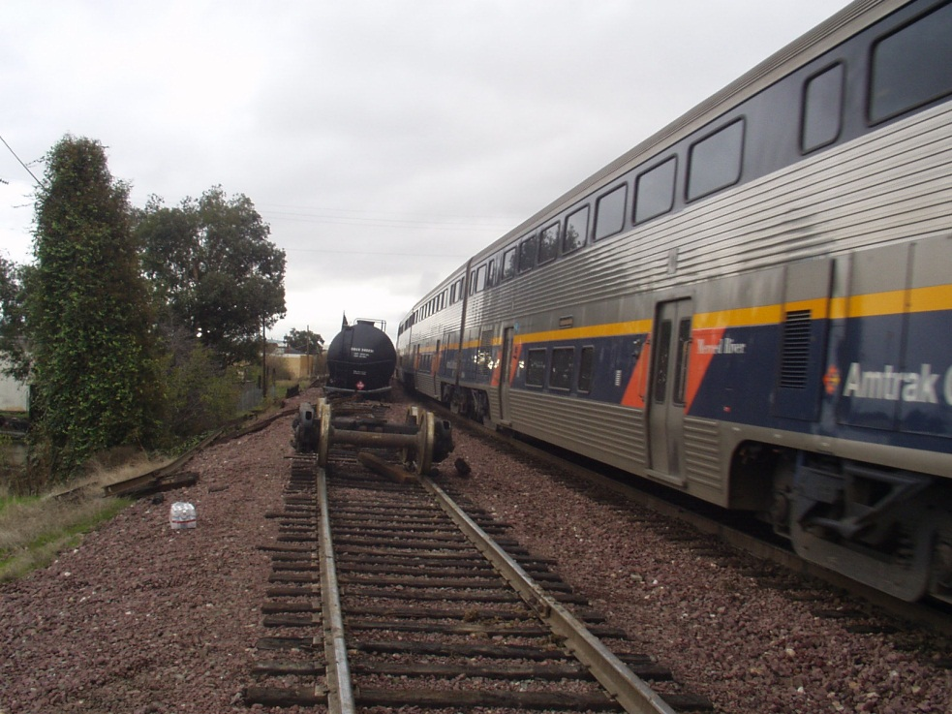
§ 213.4 Excepted Track
A track owner may designate a segment of track as excepted track provided that –
213.4(b)
The identified segment is not located within 30 feet of an adjacent track which can be subjected to simultaneous use at speeds in excess of 10 miles per hour;
Notes:
Notes
(b) Guidance. This paragraph prohibits excepted track designation of any track located within a 30-foot envelope of a track that can be subjected to simultaneous use at speeds in excess of 10 mph. As shown in Figure 1, the 30-foot dimension is measured between track centerlines and applies to all tracks within that envelope (e.g., tracks converging at turnouts and rail crossings). Simultaneous use means movement of cars or locomotives on both tracks at the same time.

Slide 57
§ 213.4 Excepted Track
Notes:
Notes
Operation on any track(s) located within 30 feet of excepted track may be restricted to 10 m.p.h. by the physical layout of the tracks, or by definite restrictions placed by the track owner by rule, timetable, special instruction, or other positive instruction or order. The criterion is the positive protection of trains on higher speed track against a collision with fouling equipment from a potential derailment on the excepted track.

Slide 58
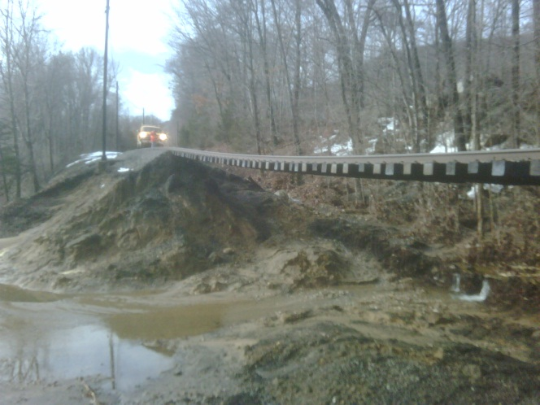
§ 213.4 Excepted Track
A track owner may designate a segment of track as excepted track provided that –
213.4(c) The identified segment is inspected in accordance with 213.233(c) and 213.235 at the frequency specified for Class 1 track;
Notes:
Notes
(c) Guidance. Pursuant to § 213.5(b), a railroad may continue train operations on track segments designated as excepted track without complying with Subparts B, C, D, and E of Part 213. However, a railroad must still comply with the inspection requirements found in Subpart F for track segments designated as excepted track. Railroads must inspect excepted track in accordance with §§ 213.233(c) and 213.235 at the frequency specified for Class 1 track.

Slide 59
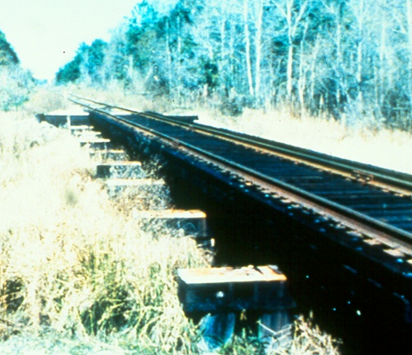
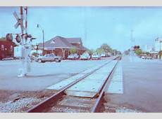
§ 213.4 Excepted Track
213.4(d) The identified segment of track is not located on a bridge including the track approaching the bridge for 100 feet on either side, or located on a public street or highway, if railroad cars containing commodities required to be placarded by the Hazardous Materials Regulations (49 CFR part 172), are moved over the track; and
100’ on either side of Bridge
Public Crossings
cannot be EXCEPTED
Notes:
Notes
(d) Guidance. In the application of this paragraph, a public street or highway is defined as a roadway that is open to the public and is owned and maintained by a public entity. This paragraph includes both crossings of public roadways at grade and longitudinal running of the track for extended distances in a public roadway (street trackage).
Under § 214.7, a railroad bridge is defined as follows: 1) a railroad bridge is any structure supporting one or more railroad tracks with a span length of 12 feet or more measured along the track centerline; and 2) the term ”bridge” shall apply to the entire structure between the faces of the backwalls of abutments or equivalent components, regardless of the number of spans. The term shall include all structures, whether of timber, stone, concrete, metal, or any combination thereof.

Slide 60
§ 213.4 Excepted Track
213.4(e) The railroad conducts operations on the identified segment under the following conditions:
No train shall be operated at speeds in excess of 10 miles per hour;
No occupied passenger train shall be operated;
No freight train shall be operated that contains more than five cars required to be placarded by the Hazardous Materials Regulations (49 CFR part 172); and
The gage on excepted track shall not be more than 4 feet 10 ¼ (58-1/4”) inches.
213.4(f) A track owner shall advise the appropriate FRA Regional Office at least 10 days prior to removal of a segment of track from excepted status.
Notes:
Notes
Additional language regarding industrial plant language can also be found in 49 CFR Part 209, Appendix A, which explains that the track owner of any plant railroad trackage over which a general system railroad operates is responsible for the condition of track used by the general system railroad. Appendix A is not meant to imply that all of the requirements of the TSS, including inspection frequencies and record keeping, become applicable to a plant railroad once a general system railroad enters the property. Rather, it is a statement meant to convey FRA's intent that plants should maintain in a safe condition that portion of their trackage used by a general system railroad.
(e) Guidance. In reference to (e)(1) through (4), a well-documented pattern of repeated or widespread deviations from these requirements by a track owner, including train operations in excess of 10 mph, will effectively terminate the privilege afforded by this section. The affected track would then become subject to all requirements of the TSS.
The word ‘‘occupied’’ in (e)(2) refers to paying and non-paying passengers. It does not include train crew members, track maintenance crews, and other railroad employees who must travel over the track to attend to their work duties.
The gage requirement only applies to the actual measurement itself under load, and does not extend to the evaluation of crossties and fasteners that provide the gage restraint. In the case of noncompliance with the gage requirement in excepted track, the railroad may invoke
§ 213.9(b) as remedial action. [See § 213.9(b) for restrictions.]
9F)Guidance: The railroad or track owner is required to notify the appropriate FRA Regional Office 10 days before removing trackage from excepted status. A railroad may not move the track from excepted to non excepted status to operate an occupied passenger train or a train containing more than five cars placarded in accordance with 49 CFR Part 172, unless proper notification procedures are followed.

Slide 61

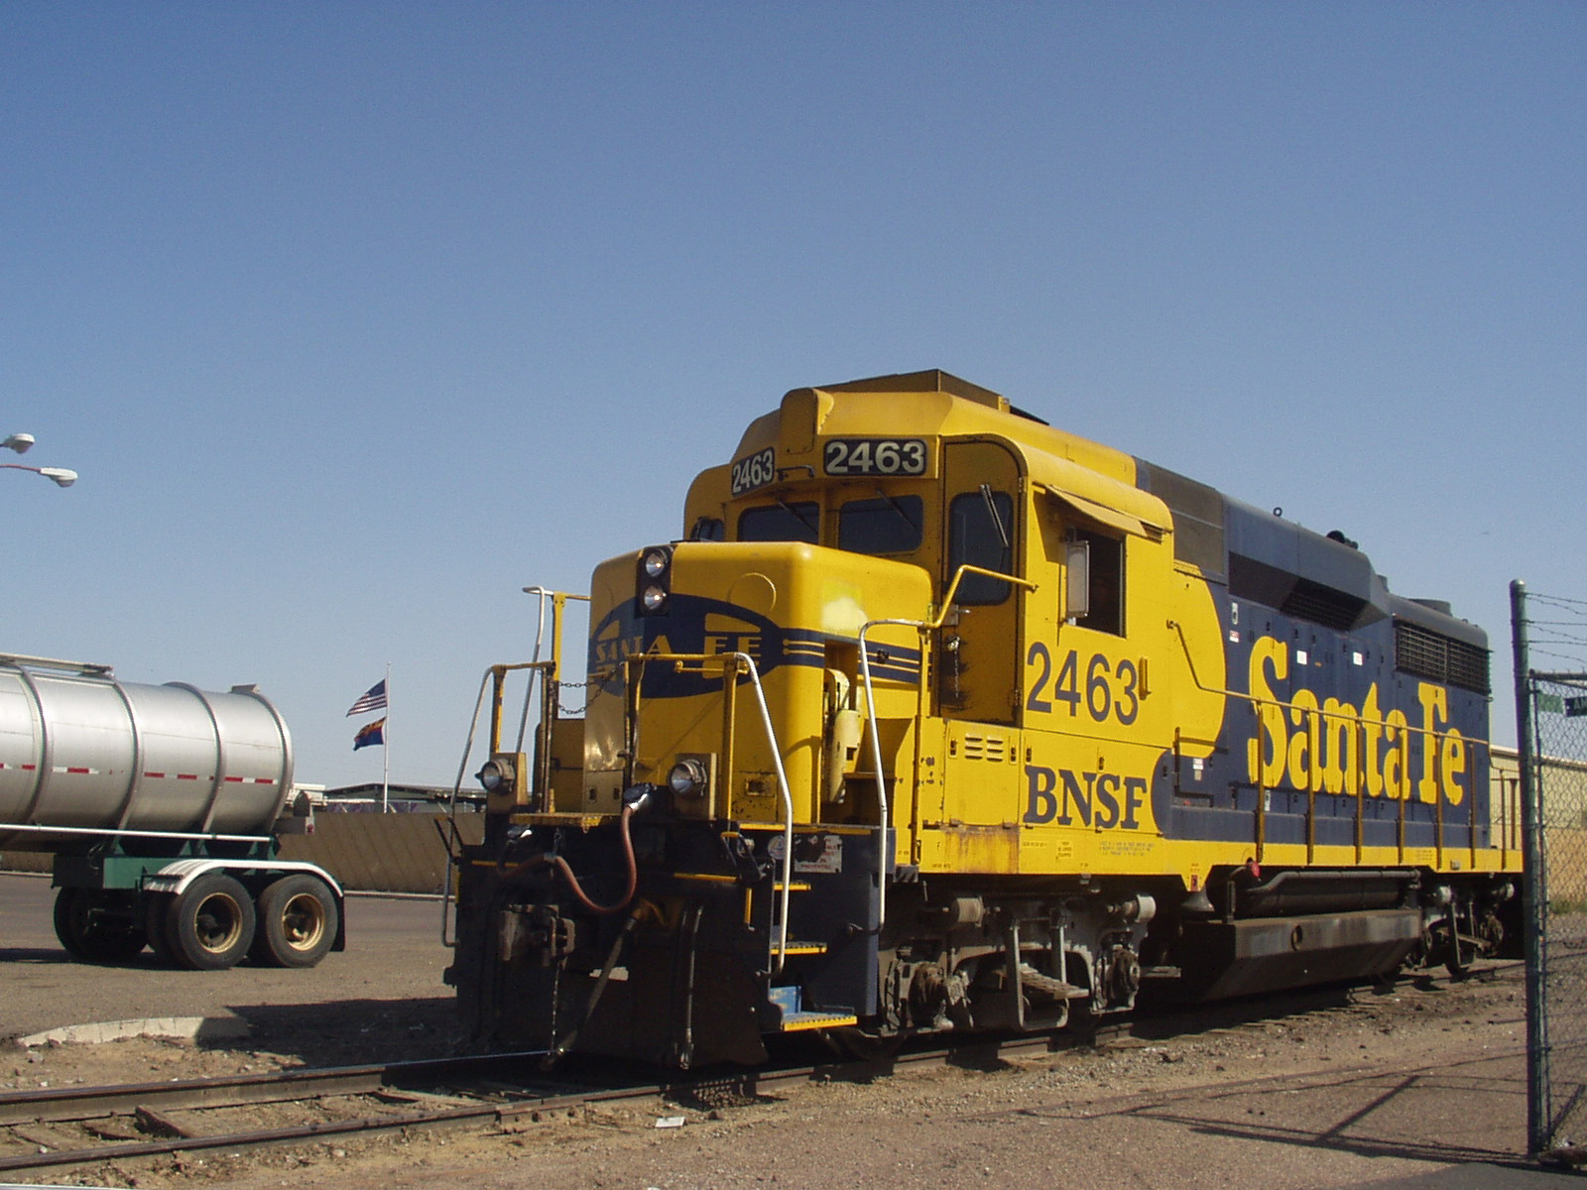
§ 213.4 Excepted Track
Is this a train?
The term “train” is defined in 49 CFR § 236.832 as, “A locomotive or more than one locomotive coupled, with or without cars”.
That definition applies to this rule.
Notes:
Notes

Slide 62
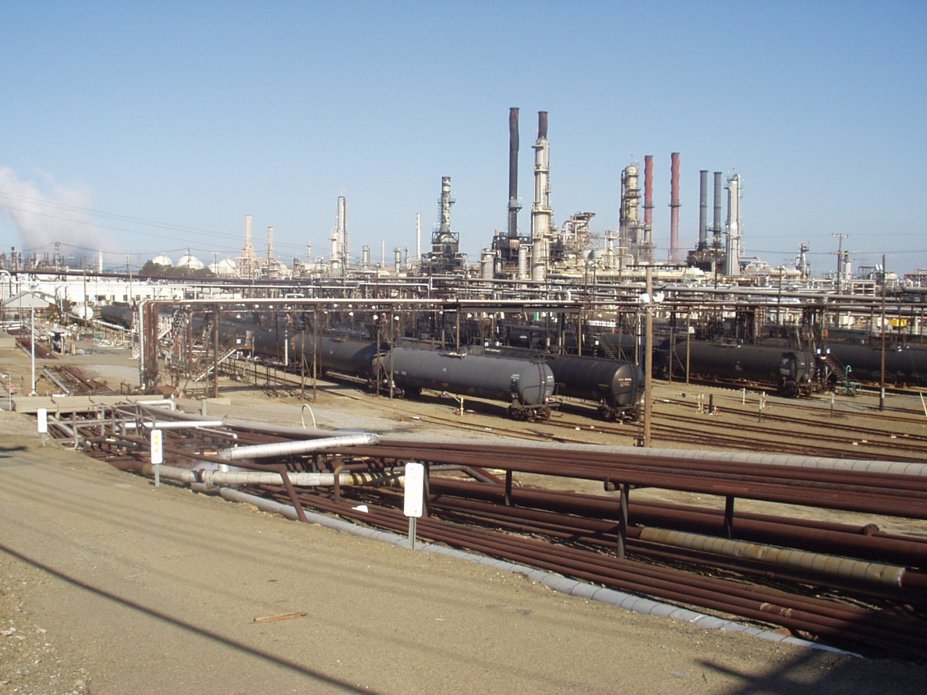
§ 213.4 Excepted Track
Conditions that Apply to all excepted track
Identified in writing
Within 30’ of track operated at > 10 mph
Inspected at class 1 frequency
Not on Bridge + 100’
Not on public crossing
Speed not > 10mph
No occupied Passenger cars
≤ 5 haz-mat cars
No more than 4 feet 10- ¼ inch (58 ¼”) gage
10 Day notice to remove

Slide 63




§ 213.5 Responsibility for
Compliance
FRA Technical Training Material is Intended for Internal Instructional Purposes Only.
Do not distribute outside FRA or State Agency pursuant to 49 CFR Part 212
63
Notes:
What’s wrong with these books?
This slide is to illustrate that inspectors should be aware of the current regulations – using a dated field guide could lead to improper or incorrect action

Slide 64
§ 213.5 Responsibility for
Compliance
(a) Except as provided in (b), an owner that knows or has notice that the track does not comply, shall
(1) Bring the track into compliance;
(2) Halt operations over that track; or
(3) Operate under authority of a person designated under 213.7(a) subject to conditions set forth in this part.
(b) If an owner designates a segment of track as “excepted track” (213.4), operations may continue without complying with the provisions of subparts B [roadbed], C [geometry], D [structure] , and E [appliances], unless otherwise expressly stated.
Notes:
Notes
This section describes the action that must be taken by the track owner once he/she knows that the track is not in compliance with the TSS. The track owner must:
(1) Bring the track into compliance by either repairing the defects or imposing an appropriate speed restriction;
(2) Remove the track from service; or
(3) Operate under authority of a qualified person designated under §213.7 in accordance with the following provisions:
5(B) Guidance. The owner may designate the track ”excepted” provided it meets the requirements of § 213.4.

Slide 65
§ 213.5 Responsibility for
Compliance
(c) If an owner of track assigns responsibility for the track to another person written notification must be provided to the appropriate FRA Regional Office at least 30 days in advance of the assignment. The notification may be made by any party to that assignment and include the following --
(1) The name and address of the track owner;
(2) The name and address of the assignee;
(3) A statement of the exact relationship between parties;
(4) A precise identification of the track;
(5) A statement as to the competence and ability of the assignee to carry out the duties of the track owner under this part; and
(6) A statement signed by the assignee acknowledging the assignment of responsibility.

Slide 66
§ 213.5 Responsibility for
Compliance
(d) The Administrator may hold the track owner or the assignee or both responsible for compliance with this part and subject to penalties under 213.15.
(e) A common carrier by railroad which is directed by the Surface Transportation Board to provide service over the track of another railroad under 49 U.S.C. 11125 is considered the owner of that track for the purposes of the application of this part during the period the directed service order remains in effect.
(f) When any person, including a contractor for a railroad or track owner, performs any function required by this part, the person is required to perform that function in accordance with this part.
Notes:
Notes
Section 213.5(d) also provides that the party responsible for compliance can be other than the actual owner of the track through assignment of responsibility or if the Surface Transportation Board has issued a directed service order. FRA may hold responsible any party contracted by the track owner to ensure compliance with this part. The FRA may hold the track owner, the assignee, or both responsible.
5(e) Guidance. On rare occasions, such as a cessation of service by a railroad, the Surface Transportation Board has directed a railroad other than the track owner to provide service. In such cases, the designated operator shall be considered as the owner for the purposes of compliance of the TSS.
5(f) Guidance. This paragraph specifies that both employees of railroads and track owners, and contractors to railroads, are subject to the requirements of the TSS when they perform functions required by the TSS.

Slide 67
§ 213.7 Designation of Qualified Persons to
Supervise Certain Renewals and Inspect Track
(a) Owners shall designate qualified persons to supervise restorations and renewals under traffic conditions. Each person designated must have --
(1) At least --
(i) 1 year of supervisory experience in track maintenance; or
(ii) A combination of supervisory experience in track maintenance and track maintenance training or from a college program;
(2) Demonstrated to the owner that he --
(i) Knows and understands the requirements of this part that . apply to the restoration and renewal of the track for which . . . he or she is responsible;
(ii) Can detect deviations from those requirements;
(iii) Can prescribe appropriate remedial action to correct or safely compensate for those deviations; and
(3) Written authorization from the track owner to prescribe remedial actions to correct or safely compensate for deviations.
Notes:
Notes
Guidance: (2137(a)(b) Inspectors may request verification of the experience and qualifications of the supervisory and track inspection personnel from a track owner. The submission of a seniority roster or job awarding bulletin is not to be considered as satisfactory identification of qualified employees or as a basis for their designation. The owner should make specific names of individuals and their qualifications available in writing.
When in doubt as to the qualifications of an owner’s supervisors or inspectors, the inspector should discuss the matter with the RR
2013 Fed Reg Update – a 2i)
Fed Reg - As a result, the Task Force recommended and FRA agrees that this rule add text clarifying that the requirements for a person to be qualified
under this section concern those portions of this part necessary for the performance of that person’s duties. This section continues to require that a person designated under it possess the knowledge, understanding, and ability necessary to supervise the restoration and renewal of track, or to perform VerDate Mar<15>2010 19:41 Mar 12, 2013 Jkt 229001 PO 00000 Frm 00014 Fmt 4701 Sfmt 4700 E:\FR\FM\13MRR2.SGM 13MRR2 stock-still on DSK4VPTVN1PROD with RULES2 Federal Register /Vol. 78, No. 49 /Wednesday, March 13, 2013 /Rules and Regulations 16065
inspections of track, or both, for which he or she is responsible. Yet, adding the text makes clear that the person is not required to know or understand specific requirements of this part not necessary to the fulfillment of that person’s duties. In this regard, the AAR commented that
these changes are particularly needed in light of the adoption of high cant deficiency requirements in this final rule. FRA does not believe that safety will be in any way diminished by these changes, and they were supported by the Task Force.
VTI Guidance: The changes to paragraphs (a)(2)(i) and (b)(2)(i) clarify that the requirements for a person to be qualified under this section concern the portions of Part 213 necessary for the person to perform his or her duties. The person is not required to know or understand specific requirements of this part that are not necessary to fulfill his or her duties. The addition of vehicle qualification and testing requirements for high cant deficiency operations in lower-speed track classes, in particular, adds a level of complexity that may be outside the purview of track foremen and inspectors in fulfilling their duties.

Slide 68
§ 213.7 Designation of Qualified Persons to
Supervise Certain Renewals and Inspect Track
(b) Owner shall designate qualified persons to inspect track for defects. Each person designated must have --
(1) At least --
(i) 1 year of experience in railroad track inspection; or
(ii) A combination of supervisory experience in track maintenance and track maintenance training or from a college program;
(2) Demonstrated to the owner that he --
(i) Knows and understands the requirements of this part that . . . .. apply to the inspection of the track for which he or she is . . . responsible;
(ii) Can detect deviations from those requirements;
(iii) Can prescribe appropriate remedial action to correct or safely compensate for those deviations; and
(3) Written authorization from the owner to prescribe remedial actions to compensate for deviations, pending review by person under (a).
Notes:
Notes
213.7(b) If the Inspector is in doubt as to the qualifications of the owner's supervisory or inspection personnel, he/she should examine the owner's inspection records. The TSS requires the retention of required track inspection reports for one year at the owner's division office. Should the records consistently fail to reflect the actual track condition, questions can be raised as to the competence and/or qualifications of the person(s) establishing the record.
2013 Fed Reg update b2i

Slide 69
§ 213.7 Designation of Qualified Persons to
Supervise Certain Renewals and Inspect Track
213.7(c)
Individuals designated under paragraphs (a) or (b) of this section that inspect continuous welded rail (CWR) track or supervise the installation, adjustment, and maintenance of CWR track in accordance with the written procedures of the track owner shall have:
(1) Current qualifications under either paragraph (a) or (b) of this section;
(2) Successfully completed a comprehensive training course specifically developed for the application of written CWR procedures issued by the track owner;
Notes:
Guidance: As CWR track has characteristics inherently different than those of traditional jointed rail, track owners are required to designate which individuals are specifically qualified to inspect or supervise the installation, adjustment, and maintenance of CWR. In addition to the qualifications that an individual must have under either paragraph (a) or (b), an individual designated under paragraph (c) must have completed a CWR training course and be well-versed in the maintenance of CWR track as detailed in the track owner’s CWR plan. The comprehensive nature of the training course is more important than its duration; therefore, the railroad employee must successfully complete an in-depth initial training course of the track owner’s written CWR procedures and continue subsequent periodic re-training thereafter, pursuant to the training program required by § 213.343(g). In addition, all individuals qualified on CWR for train operations must successfully complete a recorded examination on the track owner’s CWR procedures. This recorded examination may be, for example, a traditional written examination, an electronic file of a computerized interactive training course that concludes with an examination, or a record of a supervisor’s oral testing of the employee's knowledge through practical field application. Due to the language of the regulation, track owners have flexibility to test an individual’s knowledge to one of the previously stated methods. However, it should be noted that the results of the examination must be recorded so that FRA may inspect the basis for the qualification of an individual under paragraph (c).

Slide 70
§ 213.7 Designation of Qualified Persons to
Supervise Certain Renewals and Inspect Track
213.7(c) CONTINUED
(3) Demonstrated to the track owner that the individual:
(i) Knows and understands the requirements of those written CWR procedures;
(ii) Can detect deviations from those requirements; and
(iii) Can prescribe appropriate remedial action to correct or safely compensate for those deviations; and
(4) Written authorization from the track owner to prescribe remedial actions to correct or safely compensate for deviations from the requirements in those procedures and successfully completed a recorded examination on those procedures as part of the qualification process

Slide 71
§ 213.7 Designation of Qualified Persons to
Supervise Certain Renewals and Inspect Track
213.7(d)
(d) Persons not fully qualified to supervise certain renewals and inspect track as required in paragraphs (a) through (c) of this section, but with at least one year of maintenance‑of‑way or signal experience, may pass trains over broken rails and pull aparts provided that
(1) The track owner determines the person to be qualified and, as part of doing so, trains, examines, and re‑examines the person periodically within two years after each prior examination on the following topics as they relate to the safe passage of trains over broken rails or pull aparts: rail defect identification, crosstie condition, track surface and alinement, gage restraint, rail end mismatch, joint bars, and maximum distance between rail ends over which trains may be allowed to pass. The sole purpose of the examination is to ascertain the person's ability to effectively apply these requirements and the examination may not be used to disqualify the person from other duties. A minimum of four hours training is required for initial training;
Notes:
Notes
Every 2 years
Guidance: Paragraph (d) allows employees to be qualified for the specific purpose of authorizing train movements over broken rails or pull-aparts. This section requires the employees to have at least 1 year of maintenance-of-way or signal experience and a minimum of 4 hours of training, plus an examination (and periodic re-examination within 2 years of each examination) on requirements related to the safe passage of trains over broken rails and pull-aparts.
The purpose of the examination is to ascertain the person’s ability to effectively apply these requirements. A railroad may use the examination to
determine whether a person should be allowed to authorize train movements over broken rails or pull-aparts.

Slide 72
§ 213.7 Designation of Qualified Persons to
Supervise Certain Renewals and Inspect Track
213.7(d) CONTINUED
(d) Persons not fully qualified to supervise certain renewals and inspect track as required in paragraphs (a) through (c) of this section, but with at least one year of maintenance‑of‑way or signal experience, may pass trains over broken rails and pull aparts provided that
(2) The person deems it safe and train speeds are limited to a maximum of 10 m.p.h. over the broken rail or pull apart;
(3) The person shall watch all movements over the broken rail or pull apart and be prepared to stop the train if necessary; and
(4) Person(s) fully qualified under  213.7 are notified and dispatched to the location promptly for the purpose of authorizing movements and effecting temporary or permanent repairs.
FRA Technical Training Material is Intended for Internal Instructional Purposes Only.
Do not distribute outside FRA or State Agency pursuant to 49 CFR Part 212
Notes:
Notes
The maximum speed over broken rails and pull aparts shall not exceed 10 m.p.h. However, movement authorized by a person qualified under this subsection may further restrict speed, if warranted, by the particular circumstances. The person qualified under this paragraph must be present at the site and able to instantly communicate with the train crew so that the movement can be stopped immediately, if necessary.
Fully qualified persons under §213.7 must be notified and dispatched to the location promptly to assume responsibility for authorizing train movements and effecting repairs. The word "promptly" is meant to provide the railroad with some flexibility in event where there is only one train to pass over the condition prior to the time when a fully qualified person would report for a regular tour of duty, or where a train is due to pass over the condition before a fully qualified person is able to report to the scene. Railroads should not use persons qualified under §213.7(c) to authorize multiple train movements over such conditions for an extended period of time.
CM GUIDANCE: The maximum speed over broken rails and pull-aparts shall not exceed 10 mph. However, movement authorized by a person qualified under this subsection may further restrict speed, if warranted by the particular circumstances. The person qualified under this paragraph must be present at the site and able to instantly communicate with the train crew so that the movement can be stopped immediately, if necessary.
Fully qualified persons under § 213.7 must be notified and dispatched to the location promptly to assume responsibility for authorizing train movements and effecting repairs. The word “promptly” is meant to provide the railroad with flexibility to pass trains over the condition prior
to the time the fully qualified person would report to the scene. Railroads may permit persons qualified under § 213.7(d) to authorize multiple train movements over such conditions, but the person qualified under § 213.7(d) must examine the broken rail or pull-apart area initially, and
before each subsequent movement, to ensure the location is safe for the passage of the next train.

Slide 73
§ 213.7 Designation of Qualified Persons to
Supervise Certain Renewals and Inspect Track
(e) With respect to designations under paragraphs (a) through (d) of this section, each track owner shall maintain written records of ---
(1) Each designation in effect;
(2) The basis for each designation; and
(3) Track inspections made by each designated qualified person as required by 213.241. These records shall be kept available for inspection or copying by the Federal Railroad Administration during regular business hours.
Name | 213.7(a) | 213.7(b) | 213.7(c) | 213.7(d)
Spike Bender | X 1 | X 1 | X 1
Sparky | X 2
Gandy Dancer |  |  | X
Casey Jones |  |  |  | x
73
Notes:
Notes
Failure of the owner to have and maintain written records designating employees or the basis for each designation is a deviation from the TSS. Designated employees include supervisors, inspectors, and those partially qualified to pass trains over broken rails and pull aparts.
Inspectors are also instructed to note that incomplete qualification records may not reflect the actual qualification of an individual. As such, a record deficiency shall not be the sole basis for a defect or civil penalty recommendation for not having a qualified designated person performing these functions. If there are questions about the qualifications of an individual, it will be necessary for the inspector to interview railroad or contractor employees.

Slide 74
§ 213.7 Designation of Qualified Persons to
Supervise Certain Renewals and Inspect Track
(e) With respect to designations under paragraphs (a) through (d) of this section, each track owner shall maintain written records of ---
(1) Each designation in effect;
(2) The basis for each designation; and
(3) Track inspections made by each designated qualified person as
required by 213.241. These records shall be kept available for inspection or copying by the Federal Railroad Administration during regular business hours.
Name | 213.7(a) | 213.7(b) | 213.7(c) | 213.7(d)
Spike Bender | X 1 | X 1 | X 1
Sparky | X 2
Gandy Dancer |  |  | X
Casey Jones |  |  |  | x
FRA Technical Training Material is Intended for Internal Instructional Purposes Only.
Do not distribute outside FRA or State Agency pursuant to 49 CFR Part 212
74
Notes:
This designation does not full fill the requirements of 213.7(c)1 – they must also have an A and or B designation

Slide 75
§ 213.9 Classes of Track:
Operating Speed Limits
(a) Except as provided in paragraphs (b) of this section and 213.57(b), [unbalance], 213.59(a) [elevation runoff in a curve], and 213.113(a), [rail defects] and 213.137(b) and (c) [frogs], the following maximum allowable operating speeds apply --
75
Notes:
Notes
The TSS classify track solely on the basis of authorized speeds for freight and passenger trains. Tolerances are specified in the TSS for each class of track. A deviation beyond the limiting tolerances for Classes 1 through 5 requires repair, or reduction of speeds to the appropriate class. The only structural or geometry defect that is applicable on excepted track is gage exceeding 4-foot 10-1/4 inches (58-1/4).
The initial speed of any track is based on the design characteristics of the track. FRA does not set the speed and railroads are required to keep track in compliance with the requirements of this Part. In addition to track design characteristics, speeds may be set by other factors such as the type of signal apparatus. Speeds are also imposed upon track if a signal system is not in place on a track (refer to 49 CFR §236.0 for further information).
As described in paragraph (a), the maximum allowable operating speed for each class of track is shown in the table. However, the maximum allowable operating speed on a curve is limited by the geometric parameters contained in §213.57(b) [unbalance] and 213.59(a) [superelevation runoff]. For example, a speed for a passenger train based on the elevation at a curve may be only 18 m.p.h. even though the track may otherwise comply with a higher class. Additionally, regardless of the track class, the appropriate remedial action for a defective rail under §213.113 must be initiated.

Slide 76

§ 213.9 Classes of Track:
Operating Speed Limits
What does 213.9(a) mean?
213.57(b) The maximum allowable operating speed for each curve is determined by the following formula --
213.59(a) [elevation runoff in a curve] If a curve is elevated, the full elevation must be provided throughout the curve, unless physical conditions do not permit.
213.113(a) [rail defects] and Rail table
213.137(b) and (c) [frogs] - (Tread 10 mph)
Defects identified in these § have specific Remedial Actions or Speeds prescribed. You CANNOT exercise 2139(b)
76
Notes:
Notes
Examples where an inspector cannot use 213.9(B)

Slide 77

§ 213.9 Classes of Track:
Operating Speed Limits
    (b) If a segment of track does not meet all of the requirements for its intended class, it is reclassified to the next lowest class of track for which it does meet all of the requirements of this part. However, if the segment of track does not at least meet the requirements for Class 1 track, operations may continue at Class 1 speeds for a period of not more than 30 days without bringing the track into compliance, under the authority of a person designated under 213.7(a), who has at least one year of supervisory experience in railroad track maintenance, after that person determines that operations may safely continue and subject to any limiting conditions specified by such person.
FRA Technical Training Material is Intended for Internal Instructional Purposes Only.
Do not distribute outside FRA or State Agency pursuant to 49 CFR Part 212
77
Notes:
Notes
Guidance. A track segment must meet all the requirements for its designated class. Where a track segment does not meet all the requirements, railroads can reclassify the segment for the next lowest class for which it complies. For example, on a Class 3 Track, where the alinement measured off a 62-foot chord in a tangent is 2 inches, the railroad can elect to reduce the speed equivalent to Class 2 track.
The TCM has a list of class and non-class specific defects

Slide 78

§ 213.9 Classes of Track:
Operating Speed Limits
This is my brain – you have to use your own
… if the ties look like this?
Notes:
Trains may continue to operate over a noncomplying condition under § 213.9(b). However, the 30-day limit for any given condition cannot be exceeded.

Slide 79
§ 213.9 Classes of Track:
Operating Speed Limits
This is my brain – you have to use your own
After claiming 213.9b the 30 days expire but the RR still has cars on the track – now what?
The railroad locks the track out with the cars in it; you come back a month or so later and you notice the track is still locked out but there are different cars on the track – So now what?
In the next picture the railroad is operating at 15MPH – what class of track is it?
Notes:
Guidance: When a railroad representative places a slow order on a segment of track for a defect for immediate corrective action, any other items within the same slow order segment would be “protected”. For example, an FRA inspector finds a defect at Milepost (MP) 5.5 and railroad immediately places a slow order from MP 5.0 to MP 6.0. During the same inspection, the FRA inspector also finds a condition at MP 5.8 that would be a defect without the speed restriction. While the defect at MP 5.8 is under the slow order just imposed, it was obviously a defect prior to the placement of the temporary restriction. The FRA inspector can record a defect at MP 5.8.
Trains may continue to operate over a noncomplying condition under § 213.9(b). However, the 30-day limit for any given condition cannot be exceeded. The 30-day period commences when:
• An FRA inspector notifies the carrier or issues notice with a F6180.96 form.
• A person designated under § 213.7 records the defect on a track owner’s record of inspection.
• Notices of substandard conditions are received from third parties.
• The track owner is deemed to have constructive knowledge if the defects were discoverable through properly performed track inspections required by the TSS, even if the defects are not reported on the owner’s record of inspection.

Slide 80

§ 213.9 Classes of Track:
Operating Speed Limits
Passenger Cars - Passenger Speeds
?
Notes:
Notes
These cars, especially the gondola with seating DO NOT have passenger wheel sets the speed chart is intended for; so they are freight cars. If a RR wants to go 15MPH then its class 2.

Slide 81
§ 213.11 Restoration or Renewal of Track Under Traffic Conditions
If during a period of restoration or renewal, track is under traffic conditions and does not meet all of the requirements prescribed in this part, the work on the track must be under the continuous supervision of a person designated under 213.7(a) who has at least one year of supervisory experience in railroad track maintenance, and subject to any limiting conditions specified by such person.
GUIDANCE: The term “continuous supervision” as used in this section means the physical presence of that person at a job site. However, since the work may be performed over a large area, it is not necessary that each phase of the work be done under the visual supervision of that person.
Notes:
Notes
The qualified person at a work site may determine that it is safe to permit a train to pass through the work area at any speed up to the permanent speed on the track. For example, during a crosstie and resurfacing project, the qualified person may analyze the conditions present and authorize a speed higher than 10 m.p.h. through the limits of the work when temporary crosslevel conditions exceed the limits in §213.63 for Class 1 track. Similarly, a welder may permit a train to pass over a frog when the point is temporarily removed by the welding and grinding process more than six inches back and 5/8-inch down. At the end of the work period when the designated person leaves the work site, the track must be in compliance with the TSS. It is acceptable for the designated person to determine that the track is safe for operation at Class 1 speeds and use §213.9(b) as a remedial action. Also keep in mind that with the introduction of new requirements established in 213.119 (CWR), some restrictions may apply.

Slide 82

§ 213.11 Restoration or Renewal of Track Under Traffic Conditions
When a 213.7 qualified welder is here working on this - how fast can he allow trains to pass?
Notes:
This was on 60 MPH main line track near Davis CA. When a 213.7 qualified welder is there working on this how fast can he allow trains to pass?

Slide 83
§ 213.13 Measuring Track Under
Load
When unloaded track is measured to determine compliance with requirements of this part, the amount of rail movement, if any, that occurs while the track is loaded must be added to the measurements of the unloaded track.
5/8" below top of rail
Static Gage 4'9" (57")
Movement 1/2"
Dynamic Gage 4'9-1/2" (57-1/2")
Notes:
Notes
In addition to the static (unloaded) geometry measurements taken, the amount of visually detectable dynamic (loaded) deflection that occurs under train movement must be considered. This includes the amount of vertical or lateral rail deflection occurring between rail base and tie plate, a tie plate and crosstie, from voids between the crosstie and ballast section resulting from elastic compression, or any combinations of the above must be added. Each deflection under the running rails must be measured and properly considered when computing the collective deviations under a load. It is very important that consideration be given to both rails when measuring these deflections.

Slide 84


§ 213.13 Measuring Track Under
Load
Lateral Load
Vertical Load
Notes:
Self Explanatory

Slide 85


§ 213.13 Measuring Track Under
Load
Notes:
Self Explanatory
A String line and tape are the proper tools to measure alinement NOT a taper or step gage

Slide 86

§ 213.14 Application of Requirements to Curved Track
Unless otherwise provided in this part, requirements specified for curved track apply only to track having a curvature greater than 0.25
Notes:
Fed Reg 2013
This is a new section that is being added to help define the application of requirements for curved track, following publication of and comment on the NPRM. Rather than define what is meant by curved track in each section where requirements for curved track appear, FRA believes it more
appropriate to provide the definition here for all of part 213. This new section states that, unless otherwise provided in this part, requirements specified for curved track apply only to track having a curvature greater than 0.25 degree. This definition is intended to apply in all sections where limits for curved track are specified, unless otherwise provided.
Guidance: Rather than define what is meant by curved track in each section where requirements for curved track apply, it was more appropriate to provide the definition here for all of Part 213. This new section states that, unless otherwise provided in this part, requirements specified for curved track apply only to track having a curvature greater than 0.25 degrees. This definition is intended to apply to all sections where limits
for curved track are specified, unless otherwise provided. Please note that, by implication of this section, track measurement systems required for
compliance with Part 213 must be able to detect curves with this minimum specified degree of curvature.

Slide 87
§ 213.15 Penalties
Any person who violates any requirement of this part or causes the violation of any such requirement is subject to a civil penalty of at least $650 and not more than $25,000 per violation, except that: Penalties may be assessed against individuals only for willful violations, and, where a grossly negligent violation or a pattern of repeated violations has created an imminent hazard of death or injury to persons, or has caused death or injury, a penalty not to exceed $105,000 per violation may be assessed. (Continued)
Person" means an entity of any type covered under 1 U.S.C. 1, including but not limited to the following: a railroad; a manager, supervisor, official, or other employee or agent of a railroad; any owner, manufacturer, lessor, or lessee of railroad equipment, track, or facilities; any independent contractor providing goods or services to a railroad; any employee of such owner, manufacturer, lessor, lessee, or independent contractor; and anyone held by the Federal Railroad Administrator to be responsible under §213.5(d) or §213.303(c). Each day a violation continues shall constitute a separate offense. See Appendix B to this part for a statement of agency civil penalty policy.
Notes:
Notes
This section covers all subparts of 213 including a schedule of civil and criminal penalties found under Appendix B part 213.
A penalty may be assessed against an individual only for a willful violation. The Administrator reserves the right to assess a penalty of up to $100,000 for any violation where circumstances warrant. See 49 CFR part 209, appendix A.

Slide 88

§ 213.15 Penalties
(b) Any person who knowingly and willfully falsifies a record or report required by this Part may be subject to criminal penalties under 49 U.S.C. 21311.

Slide 89
§ 213.17 Waivers
(a) Any owner of track to which this part applies, or other person subject to this part, may petition the Federal Railroad Administrator for a waiver from any or all requirements prescribed in this part. The filing of such a petition does not affect that person's responsibility for compliance with that requirement while the petition is being considered….
Waivers in Effect
Flange-bearing Frogs | Operate more than 5 Haz-mat cars on excepted track | Non-stop high speed rail testing
Radios for train Approach | TAWS | Waiver from twice weekly inspection on passenger line
Heavy Point Frog; Class 5 at Class 4 guard check measurement | Remote Controlled RMM W/O requirement for enclosed cab | Relief from using hand tools to remove snow from platforms
Use of GRMS to supplement twice weekly inspection (SEPTA) | Use of TGMS to supplement twice weekly inspection (NJT) | Allow use of concrete tie with one fastener missing
Notes:
(b) Each petition for a waiver under this section shall be filed in the manner and contain the information required by part 211 of this chapter.
213.17(c)
(c) If the Administrator finds that a waiver is in the public interest and is consistent with railroad safety, the Administrator may grant the exemption subject to any conditions the Administrator deems necessary. Where a waiver is granted, the Administrator publishes a notice containing the reasons for granting the waiver.

Slide 90

Part 213 - Track Safety Standards
SUBPART – B ROADBED
§ 213.31 Scope
§ 213.33 Drainage
§ 213.37 Vegetation

Slide 91

§ 213.31 Scope
This part prescribes minimum requirements for roadbed and areas immediately adjacent to roadbed.
Notes:
This is a good drawing of the ballast section in a cut or fill area

Slide 92

§ 213.33 Drainage
Each drainage or other water carrying facility under or immediately adjacent to the roadbed must be maintained and kept free of obstruction, to accommodate expected water flow for the area concerned.
Notes:
Guidance. One of the most essential elements of track maintenance is a comprehensive drainage system. Drainage facilities (bridges, trestles, or culverts) should be given careful detailed consideration during inspections. Openings under the track are used to channel and divert water from one side of the roadbed to the other.
NOTE; This should be immediately adjacent to, and apply to the track structure

Slide 93




§ 213.33 Drainage
Notes:
Notes
Top left - obstructed culvert.
Top right - scouring due to water diverted onto the track structure due to construction of housing sub-division.
Bottom left - First indication of potential mud slide problem caused by farmer performing fill work adjacent to track.
Bottom right - mud slide due to heavy rain where farmer performed fill work.

Slide 94
§ 213.37 Vegetation
Vegetation on railroad property, on or immediately adjacent, must be controlled so that it does not:
(a) Become a fire hazard to track-carrying structures;
(b) Obstruct visibility of railroad signs and signals:
(1) Along the right-of-way, and
(2) At highway-rail crossings; (effective 9/21/99)
(c) Interfere with employees performing trackside duties;
(d) Prevent proper functioning of signal and communication lines; or
(e) Prevent railroad employees from visually inspecting moving equipment from their normal duty stations.
Notes:
Guidance. (A) Inspectors must be aware that live and dead growth, drift, tumbleweeds, debris, etc., can constitute fire hazards to timber bridges, trestles, wooden box culverts, and other track carrying structures.
Guidance. (B) Guidance. This paragraph includes a requirement to clear vegetation from signs and signals along railroad rights-of-way and at highway-rail grade crossings. Because the scope of Part 213 limits vegetation requirements to railroad property, this is not intended to be an attempt to dictate standards for surrounding landowners. This paragraph also requires signs and signals on railroad property at highway-rail grade crossings be kept clear of vegetation and is intended to provide adequate visibility of these devices for the traveling public. It is not
intended to preempt State or local requirements for the clearing of vegetation on railroad rights-of-way at highway-rail grade crossings.
Obstruction of the visibility of railroad signs and signals by vegetation is a deviation from the TSS. Although all signals are important, the visibility of certain signals must be closely observed [i.e., block signals, interlocking signals, speed signs (or other signs affecting the movement of trains), close clearance signs, whistle posts, and mileposts].
Guidance (C) Judgment must be exercised by the inspector in determining whether trackside vegetation will interfere with the railroad employees’ performance of normal trackside duties. Weeds covering the track that hinder the ability of an inspector to see track structure
components is not necessarily a noncomplying condition.
Guidance (D) Before citing the railroad for vegetation interfering with signal or communication lines, the inspector must confirm that the line is active.
Guidance. (E) There are several ways in which vegetation can prevent railroad employees from visually inspecting moving equipment. For example, if vegetation is striking the window of the locomotive cab, that can interfere with a train crew’s ability to observe rolling stock. Or, if vegetation is striking trains, that can interfere with ground employees’ ability to observe the rolling stock during switching operations.

Slide 95




§ 213.37 Vegetation
Notes:
Notes
Top left - combustible vegetation at bridge.
Top right - general brush conditions.
Bottom left - Vegetation in pole line. Note, inspectors must verify that the vegetation is interfering with the function of the C&S system.
Bottom right - Illustration of properly controlled vegetation at a highway-rail grade crossing cross buck..

Slide 96


§ 213.37 Vegetation
Notes:
Notes
Top left – Vegetation blocking signal (LA)
Top right – Same location (view from train)

Slide 97

§ 213.37 Vegetation
Notes:
Notes
PHOTOSHOP

Slide 98



Part 213 - Track Safety Standards
SUBPART – C TRACK GEOMETRY
§ 213.53 Scope
§ 213.53 Gage
§ 213.55 Alinement
§ 213.57 Curves; Elevations and Speed Limitations
§ 213.59 Elevation of Curved Track; Runoff
§ 213.63 Track Surface
§ 213.65 Combined track alinement and surface deviations. NEW

Slide 99
§ 213.51 Scope
This subpart prescribes requirements for the gage, alinement, and surface of track, and the elevation of outer rails and speed limitations for curved track.

Slide 100
§ 213.53 Gage
Gage is measured between the heads of the rails at right-angles to the rails in a plane 5/8" below the top of the rail head.
Notes:
Notes
High spikes tipping outward
- Misalignment of the rails
- Flat alinement of the low rail of a curve
- A rust or grease streak on field side of the ball of the rail
- Lateral rail and plate movement and damage to, or peeling of the top of the ties on the field side the tie plate
- Flange marks in the mud rail or flangeway of a grade crossing
- Gage corner of rail worn, particularly on a curve
Wide Gage Causes
- Defective ties
- Curvature
- Heavy train tonnage
- Improper maintenance practices
Tight Gage Visual Signs
- Skewed ties
- Twisted tie plates and spikes
- Gage corner of the rail shaved
Tight Gage Causes
- Insufficient ballast
- Insufficient anchoring
- Heavy train tonnage

Slide 101
§ 213.53 Gage
(b) Gage must be within the limits prescribed as follows --
Notes:
Notes
Guidance. This rule establishes the minimum and maximum limits for gage on all tracks and differentiates with the authorized speed, including a maximum gage dimension of 4 feet 10¼ inches for track in excepted status under

Slide 102

§ 213.53 Gage
Derailment investigations sometimes call for other methods to measure gage; base gage is one.
Notes:
Derailment investigations sometimes call for alternative methods to measure gage where damage has occurred.

Slide 103



§ 213.53 Gage
Notes:
Notes
Top let - shows why streaks occur on tread of rail when gage is wide. Note hi-rail wheel is close to falling off rail into the gage.
Right - Curved closure rail with high spikes indication wide gage.
Bottom left - Measurement of gage with tape.

Slide 104
§ 213.55 Alinement
(a) Except as provided in paragraph (b) of this section, alinement may not deviate from uniformity more than the amount prescribed in the following table: --
Notes:
Notes 2013 Fed Reg
New wording
Guidance: This new paragraph applies only to operations at a qualified cant deficiency of more than 5 inches. Note that the limits for Class 4 and lower track have been tightened-most notably for Class 1 and 2 track. The limits in this paragraph were established based on computer imulations to provide sufficient margins of safety, as higher cant deficiency operations will result in higher lateral wheel loads. For any operation involving more than 5 inches of cant deficiency, the track owner or railroad must have the necessary FRA approval or documentation showing that the
operations are qualified for a cant deficiency higher than 5 inches.

Slide 105
§ 213.55 Alinement
(b) For operations at a qualified cant deficiency, Eu, of more than 5 inches, the alinement of the outside rail of the curve may not deviate from uniformity more than the amount prescribed in the following table:
Class of track | Curved track
 | The deviation of the mid-ordinate from a 31-foot chord¹ may not be more than—(inches) | The deviation of the mid-ordinate from a 62-foot chord¹ may not be more than—(inches)
Class 1 track² | ³N/A | 1 ¼
Class 2 track² | ³N/A | 1 ¼
Class 3 track | ¾ | 1 ¼
Class 4 track | ¾ | ⅞
Class 5track | ½ | ⅝
¹The ends of the chord shall be at points on the gage side of the outer rail, five-eighths of an inch below the top of the railhead. ²Restraining rails or other systems may be required for derailment prevention. ³N/A—Not Applicable
Notes:
Notes 2013 Fed Reg
New wording
Guidance: This paragraph is redesignated as§ 213.55(a) as a result of the addition of what is now§ 213.55(b).

Slide 106
§ 213.55 Alinement
Measuring Alinement on Tangent Track
Place 62' string centered on alinement deviation
Tangent - alinement deviation is the distance between the gage line and string (chord)
Notes:
Notes
This rule establishes the maximum alinement deviations allowed for tangent and curved track in Class 1 through 5 track.
Alinement is the local variation in curvature of each rail of the track. On tangent track, the intended curvature is zero, and thus the alinement is measured as the variation or deviation from zero. In a curve, the alinement is measured as the variation or deviation from the "uniform" alinement over a specified distance

Slide 107
§ 213.55 Alinement
Alignment Stations
Geometry | Class | Chord (feet) | Total No. Stations | Station Spacing (feet) | Curve Length (feet)
Curve | 1-2 | 62 | 9 or | 31 | 248
 |  | 62 | 17 | 15½ | 248
 | 3-5 | 31 | 17 | 15½ | 248
 |  | 62 | 9 or | 31 | 248
 |  | 62 | 17 | 15½ | 248
Tangent | 1 - 5 | 62 | 1 | n/a | n/a
The distance between the first mid-chord offset (MCO) measurement point and the last point will be 248 feet on curves.
Notes:
Notes
As indicated, the suspected alinement location in a curve body is calculated by measuring an equal number of stations on each side of the area in question. For the majority of occurrences, averaging the MCOs on both sides of the location in question will develop sufficient data to determine “uniform alinement.” However, if the location in question is close to or in a spiral, uniformity must be determined in a different manner. If the location is located at the portion of a curve body close to a spiral, measure the stations in the curve body only. That is, shift the averaging area sufficiently so that none of the MCOs are in the spiral.

Slide 108
§ 213.55 Alinement
The distance between the first mid-chord offset (MCO) measurement point and the last point will be 248 feet on curves.
Notes:
Notes
As indicated, the suspected alinement location in a curve body is calculated by measuring an equal number of stations on each side of the area in question. For the majority of occurrences, averaging the MCOs on both sides of the location in question will develop sufficient data to determine “uniform alinement.” However, if the location in question is close to or in a spiral, uniformity must be determined in a different manner. If the location is located at the portion of a curve body close to a spiral, measure the stations in the curve body only. That is, shift the averaging area sufficiently so that none of the MCOs are in the spiral.

Slide 109
§ 213.55 Alinement
31’ and 62’ Chord Concept
A 31' chord will be able
to “see” short wave deviations
The 62' chord is “blind” to
certain alinement deviations
Note: For classes 3 through 5, measure the mid-chord offsets for both chords to determine the deviation from uniform (average) alinement, and consult table 213.55. It is important to check the perturbation with both chords. See the following calculation examples.
Notes:
Notes
For curves in Class 3 through 5 track, an alinement condition may be in noncompliance with either the maximum limits for the 31-foot chord or the 62-foot chord, or both. A 31-foot chord is particularly necessary for determining short alinement deviations. Inspectors must be aware that a 62-foot chord may be "blind" to short alinement conditions, whereby a 31-foot chord can detect those non-complying conditions.

Slide 110

§ 213.55 Alinement
Notes:
Notes:
Compound curves are difficult to average out deviations

Slide 111
§ 213.55 Alinement
62’ Chord
Obtained
using 62'
chord
Worst Spot
Deviation =
difference
between
measured
& average
Average of
9 Stations
31’ apart
62’ Chord, 9 - 31’ stations required to determine average alinement classes 1 through 5. Classes 3 through 5 also require 31’ chord (see next slide).
111
Notes:
Notes
This example shows how to calculate the deviation from the average of 9 stations using a 62 ft. chord (Classes 1 through 5). The measured values are converted to decimal of an inch for ease in calculation. The total of the values of stations -4 through 4 are added then divided by 9 for an average of 0.340 inches. This value is subtracted from the value of station 0 (the worst spot) to obtain the deviation from the average (0.222 inches).

Slide 112
§ 213.55 Alinement
31’ or 62’ Chord
Worst spot
Average of 17
Stations 15'6" apart
Notes:
Notes
This example shows how to calculate the deviation from the average of 17 stations using a 31 ft. chord (Classes 3 through 5). The measured values are converted to decimal of an inch for ease in calculation. The total of the values of stations -8 through 8 are added then divided by 17 for an average of 0.29 inches. This value is subtracted from the value of station 0 (the worst spot) to obtain the deviation from the average (0.335 inches).

Slide 113
§ 213.55 Alinement
Plotting a spiral from tangent to the body of the curve for uniformity.
Notes:
Notes
Figure 7 shows a spiral calculation for 62-foot chord with MCO units in 1/16-inch increments. A similar analysis is required for 31-foot chord for Classes 3 through 5. At Station 5, the existing value is 18 units (1⅛ inches) and the projected value is 12 units (¾ inch); therefore, the deviation from uniformity is 6 units (⅜ inch).

Slide 114

§ 213.55 Alinement
Plotting a spiral from tangent to the body of the curve for uniformity.
Lets plot the transition from tangent (0°) to the full body (3°) it’s186’ to the a perfect curve:
The Elevation will go from 0 (tangent) 3” (full body) in the same 186’
Notes:
Notes
Figure 7 shows a spiral calculation for 62-foot chord with MCO units in 1/16-inch increments. A similar analysis is required for 31-foot chord for Classes 3 through 5. At Station 5, the existing value is 18 units (1⅛ inches) and the projected value is 12 units (¾ inch); therefore, the deviation from uniformity is 6 units (⅜ inch).

Slide 115
§ 213.55 Alinement
Station1 | MCO | Elevation
1 | ¼ | 0
2 | ¼ | ½
3 | 1 | ½
4 | 1 | ¾
5 | 1 ½ | 1 ¼
6 | 1 ¾ | 2
7 | 1 ¾ | 1 ½
8 | 1 ¾ | 2
9 | 1 ¾ | 2
10 | 2 ¾ | 2 ¼
11 | 3 ½ | 2 ½
12 | 3 | 3
Plotting a spiral from tangent to the body of the curve for uniformity.
Notes:
Notes
Just a quick spiral to plot 3 degrees, 3 inches elevation; 186’ Tangent to full body

Slide 116


§ 213.55 Alinement
3
¾
½
¼
2
¾½¼
1
¾½¼
0
•
•
•
•
•
•
1 2 3 4 5 6 7 8 9 10 11 12 13 14 15 16 17
Plotting a spiral from tangent to the body of the curve for uniformity.
Notes:
Notes
Just a quick spiral to plot 3 degrees, 3 inches elevation; 186’ Tangent to full body

Slide 117
§ 213.57 Curves, Elevations and Speed Limitations
(a) The maximum elevation of the outside rail of a curve may not be more than 8 inches on track Classes 1 and 2, and 7 inches on track Classes 3 through 5. The outside rail of a curve may not be lower than the inside rail by design, except when engineered to address specific track or operating conditions; the limits in § 213.63 apply in all cases.
Note: Regardless of the elevation permitted in table 213.63, the absolute crosslevel at any point is limited as indicated above.
Notes:
Notes
Guidance. Paragraph (a) does not imply that more than 6 inches of superelevation is recommended in a curve; rather the paragraph limits the amount of crosslevel in a curve to control the unloading of the wheels on the high rail, especially at low speeds. The crosslevel limits notwithstanding, this standard establishes the maximum crosslevel at any point on the curve; which may not be more than 8 inches on Classes 1 and 2, and 7 inches on Classes 3 through 5….
NEW: Guidance: Formerly, the provision had been stated in terms of the maximum crosslevel of the outside rail, with the same limits. As crosslevel is a function of elevation differences between two rails, and is specifically addressed by other provisions of this rule, specifically§ 213.63, this clarification is intended to focus the provision on the maximum allowable elevation of a single rail. The phrase "except when engineered to address specific track or operating conditions" is intended to address special cases, such as a turnout that comes off the high rail in a curve, to allow reverse elevation to be designed into the curve out of necessity and for safety reasons.

Slide 118

§ 213.57 Curves, Elevations and Speed Limitations
(b) The maximum allowable posted timetable operating speed for each curve is determined by the following formula—
[Where—
Vmax = Maximum allowable posted timetable operating speed (m.p.h.).
Ea = Actual elevation of the outside rail (inches).
Eu = Qualified cant deficiency 2 (inches) of the vehicle type.
D = Degree of curvature (degrees).3
Notes:
2013 Fed
Guidance. Paragraph (b)(1) prescribes the formula to be used to determine the maximum train speed in curves based on average curve alinement in degrees, and the amount of superelevation at the same location. Several combinations of curvature and elevation resulting in speed limitations may exist and should be considered throughout the curve when determining compliance with this section.
NEW: The designation of Vmax has been changed from "maximum allowable operating" speed to "maximum allowable posted timetable operating speed." Track owners or railroads can use it to establish the "posted timetable operating speed" based on the qualified cant deficiency (Eu) and the design values of elevation (Ea) and curvature (D)….

Slide 119
§ 213.57 Curves, Elevations and Speed Limitations
Curve | Table A1 – Elevation Inches – Three Inches Unbalance
Degree | 0 | ½ | 1 | 1½ | 2 | 2½ | 3 | 3½ | 4 | 4½ | 5 | 5½ | 6
0º30' | 93 | 100 | 107 | 113 | 120 | 125 | 131 | 136 | 141 | 146 | 151 | 156 | 160
0º40' | 80 | 87 | 93 | 98 | 103 | 109 | 113 | 118 | 122 | 127 | 131 | 135 | 139
0º50' | 72 | 78 | 83 | 88 | 93 | 97 | 101 | 106 | 110 | 113 | 117 | 121 | 124
1º00' | 66 | 71 | 76 | 80 | 85 | 89 | 93 | 96 | 100 | 104 | 107 | 110 | 113
1º15' | 59 | 63 | 68 | 72 | 76 | 79 | 83 | 86 | 89 | 93 | 96 | 99 | 101
1º30' | 54 | 58 | 62 | 66 | 69 | 72 | 76 | 79 | 82 | 85 | 87 | 90 | 93
1º45' | 50 | 54 | 57 | 61 | 64 | 67 | 70 | 73 | 76 | 78 | 81 | 83 | 86
2º00' | 46 | 50 | 54 | 57 | 60 | 63 | 66 | 68 | 71 | 73 | 76 | 78 | 80
2º15' | 44 | 47 | 50 | 54 | 56 | 59 | 62 | 64 | 67 | 69 | 71 | 74 | 76
2º30' | 41 | 45 | 48 | 51 | 54 | 56 | 59 | 61 | 63 | 66 | 68 | 70 | 72
2º45' | 40 | 43 | 46 | 48 | 51 | 54 | 56 | 58 | 60 | 62 | 65 | 66 | 68
3º00' | 38 | 41 | 44 | 46 | 49 | 51 | 54 | 56 | 58 | 60 | 62 | 64 | 66
3º15' | 36 | 39 | 42 | 45 | 47 | 49 | 51 | 54 | 56 | 57 | 59 | 61 | 63
3º30' | 35 | 38 | 40 | 43 | 45 | 47 | 50 | 52 | 54 | 55 | 57 | 59 | 61
3º45' | 34 | 37 | 39 | 41 | 44 | 46 | 48 | 50 | 52 | 54 | 55 | 57 | 59
4º00' | 33 | 35 | 38 | 40 | 42 | 44 | 46 | 48 | 50 | 52 | 54 | 55 | 57
4º30' | 31 | 33 | 36 | 38 | 40 | 42 | 44 | 45 | 47 | 49 | 50 | 52 | 54
5º00' | 29 | 32 | 34 | 36 | 38 | 40 | 41 | 43 | 45 | 46 | 48 | 49 | 51
5º30' | 28 | 30 | 32 | 34 | 36 | 38 | 40 | 41 | 43 | 44 | 46 | 47 | 48
6º00' | 27 | 29 | 31 | 33 | 35 | 36 | 38 | 39 | 41 | 42 | 44 | 45 | 46
6º30' | 26 | 28 | 30 | 31 | 33 | 35 | 36 | 38 | 39 | 41 | 42 | 43 | 45
7º00' | 25 | 27 | 29 | 30 | 32 | 34 | 35 | 36 | 38 | 39 | 40 | 42 | 43
8º00' | 23 | 25 | 27 | 28 | 30 | 31 | 33 | 34 | 35 | 37 | 38 | 39 | 40
9º00' | 22 | 24 | 25 | 27 | 28 | 30 | 31 | 32 | 33 | 35 | 36 | 37 | 38
10º00' | 21 | 22 | 24 | 25 | 27 | 28 | 29 | 31 | 32 | 33 | 34 | 35 | 36
11º00' | 20 | 21 | 23 | 24 | 26 | 27 | 28 | 29 | 30 | 31 | 32 | 33 | 34
12º00' | 19 | 20 | 22 | 23 | 24 | 26 | 27 | 28 | 29 | 30 | 31 | 32 | 33
Notes:
2013 Fed
Guidance. Paragraph (b)(1) prescribes the formula to be used to determine the maximum train speed in curves based on average curve alinement in degrees, and the amount of superelevation at the same location. Several combinations of curvature and elevation resulting in speed limitations may exist and should be considered throughout the curve when determining compliance with this section.
NEW: The designation of Vmax has been changed from "maximum allowable operating" speed to "maximum allowable posted timetable operating speed." Track owners or railroads can use it to establish the "posted timetable operating speed" based on the qualified cant deficiency (Eu) and the design values of elevation (Ea) and curvature (D)….

Slide 120
§ 213.57 Curves, Elevations and Speed Limitations
Center of Gravity
Centrifugal Force
Pendulum
Balance Elevation
2
Elevation = 0.0007 x Degree x Speed
Notes:
Notes
The above diagram shows a balanced condition where the curve degree, superelevation, and speed match to balance the weight to the low and high rails.
In practice, railroads generally do not operate trains at balanced speed; that is, train speeds are set to move the resultant force toward the outer rail, resulting in an unbalance typically less than three inches. Unbalance or cant deficiency is the amount of elevation that would have to be added to the existing elevation to achieve a balanced condition. The TSS for Classes 1-5 limit the amount of unbalance to three inches, except that four inches is permitted for authorized and approved equipment types.

Slide 121
§ 213.57 Curves, Elevations and Speed Limitations
Unbalance or cant deficiency is the theoretical amount of elevation that would have to be added to the existing elevation to achieve a balanced condition.
Notes:
Notes
The above diagram shows a balanced condition where the curve degree, superelevation, and speed match to balance the weight to the low and high rails.
In practice, railroads generally do not operate trains at balanced speed; that is, train speeds are set to move the resultant force toward the outer rail, resulting in an unbalance typically less than three inches. Unbalance or cant deficiency is the amount of elevation that would have to be added to the existing elevation to achieve a balanced condition. The TSS for Classes 1-5 limit the amount of unbalance to three inches, except that four inches is permitted for authorized and approved equipment types.

Slide 122
§ 213.57 Curves, Elevations and Speed Limitations
(c) All vehicles are considered qualified for operating on track with a cant deficiency, Eu, not exceeding 3 inches. Table 1 of appendix A to this part is a table of speeds computed in accordance with the formula in paragraph (b) of this section, when Eu equals 3 inches, for various elevations and degrees of curvature.
(d) Each vehicle type must be approved by FRA to operate on track with a qualified cant deficiency, Eu, greater than 3 inches. Each vehicle type must demonstrate, in a ready-for-service load condition, compliance with the requirements of either paragraph (d)(1) or (2) of this section….
Notes:
2013 Fed Reg
Guidance (C): This paragraph provides that all vehicle types are considered qualified for up to 3 inches of cant deficiency, as allowed by the former rule.
Guidance (D): The rule no longer limits cant deficiency to a maximum of 4 inches in Track Classes 1 through 5, which has necessitated waivers. To be consistent with the higher-speed standards in§ 213.329, the requirements limit (1) vertical wheel load remaining on the raised wheels to no less than 60 percent of their static level values and (2) car body roll for passenger cars to no more than 8.6 degrees with respect to the horizontal when the vehicle is standing (stationary) on track with a uniform superelevation equal to the proposed cant deficiency….

Slide 123
§ 213.57 Curves, Elevations and Speed Limitations
(e) The track owner or railroad shall transmit the results of the testing specified in paragraph (d) of this section to FRA’s Associate Administrator for Railroad Safety/Chief Safety Officer (FRA) requesting approval for the vehicle type to operate at the desired curving speeds allowed under the formula in paragraph (b) of this section. The request shall be made in writing and contain, at a minimum, the following information—
A description of the vehicle type…
Test procedures…
Procedures and standards in effect
Notes:
2013 Fed Reg
Guidance: This paragraph clarifies the submittal requirements to FRA to obtain approval for the qualifying cant deficiency of a vehicle type, including that the load condition under which the testing is performed is included in the description of the test procedure. Additional clarification in paragraph (e) has been included for submitting suspension system maintenance information. The requirement for submitting suspension system maintenance information applies to vehicle types not subject to Parts 238 or 229, such as a freight car operated in a freight train, and then only to
safety-critical components.

Slide 124
§ 213.57 Curves, Elevations and Speed Limitations
(f) In approving the request made pursuant to paragraph (e) of this section, FRA may impose conditions necessary for safely operating at the higher curving speeds. Upon FRA approval of the request, the track owner or railroad shall notify FRA in writing no less than 30 implementation of the approved higher curving speeds allowed under the formula in paragraph (b) of this section. The notification shall contain, at a minimum, identification of the track segment(s) on which the higher curving speeds are to be implemented.
Notes:
2013 Fed Reg
Guidance: The paragraph requires that a track owner or railroad notify FRA prior to the implementation of the approved higher curving speeds. The paragraph also clarifies that in approving the request made pursuant to paragraph (e), FRA may impose conditions necessary for safely operating at the higher curving speeds.

Slide 125
§ 213.57 Curves, Elevations and Speed Limitations
62' Chord Example
1" Mid Chord Offset (MCO) = 1 Degree
Unbalance when speed is known
3=75²x0.0007x0.875-0.439
Stations Spaced 15.5'
Speed
Average Curvature
Average Elevation
(0.439+ 3) / 0.875x0.0007 = 75 mph
Max. Speed
Average Elevation
Average Curvature
Note: For 31' chord each 1/4" equals 1 degree
10 points plus spot
of concern = 11 points
(Total/11 = average)
Approved Unbalance
Notes:
Notes
This is an example showing the relationship between curvature, elevation, and speed. The elevation from 11 stations are added (4.833) then divided by 11 to obtain an average elevation of 0.439 inches. The degrees is also obtained in the same manner. In this example, a 62 ft chord is used therefore, each inch MCO equals one degree. The average curvature is 0.875 degrees.
The maximum speed can be determined by plugging the average elevation (0.439 inches) and average curvature (0.875 degrees) and approved unbalance (3 inches this example) into the bottom formula to determine the maximum speed (75 m.p.h.)
The unbalance can also be determined by plugging the average elevation (0.439), average curvature (0.875 degrees), and maximum authorized speed (75 m.p.h. this example) into the top formula to determine the unbalance (3 inches).

Slide 126

§ 213.57 Curves, Elevations and Speed Limitations
(g) The documents required by this section must be provided to FRA by:
The track owner; or
A railroad that provides service with the same vehicle type over trackage of one or more track owner(s), with the written consent of each affected track owner.
Notes:
2013 Fed Reg
Guidance: This paragraph was formerly designated as paragraph (e). This paragraph is identical to two other provisions in this final rule: § 213.329(g), the Subpart G counterpart to this section, and § 213 .345(i).

Slide 127
§ 213.57 Curves, Elevations and Speed Limitations
(h)
(1) Vehicle types permitted by FRA to operate at cant deficiencies, Eu, greater than 3 inches but not more than 5 inches shall be considered qualified under this section to operate at those permitted cant deficiencies for any track segment. The track owner or railroad shall notify FRA in writing no less than 30 calendar days prior to the proposed implementation of such curving speeds in accordance with paragraph (f) of this section.
(2) Vehicle types permitted by FRA to operate at cant deficiencies, Eu, greater than 5 inches shall be considered qualified under this section to operate at those permitted cant deficiencies only for the previously operated or identified track segments(s).
Notes:
2013 Fed Reg
Guidance: This paragraph clarifies that vehicle types that have been permitted by FRA to operate at cant deficiencies, Eu, greater than 3, but no more than 5, inches prior to this final rule are considered qualified under this section to operate at those permitted cant deficiencies for any track segment…

Slide 128

§ 213.57 Curves, Elevations and Speed Limitations
(i) For vehicle types intended to operate at any curving speed producing more than 5 inches of cant deficiency, the following provisions of subpart G of this part shall apply: §§ 213.333(a) through (g), (j)(1), (k) and (m), 213.345, and 213.369(f).
Notes:
2013 Fed Reg
Guidance: This paragraph applies to operations at more than 5 inches of cant deficiency. It refers to §§ 213.333, Automated vehicle-based inspection systems (specifically paragraphs (a) through (g), G), (k), (1), and (m)); 213.345, Vehicle/track system qualification; and 213.369, Inspection records (specifically paragraph (f)).

Slide 129

§ 213.57 Curves, Elevations and Speed Limitations
COMPARED
Notes:
2013 Fed Reg

Slide 130
§ 213.57 Curves, Elevations and Speed Limitations
(j) As used in this section—
(1) Vehicle means a locomotive, as defined in § 229.5 of this chapter; a freight car, as defined in § 215.5 of this chapter; a passenger car, as defined in § 238.5 of this chapter; and any rail rolling equipment used in a train with either a freight car or a passenger car.
(2) Vehicle type means like vehicles with variations in their physical properties, such as suspension, mass, interior arrangements, and dimensions that do not result in significant changes to their dynamic characteristics.
Notes:
2013 Fed Reg
Guidance: Paragraph G)(2) explains the term "vehicle type." The paragraph is of particular importance when determining if a vehicle type is subject to the qualification requirements of this section. For example, a vehicle type with modified primary springs to improve high-speed performance may be considered a new vehicle type.

Slide 131
§ 213.59 Elevations and Curved
Track; Runoff
If a curve is elevated, the full elevation must be provided throughout the curve, unless physical conditions do not permit If elevation runoff occurs in a curve, the actual minimum elevation shall be used in computing the maximum allowable posted timetable operating speed for that curve under § 213.57(b).
(b) Elevation runoff must be at a uniform rate, within the limits of track surface deviation prescribed in 213.63, and it must extend at least the full length of the spirals. If physical conditions do not permit a spiral long enough to accommodate the minimum length of runoff, part of the runoff may be on tangent track.
Notes:
2013 Fed Reg update
Guidance: Section 213.59 is closely connected to §§ 213.57 and 213.63. When determining whether curved track is in compliance with the TSS, inspectors should consider §§ 213.57, 213.59, and 213.63 in conjunction with one another. Because the language in § 213.59 is explanatory in nature and intertwined with the requirements in §§ 213.57 and 213.63, 213.59 should not stand alone in support of an alleged violation. FRA Inspectors should cite either § 213.57 or § 213.63, whichever is most applicable. Accordingly, FRA has not included any defect codes for § 213.59.
NEW Guidance(A): The final rule makes a conforming change to this section's reference to § 213.57(b) to reflect the changes adopted in that section. "[M]aximum allowable operating speed" has been changed to "maximum allowable posted timetable operating speed" to be consistent with revised§ 213.57(b). No other change is intended.

Slide 132
§ 213.59 Elevations and Curved
Track; Runoff
4 Degree Curve - 40 mph
31' Stations
3 stations = 93'
1/2" per station
Tangent to Spiral
186'
Spiral to Curve
0"
3"
31' Stations
6 stations = 186'
1/2" per station
3"
1-1/2" Unbalance
1.5"
3" Unbalance
1.5"
Highway/Rail Grade Crossing
3"
3"
1.5"
0"
Strip Chart of Curve Above
Notes:
Notes
This illustration illustrates how a railroad reduced superelevation in the body of the curve to accommodate a highway/rail crossing for unqualified equipment (three inches unbalance):

Slide 133
§ 213.63 Track Surface
Runoff
(a) Except as provided in paragraph (b) of this section, each track owner shall maintain the surface of its track within the limits prescribed in the following table:
Track Surface (Inches) | Class of Track
 | 1 | 2 | 3 | 4 | 5
The runoff in any 31 feet of rail at the end of a raise may not be more than | 31⁄2 | 3 | 2 | 11⁄2 | 1
The deviation from uniform profile on either rail at the mid-ordinate of a 62-foot chord may not be more than | 3 | 23⁄4 | 21⁄4 | 2 | 11⁄4
The deviation from zero crosslevel at any point on tangent or reverse crosslevel elevation on curves may not be more than | 3 | 2 | 13⁄4 | 11⁄4 | 1
The difference in crosslevel between any two points less than 62 feet apart may not be more than*1, 2 | 3 | 21⁄4 | 2 | 13⁄4 | 11⁄2
*Where determined by engineering decision prior to June 22, 1998, due to physical restrictions on spiral length and operating practices and experience, the variation in crosslevel on spirals per 31 feet may not be more than | 2 | 13⁄4 | 11⁄4 | 1 | 3⁄4
1 Except as limited by § 213.57(a), where the elevation at any point in a curve equals or exceeds 6 inches, the difference in crosslevel within 62 feet between that point and a point with greater elevation may not be more than 11⁄2 inches. 2 However, to control harmonics on Class 2 through 5 jointed track with staggered joints, the crosslevel differences shall not exceed 11⁄4 inches in all of six consecutive pairs of joints, as created by seven low joints. Track with joints staggered less than 10 feet apart shall not be considered as having staggered joints. Joints within the seven low joints outside of the regular joint spacing shall not be considered as joints for purposes of this footnote.
Notes:
Notes 2013 Fed Reg update
Guidance. Track surface is the evenness or uniformity of track in short distances measured along the tread of the rails. Under load, the track structure gradually deteriorates due to dynamic and mechanical wear effects of passing trains. Improper drainage, unstable roadbed, inadequate tamping, and deferred maintenance can create surface irregularities. Track surface irregularities can lead to serious consequences if ignored.
NEW Guidance: This new paragraph (a) is the entire former§ 213.63, and has been designated as paragraph (a) due to the addition of new paragraph (b). This new paragraph (a) generally mirrors the former section, but substitutes the wording "prior to June 22, 1998" (to reference when the Track Safety Standards were revised in 1998) to replace "prior to the promulgation of this rule" in the asterisked portion of the table.

Slide 134

§ 213.63 Track Surface
Runoff
(b) For operations at a qualified cant deficiency, Eu, of more than 5 inches, each track owner shall maintain the surface of the curve within the limits prescribed in the following table:
Track Surface (Inches) | Class of Track
 | 1 | 2 | 3 | 4 | 5
The deviation from uniform profile on either rail at the mid-ordinate of a 31-foot chord may not be more than | N/A1 | N/A1 | 1 | 1 | 1
The deviation from uniform profile on either rail at the mid-ordinate of a 62-foot chord may not be more than .............................................................................................................................. | 21⁄4 | 21⁄4 | 13⁄4 | 11⁄4 | 1
The difference in crosslevel between any two points less than 10 feet apart (short warp) shall not be more than | 2 | 2 | 13⁄4 | 13⁄4 | 11⁄2
1 N/A—Not Applicable.
Notes:
Notes 2013 Fed Reg update
Guidance: The newly added paragraph (b) contains tighter, single-deviation geometry limits for operations above 5 inches of cant deficiency on curves. These limits include tighter 62-foot mid-chord offset (MCO) limits and new limits for 31-foot MCO and 1 0-foot warp-the difference in crosslevel between any two points less than 1 0 feet apart. The other limits in rows 1, 3, 4, and 5 in paragraph (a) are still applicable.

Slide 135

§ 213.63 Track Surface
Runoff
Notes:
Notes
The first parameter in the table in this section refers to the runoff (ramp) in any 31 feet at the end of a raise where the track is elevated as a result of automatic or manual surfacing or bridge work. Conditions created by track degradation (e.g., settlement or frost heaves) are to be addressed using the uniform profile parameter, under §213.63. Trains encountering a ramp (up or down) will experience a vertical pitch or bounce if the runoff is too abrupt or short. As in the more general profile parameter, damage to car components, undesirable brake applications, or derailments may occur, especially when the vehicle experiences a lateral force such as a buff force.

Slide 136
§ 213.63 Track Surface
Runoff
The runoff in any 31 feet of rail at the end of a raise may not be more than:
EXAMPLE: What class of track is this good for?
Raised Track
31'
2-1/4” Runoff
Undisturbed Track
Ramp
Notes:
Notes
The first parameter in the table in this section refers to the runoff (ramp) in any 31 feet at the end of a raise where the track is elevated as a result of automatic or manual surfacing or bridge work. Conditions created by track degradation (e.g., settlement or frost heaves) are to be addressed using the uniform profile parameter, under §213.63. Trains encountering a ramp (up or down) will experience a vertical pitch or bounce if the runoff is too abrupt or short. As in the more general profile parameter, damage to car components, undesirable brake applications, or derailments may occur, especially when the vehicle experiences a lateral force such as a buff force.

Slide 137
§ 213.63 Track Surface
Profile
Notes:
Notes
Trains encountering short dips or humps in the track can cause vertical separation of couplers, broken springs, bolsters, and truck frames. When encountering a hump, i.e., frost heaves over culverts, place two uniform (reference offset) blocks on top of the running rail. Stretch (taut) a 62-foot string, positioned over the blocks, with the observed highpoint at the 31-foot midpoint of the string. Measure the distance from the string to the running surface of the rail. Subtract this distance from the height of the (offset) blocks to determine the mid-offset.
Poor Surface Visual Signs
- Low spots or joints
- Sags or crosslevel
- Poor train ride quality
- Subgrade or ballast pushing up in and around the tie crib
Poor Surface Causes
- Soft subgrade (soil)
- Wet or saturated subgrade due to drainage problem
- Subgrade not compacted
- Insufficient ballast
- Poor condition of components of the track structure
- Heavy train tonnage

Slide 138


§ 213.63 Track Surface
Profile
Measure condition
Add Under Load Measurement
Notes:
Notes
Top- profile measurement.
Bottom- static measurement with string plus dynamic movement

Slide 139


§ 213.63 Track Surface
Profile
Class 3
3-3/4” Profile
Notes:
3’3/4” Profile MP 23 on UP Martinez Sub – What Speed is it good for?

Slide 140
§ 213.63 Track Surface
Crosslevel/Reverse Elevation
Curved Track Example
+ 2” (level board)
+ 3/8” (Outside rail)
- 1/8” (Inside rail)
----------
2-1/4” reverse crosslevel
Level Board
1/8”
2”
3/8”
Note - “designated”
elevation no longer used
Inside Rail
Outside Rail
Notes:
Notes
The third parameter in the table refers to the deviation from zero crosslevel at a point or reverse crosslevel in a curve. Crosslevel, utilizing a level board, is measured by subtracting the difference in height between the top surface (tread) of the one rail to the tread of the opposite rail. On tangent, track both rails by design should be the same height, a term known as zero crosslevel. On the spiral or body of a curve, the outer rail may not be lower than inner rail (reverse elevation) beyond the limits provided in the surface table. Also consider what implications, if any, Vmax (§213.57) may impose at a curve body where reverse elevation is encountered.

Slide 141

§ 213.63 Track Surface
Crosslevel/Reverse Elevation
Notes:
Notes
The third parameter in the table refers to the deviation from zero crosslevel at a point or reverse crosslevel in a curve. Crosslevel, utilizing a level board, is measured by subtracting the difference in height between the top surface (tread) of the one rail to the tread of the opposite rail. On tangent, track both rails by design should be the same height, a term known as zero crosslevel. On the spiral or body of a curve, the outer rail may not be lower than inner rail (reverse elevation) beyond the limits provided in the surface table. Also consider what implications, if any, Vmax (§213.57) may impose at a curve body where reverse elevation is encountered.

Slide 142
§ 213.63 Track Surface
Crosslevel Difference – Warp
[*] = Spiral variation
[1] = Max. difference @ 6” elev. curve
[2] = Harmonic rock
Tangent Example
Low Joint
= Rail Joint
3/4"
1/2"
1/2"
1-1/2"
1/2"
3/4"
Add opposite rail measurements within 62’
(largest opposing side figures)
Worst 2 within 62'
Note - Difference (warp) parameter now applies to tangent, curves, and spirals
Notes:
Notes
The parameter for the difference in crosslevel between any two points less than 62 feet apart is commonly referred to as the "warp" parameter. This parameter provides maximum change in crosslevel between two points within specific distances along the track. The warp parameter is, perhaps, the most critical of the parameters specified in the table. Excessive warp contributes to wheel climb derailments.
These values apply to any location (tangent, curve, or spiral) except spiral variation (“short spiral” slide 57), high elevation curve (slide 58), and harmonic rock (slide 59). In all examples, the calculations are based on using a level board with a scale on one side and applying the values to the same rail as the scale. Therefore, add opposite rail and subtract same rail values. If all numbers are placed on the same rail, plus and minus numbers must be used to obtain the same warp values.
The above shows warp calculation at tangent track.

Slide 143
§ 213.63 Track Surface
Crosslevel Difference – Warp
Curve Example
Add opposite rail measurements within 62’
(largest opposing side figures)
Worst 2 within 62
this example'
7/8"
Reverse
elevation
1/8"
1/2"
1/8"
3/4"
5/8"
5/8"
Subtract same rail measurements within 62’
(largest and smallest same side figures)
Level Board
Measurements
Notes:
Notes
The above shows warp calculation at curved track.

Slide 144

§ 213.63 Track Surface
Crosslevel Difference – Warp
Warp Conditions

Slide 145
§ 213.63 Track Surface
Spiral Variation
Variation (warp) level board measurements in 31’ only
Same rail subtract
Tangent to Spiral
Reverse
elevation
1-5/8”
Opposite rail add
1/8”
3/4”
Spiral
to Curve
0”
= Rail Joint
Low joint
0”
31 Ft.
1-1/2”
Note - Variation 31’ warp applies where spiral lengths are limited because of tunnels, rock cuts, platforms, etc.
1-1/2”
31 Ft.
3/4”
Notes:
Notes
Footnote designated by a "*" is an exception to the above warp requirement in spirals because the railroad has made a prior engineering decision, due to physical restrictions, to design a shorter spiral than would be found in new construction. When encountering a spiral that does not have a sufficient length to "runoff" elevation in accordance with the warp parameter, the Inspector must determine if the "short spiral" is a result of a man made or other natural obstruction. In short spirals, the amount of warp determined by measuring the "variation" in crosslevel between two points 31 feet apart.
Examples of "short spiral" situations include rock cuts, tunnels, station platforms, etc.
When measuring track surface parameters, remember that the location of the transition points between tangent, spiral, and curve body are determined by actual physical layout and are not assumed to be synonymous with railroad markers, tags, curve charts, or similar information. Therefore, be governed accordingly when applying the "*" footnote or any other track geometry parameter.

Slide 146
§ 213.63 Track Surface
Note [1] 6” Elevation
1 Except as limited by § 213.57(a), where the elevation at any point in a curve equals or exceeds 6 inches, the difference in crosslevel within 62 feet between that point and a point with greater elevation may not be more than 11⁄2 inches.
= Rail Joint
Value beyond permissible limit
5-1/2"
7-5/8"
6"
5-1/2"
1-5/8"
5-7/8"
Level Board Measurements
Notes:
Notes
Under Footnote 1, where the elevation at any point in a curve equals or exceeds six inches, the difference (warp) in crosslevel within 62 feet between that point and a point with greater elevation may not be more than 1-1/2 inches regardless of track class. This footnote is included to address the condition where a vehicle is operating on a curve with a large amount of elevation and then encounters a warp condition. Since the vehicle is typically in an unbalance condition, the warp may induce wheel climb. Slow speed curve negotiation is a particular concern since the wheels on the outside rail of the curve will tend to unload due to the overbalanced condition of the vehicle. Where this condition is found, the appropriate corrective action would be reduction to Class 1 speed under the provisions of §213.9(b).

Slide 147
§ 213.63 Track Surface
Note [2] Harmonics
. 2 However, to control harmonics on Class 2 through 5 jointed track with staggered joints, the crosslevel differences shall not exceed 11⁄4 inches in all of six consecutive pairs of joints, as created by seven low joints. Track with joints staggered less than 10 feet apart shall not be considered as having staggered joints. Joints within the seven low joints outside of the regular joint spacing shall not be considered as joints for purposes of this footnote.
= Rail Joint
3/4"
3/4"
5/8"
1/2"
1/2"
1/2"
3/4"
3/4"
7/8"
1/8"
7/8"
1"
1-1/2"
1-1/2"
1-1/2”
5/8"
1-3/8"
1-1/2"
1-1/2"
1-3/8"
1-3/8"
5/8"
1-3/8"
In this example the worst single warp is 1-1/2” good for class 5 but six consecutive pairs of joints have differences that all exceed 1-1/4” therefore the track must be dropped to class 1.
Notes:
Notes
Footnote 2 addresses the critical harmonic rock-off condition that may result in the vehicle rocking back and forth and derailing following wheel climb. It is considered rare that this condition could occur in continuous welded rail (CWR), but it may occur where "joint memory exists." In this case, while the condition is not a defect unless it exceeds the warp limits specified in the table, the Inspector should call the condition to the attention of the railroad. The crosslevel difference (warp) may not exceed 1-1/4 inches on all six consecutive pairs of joints, under the conventional joint spacing (33, 36, 39-foot long rails). Each one of the six pairs must exceed 1-1/4 inches for this condition to be a defect. Additional joints that have been introduced outside of the regular joint spacing, characteristically as a result of rail repair, are not considered harmonic "joints" for the purposes of this footnote.
Jointed rail stagger that is not identical from stagger to stagger, such as in a curve or when a rail slightly longer than the original construction is installed, shall be considered in the harmonic calculation. Additional joints introduced by the installation of short rail(s) are ignored in evaluating a harmonic condition. Construction consisting of 79-foot or 80-foot rails does not result in harmonic rock off conditions since they occur outside of vehicle truck spacing. For 79-foot or 80-foot rails and stagger spacing less than 10 feet, this footnote is not applicable and Inspectors shall review the condition for compliance with other track surface parameters.

Slide 148

Part 213. 65 – Combined Track
Alinement and Surface Deviations
On any curved track where operations are conducted at a qualified cant
deficiency, Eu, greater than 5 inches, the combination of alinement and surface deviations for the same chord length on the outside rail in the curve, as measured by a TGMS, shall comply with the following formula:
Am = measured alinement deviation from uniformity (outward is positive, inward is negative).
AL = allowable alinement limit as per § 213.55(b) (always positive) for the class of track.
Sm = measured profile deviation from uniformity (down is positive, up is negative).
SL = allowable profile limit as per § 213.63(b) (always positive) for the class of track.
Notes:
2013 Fed Reg update
Guidance: FRA has added this new section, which contains limits addressing combined track alinement and surface deviations for operations above 5 inches of cant deficiency on curves.
The equation is given for computing the combined track alinement and surface deviations within a single chord length. The limits are intended to be used only with a TGMS, and applied on the outside rail in curves.
The Track Safety Standards have traditionally prescribed limits on geometry variations existing in isolation. However, a combination of track alinement and surface variations may result in undesirable vehicle response, even though neither the alinement nor the surface variation individually amounts to a deviation from the requirements in§ 213.55 and§ 213.63.

Slide 149
Part 213 - Track Safety Standards
SUBPART – D TRACK STRUCTURE
§ 213.101 Scope
§ 213.103 Ballast
§ 213.109 Crossties
§ 213.110 Gage Restraint Measurement Systems
§ 213.113 Defective Rails
§ 213.115 Rail End Mismatch
§ 213.118 Continuous Welded Rail )CWR) Plan Review and
Approval
§ 213.119 Continuous Welded Rail (CWR)
§ 213.121 Rail Joints
§ 213.122 Torch Cut Rail
§ 213.123 Tie Plates

Slide 150

§ 213.101 Scope
This section prescribes minimum requirements for ballast, cross ties, track assembly fittings and the physical conditions of rails.

Slide 151
§ 213.103 Ballast; General
Unless it is otherwise structurally supported, all track must be supported by material which will –
Transmit and distribute the load of the track and railroad rolling equipment to the subgrade;
Restrain the track laterally, longitudinally, and vertically under dynamic loads imposed by railroad rolling equipment and thermal stress exerted by the rails;
Provide adequate drainage for the track; and
Maintain proper track crosslevel, surface, and alinement.
Notes:
Notes
Guidance (a)(b) Ballast may consist of crushed slag, crushed stone, screened gravel, pit-run gravel, chat, cinders, scoria, pumice, sand, mine waste, or other native material, and is an integral part of the track structure. Ballast, regardless of the material, must satisfy the requirements stated in the TSS.
Guidance (c)(d) Inspectors should consider the overall condition of a track when citing fouled ballast. For example, fouled ballast would be appropriate for a track that has a poor drainage system coupled with other track surface conditions at the area in question.

Slide 152




§ 213.103 Ballast; General
Notes:
Notes
Top left - insufficient ballast and bridge approach.
Right - fouled ballast.
Bottom left – speaks for itself
Bottom Right – Fouled ballast covering defective tie condition
Inspectors should consider the overall condition of a track when citing fouled ballast. For example, fouled ballast would be appropriate for a track that has a poor drainage system coupled with incipient track surface conditions at the area in question.

Slide 153




§ 213.103 Ballast; General
Notes:
Notes
Top left - insufficient ballast and bridge approach.
Right - fouled ballast.
Bottom left – speaks for itself
Bottom Right – Fouled ballast covering defective tie condition
Inspectors should consider the overall condition of a track when citing fouled ballast. For example, fouled ballast would be appropriate for a track that has a poor drainage system coupled with incipient track surface conditions at the area in question.

Slide 154

FRA Technical Training Material Intended for Internal Instructional Purposes Only Do Not Distribute Outside FRA or State Agency Participants Pursuant to 49 CFR Part 212.

Slide 155
§ 213.109 Crossties
Crossties shall be made of a material to which rail can be securely fastened
Each 39-foot segment of track shall have –
(1) A sufficient number of crossties which in combination . provide effective support that will -
(i) Hold gage within the limits prescribed in §213.53(b);
(ii) Maintain surface within the limits prescribed in §213.63; and
(iii) Maintain alinement within the limits prescribed in §213.55.
(2) The minimum number and type of crossties specified in . paragraphs (c) and (d) of this section effectively distributed . to support the entire segment; and
(3) At least one crosstie of the type specified in paragraphs (c) . . and (d) of this section that is located at a joint location as . specified in paragraph (f) of this section.
Notes:
Guidance. Guidance. The TSS determines the adequacy of crosstie support by including its functional requirements to maintain track geometry within the limits specified in Subpart C. The failure of the crossties to meet any of the three above criteria constitutes a deviation from the TSS.
Effective distribution has not been defined, but must not be interpreted by the inspector as synonymous with equally spaced. The language is intended to address situations where all of the non-defective or defective ties exist in a group at a short area of the 39-foot segment of
track in question. Evidence that crossties are not effectively distributed includes, primarily, indications of an actual deviation or a geometry condition.
No criterion exists for the maximum distance between non-defective ties, and this measurement should not be used to describe a tie defect. If such a description is appropriate, it should be in terms of the number of consecutive defective ties in a group.

Slide 156



§ 213.109 Crossties
Notes:
Left: Blown out ties
Right: Broken rail due to tie condition
Guidance. When citing 213 defect code 0109B2 (Crossties not effectively distributed to support a 39-foot segment of track), the inspector must show evidence of one or more of the geometry conditions cited in § 213.109(b)(1). Several factors may be documented if the defect is being
cited. These factors include, but are not limited to:
􀁸 Geometry conditions.
􀁸 Class of track.
􀁸 Curvature.
􀁸 Traffic density (annual tonnage).
􀁸 Rail weight and condition.
􀁸 Condition of other components of the track.
When determining compliance with this section, the inspector must determine that crossties meet the requirements of effectiveness as defined above and make geometry measurements to verify that each 39-foot segment of track has:
􀁸 A sufficient number of effective ties to maintain geometry.
􀁸 The required number of nondefective ties for the track class as described in paragraph (d).
􀁸 The proper placement of nondefective ties as described in paragraph (d) and positioned as required in paragraph (f) to support joints.
The majority of crossties throughout the nation are made from wood. However, there are varieties of alternate designed crossties made from materials such as composites, steel, and concrete. These types of crossties are becoming more common throughout the industry.
Because of the increased use of these alternate design crossties and their associated resilient type rails fasteners, inspectors should more rigorously consider the rail/crosstie interface. Also, see § 213.127, Rail fastenings.

Slide 157


§ 213.109 Crossties
Notes:
Left: pumping ties
Right: Broken Rail due to non-support
Guidance When Several factors may be documented if the defect is being
cited. These factors include, but are not limited to:
􀁸 Geometry conditions.
􀁸 Class of track.
􀁸 Curvature.
􀁸 Traffic density (annual tonnage).
􀁸 Rail weight and condition.
􀁸 Condition of other components of the track.
When determining compliance with this section, the inspector must determine that crossties meet the requirements of effectiveness as defined above and make geometry measurements to verify that each 39-foot segment of track has:
􀁸 A sufficient number of effective ties to maintain geometry.
􀁸 The required number of nondefective ties for the track class as described in paragraph (d).
􀁸 The proper placement of nondefective ties as described in paragraph (d) and positioned as required in paragraph (f) to support joints.
The majority of crossties throughout the nation are made from wood. However, there are varieties of alternate designed crossties made from materials such as composites, steel, and concrete. These types of crossties are becoming more common throughout the industry.
Because of the increased use of these alternate design crossties and their associated resilient type rails fasteners, inspectors should more rigorously consider the rail/crosstie interface. Also, see § 213.127, Rail fastenings.

Slide 158
§ 213.109 Crossties Continued
Each 39-foot segment of: Class 1 track shall have five crossties; Classes 2 and 3 track shall have eight crossties; and Classes 4 and 5 track shall have 12 crossties, which are not:
Broken through;
Split or otherwise impaired to the extent the crossties will allow the ballast to work through, or will not hold spikes or rail fasteners;
So deteriorated that the tie plate or base of rail can move laterally more than ½ inch relative to the crossties; or
Cut by the tie plate through more than 40 percent of a ties’ thickness.
Notes:
Guidance. Paragraph (c) above has been superseded by (d), which became effective on
September 21, 2000.

Slide 159
§ 213.109 Crossties Continued
Class of Track | Tangent track and Curves ≤ 2 Degrees | Turnouts and Curved track over 2 degrees
1 | 5 | 6
2 | 8 | 9
3 | 8 | 10
4 and 5 | 12 | 14
Notes:
Guidance. Crossties are evaluated individually by the definitional and functional criteria set forth in the regulations. Crosstie “effectiveness” is naturally subjective and requires good judgment in the application and interpretation of this standard. The soundness and durability of a crosstie is demonstrated when a 39-foot track segment maintains safe track geometry and structurally supports the imposed wheel loads with minimal deviation. Key to the track segment lateral, longitudinal, and vertical support is a strong track modulus, which is a measure of the vertical stiffness of the rail foundation. Continuous superior superstructure (including rails, crossties, fasteners, etc.) and high-quality ballast characteristics that transmit both dynamic and thermal loads to the subgrade are also important.

Slide 160




§ 213.109 Crossties Continued
Notes:
Defective joint ties

Slide 161



§ 213.109 Crossties Continued
Gage rods are not an effective substitute for a proper crosstie and rail-fastening system. Gage rods can be subject to sudden failure, they provide no vertical rail support, and they provide no resistance to rail roll-over forces. However, gage rods may be installed when they are used as a secondary means of support for maintaining gage. Where gage rods are used and it is obvious that the condition of the crosstie and fastening system in the immediate vicinity is incapable of maintaining adequate gage, then the inspector should consider citing a crosstie or fastener defect.
Notes:
Guidance. Gage rods are not an effective substitute for a proper crosstie and rail-fastening system.

Slide 162
§ 213.109 Crossties Continued
(d) Concrete crossties counted to satisfy the requirements set forth in paragraph (b)(4) of this section shall not be--
(1) Broken through or deteriorated to the extent that pre-stressing material is visible;
(2) Deteriorated or broken off in the vicinity of the shoulder or insert so that the fastener assembly can either pull out or move laterally mare than 3/8 inch relative to the crosstie.
(3) Deteriorated such that the base of either rail can move laterally more than 3/8 inch relative to the crosstie on curves of 2 degrees or greater; or can move laterally more than ½ inch relative to the crosstie on tangent track or curves of less than 2 degrees;
Notes:
Paragraph (d) delineates the requirements related to concrete crossties. Modern concrete crossties are designed to accept the stresses imposed by irregular rail head geometry and loss, excessive wheel loading caused by wheel irregularities (out of round), excessive unbalance speed, and track geometry defects. Section 213.109 considers the worst combinations of conditions, which can cause excessive impact and eccentric loading stresses that would increase failure rates and other measures concerning loss of toeload, longitudinal and lateral restraint, in addition to improper rail cant.
Paragraph (d)(1) states that as with non-concrete crossties, concrete crossties counted to fulfill the requirements of paragraph (b)(4) must not be broken through or deteriorated to the extent that prestressing material is visible….
Paragraph (d)(2) makes clear that crossties counted to fulfill the requirements of paragraph (b)(4) of this section must not be deteriorated or broken off in the vicinity of the shoulder or insert so that the fastener assembly can either pull out or move laterally more than three eighths
inch relative to the crosstie, as these conditions weaken rail fastener integrity.
Paragraph (d)(3) provides that a crosstie counted to fulfill the requirements of (b)(4) must not be deteriorated such that the base of either rail can move laterally more than three-eighths inch relative to the crosstie on curves of 2 degrees or greater; or can move laterally more than
one-half inch relative to the crosstie on tangent track or curves of less than 2 degrees. This section allows for a combination rail movement up to the dimensions specified, but not separately. The rail and fastener assembly work as a system capable of providing electrical insulation, adequate resistance to lateral displacement, undesired gage widening, rail canting, rail rollover, and abrasive or excessive compressive stresses. In accordance with policy and procedures, inspectors are encouraged to use the assigned portable track loading fixture (PTLF) in assessing the amount of lateral rail movement, wherever applicable.

Slide 163

§ 213.109 Crossties Continued
(d) Concrete crossties counted to satisfy the requirements set forth in paragraph (b)(4) of this section shall not be--
(4) Deteriorated or abraded at any point under the rail seat to a depth of ½ inch or more;
Notes:
Paragraph (d)(4) requires that crossties counted to fulfill the requirements of paragraph (b)(4) of this section must not be deteriorated or abraded at any point under the rail seat to a depth of one-half inch or more. The measurement of one-half inch includes depth from the loss of rail pad material. The importance of having pad material in place with sufficient hysteresis (i.e., resilience (elasticity) to dampen high impact loading and recover) is paramount to control rail seat cracks caused by rail surface defects, wheel flats, or out of round wheels. Additionally,
concrete crossties must be capable of providing adequate rail longitudinal restraint from excessive rail creepage or thermally induced forces or stress. “Rail creepage” is the tractive effort or pulling force exerted by a locomotive or car wheels, and “thermally induced forces or stress” is the longitudinal expansion and contraction of the rail, creating either compressive or tensile forces as the rail temperature increases or decreases, respectively. The loss of pad material causes a loss of toeload force, which may decrease longitudinal restraint. See Figure 1 below. Note: inward or outward rail cant angle conventions are interchangeable among geometry measurement systems.

Slide 164
§ 213.109 Crossties Continued
(d) Concrete crossties counted to satisfy the requirements set forth in paragraph (b)(4) of this section shall not be--
(5) Deteriorated such that the crosstie’s fastening or anchoring system, including rail anchors (see § 213.127(b)), is unable to maintain longitudinal rail restraint, or maintain rail hold down, or maintain gage due to insufficient fastener toeload; or
(6) Configured with less than two fasteners on the same rail except as provided in § 213.127(c).
Notes:
Paragraph (d)(5) requires that crossties counted to fulfill the requirements of paragraph (b)(4) of this section must not be deteriorated such that the crosstie’s fastening or anchoring system including rail anchors is unable to maintain longitudinal rail restraint, maintain rail hold down, or
maintain gage, due to insufficient fastener toeload. Inspectors evaluate crossties individually by “definitional and functional” criteria. A compliant crosstie is demonstrated when a 39-foot track segment maintains safe track geometry and structurally supports the imposed wheel loads. In
addition to ballast, anchors bear against the sides of crossties to control longitudinal rail movement, and certain types of fasteners also act to control rail movement by exerting a downward clamping force (toeload) on the upper rail base. Part of the complexity of crosstie assessment is the fastener component. Both crossties and fasteners act as a system to deliver the expected performance effect. A noncompliant crosstie and defective fastener assembly improperly maintains the rail position and support in the rail seat and contributes to excessive lateral gage widening (rail cant-rail rollover), and longitudinal rail movement because of loss of toeload. Fastener assemblies or anchoring systems allow a certain amount of rail movement through the crosstie to effectively relieve rail creepage (tractive and thermal force build-up). However, because of the unrestrained buildup caused by rail creep, the longitudinal expansion and contraction of the rail creates either compressive or tensile forces, respectively. When longitudinal rail movement is ‘uncontrolled,’ it may disturb the track structure, causing misalignment (compression) or pull-apart (tensile) conditions to catastrophic failure. Specific longitudinal performance metrics would be undesirable and restrict certain fastener assembly designs and capabilities to control longitudinal rail movement. Therefore, inspectors must use good judgment in determining fastener assembly and crosstie effectiveness.
Paragraph (d)(6) makes clear that crossties counted to fulfill the requirements of paragraph (b)(4) of this section must not be configured with less than two fasteners on the same rail, except as provided in amended § 213.127(c), which includes requirements specific to fasteners used in
conjunction with concrete crossties. As with nonconcrete ties, one of the safety requirements of an effective concrete tie is its ability to hold fasteners.

Slide 165
§ 213.109 Crossties Continued
(e) Crossties counted to satisfy the requirements set forth in the table in paragraph (d) of this section shall not be –
(1) Broken through;
(2) Split or otherwise impaired to the extent the crossties will allow the ballast to work through, or will not hold spikes or rail fasteners;
(3) So deteriorated that the tie plate or base of rail can move laterally ½ inch relative to the crossties; or
(4) Cut by the tie plate through more than 40 percent of a crosstie’s thickness.
Notes:
Guidance. When a crosstie exhibits any one or more of the conditions described in the four criteria for evaluation [§ 213.109(d)1–4] it may be considered non-effective itself, although that determination may not always result in a defective condition that can be recorded under 213 Defect Codes 0109A, 0109B2, or 0109B3.

Slide 166

§ 213.109 Crossties Continued

Slide 167

§ 213.109 Crossties Continued
(f) Class 1 and Class 2 track shall have one crosstie whose centerline is within 24 inches of each rail joint location, and Classes 3 through 5 track shall have one crosstie whose centerline is within 18 inches of each rail joint location or, two crossties whose centerlines are within 24 inches either side of each rail joint location. The relative position of these ties is described in the following figure:
Notes:
Guidance. A nondefective joint tie must be found within the prescribed distance of the centerline of the joint measured at the rail end. In Classes 3 through 5, joint tie placement can be satisfied by either a one tie configuration, or by a two-tie configuration. For clarity of measurement and description: 1. Where a short piece of rail only inches in length is inserted between the rail ends and incorporated into the joint bar assembly, measure from the bar centerline. Also see § 213.121(d), Rail Joints.2. Where nonsymmetrical bars exist, (e.g., five-hole heel block bars, five-hole
compromise bars) measure from the design point where rail ends normally abut.

Slide 168
§ 213.109 Crossties Continued
Each rail joint in Classes 1 and 2 track shall be supported by at least one crosstie specified in paragraph (c) and (d) of this section whose centerline is within 48."
Defective
24”

Slide 169
§ 213.109 Crossties Continued
Each rail joint in Classes 3 through 5 track shall be supported by at least one crosstie specified in paragraph (c) and (d) of this section whose centerline is within 36”, or;
18"
Defective

Slide 170
§ 213.109 Crossties Continued
Two crossties, one on each side of the rail joint, whose centerlines are within 24” of the rail joint location shown below.
24"
24"
Notes:
Guidance. A nondefective joint tie must be found within the prescribed distance of the centerline of the joint measured at the rail end. In Classes 3 through 5, joint tie placement can be satisfied by either a one tie configuration, or by a two-tie configuration. For clarity of measurement and description:
1. Where a short piece of rail only inches in length is inserted between the rail ends and incorporated into the joint bar assembly, measure from the bar centerline. Also see § 213.121(d), Rail Joints.
2. Where nonsymmetrical bars exist, (e.g., five-hole heel block bars, five-hole compromise bars) measure from the design point where rail ends normally abut.

Slide 171

§ 213.109 Crossties Continued
109(g) For track constructed without crossties, such as slab track, track connected directly to bridge structural components and track over servicing pits, the track structure shall meet the requirements of paragraphs (b)(1)(i), (ii), and (iii) of this section.
Notes:
Guidance. This paragraph addresses track constructed without crossties or bridge timbers, such as concrete-slab track, in which running rails are secured through fixation to another structural member.

Slide 172
Concrete Tie Manufacturing
Tucson, AZ
LB Foster & Nevada Rail Materials

Slide 173


Slide 174

Materials

Slide 175


Slide 176

Outside and underground they prepare the concrete for the molds

Slide 177


Slide 178


Slide 179


Slide 180


Slide 181

Then send it up into the overhead cranes, into the hoppers and the molds

Slide 182

There are 6 beds, 4 rows in each bed - 400’ long

Slide 183

The ties are manufactured upside down and the clips are installed in the molds first

Slide 184

After the clips are installed the pre-stress wires are installed

Slide 185

It takes about 12 hours from start to finish for each bed

Slide 186

There are tracks on the sides of each bed. Above you see them pouring concrete from the hopper filling the molds

Slide 187


Slide 188


Slide 189

These are the wire spools at the end of the molds (Generally, 20 strands for ML, 16 for other than main)

Slide 190


Slide 191


Slide 192

They install small plastic “trees” too keep the wires from crossing when they start the stressing, Once the tension is in place they are removed

Slide 193

On each end of the beds they have hydraulic presses which apply the stress to the wires

Slide 194


Slide 195


Slide 196


Slide 197

Here the wire is stressed, and the concrete is cured sufficiently. Next they’ll lower the molds

Slide 198

Leaving the upside down ties ready to be cut into their finished lengths

Slide 199

The saw rolls down the track making the cuts

Slide 200

Then this machine, using suction, grabs the upside down ties and flips them right side up

Slide 201

Literally flipping them over, 4 at a time

Slide 202

They are moved to the next phase where they are inspected and set up for pad installation

Slide 203


Slide 204


Slide 205


Slide 206


Slide 207

You can see the difference between a ML or other tie

Slide 208


Slide 209


Slide 210


Slide 211

QC checks are conducted at various points

Slide 212

Concrete sometimes chips, so repairs are made, minor chips do not compromise the tie strength

Slide 213

These are patched, sometimes they reclassify the tie for use on other than main

Slide 214


Slide 215
§ 213.110 Gage Restraint
Measurement Systems
(a) A track owner may elect to implement a Gage Restraint Measurement System (GRMS), supplemented by the use of a Portable Track Loading Fixture (PTLF), to determine compliance with the crosstie and fastener requirements specified in §§213.109 and 213.127 provided that--
(1) The track owner notifies the appropriate FRA Regional office at least 30 days prior to the designation of any line segment on which GRMS technology will be implemented; and
(2) The track owner notifies the appropriate FRA Regional office at least 10 days prior to the removal of any line segment from GRMS designation.
Notes:
Guidance. This paragraph provides for the implementation of a GRMS, supplemented by the use of a PTLF, to determine compliance with the crosstie and rail fastener requirements specified in §§ 213.109 and 213.127. Track owners electing to implement this technology must provide the appropriate FRA regional office with notification that specifically identifies the line segments where GRMS will be used. The appropriate FRA office is the headquarters location for the FRA region in which the GRMS designated line segment is located.

Slide 216
§ 213.110 Gage Restraint
Measurement Systems
(b) Initial notification under paragraph (a)(1)of this section shall include--
(1) Identification of the line segment(s) by timetable designation, milepost limits, class of track, or other identifying criteria; and
(2) The most recent record of million gross tons of traffic per year over the identified segment(s).
Notes:
Guidance. This paragraph specifies what information track owners should include in their notifications to FRA about line segments designated for GRMS inspection. The information must include, at a minimum, the segment's timetable designation, milepost limits, track class, million gross tons of traffic per year, and any other identifying characteristics of the segment.

Slide 217
§ 213.110 Gage Restraint
Measurement Systems
Section 213.110 is amended by revising paragraphs (c) through (f), (l), (p)(2) and (3) to read as follows: ….
[EXCERPT from Federal Register Vol. 78, No.49 3/13/13]
The final rule revises standards for track geometry and safety limits for vehicle response to track conditions, enhances vehicle/track qualification procedures, and adds flexibility for permitting high cant deficiency train operations through curves at conventional speeds.
Notes:
SUMMARY: These changes will address vehicle types, cant deficiency, unbalance, approval, etc.

Slide 218
§ 213.113 Defective Rails
Identifying the TYPE and SIZE first – then, READING THE TABLE properly - will enable Inspectors to initiate the proper remedial action.
Notes:
We want to discuss the remedial action code to assure that inspectors understand the requirements of the table. This will be useful during a records inspection/audit; also sometimes inspectors don’t read the whole action and that leads to assumptions or mistakes ( The most common use is 100% failures and for a break out in the rail head.

Slide 219
§ 213.113 Defective Rails
It is important that rail defects be properly identified.
This allows the RR to continue operation while remaining in compliance with the CFR’s
Defects are generally identified one of two ways:
Internal – those found by UT, measured in percentage.
External – those visible to the naked eye usually measured in inches.
Notes:
We’ll explain the Regs as they are in effect today; and Discuss them as they are displayed in the book and table

Slide 220
§ 213.113 Defective Rails
(a) When an owner of track learns that a rail in the track contains any of the defects listed in the table contained in paragraph (c) of this section, a person designated under § 213.7 shall determine whether the track may continue in use. If the designated person determines that the track may continue in use, operation over the defective rail is not permitted until—
The rail is replaced or repaired; or
The remedial action prescribed in the table contained in paragraph (c) of this section is initiated.
Notes:
GUIDANCE: In paragraph (a), FRA clarifies that only a person qualified under § 213.7 is qualified to determine that a track may continue to be utilized once a defective condition is identified in a rail.
Adds “or repaired” to paragraph (a)(1) to allow railroads to use recently-developed processes to remove the defective portion of the rail section and replace that portion utilizing recently-developed weld technologies commonly referred to as “slot weld” or “wide gap weld.” These processes allow the remaining portion of non-defective rail to remain in the track.

Slide 221
§ 213.113 Defective Rails
(b) When an owner of track learns that a rail in the track contains an indication of any of the defects listed in the table contained in paragraph (c) of this section, the track owner shall verify the indication. The track owner must verify the indication within four hours, unless the track owner has an indication of the existence of the defects that require remedial action A, A2, or B identified in the table contained in paragraph (c) of this section, in which case the track owner must immediately verify the indication. If the indication is verified, the track owner must—
Replace or repair the rail; or
Initiate the remedial action prescribed in the table contained in paragraph (c) of this section
Notes:
GUIDANCE: FRA redesignates former paragraph (b) as paragraph (d) and adds a new paragraph (b). Paragraph (b) provides that track owners have up to a four-hour period in which to verify that certain suspected defects exist in a rail section, once they learn that the rail contains an indication of any of the defects identified in paragraph (c)’s remedial action table. This four-hour, deferred verification period applies only to suspected defects that may require remedial action notes “C” through “I,” found in the remedial action table. This four-hour period does not apply to suspected defects that may require remedial action notes “A,” “A2,” or “B,” which are more serious and must continue to be verified immediately.
The four-hour timeframe provides flexibility to allow the rail flaw detector car to continue testing in a non-stop mode, without requiring verification of less serious, suspected defects that may require remedial action under notes “C” through “I.” This flexibility also helps to avoid the need to operate the detector car in a non-test, “run light” mode over a possibly severe defective rail condition that could cause a derailment, when having to clear the track for traffic movement. However, any suspected defect encountered that may require remedial action notes “A,” “A2, “or “B” requires immediate verification. Overall, the four-hour, deferred-verification period will help to improve rail flaw detector car utilization, increase the opportunity to detect more serious defects, and ensure that all the rail a detector car is intended to travel over while in service is inspected.
Adds “or repaired” to paragraph (b)(1) to allow railroads to use recently-developed processes to remove the defective portion of the rail section and replace that portion utilizing recently-developed weld technologies commonly referred to as “slot weld” or “wide gap weld.” These processes allow the remaining portion of non-defective rail to remain in the track.

Slide 222
§ 213.113 Defective Rails
(c) Remedial action table. A track owner who learns that a rail contains one of the following defects shall prescribe the remedial action specified if the rail is not replaced or repaired
Notes:
GUIDANCE: FRA adds a new paragraph (c) to contain both the remedial action table and its notes, as revised, which formerly were included under paragraph (a).

Slide 223
§ 213.113 Defective Rails
Notes:
GUIDANCE: FRA adds a new paragraph (c) to contain both the remedial action table and its notes, as revised, which formerly were included under paragraph (a). We’ll discuss the defect descriptions as they appear in the book
The remedial action table and specifications in the rule address the risks associated with rail failure. These risks are primarily dependent upon defect type and size and should not be dependent upon the manner or mechanism that reveals the existence of the defect. Failure of the track owner to comply with the operational (speed) restrictions, maintenance procedures and the prescribed inspection intervals specified in this section and § 213.237 (Defective rails and Inspection of rail, respectively), may constitute a violation of the TSS.

