Slide 1

§ 213.113 Defective Rails
Notes:
GUIDANCE: FRA adds a new paragraph (c) to contain both the remedial action table and its notes, as revised, which formerly were included under paragraph (a). We’ll discuss the defect descriptions as they appear in the book
The remedial action table and specifications in the rule address the risks associated with rail failure. These risks are primarily dependent upon defect type and size and should not be dependent upon the manner or mechanism that reveals the existence of the defect. Failure of the track owner to comply with the operational (speed) restrictions, maintenance procedures and the prescribed inspection intervals specified in this section and § 213.237 (Defective rails and Inspection of rail, respectively), may constitute a violation of the TSS.

Slide 2
§ 213.113 Defective Rails
Notes:
GUIDANCE: FRA adds a new paragraph (c) to contain both the remedial action table and its notes, as revised, which formerly were included under paragraph (a). We’ll discuss the defect descriptions as they appear in the book
The remedial action table and specifications in the rule address the risks associated with rail failure. These risks are primarily dependent upon defect type and size and should not be dependent upon the manner or mechanism that reveals the existence of the defect. Failure of the track owner to comply with the operational (speed) restrictions, maintenance procedures and the prescribed inspection intervals specified in this section and § 213.237 (Defective rails and Inspection of rail, respectively), may constitute a violation of the TSS.

Slide 3
§ 213.113 Defective Rails
Notes:
GUIDANCE: FRA adds a new paragraph (c) to contain both the remedial action table and its notes, as revised, which formerly were included under paragraph (a). We’ll discuss the defect descriptions as they appear in the book
The remedial action table and specifications in the rule address the risks associated with rail failure. These risks are primarily dependent upon defect type and size and should not be dependent upon the manner or mechanism that reveals the existence of the defect. Failure of the track owner to comply with the operational (speed) restrictions, maintenance procedures and the prescribed inspection intervals specified in this section and § 213.237 (Defective rails and Inspection of rail, respectively), may constitute a violation of the TSS.

Slide 4
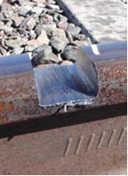
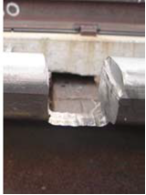
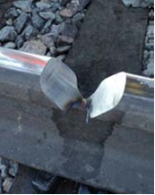
Railhead Repair Welds
Repair of railhead defects without altering rail neutral stress temperature
Railtech Boutet – Head Wash Repair (HWR)
Thermite
Orgo-Thermite – Head Repair Weld (HRW)
Thermite
Holland/EWI – Head Defect Repair (HDR)
Electric-Flash
4
Notes:
Repair of railhead defects without altering rail neutral stress temperature

Slide 5
§ 213.113 Defective Rails
5
Notes:
GUIDANCE: FRA adds a new paragraph (c) to contain both the remedial action table and its notes, as revised, which formerly were included under paragraph (a). We’ll discuss the defect descriptions as they appear in the book
The remedial action table and specifications in the rule address the risks associated with rail failure. These risks are primarily dependent upon defect type and size and should not be dependent upon the manner or mechanism that reveals the existence of the defect. Failure of the track owner to comply with the operational (speed) restrictions, maintenance procedures and the prescribed inspection intervals specified in this section and § 213.237 (Defective rails and Inspection of rail, respectively), may constitute a violation of the TSS.

Slide 6

§ 213.113 Defective Rails
6
Notes:
GUIDANCE: FRA adds a new paragraph (c) to contain both the remedial action table and its notes, as revised, which formerly were included under paragraph (a). We’ll discuss the defect descriptions as they appear in the book
The remedial action table and specifications in the rule address the risks associated with rail failure. These risks are primarily dependent upon defect type and size and should not be dependent upon the manner or mechanism that reveals the existence of the defect. Failure of the track owner to comply with the operational (speed) restrictions, maintenance procedures and the prescribed inspection intervals specified in this section and § 213.237 (Defective rails and Inspection of rail, respectively), may constitute a violation of the TSS.

Slide 7
§ 213.113 Defective Rails
7
Notes:
GUIDANCE: FRA adds a new paragraph (c) to contain both the remedial action table and its notes, as revised, which formerly were included under paragraph (a). We’ll discuss the defect descriptions as they appear in the book
The remedial action table and specifications in the rule address the risks associated with rail failure. These risks are primarily dependent upon defect type and size and should not be dependent upon the manner or mechanism that reveals the existence of the defect. Failure of the track owner to comply with the operational (speed) restrictions, maintenance procedures and the prescribed inspection intervals specified in this section and § 213.237 (Defective rails and Inspection of rail, respectively), may constitute a violation of the TSS.

Slide 8
§ 213.113 Defective Rails
8
Notes:
The Table Prior to this Update

Slide 9
§ 213.113 Defective Rails
9
Notes:
GUIDANCE FRA also adds a required remedial action for a longitudinal defect that is associated with a defective weld. This addition is based on current industry detection and classification experience for this type of defect. FRA adds this defect to the remedial action table and includes all longitudinal defects within one group subject to identical remedial actions based on their reported sizes. These types of longitudinal defects all share similar growth rates and the same remedial actions are considered appropriate for each type. FRA makes clear that defective weld also continues to be identified in the remedial action table for transverse-oriented defects.

Slide 10
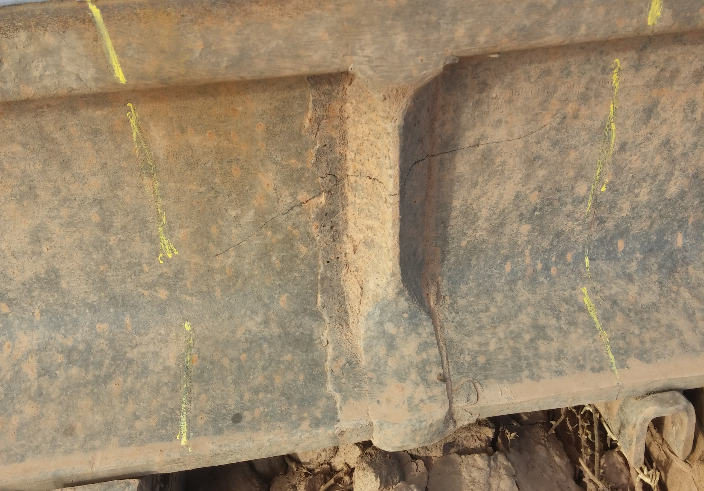


Slide 11
§ 213.113 Defective Rails
11
Notes:
GUIDANCE FRA adds a second footnote, Footnote 2, to the remedial action table. The footnote provides that remedial action “D” applies to a moon-shaped breakout, resulting from a derailment, with a length greater than 6 inches but not exceeding 12 inches and a width not exceeding one-third of the rail base width. FRA has made this change to allow relief because of the occurrence of multiple but less severe “broken base” defects that result from a dragging wheel derailment and may otherwise prevent traffic movement if subject to more restrictive remedial action. FRA also recommends that track owners conduct a special visual inspection of the rail pursuant to § 213.239, before the operation of any train over the affected track. A special visual inspection pursuant to § 213.239, which requires that an inspection be made of the track involved in a derailment incident, should be done to assess the condition of the track associated with these broken base conditions before the operation of any train over the affected track.

Slide 12
§ 213.113 Defective Rails
12
Notes:
GUIDANCE The final rule expressly adds “crushed head” to the remedial action table. This type of defect may affect the structural integrity of the rail section and impact vehicle dynamic response in the higher speed ranges. AAR and NTSB pointed out in their comments on the NPRM that the remedial action table had several changes that were not included in the consensus language generated by the Task Force meetings. In particular, AAR mentioned that a flattened rail/crushed head defect has always been defined in the remedial action table as having a depth greater than or equal to3/8inch and a length greater than or equal to 8 inches. However, in the NPRM's remedial action table, a flattened rail/crushed head defect was defined as having a depth greater than3/8inch and a length greater than 8 inches.

Slide 13
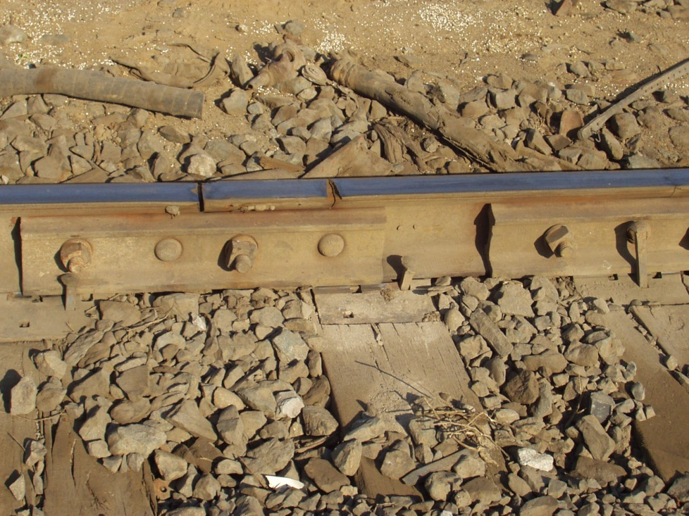
§ 213.113 Defective Rails
NOTES:
A. Assign a person designated under § 213.7 to visually supervise each operation over the defective rail.
13
Notes:
We want to discuss the remedial action code to assure that inspectors understand the requirements of the table. This will be useful during a records inspection/audit; also sometimes inspectors don’t read the whole action and that leads to assumptions or mistakes ( The most common use is 100% failures and for a break out in the rail head.

Slide 14
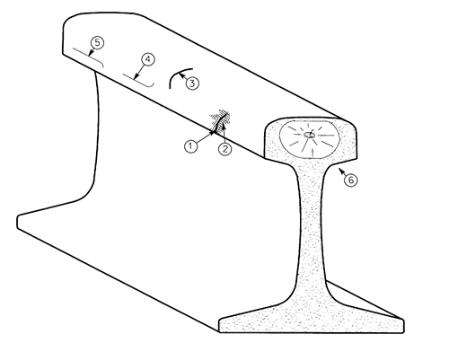
§ 213.113 Defective Rails
NOTES:
A2. Assign person designated under § 213.7 to make visual inspection. After a visual inspection, that person may authorize operation to continue without continuous visual supervision at a maximum of 10 m.p.h. for up to 24 hours prior to another such visual inspection or replacement or repair of the rail.
14
Notes:
A2 is only used for defects generally identified Ultrasonically (% breaks in the rail head of a large in nature – 70 to <100%), obviously, break-outs can be seen visually.
Not a great practice because one can’t tell if it has grown during the 24 hours or if might break in service.
Note “A2” addresses mid-range transverse defect sizes. This remedial action allows for train operations to continue at a maximum of 10 mph up to 24 hours, following a visual inspection by a person designated under § 213.7. If the rail is not replaced, another 24-hour cycle begins.

Slide 15
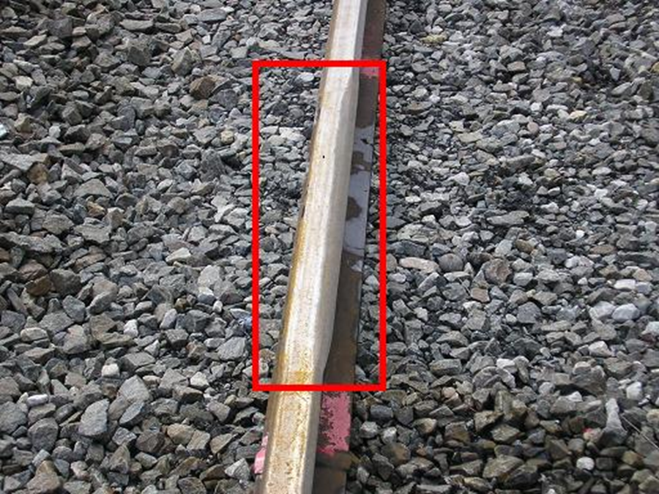
§ 213.113 Defective Rails
NOTES:
B. Limit operating speed over defective rail to that as authorized by a person designated under §213.7(a), who has at least one year of supervisory experience in railroad track maintenance. The operating speed cannot be over 30 m.p.h. or the maximum allowable speed under §213.9 for the class of track concerned, whichever is lower.
15
Notes:
Note “B” limits speed to that as authorized by a person designated under § 213.7(a) who has at least 1 year of supervisory experience in track maintenance. The qualified person has the responsibility to evaluate the rail defect and authorize the maximum operating speed over the
defective rail based on the size of the defect and the operating conditions; however, the maximum speed over the rail may not exceed 30 mph or the maximum speed under § 213.9 for the class of track concerned, whichever is lower.

Slide 16
§ 213.113 Defective Rails
NOTES:
C. Apply joint bars bolted only through the outermost holes to the defect within 10 days after it is determined to continue the track in use. In the case of Class 3 through 5 track, limit the operating speed over the defective rail to 30 m.p.h. until joint bars are applied; thereafter, limit the speed to 50 m.p.h. or the maximum allowable speed under § 213.9 for the class of track concerned, whichever is lower….
16
Notes:
GUIDANCE: Note C, which applies specifically to detail fractures, engine burn fractures, transverse fissures, and defective welds, and addresses defects that are discovered during an internal rail inspection required under § 213.237 and whose size is determined not to be in excess of twenty-five percent of the rail head cross-sectional area. For these specific defects, a track owner formerly had to apply joint bars bolted only through the outermost holes at the defect location within 20 days after it had determined to continue the track in use.

Slide 17
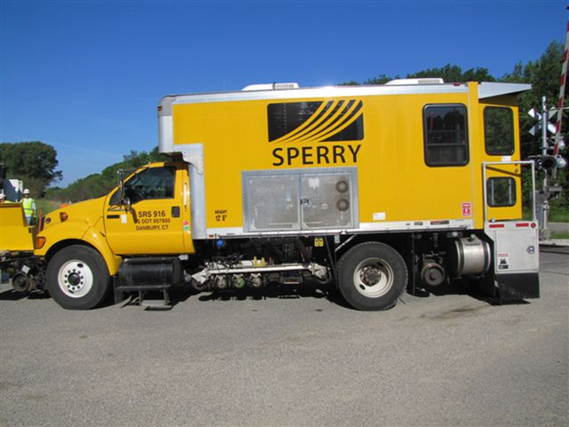
§ 213.113 Defective Rails
NOTES: CONTINUED
C. …When a search for internal rail defects is conducted under § 213.237, and defects are discovered in Class 3 through 5 track that require remedial action C, the operating speed shall be limited to 50 m.p.h. or the maximum allowable speed under § 213.9 for the class of track concerned, whichever is lower, for a period not to exceed 4 days…
17
Notes:
Revised for these specific defects, a track owner must apply joint bars bolted only through the outermost holes to the defect within 10 days after it is determined to continue the track in use

Slide 18
§ 213.113 Defective Rails
NOTES: CONTINUED
C. …If the defective rail has not been removed from the track or a permanent repair made within 4 days of the discovery, limit operating speed over the defective rail to 30 m.p.h. until joint bars are applied; thereafter, limit speed to 50 m.p.h. or the maximum allowable speed under § 213.9 for the class of track concerned, whichever is lower. When joint bars have not been applied within 10 days, the speed must be limited to 10 m.p.h. until joint bars are applied.
18
Notes:
When joint bars have not been applied within 10 days, the track speed must be limited to 10 m.p.h. until joint bars are applied. This addition allows the railroads alternative relief from remedial action for these types of defects in Class 1 and 2 track.

Slide 19
§ 213.113 Defective Rails
NOTES:
D. Apply joint bars bolted only through the outermost holes to the defect within 7 days after it is determined to continue the track in use. In the case of Class 3 through 5 track, limit operating speed over the defective rail to 30 m.p.h. or less as authorized by a person designated under § 213.7(a),…
19
Notes:
GUIDANCE: Note D, which applies specifically to detail fractures, engine burn fractures, transverse fissures, and defective welds, and addresses defects that are discovered during an internal rail inspection required under § 213.237 and whose size is determined not to be in excess of 60 percent of the rail head cross-sectional area.

Slide 20
§ 213.113 Defective Rails
NOTES: CONTINUED
D. …who has at least one year of supervisory experience in railroad track maintenance, until joint bars are applied; thereafter, limit speed to 50 m.p.h. or the maximum allowable speed under § 213.9 for the class of track concerned, whichever is lower. When joint bars have not been applied within 7 days, the speed must be limited to 10 m.p.h. until the joint bars are applied.
20
Notes:
Formerly, for these specific defects, a track owner had to apply joint bars bolted only through the outermost holes at the defect location within 10 days after it is determined that the track should continue in use.

Slide 21
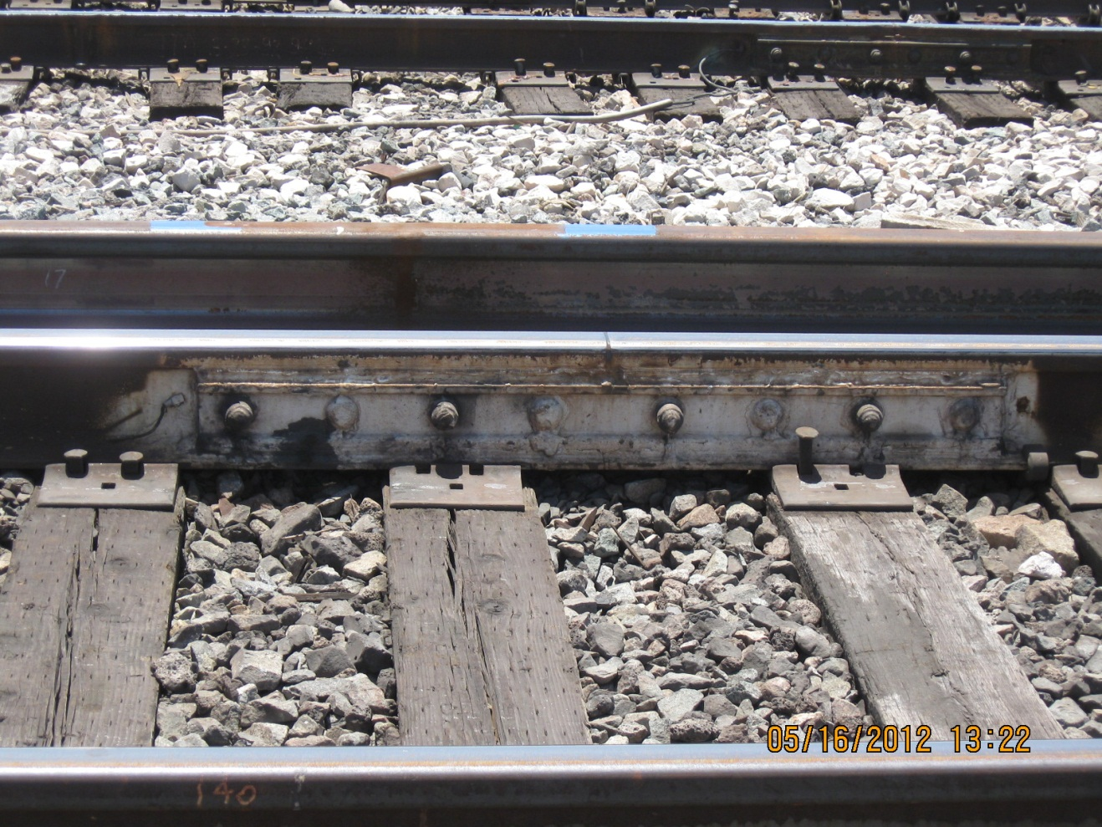
§ 213.113 Defective Rails
Notice how many bolts are in these bars
21
Notes:
GUIDANCE: Revises for these specific defects a track owner must apply joint bars bolted only through the outermost holes to the defect within 7 days after it is determined to continue the track in use.
When joint bars have not been applied within 10 days, the track speed must be limited to 10 m.p.h. until joint bars are applied. This addition allows the railroads alternative relief from remedial action for these types of defects in Class 1 and 2 track.

Slide 22
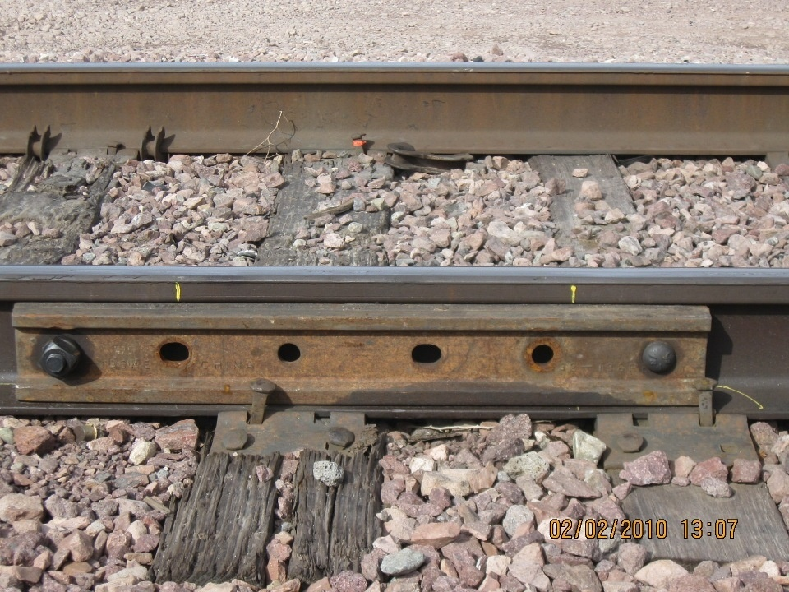
§ 213.113 Defective Rails
22
Notes:
GUIDANCE: Revises for these specific defects a track owner must apply joint bars bolted only through the outermost holes to the defect within 7 days after it is determined to continue the track in use.
When joint bars have not been applied within 10 days, the track speed must be limited to 10 m.p.h. until joint bars are applied. This addition allows the railroads alternative relief from remedial action for these types of defects in Class 1 and 2 track.

Slide 23
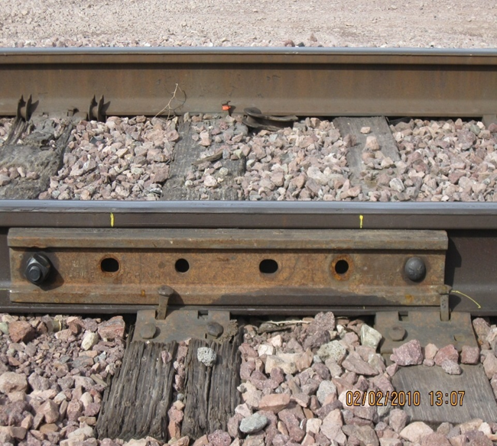
§ 213.113 Defective Rails
Under note D, there are several acceptable “outermost hole” bolting arrangements for joint bars centered on a rail defect. In all cases, railroads may not drill a bolt hole next to a defect that is being remediated with the application of joints bars (pursuant to note D). The reason for not drilling next to the defect is to prevent the propagation of the crack into the hole closest to the defect.
23
Notes:
In the case of a Detail Fracture, Engine Burn, Defective weld, Broken Base or Damaged rail the defect may remain in the track – with bars on – however the maximum speed CANNOT exceed 50mph; inspectors should be aware of these barred defects and insure proper speeds govern train movements.

Slide 24
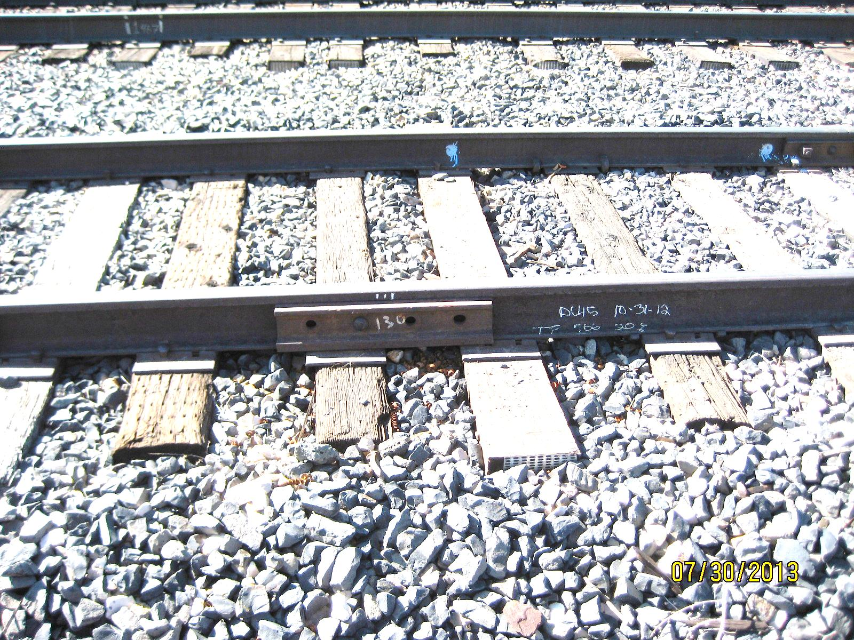

Regional Support
Provides input and advice to headquarters and regional personnel for improved development of effective policies and programs regarding FRA Rail Integrity oversight to enhance rail safety
Defect Date
Defect Repair
Regional NSPP 2014.
Picture Date

Slide 25
§ 213.113 Defective Rails
Could be –
ONE VIOLATION FOR DEFECTIVE RAIL - IMPROPER REMEDIAL ACTION, WHICH COULD BE WILLFULL BECAUSE IT WAS DONE ON PURPOSE.
ONE VIOLATION FOR RECORDS NOT REFLECTING CONDITIONS IN THE FIELD
ONE VIOLATION FOR EACH MONTH IT WAS INSPECTED WITHOUT DOCUMENTATION, REMEDIALACTION OR REPAIR (8X)
When was the picture taken? July, 30, 2013
When was the defect marked? October 31, 2012 (8 months)
How was the defect fixed? With one bolt – inside
How often is it inspected? Let’s say once a month
RESULT?
25
Notes:
In the case of a Detail Fracture, Engine Burn, Defective weld, Broken Base or Damaged rail the defect may remain in the track – with bars on – however the maximum speed CANNOT exceed 50mph; inspectors should be aware of these barred defects and insure proper speeds govern train movements.

Slide 26
§ 213.113 Defective Rails
NOTES:
E. Apply joint bars to defect and bolt in accordance with § 213.121(d) and (e).
§ 213.121(d) In the case of conventional jointed track, each rail shall be bolted with at least two bolts at each joint in Classes 2 through 5 track, and with at least one bolt in Class 1 track.
§ 213.121(e) In the case of continuous welded rail track, each rail shall be bolted with at least two bolts at each joint.
26

Slide 27
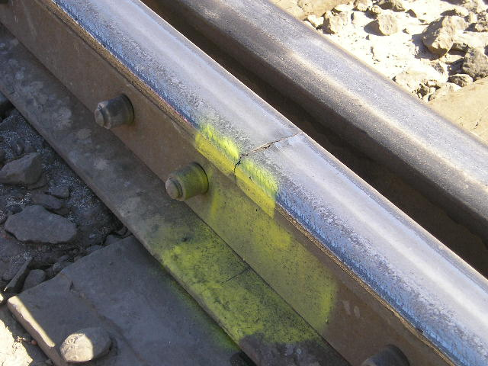
§ 213.113 Defective Rails
What’s the remedial action for a cracked or broken switch point?
27
Notes:
Consult the Rail Table

Slide 28
§ 213.113 Defective Rails
§213.135 Switches.
(b) Each switch point shall fit its stock rail properly, with the switch stand in either of its closed positions to allow wheels to pass the switch point. Lateral and vertical movement of a stock rail in the switch plates or of a switch plate on a tie shall not adversely affect the fit of the switch point to the stock rail.
Broken or cracked switch point rails will be subject to the requirements of § 213.113, except that where remedial actions C, D, or E require the use of joint bars, and joint bars cannot be placed due to the physical configuration of the switch, remedial action B will govern, taking into account any added safety provided by the presence of reinforcing bars on the switch points.
28
Notes:
Consult the Rail Table

Slide 29
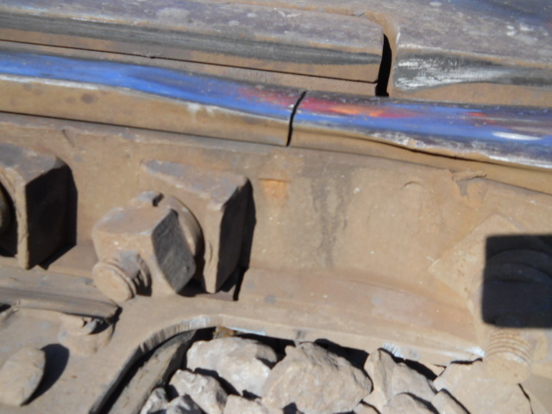
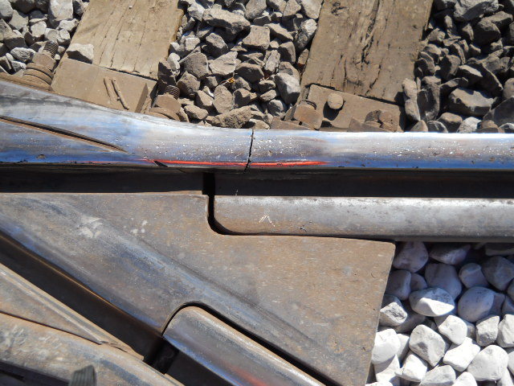
§ 213.113 Defective Rails
What’s the remedial action for this broken wing rail?
29
Notes:
Consult the Rail Table
This is a broken rail in which bars cannot be applied – the remedial action is to supervise movements

Slide 30
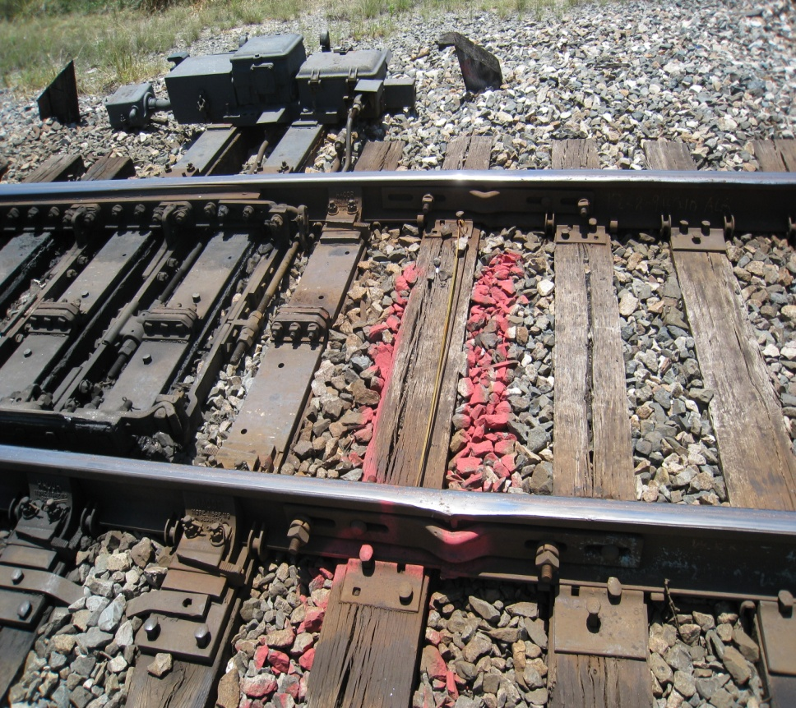
§ 213.113 Defective Rails
  Is this a proper application for remedial action E?
  E. Apply joint bars to defect and bolt in accordance with § 213.121(d) and (e).
30
Notes:
Straps are never bars

Slide 31
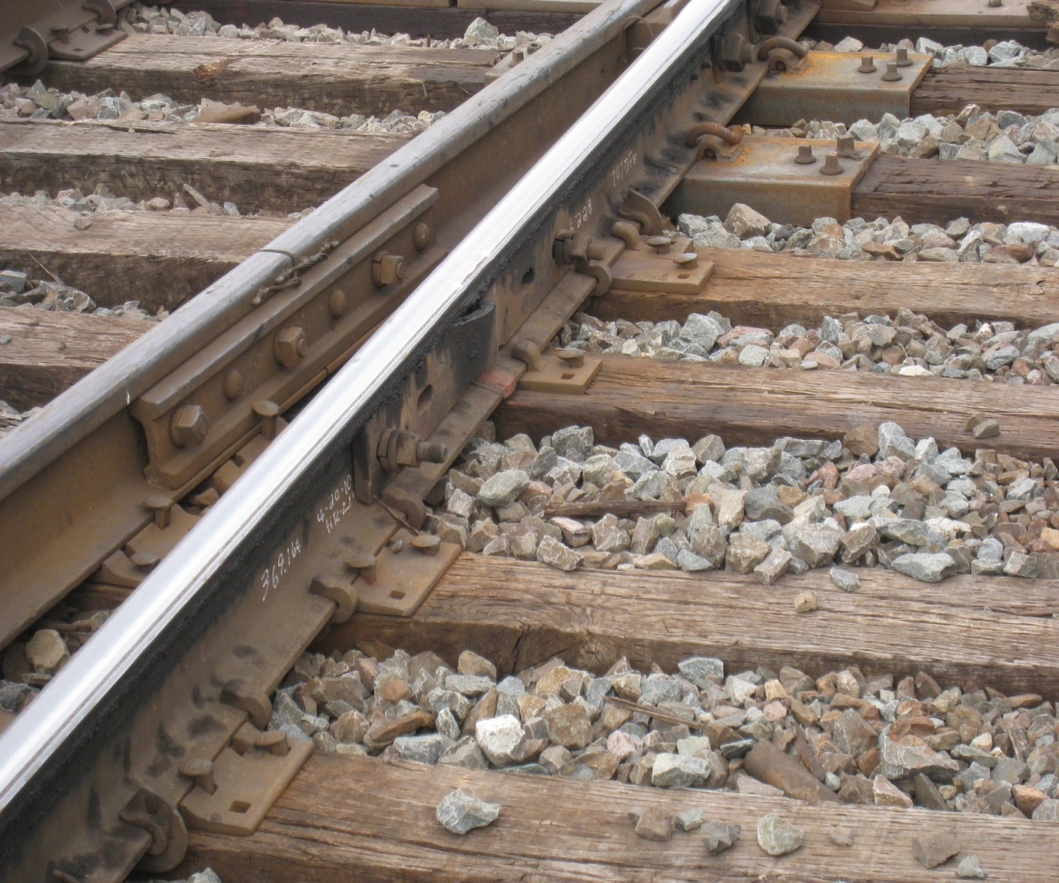
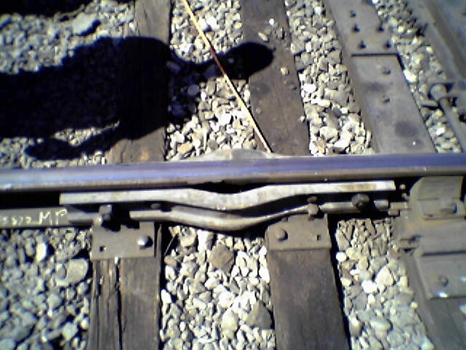
Strap Bar
Guidance - Some railroad’s apply safety “weld straps” to thermite type field welds. These straps do not provide the same support of a joint bar. They would provide only limited support if a weld were to break under a train movement and as such, they do not comply with the provisions of corrective actions C, D, or E (installation of joint bars). Only a joint bar with full contact with the bottom of the rail head and rail base [see 121.(a)] and with a manufactured relief for the weld material would comply with corrective actions C, D, or E.
31
Notes:
Remedial action “E” is used in conjunction with either action “H” or “I” and a limiting speed of 50mph or 30mph must also accompany the remedial action - if the defect is NOT removed

Slide 32
§ 213.113 Defective Rails
NOTES:
F. Inspect the rail within 90 days after it is determined to continue the track in use. If the rail remains in the track and is not replaced or repaired, the reinspection cycle starts over with each successive reinspection unless the reinspection reveals the rail defect to have increased in size and therefore become subject to a more restrictive remedial action…
32
Notes:
GUIDANCE: Revises note F so that if the rail remains in the track and is not replaced or repaired, the re-inspection cycle starts over with each successive re-inspection unless the re-inspection reveals the rail defect to have increased in size and therefore become subject to a more restrictive remedial action. This process continues indefinitely until the rail is removed from the track or repaired.

Slide 33
§ 213.113 Defective Rails
NOTES:
F. …This process continues indefinitely until the rail is removed from the track or repaired. If not inspected within 90 days, limit speed to that for Class 2 track or the maximum allowable speed under § 213.9 for the class of track concerned, whichever is lower, until it is inspected.
33
Notes:
If not inspected within 90 days, the track owner is required to limit the speed to that for Class 2 track or the maximum allowable speed under § 213.9 for the class of track concerned, whichever is lower, until inspected. This change defines the re-inspection cycle and requires the track owner to continue the re-inspection or apply a reduction in speed.

Slide 34
§ 213.113 Defective Rails
NOTES:
G. Inspect rail within 30 days after it is determined to continue the track in use. If the rail remains in the track and is not replaced or repaired, the reinspection cycle starts over with each successive reinspection unless the reinspection reveals the rail defect to have increased in size and therefore become subject to a more restrictive remedial action
34
Notes:
GUIDANCE: Revises note G so that if the rail remains in the track and is not replaced or repaired, the re-inspection cycle starts over with each successive re-inspection unless the re-inspection reveals the rail defect to have increased in size and therefore become subject to a more restrictive remedial action.

Slide 35
§ 213.113 Defective Rails
NOTES:
G. This process continues indefinitely until the rail is removed from the track or repaired. If not inspected within 30 days, limit speed to that for Class 2 track or the maximum allowable speed under § 213.9 for the class of track concerned, whichever is lower, until it is inspected.
35
Notes:
This process continues indefinitely until the rail is removed from the track or repaired. If not inspected within 30 days, the track owner is required to limit the speed to that for Class 2 track or the maximum allowable speed under § 213.9 for the class of track concerned, whichever is lower, until inspected. This change defines the re-inspection cycle and requires the track owner to continue the re-inspection or apply a reduction in speed.

Slide 36
§ 213.113 Defective Rails
NOTES:
H. Limit operating speed over defective rail to 50 m.p.h. or the maximum allowable speed under § 213.9 for the class of track concerned, whichever is lower.
I. Limit operating speed over defective rail to 30 m.p.h. or the maximum allowable speed under § 213.9 for the class of track concerned, whichever is lower.
36
Notes:
Consult the Rail Table

Slide 37
§ 213.113 Defective Rails
(d) As used in this section –
Alphabetized Definitions and Descriptions
37
Notes:
GUIDANCE: FRA redesignates former paragraph (b) as paragraph (d) and adds a new paragraph (b).

Slide 38
§ 213.113 Defective Rails
(d) As used in this sections – (DEFINITIONS):
There are now 16 alphabetized terms defined in this section.
3 were modified definitions, and,
1 addition
38
Notes:
GUIDANCE: FRA redesignates former paragraph (b) as paragraph (d) and adds a new paragraph (b).

Slide 39
§ 213.113 Defective Rails
213.113(d) As used in this sections – (DEFINITIONS):
Bolt hole crack
Broken base
Compound fissure means a progressive fracture originating from a horizontal split head that turns up or down, or in both directions, in the head of the rail. Transverse development normally progresses substantially at a right angle to the length of the rail.
Crushed head means a short length of rail, not at a joint, which has drooped or sagged across the width of the rail head to a depth of 3⁄8 inch or more below the rest of the rail head and 8 inches or more in length. Unlike flattened rail where the depression is visible on the rail head only, the sagging or drooping is also visible in the head/web fillet area.
Damaged rail
39
Notes:
GUIDANCE: FRA redesignates former paragraph (b) as paragraph (d) and adds a new paragraph (b).

Slide 40
§ 213.113 Defective Rails
213.113(d) As used in this sections – (DEFINITIONS):
(6) Defective Weld means a field or plant weld containing any discontinuities or pockets, exceeding 5 percent of the rail head area individually or 10 percent in the aggregate, oriented in or near the transverse plane, due to incomplete penetration of the weld metal between the rail ends, lack of fusion between weld and rail end metal, entrainment of slag or sand, under-bead or shrinkage cracking, or fatigue cracking. Weld defects may originate in the rail head, web, or base, and in some cases, cracks may progress from the defect into either or both adjoining rail ends. If the weld defect progresses longitudinally through the weld section, the defect is considered a split web for purposes of remedial action required by this section.
(7) Detail fracture
(8) Engine burn fracture
40
Notes:
GUIDANCE: FRA redesignates former paragraph (b) as paragraph (d) and adds a new paragraph (b).

Slide 41
§ 213.113 Defective Rails
213.113(d) As used in this sections – (DEFINITIONS):
(9) Flattened rail means a short length of rail, not at a joint, which has flattened out across the width of the rail head to a depth of 3⁄8 inch or more below the rest of the rail and 8 inches or more in length. Flattened rail occurrences have no repetitive regularity and thus do not include corrugations, and have no apparent localized cause such as a weld
(10) Head and web separation
(11) Horizontal split head
(12) Ordinary break
(13) Piped rail
(14) Split web
(15) Transverse fissure
(16) Vertical split head
41
Notes:
GUIDANCE: FRA redesignates former paragraph (b) as paragraph (d) and adds a new paragraph (b).

Slide 42
Bond Pin
A welded bond wire connection can be the origin of a transverse defect that develops and expands from the point on the rail head where a head bond is attached by welding.
When an FRA inspector finds a rail defect that appears to originate from fatigue at a bond wire attachment weld, the inspector should cite the railroad for 213 defect code 0113D.
FRA Technical Training Material is Intended for Internal Instructional Purposes Only.
Do not distribute outside FRA or State Agency pursuant to 49 CFR Part 212
42
Notes:
Description – A welded bond wire connection can be the origin of a transverse defect that develops and expands from the point on the rail head where a head bond is attached by welding. It is questionable whether the primary cause of transverse defects associated with welded bonds is due to thermal cracks being created by rapid or irregular cooling at or near the point where the bond is attached or whether the focal point of the defect is a metallurgic reaction and the resulting penetration of the native metal through a martensite layer sometimes developed between the bond and the rail head. The inspector should be aware that rail defects can also develop from bond applications to the rail web.
Figure 42:

Slide 43
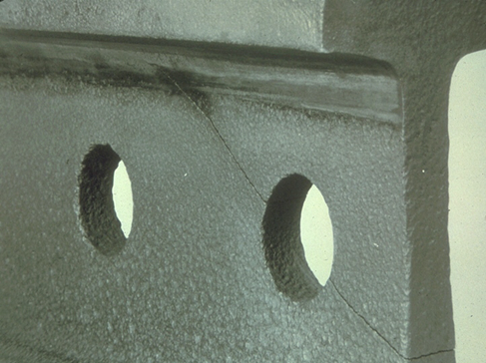
Bolt Hole Crack
Bolt hole crack means a crack across the web, originating from a bolt hole, and progressing on a path either inclined upward toward the rail head or inclined downward toward the base.
43
Notes:
§213.113 Fully developed bolt hole cracks may continue horizontally along the head/web or base/web fillet, or they may progress into and through the head or base to separate a piece of the rail end from the rail. Multiple cracks occurring in one rail end are considered to be a single defect. However, bolt hole cracks occurring in adjacent rail ends within the same joint must be reported as separate defects.
(1) Bolt hole crack means a crack across the web, originating from a bolt hole, and progressing on a path either inclined upward toward the rail head or inclined downward toward the base. Fully developed bolt hole cracks may continue horizontally along the head/web or base/web fillet, or they may progress into and through the head or base to separate a piece of the rail end from the rail. Multiple cracks occurring in one rail end are considered to be a single defect. However, bolt hole cracks occurring in adjacent rail ends within the same joint must be reported as separate defects.
It is not recommended to drill through stamps or brands

Slide 44
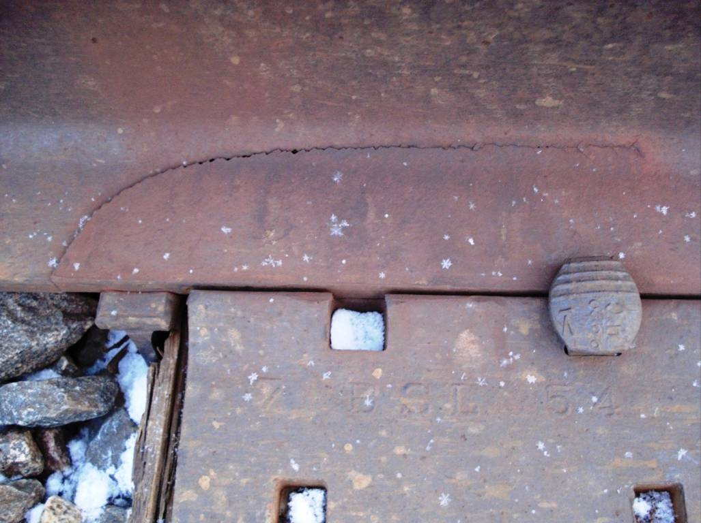
Broken Base
A broken base is normally confined within the flange area of the rail base and is normally an oval shaped break referred to as a “half moon” break. This type of base break is commonly caused by a seam, segregation, or improper bearing on the tie.
44
Notes:
§213.113 Broken base is generally categorized into two types of failure – Broken Base and Base Fracture. A base fracture is normally the result of a nick or other type damage to the base that results in an identifiable indentation. A broken base is normally confined within the flange area of the rail base and is normally an oval shaped break referred to as a “half moon” break.

Slide 45
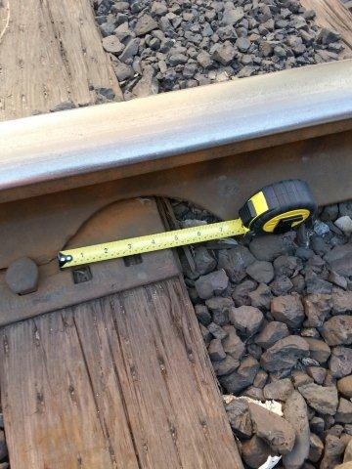
Notes:
A broken base in excess of 6 inches requires the assignment of a person designated under § 213.7 to visually supervise each train operation over the defective rail. The railroad may apply joint bars to the defect and bolt them in accordance with §§ 213.121(d) and (e) and thereafter must limit train operations to 30 mph or the maximum allowable under § 213.9 for the class of track concerned, whichever is lower.

Slide 46
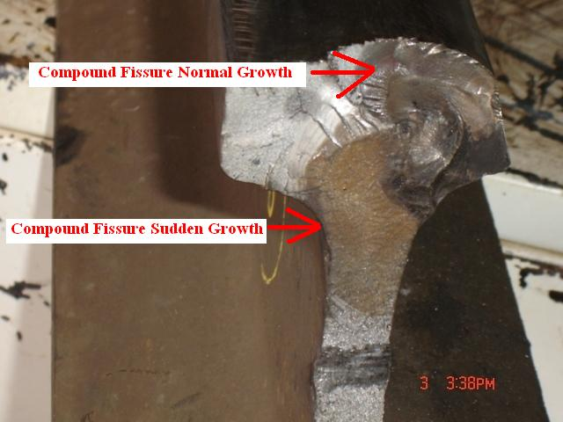
Compound Fissure
Compound Fissure means a progressive fracture originating in a horizontal split head which turns up or down in the head of the rail as a smooth, bright, or dark surface progressing until substantially at a right angle to the length of the rail.
46
Notes:
(2) Compound fissure means a progressive fracture originating in a horizontal split head which turns up or down in the head of the rail as a
smooth, bright, or dark surface progressing until substantially at a right angle to the length of the rail. Compound fissures require examination of
both faces of the fracture to locate the horizontal split head from which they originate.

Slide 47
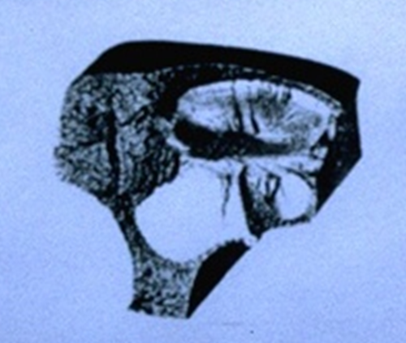
Compound Fissure
Compound Fissure means a progressive fracture originating in a horizontal split head which turns up or down in the head of the rail as a smooth, bright, or dark surface progressing until substantially at a right angle to the length of the rail.
47
Notes:
(2) Compound fissure means a progressive fracture originating in a horizontal split head which turns up or down in the head of the rail as a
smooth, bright, or dark surface progressing until substantially at a right angle to the length of the rail. Compound fissures require examination of
both faces of the fracture to locate the horizontal split head from which they originate.

Slide 48
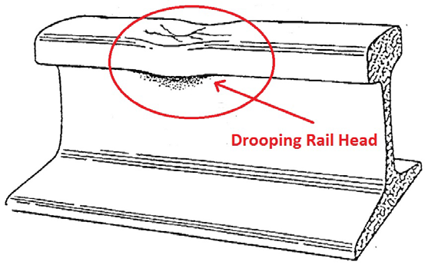
Crushed Head
Crushed head means a short length of rail, not at a joint, which has drooped or sagged across the width of the rail head to a depth of ⅜ inch or more below the rest of the rail head and 8 inches or more in length. Unlike flattened rail where the depression is visible on the rail head only, the sagging or drooping is also visible in the head/web fillet area.
48
Notes:
(4) Crushed head means a short length of rail, not at a joint, which has drooped or sagged across the width of the rail head to a depth of ⅜ inch or more below the rest of the rail head and 8 inches or more in length. Unlike flattened rail where the depression is visible on the rail head only, the sagging or drooping is also visible in the head/web fillet area.

Slide 49
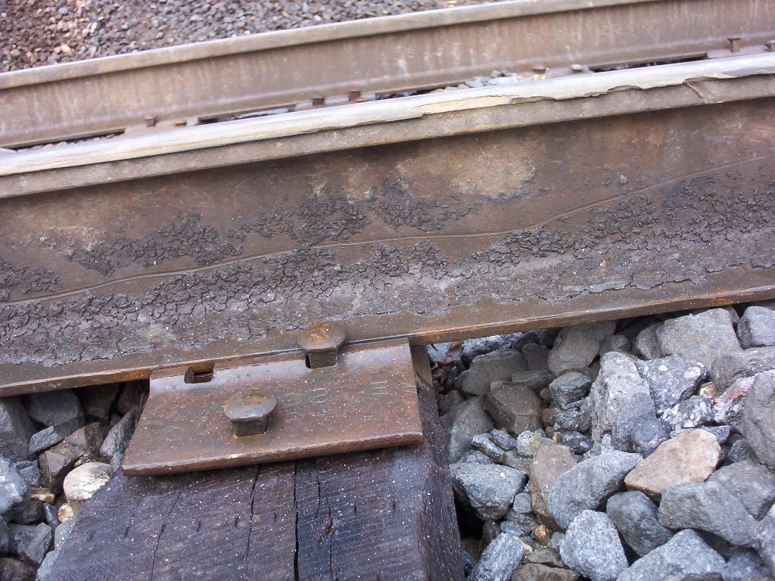
Damaged Rail
Damaged rail means any rail broken or injured by wrecks, broken, flat, or unbalanced wheels, slipping, or similar causes.
49
Notes:
Damaged rail means any rail broken or injured by wrecks, broken, flat, or unbalanced wheels, slipping, or similar causes.
(5) Damaged rail means any rail broken or otherwise damaged by a derailment, broken, flat, or unbalanced wheel, wheel slipping, or similar causes.

Slide 50
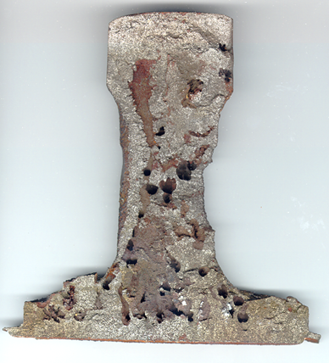
Defective Weld
Defective weld means a field or plant weld containing any discontinuities or pockets, exceeding 5 percent of the rail head area individually or 10 percent in the aggregate, oriented in or near the transverse plane,
50
Notes:
(6) Defective weld means a field or plant weld containing any discontinuities or pockets, exceeding 5 percent of the rail head area individually or 10 percent in the aggregate, oriented in or near the transverse plane, due to incomplete penetration of the weld metal between the rail ends, lack of fusion between weld and rail end metal, entrainment of slag or sand, under-bead or shrinkage cracking, or fatigue cracking. Weld defects may originate in the rail head, web, or base, and in some cases, cracks may progress from the defect into either or both adjoining rail ends. If the weld defect progresses longitudinally through the weld section, the defect is considered a split web for purposes of remedial action required by this section.

Slide 51
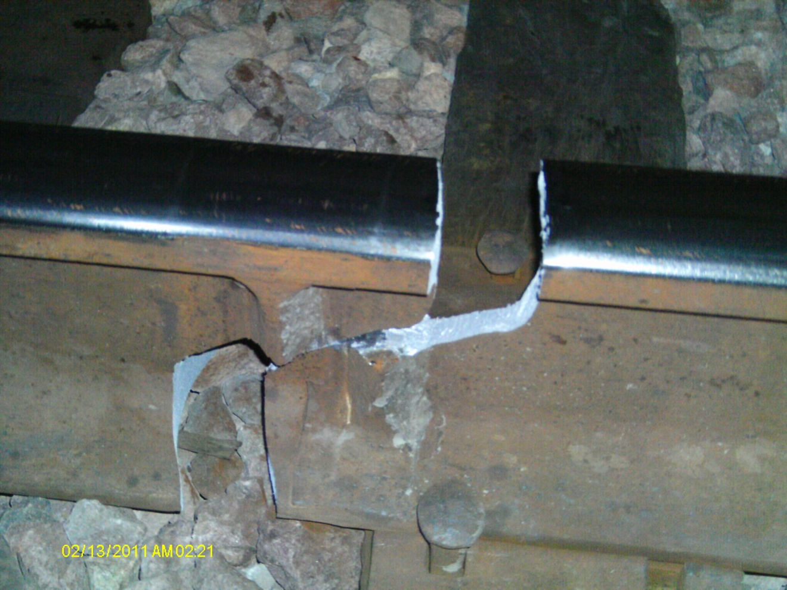
Defective Weld Longitudinal
Defective weld means a field or plant weld containing any discontinuities or pockets, exceeding 5 percent of the rail head area individually or 10 percent in the aggregate, oriented in or near the transverse plane,
51
Notes:
§213.113 There are MANY types of welds / Weld Defects: Plant (DPW or DWP), Electric, Gas Pressure Split Web, Field, Orgotherm , Wide Gap, Boutet, Split Web Bond Wires and Pins – ALL require the same remedial action per the table
Defective weld means a field or plant weld containing any discontinuities or pockets, exceeding 5 percent of the rail head area individually or 10 percent in the aggregate, oriented in or near the transverse plane, due to incomplete penetration of the weld metal between the rail ends, lack of fusion between weld and rail end metal, entrainment of slag or sand, under-bead or other shrinkage cracking, or fatigue cracking. Weld defects may originate in the rail head, web, or base, and in some cases, cracks may progress from the defect into either or both adjoining rail ends.

Slide 52
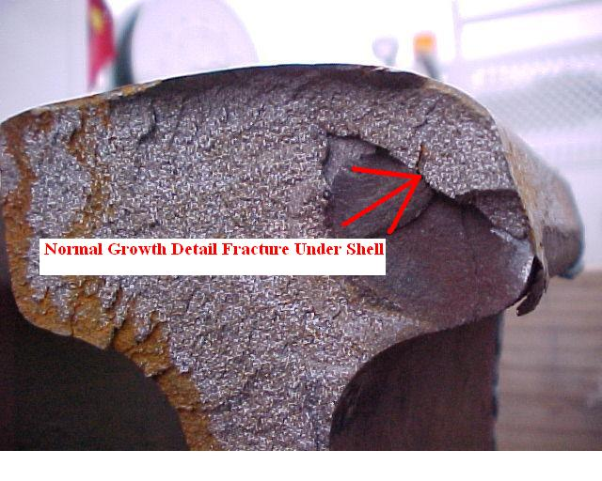
Detail Fracture
Detail Fracture means a progressive fracture originating at or near the surface of the rail head. These fractures should not be confused with transverse fissures, compound fissures, or other defects which have internal origins.. Detail fractures may originate from shelly spots, head checks, or flaking
52
Notes:
Detail fracture means a progressive fracture originating at or near the surface of the rail head. These fractures should not be confused with
transverse fissures, compound fissures, or other defects which have internal origins. Detail fractures may arise from shelly spots, head
checks, or flaking.

Slide 53
Detail Fracture
Detail Fracture means a progressive fracture originating at or near the surface of the rail head. These fractures should not be confused with transverse fissures, compound fissures, or other defects which have internal origins.. Detail fractures may originate from shelly spots, head checks, or flaking
53
Notes:
(7) Detail fracture means a progressive fracture originating at or near the surface of the rail head. These fractures should not be confused with transverse fissures, compound fissures, or other defects which have internal origins. Detail fractures may arise from shelled spots, head checks, or flaking.

Slide 54
Engine Burn Fracture
Engine burn fracture means a progressive fracture originating in spots where driving wheels have slipped on top of the rail head. In developing downward they frequently resemble the compound or even transverse fissures with which they should not be confused or classified
54
Notes:
Engine burn fracture means a progressive fracture originating in spots where driving wheels have slipped on top of the rail head. In developing
downward they frequently resemble the compound or even transverse fissures with which they should not be confused or classified.

Slide 55
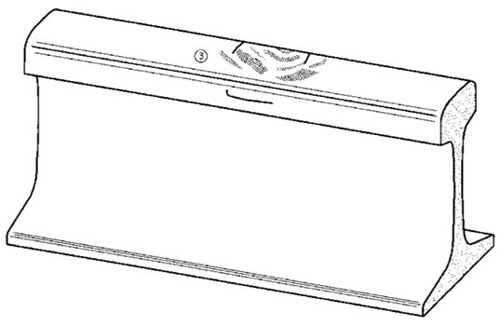
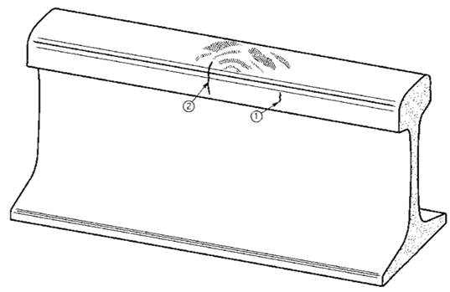
Engine Burn Fracture
Engine burn fracture means a progressive fracture originating in spots where driving wheels have slipped on top of the rail head. In developing downward they frequently resemble the compound or even transverse fissures with which they should not be confused or classified
55
Notes:
(8) Engine burn fracture means a progressive fracture originating in spots where driving wheels have slipped on top of the rail head. In developing downward these fractures frequently resemble the compound or even transverse fissures with which they should not be confused or classified.

Slide 56
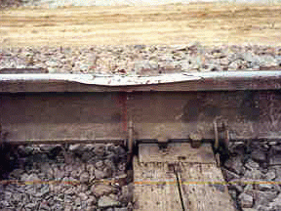
Flattened Rail
Flattened rail means a short length of rail, not at a joint, which has flattened out across the width of the rail head to a depth of ⅜ inch or more below the rest of the rail.
56
Notes:
§213.113 Flattened rail occurrences have no repetitive regularity and thus do not include corrugations, and have no apparent localized cause such as a weld or engine burn. Their individual length is relatively short, as compared to a condition such as head flow on the low rail of curves.
(9) Flattened rail means a short length of rail, not at a joint, which has flattened out across the width of the rail head to a depth of ⅜ inch or more below the rest of the rail and 8 inches or more in length. Flattened rail occurrences have no repetitive regularity and thus do not include corrugations, and have no apparent localized cause such as a weld or engine burn. Their individual length is relatively short, as compared to a condition such as head flow on the low rail of curves.

Slide 57
Head / Web Separation
Description - Head and web separation is a progressive fracture longitudinally separating the head and web of the rail at the fillet under the head.
57
Notes:
(10) Head and web separation means a progressive fracture, longitudinally separating the head from the web of the rail at the head fillet area.

Slide 58
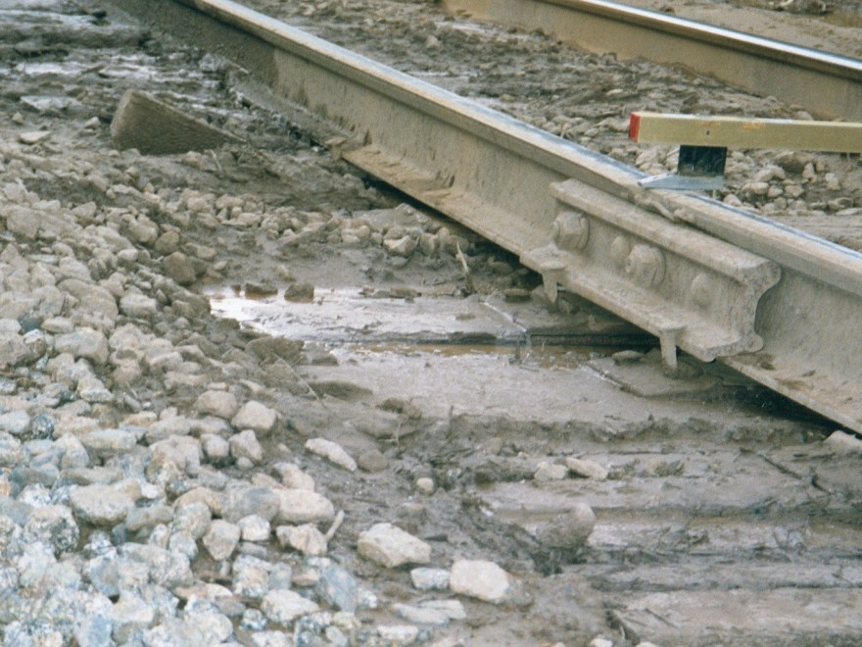
Head / Web Separation
Description - Head and web separation is a progressive fracture longitudinally separating the head and web of the rail at the fillet under the head.
58
Notes:
213.113
Fatigue development can appear as rust colored "rail strain" in the head/web fillet area, or as a slight horizontal cracking under the head. This type of defect can also develop in the head fillet area at the jointed rail end as a result of extreme stress conditions often created by pumping or swing­ing joints.

Slide 59
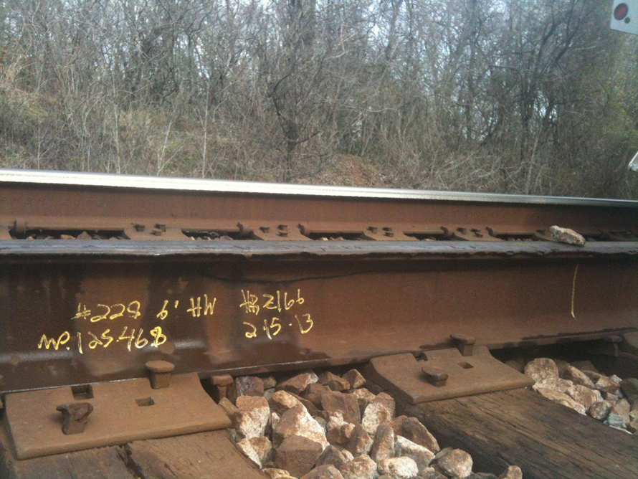
Head / Web Separation
Description - Head and web separation is a progressive fracture longitudinally separating the head and web of the rail at the fillet under the head.
59
Notes:
213.113
Fatigue development can appear as rust colored "rail strain" in the head/web fillet area, or as a slight horizontal cracking under the head. This type of defect can also develop in the head fillet area at the jointed rail end as a result of extreme stress conditions often created by pumping or swing­ing joints.

Slide 60
Horizontal Split Head
Horizontal split head means a horizontal progressive defect originating inside of the rail head, usually ¼ inch or more below the running surface and progressing horizontally in all directions, and generally accompanied by a flat spot on the running surface. The defect appears as a crack lengthwise of the rail when it reaches the side of the rail head.
60
Notes:
(11) Horizontal split head means a horizontal progressive defect originating inside of the rail head, usually ¼ inch or more below the running surface and progressing horizontally in all directions, and generally accompanied by a flat spot on the running surface. The defect appears as a crack lengthwise of the rail when it reaches the side of the rail head.

Slide 61
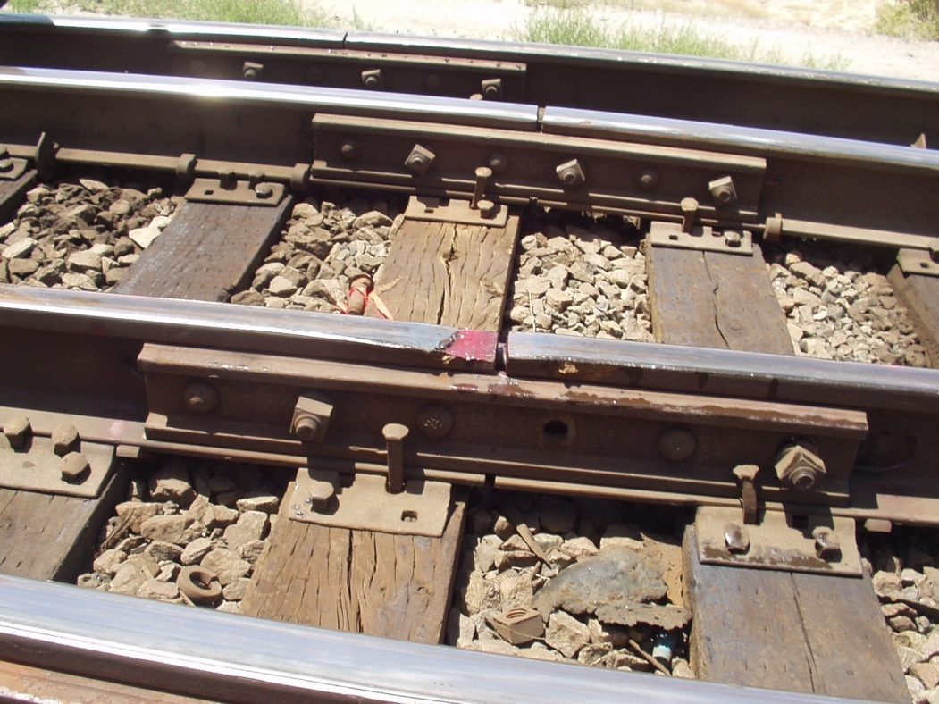
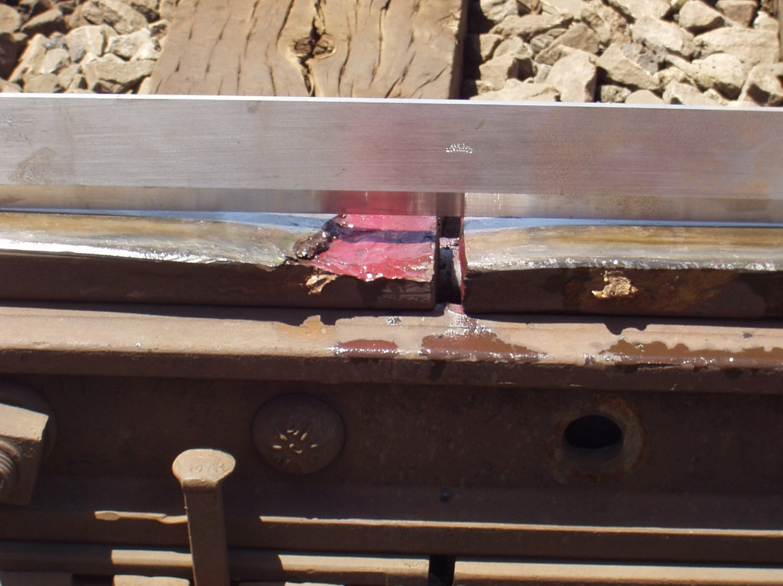
Horizontal Split Head
Inspectors should be objective when identifying defects. Is there a seam present (HSH) or would this be considered a - chip ?
61
Notes:
The photo that you are referring to is what is commonly referred to as a “chipped joint”. A true HSH originates from a seam or inclusion. However, that is up to the operator to determine if he wants to mark these. This is in the task force and will be addressed in the compliance manual. I guess there have been instances where the RR’s were violated or a defect was written by the Inspectors as a break out in the rail head.
Normally it is considered too high in the head for a longitudinal seam, and a seam is normally fairly lengthy. However, segregation or a stringer inclusion could be at any plane. They are what will initiate a shelling condition.

Slide 62
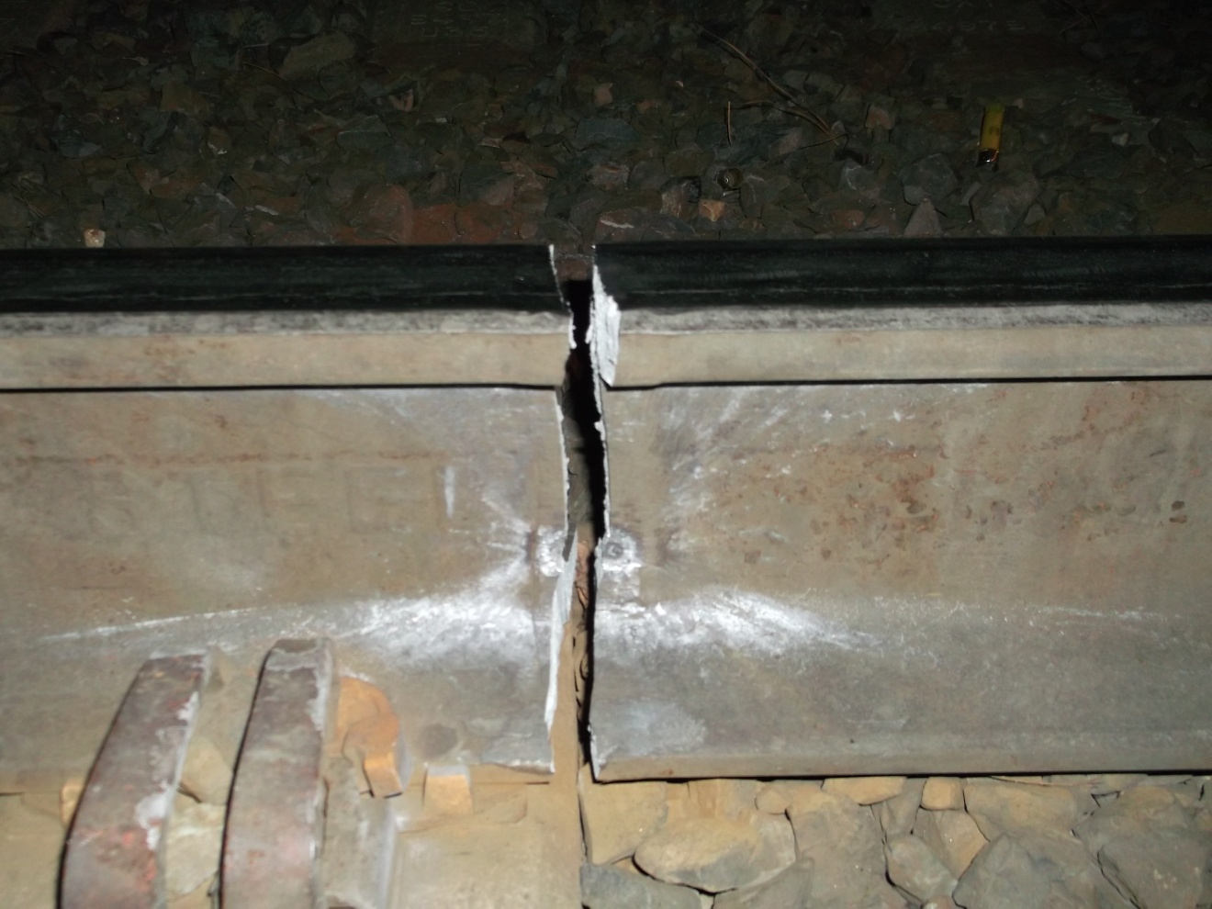
Ordinary Break
Ordinary break means a partial or complete break in which there is no sign of a fissure, and in which none of the other defects described in this paragraph (b) are found.
62
Notes:
(12) Ordinary break means a partial or complete break in which there is no sign of a fissure, and in which none of the other defects described in this paragraph (d) is found.
§213.113 This break occurred because of the damage to the web – no sign of a fissure caused the rail to fail. One might even call this a service failed rail in any case it’s 100% and requires remedial action “A”

Slide 63
Ordinary Break
Ordinary break means a partial or complete break in which there is no sign of a fissure, and in which none of the other defects described in this paragraph (b) are found.
63
Notes:
(12) Ordinary break means a partial or complete break in which there is no sign of a fissure, and in which none of the other defects described in this paragraph (d) is found.
§213.113 This break occurred because of the damage to the web – no sign of a fissure caused the rail to fail. One might even call this a service failed rail in any case it’s 100% and requires remedial action “A”

Slide 64
Piped Rail
Piped rail means a vertical split in a rail, usually in the web, due to failure of the shrinkage cavity in the ingot to unite in rolling.
64
Notes:
(13) Piped rail means a vertical split in a rail, usually in the web, due to failure of the shrinkage cavity in the ingot to unite in rolling.

Slide 65
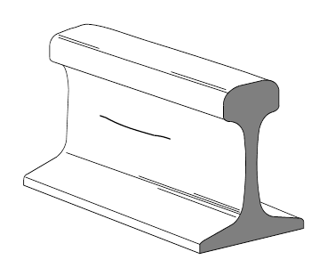
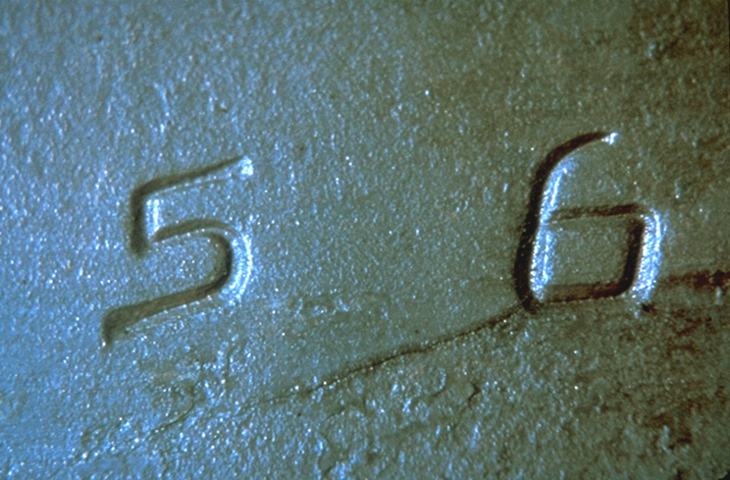
Split Web
Split web means a lengthwise crack along the side of the web and extending into or through it.
65
Notes:
(14) Split web means a lengthwise crack along the side of the web and extending into or through it.

Slide 66
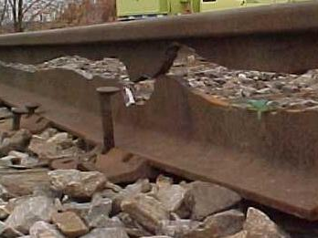
Split Web
Split web means a lengthwise crack along the side of the web and extending into or through it.
66
Notes:
Split web means a lengthwise crack along the side of the web and extending into or through it.

Slide 67
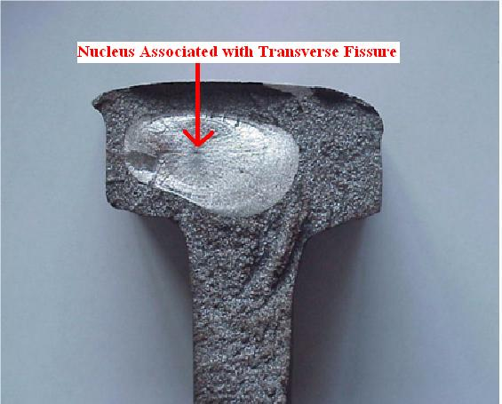
Transverse Fissure
Transverse Fissure defects are inherent from the manufacturing process and are found predominantly in non-control cooled rail prior to the mid-1930’s.
67
Notes:
(15) Transverse fissure means a progressive crosswise fracture starting from a crystalline center or nucleus inside the head from which it spreads outward as a smooth, bright, or dark round or oval surface substantially at a right angle to the length of the rail. The distinguishing features of a transverse fissure from other types of fractures or defects are the crystalline center or nucleus and the nearly smooth surface of the development which surrounds it.

Slide 68
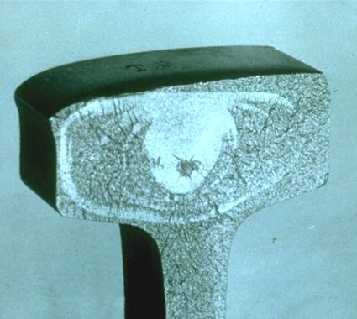
Transverse Fissure
Transverse Fissure defects are inherent from the manufacturing process and are found predominantly in non-control cooled rail prior to the mid-1930’s.
68
Notes:
(1) Transverse fissure means a progressive crosswise fracture starting from a crystalline center or nucleus inside the head from which it spreads
outward as a smooth, bright, or dark, round or oval surface substantially at a right angle to the length of the rail. The distinguishing features of a
transverse fissure from other types of fractures or defects are the crystalline center or nucleus and the nearly smooth surface of the development which surrounds it.

Slide 69
Vertical Split Head
Vertical split head means a vertical split through or near the middle of the head, and extending into or through it. A crack or rust streak may show under the head close to the web or pieces may be split off the side
of the head.
69
Notes:
(16) Vertical split head means a vertical split through or near the middle of the head, and extending into or through it. A crack or rust streak may show under the head close to the web or pieces may be split off the side of the head.

Slide 70
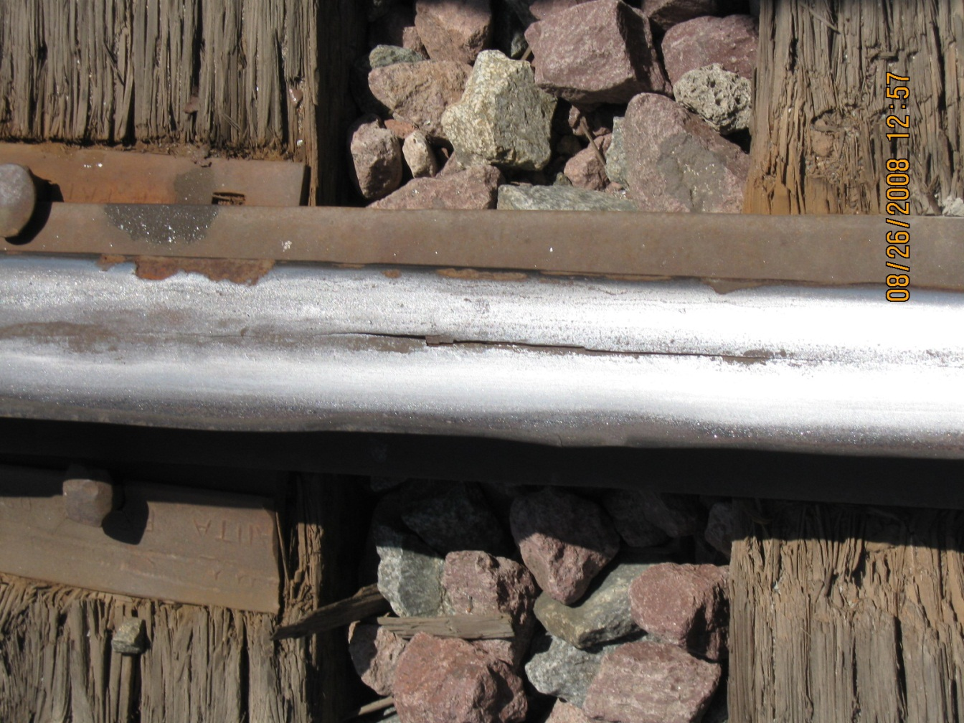
Vertical Split Head
Vertical split head means a vertical split through or near the middle of the head, and extending into or through it. A crack or rust streak may show under the head close to the web or pieces may be split off the side
of the head.
70
Notes:
Vertical split head means a vertical split through or near the middle of the head, and extending into or through it. A crack or rust streak may
show under the head close to the web or pieces may be split off the side of the head.

Slide 71
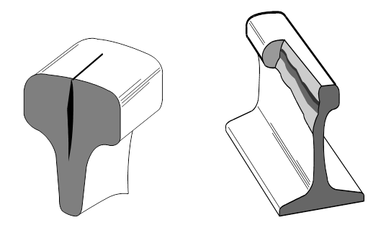
Vertical Split Head
Vertical split head means a vertical split through or near the middle of the head, and extending into or through it. A crack or rust streak may show under the head close to the web or pieces may be split off the side
of the head.
71
Notes:
Vertical split head means a vertical split through or near the middle of the head, and extending into or through it. A crack or rust streak may
show under the head close to the web or pieces may be split off the side of the head.

Slide 72

Vertical Split Head
Vertical split head means a vertical split through or near the middle of the head, and extending into or through it. A crack or rust streak may show under the head close to the web or pieces may be split off the side
of the head.
72
Notes:
Vertical split head means a vertical split through or near the middle of the head, and extending into or through it. A crack or rust streak may
show under the head close to the web or pieces may be split off the side of the head.

Slide 73
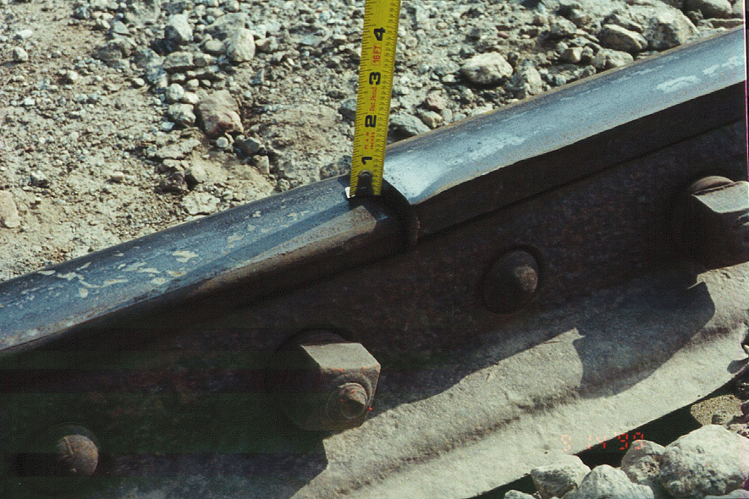
§ 213.115 Rail End
Mismatch
Any mismatch of rails at joints may not be more than that prescribed by the following table --
Tread Mismatch
Gage Mismatch
73
Notes:
Notes
Guidance. Use a straightedge to determine the mismatch by holding the straightedge longitudinally along the higher rail (tread) or along the gage side (five-eighths inch down from the running surface) of the rail. Measure the distance directly between the straightedge and the rail. Disregard plastic overflow (gage side rail edge lipping), if any.
Measure mismatch when track bolts are tight. If bolts are not tight, report the condition as loose joint bars, under §213.121.08. Use a straight-edge to measure the distance between each rail ends. Do not bridge the two rail-ends, but hold the straight-edge longitudinally along the higher rail (tread) or along the gage-side (5/8-inch down from the running surface) of the rail. Measure the distance directly between the two rails. Disregard plastic overflow (gage-side rail edge lipping), if any.
A mismatch may result in high impact forces especially at higher speeds. If a mismatch in excess of the allowable results in significant rail end damage, a violation should be considered.
Particular attention should be given to the mismatch on the gage-side of a rail. A thin flange, skewed truck, or combination of both may cause a wheel to climb, particularly on the outer rail of a curve.

Slide 74
§ 213.118 CWR; Plan
Review and Approval
(a) Each track owner with track constructed of CWR shall have in effect and comply with a plan that contains written procedures which address: the installation, adjustment, maintenance, and inspection of CWR; inspection of CWR joints; and a training program for the application of those procedures.
NOTE: Each Railroad with CWR must have a plan.
74
Notes:
The written procedures should be reasonable and consistent with current research results. The FRA will review each plan for compliance. The FRA Headquarters Rail Integrity specialists and Regional track specialists shall have primary responsibility for reviewing each set of railroad CWR procedures. Inspectors may be requested to provide recommendations concerning the comprehensiveness of those procedures.

Slide 75
§ 213.118 CWR; Plan
Review and Approval
(b) The track owner shall file its CWR plan with the FRA Associate Administrator for Railroad Safety/Chief Safety Officer (Associate Administrator). Within 30 days of receipt of the submission, FRA will review the plan for compliance with this subpart. FRA will approve, disapprove or conditionally approve the submitted plan, and will provide written notice of its determination.
NOTE: Each Railroad must submit their plan for approval.
75
Notes:
Guidance: All CWR plans must be submitted to FRA for review by the Track Division and then approval by the Associate Administrator for Railroad Safety/Chief Safety Officer. FRA reviews each plan for compliance with §§ 213.119(a) through (l). Regional track specialists may be requested to provide recommendations concerning the comprehensiveness of those procedures.

Slide 76
§ 213.118 CWR; Plan
Review and Approval
(c) The track owner’s existing plan shall remain in effect until the track owner’s new plan is approved or conditionally approved and is effective pursuant to paragraph (d) of this section.
NOTE: Each Railroad’s current plan is in effect until the new plan is reviewed and approved.
76
Notes:
Guidance: All CWR plans must be submitted to FRA for review by the Track Division and then approval by the Associate Administrator for Railroad Safety/Chief Safety Officer. FRA reviews each plan for compliance with §§ 213.119(a) through (l). Regional track specialists may be requested to provide recommendations concerning the comprehensiveness of those procedures.

Slide 77
§ 213.118 CWR; Plan
Review and Approval
(d) The track owner shall, upon receipt of FRA’s approval or conditional approval, establish the plan’s effective date. The track owner shall advise in writing FRA and all affected employees of the effective date.
NOTE: Once approved the RR establishes the date the plan goes into effect.
77
Notes:
Guidance: All CWR plans must be submitted to FRA for review by the Track Division and then approval by the Associate Administrator for Railroad Safety/Chief Safety Officer. FRA reviews each plan for compliance with §§ 213.119(a) through (l). Regional track specialists may be requested to provide recommendations concerning the comprehensiveness of those procedures.

Slide 78
§ 213.118 CWR; Plan
Review and Approval
(e) FRA, for cause stated, may, subsequent to plan approval or conditional approval, require revisions to the plan to bring the plan into conformity with this subpart. Notice of a revision requirement shall be made in writing and specify the basis of FRA’s requirement. The track owner may, within 30 days of the revision requirement, respond and provide written submissions in support of the original plan. FRA renders a final decision in writing. Not more than 30 days following any final decision requiring revisions to a CWR plan, the track owner shall amend the plan in accordance with FRA’s decision and resubmit the conforming plan. The conforming plan becomes effective upon its submission to FRA.
NOTE: FRA may require adjusting the plan.
78
Notes:
Guidance: All CWR plans must be submitted to FRA for review by the Track Division and then approval by the Associate Administrator for Railroad Safety/Chief Safety Officer. FRA reviews each plan for compliance with §§ 213.119(a) through (l). Regional track specialists may be requested to provide recommendations concerning the comprehensiveness of those procedures.

Slide 79
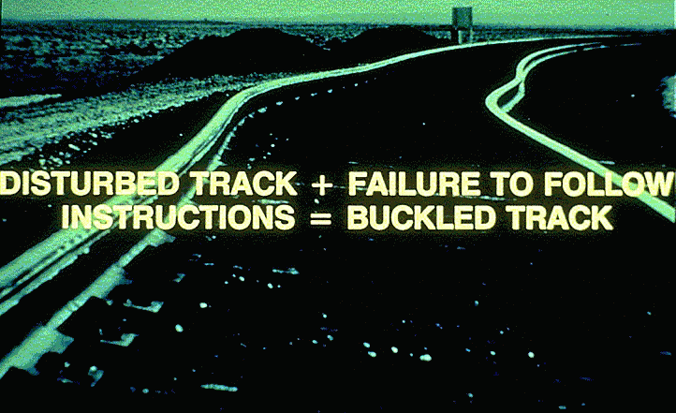
§ 213.119 CWR; Plan
Contents
79
Notes:
Notes
This document is intended only to provide guidance to track owners in fulfilling the requirement of submitting a Continuous Welded Rail (CWR) plan as required by 49 CFR 213.118.
Guidance, General: In addition to safety-critical procedures listed in this section, the railroad may decide to include procedures based on administrative or economic considerations. For example, a railroad may choose to include instructions that limit the use of worn secondhand
replacement rail because of an economic concern about the length of time that it might take to perform a satisfactory weld. The railroad may also include specific actions in their procedures that are to be taken when installation or maintenance work does not comply with its overall
procedures.

Slide 80

§ 213.119 CWR; Plan
Contents
213.119 Continuous welded rail (CWR); plan contents
The track owner shall comply with the contents of the CWR plan approved or conditionally approved under 213.118. The plan shall contain the following elements-
(Paragraphs a – l of the CFR)
80

Slide 81
§ 213.119 CWR; Plan
Contents
(a) Procedures for the installation and adjustment of CWR which include;
(1) Designation of a desired rail installation temperature range for the geographic area in which the CWR is located; and
(2) De‑stressing procedures/methods which address proper attainment of the desired rail installation temperature range when adjusting CWR.
81
Notes:
Notes
Guidance: Track owners with track constructed of CWR are required to have in effect and comply with a CWR plan. This includes track owners who operate entirely on CWR track that has been designated as excepted track pursuant to §213.4. The procedures under §213.119 do not apply to excepted track. (See §213.5(b)). However, where a railroad designates a segment of track as excepted, it still must meet the requirements of at least Class 1 track for any portion of that track that is: 1) located within 30 feet of an adjacent track which is subjected to simultaneous use at speeds in excess of 10 m.p.h.; or 2) located on a bridge or on a public street or highway and there are trains with placarded cars. (See §213.4(d)).
Railroads typically establish a desired rail installation temperature range for the geographical area that is higher than the annual mean temperature. This higher installation temperature will account for the expected reduction of the force-free
temperature caused by track maintenance, train traffic and other factors. As reference, the term for this expected occurrence is “rail neutral temperature shift.” A railroad’s failure to establish a designated installation temperature range for a specific territory is addressed under §213.119(a).

Slide 82
§ 213.119 CWR; Plan
Contents
(b) Rail anchoring or fastening requirements that will provide sufficient restraint to limit longitudinal rail and crosstie movement to the extent practical, and…
…specifically addressing CWR rail anchoring or fastening patterns on bridges, bridge approaches, and at other locations where possible longitudinal rail and crosstie movement associated with normally expected train-induced forces, is restricted.
82
Notes:
Notes
Longitudinal movement means down the length of the rail

Slide 83
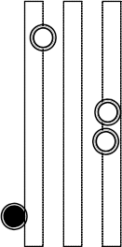
§ 213.119 CWR; Plan
Contents
§ 213.119 (c) CWR joint installation and maintenance procedures which require that-
(1) Each rail shall be bolted with at least two bolts at each CWR joint;
Jointed track Non-CWR Joint
CWR Joint
ALL INSTALLATIONS
83
Notes:
Guidance: The track inspector should determine that any joints installed in CWR or connecting to CWR must have at least two bolts in each rail end, a minimum of four bolts installed in the joint bars, if not field welded at the time of installation. § 213.121(e). This requirement serves as a reminder to track owners that they cannot create their own joint bolt requirements in their CWR plans that are less restrictive than those specified in the TSS.

Slide 84
§ 213.119 CWR; Plan
Contents
§ 213.119 (c) CONTINUED
CWR joint installation and maintenance procedures which require that-
(2) In the case of a bolted joint installed during CWR installation after (August 25, 2009), the track owner shall either, within 60 days-
(i) Weld the joint;
(ii) Install a joint with six bolts;
(iii) Anchor every tie 195 feet in both directions of he joint; and –
NEW INSTALLATIONS
84
Notes:
Guidance: This section applies to major installations of CWR, such as more than 400 feet. It is not intended for plug rails. Note that the applicability date published in the final rule for this section (August 25, 2009) was corrected via the amendment published on October 21, 2009, at 74 FR 53889.

Slide 85
§ 213.119 CWR; Plan
Contents
§ 213.119 (c) CONTINUED
CWR joint installation and maintenance procedures which require that-
(3) In the case of a bolted joint in CWR experiencing service failure or a failed bar with a rail gap present, the track owner shall either-
Weld the joint;
Replace the broken bar’s, replace the broken bolts, adjust the anchors and weld the joint within 30 days
Replace the broken bar’s, replace the broken bolts, install one additional bolt per rail end, and adjust anchors;
Replace the broken bar’s, replace the broken bolts, and anchor every tie 195 feet in both directions from the CWR
Replace the broken bar’s, replace the broken bolts, add rail with provisions for later adjustment pursuant to paragraph (d)(2) of this section, and reapply the anchors.
ALL MAINTENANCE
85
Notes:
Guidance: This section addresses CWR joints that experience a failure with a rail gap present. The definition for rail gap for this section is that the rail is under tension. An example of a joint failure under tension is a joint where the rail ends could not be pulled back together manually, as with the use of a drift pin, or if mechanical or thermal assistance is needed. A remedial action from § 213.119(c)(3) must be taken. Check for evidence of tension (such as bent and broken bolts) or application of thermal force (heat from repair rope, sawdust, or flammable mix)….

Slide 86
§ 213.119 CWR; Plan
Contents
§ 213.119 (d) Procedures which specifically address maintaining a desired rail installation temperature range when cutting CWR, including rail repairs, in-track welding, and in conjunction with adjustments made in the area of tight track, a track buckle or pull-apart. Rail repair practices shall take into consideration existing rail temperature so that --
(1) When rail is removed, the length installed shall be determined by taking into consideration the existing rail temperature and the desired rail installation temperature range; and
(2) Under no circumstances should rail be added when the temp. is below (a)(1), of this section without provisions for later adjustment.
86
Notes:
Must have procedures in plan

Slide 87
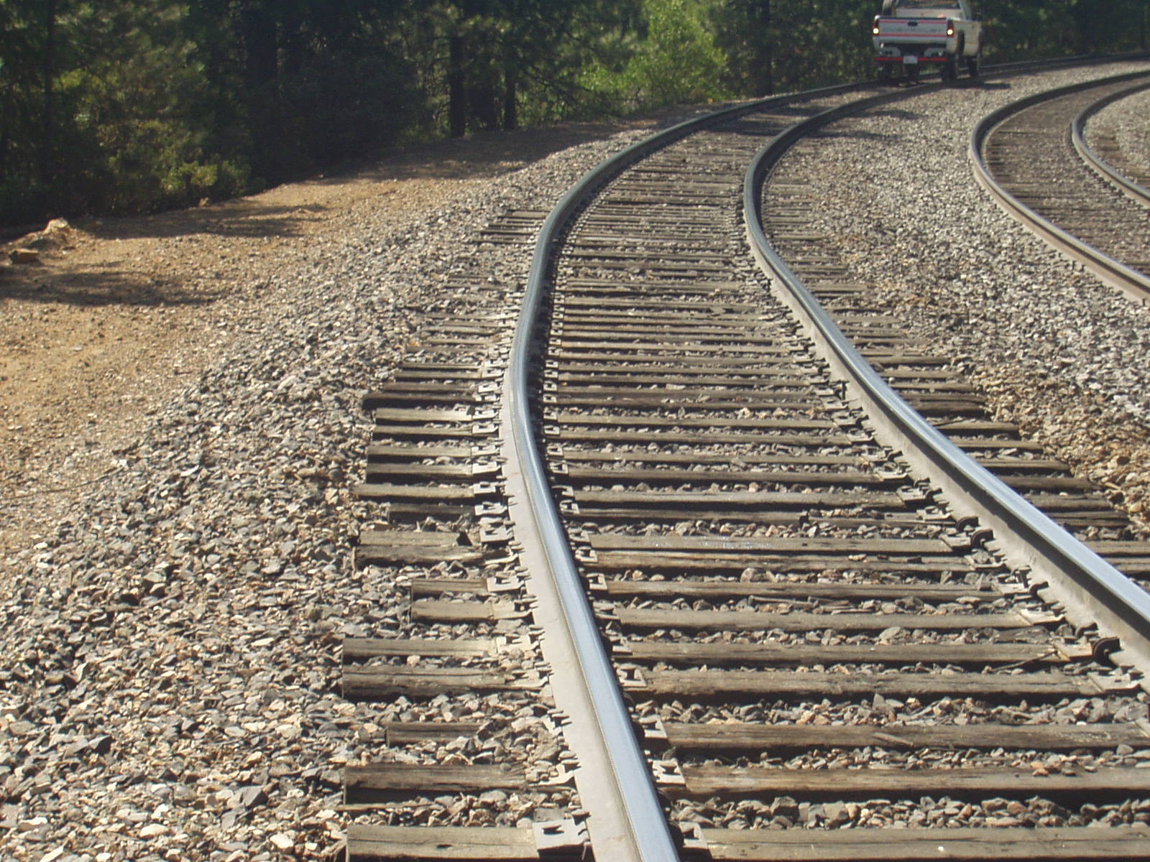
§ 213.119 CWR; Plan
Contents
§ 213.119 (e)
(e) Procedures which address the monitoring of CWR in curved track for inward shifts as a result of disturbed track.
87
Notes:
Notes
Guidance: Thermal and mechanical loads affecting track structure are decreased by the track owner’s adherence to the track engineering standards. Adherence to the track owner’s standards and the CWR plan promote CWR track stability and safety. Three engineering elements resist mechanical loads and thermal loads; lateral resistance,
longitudinal resistance, and rail neutral temperature. Track buckles can be expected to occur predominately in the lateral dimension. Lateral resistance is critical being dependent upon weight and size of crosstie material, ballast material type, shoulder width, crib content and its level of consolidation. As degree of curvature increases, the buckling resistance decreases.

Slide 88
§ 213.119 CWR; Plan
Contents
§ 213.119 (f) Procedures which control train speed on CWR track when --
(1) Maintenance work, track rehabilitation, track construction, or any other event occurs which disturbs the roadbed or ballast section and reduces the lateral and/or longitudinal resistance of the track; and
(2) The difference between the average rail temperature and the average rail neutral temperature is in a range that causes buckling-prone conditions to be present at a specific location; and-
(3) In formulating the procedures under paragraphs (f)(1) and (f)(2) of this section, the track owner shall --
(i) Determine track stabilization procedures (speed restrictions, ballast consolidation, etc.; and
(ii) Take into consideration the type of crossties used.
88
Notes:
Guidance: This requires that the railroad needs to record the new rail neutral temperature when performing rail repair and installation.
Notes
Guidance: (2) This requires that the railroad needs to record the new rail neutral temperature when performing rail repair and installation.
Guidance: (3) In formulating the procedures under paragraphs (f) (1) and (f) (2) of this section, the track
owner shall—
ENTIRE (i)paraphrased above (I) Determine the speed required, and the duration and subsequent removal of any speed restriction based on the restoration of the ballast, along with sufficient ballast re-consolidation to stabilize the track to a level that can accommodate expected train-induced forces. Ballast re-consolidation can be achieved through either the passage of train tonnage or mechanical stabilization procedures, or both; and

Slide 89
§ 213.119 CWR; Plan
Contents
§ 213.119 (g) Procedures which prescribe when physical track inspections are to be performed.
At a minimum, these procedures shall address inspecting track to identify-
(i) Buckling-prone conditions in CWR track, including-
(A) Locations where tight or kinky rail conditions are likely to occur; and
(B) Locations where track work of the nature described in paragraph (f) (1)(I) of this section has recently been performed; and
(ii) Pull-apart prone conditions in CWR track, including locations where pull-apart or stripped-joint rail conditions are likely to occur; and
89

Slide 90
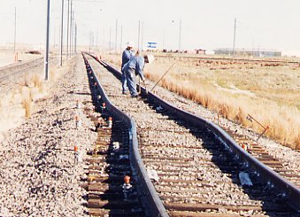
§ 213.119 CWR; Plan
Contents
§ 213.119 (g) Procedures which prescribe when physical track inspections are to be performed.
(2) In formulating the procedures under paragraph (g)(1), the track owner shall-
(i) Specify when the inspections will be conducted; and
(ii) Specify the appropriate remedial actions to be taken when either buckling-prone or pull-apart prone conditions are found.
90
Notes:
Notes
(I) EXAMPLES – heat – like between 2 & 6, cold – like before train operations
(ii) Slow orders or other appropriate action?

Slide 91
§ 213.119 CWR; Plan
Contents
119(h) Procedures which prescribe the scheduling and conduct of inspections to detect cracks and other indications of potential failures in CWR joints. In formulating the procedures under this paragraph, the track owner shall –
(1) Address the inspection of joints and the track structure at joints, including, at a minimum, periodic on foot inspections.
(2) Identify joint bars with visible or otherwise detectable cracks and conduct remedial action pursuant to §213.121;
(3) Specify the conditions of actual or potential joint failure for which personnel must inspect, including, at a minimum, the following items:
(i) Loose, bent, or missing joint bolts;
(ii) Rail end batter or mismatch that contributes to instability of the joint; and
(iii) Evidence of excessive longitudinal rail movement in or near the joint, including, but not limited to; wide rail gap, defective joint bolts, disturbed ballast, surface deviations, gap between tie plates and rail, or displaced rail anchors;
91
Notes:
Guidance (h): This paragraph requires each track owner to include in its CWR plan provisions for the scheduling and conducting of joint inspections. A person who is qualified under §213.7(c) will perform the inspections required by this paragraph on foot at the joint.
Guidance (h)(1) : This paragraph governs on-foot periodic inspections of CWR joints. Track owners are required to establish procedures for conducting these inspections. Upon identifying actual conditions of joint failures (i.e., broken or cracked joints bars) or potential conditions of joint failure, track owners must initiate the appropriate corrective action and keep the appropriate records. See §213.119(h) (5) and 213.119(h) (7). In addition, when a track owner discovers CWR joints that are not in compliance with the requirements of the TSS, the track owner must take the appropriate remedial action required by Part 213. Inspectors should note that nothing in this paragraph interferes with the track owners’ continuing obligation to conduct track inspections under §213.233. In addition, on-foot periodic inspections can be performed concurrently with §213.233. Periodic inspections, as referenced herein, are on-foot inspections of CWR joints that track owners must conduct on a regular basis. Track owners are required to conduct on foot periodic inspections at the minimum intervals specified in paragraph (h)(6). Track owners, of course, are free to conduct these inspections more frequently than required.
Guidance 2: This paragraph requires track owners to identify joint bars with visible or otherwise detectable cracks and conduct remedial action pursuant to §213.121. Railroad Inspectors must know to distinguish between joint bars that are already cracked and joint
bars that have the potential of cracking in the future. When a track owner discovers a cracked joint bar, he must take any remedial action specified in §213.121; however, if he discovers a joint bar with actual or potential joint failure, he must take the corrective action specified by his CWR plan. Corrective action will be further addressed in paragraph (h)(5).
Guidance 3 : This paragraph identifies those items relating to joint inspections that track owners must address in their CWR plans.

Slide 92
§ 213.119 CWR; Plan
Contents
119(h) CONTINUED …inspections to detect cracks and other indications of potential failures in CWR joints.
(4) Specify the procedures for the inspection of CWR joints that are imbedded in highway-rail crossings or in other structures that prevent a complete inspection of the joint, including procedures for the removal from the joint of loose material or other temporary material:
(5) Specify the appropriate corrective actions to be taken when personnel find conditions of actual or potential joint failure, including on-foot follow-up inspections to monitor conditions of potential joint failure in any period prior to completion of repairs;
(6) Specify the timing of periodic inspections, which shall be based on the configuration and condition of the joint: [see table]…
92
Notes:
Guidance 4: This paragraph requires track owners to include procedures in their CWR plans for the inspection of CWR joints that are imbedded in highway-rail grade crossings or in other structures that prevent a complete inspection of the joint (e.g., pans in fueling facilities, scales, passenger walkways at stations that cover the track, etc.).
Guidance 5: This paragraph requires track owners to specify in their plans the appropriate corrective actions that must be taken when track inspectors find conditions of actual or potential joint failure.
Guidance 6: This paragraph requires railroad owners to specify the timing of on-foot periodic inspections. The minimum number of required joint inspections is addressed in the table in paragraph (h)(6)(i).

Slide 93
§ 213.119 CWR; Plan
Contents
119(h)(6) CONTINUED
inspection frequency [table]
Unscheduled passenger train exception
Tourist, scenic, historic, or excursion operations, if limited to the maximum authorized speed for passenger trains
Minimum Number of Inspections per Calendar Year [1]
 | Freight trains operating over track with an annual tonnage of: |  |  | Passenger trains operating over track with an annual tonnage of:
Track Class | Less than 40 mgt | 40 to 60 mgt | Greater than 60 mgt | Less than 20 mgt | Greater than or equal to 20 mgt
5 and above | 2 | 3 [2] | 4 [2] | 3 [2] | 3 [2]
4 | 2 | 3 [2] | 4 [2] | 2 | 3 [2]
3 | 1 | 2 | 2 | 2 | 2
2 | 0 | 0 | 0 | 1 | 1
1 | 0 | 0 | 0 | 0 | 0
Excepted track | 0 | 0 | 0 | n/a | n/a
93
Notes:
In paragraphs (h)(6)(ii) through (iv), inspectors should be aware that FRA is allowing exceptions to the minimum inspection frequencies for unscheduled detours, certain passenger trains, and items that are already inspected on a monthly basis pursuant to § 213.235. Each of these exceptions will be discussed in more detail below.

Slide 94
§ 213.119 CWR; Plan
Contents
119(h)(6) CONTINUED
Iv. All CWR joints that are located in switches, turnouts, track crossings, lift rail assemblies or other transition devices on moveable bridges must be inspected on foot at least monthly,
Jointed track Non-CWR Joint
CWR Joint
94
Notes:
This paragraph exempts the following items from the periodic inspection frequency intervals: switches, turnouts, track crossings, lift rail assemblies or other transition devices on moveable bridges. Track owners already inspect these items on a monthly basis pursuant to §213.235. Rather than apply the additional periodic inspection requirements (i.e., apply the intervals in the table in §213.119(g)(6)(i) to switches and turnouts, etc.), FRA believes it is more appropriate to have track owners conduct their inspections of joints at these locations during their monthly §213.235 inspections….

Slide 95
§ 213.119 CWR; Plan
Contents
119(h) CONTINUED …inspections to detect cracks and other indications of potential failures in CWR joints.
(7) Specify the recordkeeping requirements related to joint bars in CWR, including the following:
(i) The track owner shall keep a record of each periodic and follow-up inspection required to be performed by the track owner’s CWR plan, except for those inspections conducted pursuant to § 213.235 for which track owners must maintain records pursuant to § 213.241.4)
(ii) The track owner shall generate a Fracture Report….
(8) In lieu of the requirements for the inspection of rail joints contained in paragraphs (h)(1) through (h)(7) of this section, a track owner may seek approval from FRA to use alternate procedures.
95
Notes:
Guidance 7i: This paragraph addresses the inspection reports that have to be created after periodic inspections required by paragraph (h)(6)(i), and follow-up inspections as required by the track owner’s CWR plan. The inspection reports of the periodic inspections shall be prepared on the day the inspection is made and are to contain the required information. The periodic inspection record can be combined with other records required pursuant to § 213.241.
Guidance 8: This paragraph permits a track owner to devise an alternate program for the inspection of joints in CWR….

Slide 96
§ 213.119 CWR; Plan
Contents
§ 213.119 (i)
(i) The track owner shall have in effect a comprehensive training program for the application of these written CWR procedures, with provisions for annual re-training, for those individuals designated under 213.7 (c) as qualified to supervise the installation, adjustment, and maintenance of CWR track and to perform inspections of CWR track. The track owner shall make the training program available for review by FRA upon request.
96
Notes:
Notes
(annual) it used to say periodic
FRA review upon request is also added
Guidance i: All railroad employees designated under §213.7(c) as qualified to supervise the installation, adjustment, and maintenance of CWR track and to perform inspections of CWR track must be trained on the track owner’s CWR plan. The track owner shall maintain a written record of this training in accordance with §213.7(d). Inspectors should refer any requests for training programs to their regional office. Railroad representatives agreed to voluntarily make an initial submission of their CWR training programs to FRA. Track inspectors should not request the training program of a specific track owner unless under the specific direction of FRA management. Rather, FRA’s headquarters staff will undertake the responsibility of obtaining and disseminating this information, as needed, to both FRA inspectors and inspectors from States participating in rail safety enforcement activities under 49 CFR part 212. However, inspection can request a copy of the track owners qualification list during regular business hours.

Slide 97
§ 213.119 CWR; Plan
Contents
§ 213.119 (j) The track owner shall prescribe and comply with recordkeeping requirements necessary to provide an adequate history of track constructed with CWR. At a minimum, these records must include:
(1) Rail temperature, location and date of CWR installations. Each record shall be retained for at least one year; and
(2) A record of any CWR installation or maintenance work that does not conform with the written procedures. Such record must include the location of the rail and be maintained until the CWR is brought into conformance with such procedures; and
(3) Information on inspection of rail joints as specified in paragraph (h)(7) of this section.
97
Notes:
Notes
Guidance: Paragraph (j) contains the recordkeeping requirements for railroads that have track constructed of CWR. At a minimum, a track owner must keep records of the items listed in paragraph (j)(1) through (j)(3). Paragraph (j)(1) requires each railroad to keep a record of the rail temperature, location and date of CWR installations. Paragraph (j)(2) requires a track owner to keep a record of any CWR installation or maintenance work that does not conform with the written procedures. Also, 119(f)(2) requires the railroad to determine the difference between the average rail t and the average rail neutral temperature. This necessitates the recording of rail neutral temperatures at rail repair locations that do not conform to the procedures. Paragraph (j)(3) requires a track owner to keep records of information on inspection of rail joints as specified in paragraph (h)(7).

Slide 98
§ 213.119 CWR; Plan
Contents
§ 213.119 (k) The track owner shall make readily available, at every job site where personnel are assigned to install, inspect or maintain CWR, a copy of the track owners CWR procedures and all revisions, appendices, updates, and referenced materials related there to prior to their effective date. Such CWR procedures shall be issued and maintained in one CWR standards and procedures manual.
98
Notes:
Notes NEW addition in 09
Guidance: Since the implementation of the CWR regulations, FRA has noted that a number of rail carriers maintain two different sets of CWR procedures. Additionally, some railroads have been maintaining the set of CWR procedures submitted to FRA as required by this section (§213.119), as well as a separate set of CWR procedures that is used by personnel in the field. While it may be acceptable for a railroad to instruct its personnel to maintain more restrictive CWR procedures in the field than what is on file with FRA, it is important to note that railroads must train their personnel on the plan formally submitted and filed with FRA. As FRA enforces the track owner’s CWR plan on file with its Office of Railroad Safety, it is critical to have these procedures at every job site where personnel are assigned to install, inspect or maintain CWR. Specifically, this will ensure that personnel in the field understand which set of procedures FRA will hold them responsible for compliance with the TSS.

Slide 99
§ 213.119 CWR; Plan
Contents
§ 213.119 (l) DEFINITIONS
(1)As used in this section –
“Adjusting/de-stressing” means the procedure by which a rail’s neutral temperature is re-adjusted to the desired value. It typically consists of cutting the rail and removing rail anchoring devices, which provides for the necessary expansion and contraction, and then re-assembling the track.
“Annual re-training” means training every calendar year.
“Buckling Incident” means the formation of a lateral misalinement sufficient in magnitude to constitute a deviation from the Class 1 requirements specified in 213.55 of this part. These normally occur when rail temperatures are relatively high and are caused by high longitudinal compressive forces.
“Buckling-prone condition” means a condition that can result in the track being laterally displaced due to high compressive forces caused by critical rail temperatures combined with insufficient track strength and/or train dynamics.
99

Slide 100
§ 213.119 CWR; Plan
Contents
§ 213.119 (l) DEFINITIONS
(1)As used in this section –
“Continuous Welded Rail (CWR)” means rail that has been welded together into lengths exceeding 400 feet. Rail installed as CWR remains CWR, regardless of whether a joint or plug is installed into the rail at a later time
“Corrective actions” mean those actions which track owners specify in their CWR plans to address conditions of actual or potential joint failure, including, as applicable, repair, restrictions on operations, and additional on-foot inspections.
“CWR joint” means any joint directly connected to CWR.
“Desired Rail Installation Temperature Range” means the rail temperature range, within a specific geographical area, at which forces in CWR should not cause a buckling incident in extreme heat, or a pull-apart during extreme cold weather.
100

Slide 101
§ 213.119 CWR; Plan
Contents
§ 213.119 (l) DEFINITIONS
(1)As used in this section –
“Disturbed Track” means the disturbance of the roadbed or ballast section, as a result of track maintenance or any other event, which reduces the lateral or longitudinal resistance of the track, or both.
“Mechanical Stabilization” means a type of procedure used to restore track resistance to disturbed track following certain maintenance operations. This procedure may incorporate dynamic track stabilizers or ballast consolidators, which are units of work equipment that are used as a substitute for the stabilization action provided by the passage of tonnage trains.
“Pull-apart or stripped joint” means a condition when no bolts are mounted through a joint on the rail end, rending the joint bar ineffective due to excessive expansive or contractive forces.
101

Slide 102
§ 213.119 CWR; Plan
Contents
§ 213.119 (l) DEFINITIONS
(1)As used in this section –
“Pull-apart prone condition” means a condition when the actual rail temperature is below the rail neutral temperature at or near a joint where longitudinal tensile forces may affect the fastenings at the joint.
“Rail Anchors” means those devices which are attached to the rail and bear against the side of the crosstie to control longitudinal rail movement. Certain types of rail fasteners also act as rail anchors and control longitudinal rail movement by exerting a downward clamping force on the upper surface of the rail base.
“Rail neutral temperature” is the temperature at which the rail is neither in compression nor tension.
“Rail Temperature” means the temperature of the rail, measured with a rail thermometer.
102

Slide 103
§ 213.119 CWR; Plan
Contents
§ 213.119 (l) DEFINITIONS
(1)As used in this section –
“Remedial actions” mean those actions which track owners are required to take as a result of requirements of this part to address a non-compliant condition.
"Tight/Kinky Rail" means CWR which exhibits minute alinement irregularities which indicate that the rail is in a considerable amount of compression.
“Tourist, scenic, historic, or excursion operations” mean railroad operations that carry passengers with the conveyance of the passengers to a particular destination not being the principal purpose.
“Track lateral resistance” means the resistance provided by the rail/crosstie structure against lateral displacement.
“Track longitudinal Resistance” means the resistance provided by the rail anchors/rail fasteners and the ballast section to the rail/crosstie structure against longitudinal displacement.
103

Slide 104
§ 213.119 CWR; Plan
Contents
§ 213.119 (l) DEFINITIONS
(1)As used in this section –
“Train-induced Forces” means the vertical, longitudinal, and lateral dynamic forces which are generated during train movement and which can contribute to the buckling potential of the rail.
“Unscheduled detour operation” means a short term, unscheduled operation where a track owner has no more than 14 calendar day’s notice that the operation is going to occur.
104

Slide 105
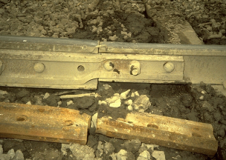
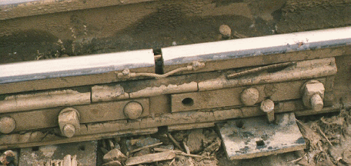
§ 213.121 Rail Joints
(a) Each rail joint, insulated joint, and compromise joint must be of a structurally sound design and dimensions for the rail on which it is applied.
105
Notes:
Guidance: For proper rail load transfer to occur, rail joints must contact the head and base of the rails when the bolts are tight. Many rail joint designs have been used with varying degrees of success, and the TSS does not attempt to single out any particular design as the only acceptable joint. This could inhibit innovation in modern track design.
Rail joints are considered to be a necessary discontinuity and require special attention by railroad maintenance personnel and safety Inspectors.
As far as possible, a rail joint should provide the same relative strength, stiffness, flexibility, and uniformity as the rail itself.
The TSS recognize these important aspects of rail joints and begin this section with a requirement that rail joints be of a structurally sound design and dimension for the rail on which they are applied. (FRA and AREMA/AAR is to convene a working group which will issue guidelines on which joint bars meet the definition of "structurally sound" for the purpose of interchangeability with different rail sections).
For proper rail-load transfer to occur, rail joints must contact the head and base of rail when the bolts are tight. Many rail-joint designs have been used with varying degrees of success, and the TSS do not attempt to single out any particular design as the only acceptable joint. This would inhibit innovation in modern track design.

Slide 106


§ 213.121 Rail Joints
(b) If a joint bar on Classes 3 through 5 track is cracked, broken, or because of wear allows excessive vertical movement of either rail when all bolts are tight, it must be replaced.
106
Notes:
Guidance. Joint bars are designed to fit into the space between the bottom of the rail head and rail base (fishing). With the bolts tight, the joint bars are wedged into the fishing space to provide lateral and vertical beam strength thereby supporting the abutting rail ends. When held up against the rail with bolts, joint bars contact the rail at two points; bottom of the rail head (or fillet) and top of the rail base.
Proper corrective action for a joint bar cracked or broken, other than center break, in Classes 3 through 5 track would be replacement or a reduction to Class 1 or 2. If both joint bars are cracked or broken between the 1st and 2nd bolt hole (including through the 2nd bolt hole) it should be considered Class 1 due to the fact that there is only one effective bolt in that end of the rail.

Slide 107


§ 213.121 Rail Joints
(c) If a joint bar is cracked or broken between the middle two bolt holes it must be replaced.
107
Notes:
Guidance: For a center-cracked or broken bar, the appropriate corrective action would be replacement or reduction to Class 1 speed under the provisions of §213.9(b).

Slide 108


§ 213.121 Rail Joints
(d) In the case of conventional jointed track, each rail must be bolted with at least two bolts at each joint in Classes 2 through 5 track, and with at least one bolt in Class 1 track.
108
Notes:
Guidance. Track owners must have the number of required bolts in each rail in a joint. This paragraph does not prescribe a tightness (torque) standard for each bolt. A bolt that no longer can support the joint bar against the rail will continue to provide resistance to pull aparts when the rail is in tension. The ability of the bolts to hold bars against the rail to support the abutting rail ends is covered under § 213.121(f).

Slide 109

§ 213.121 Rail Joints
(e) In the case of continuous welded rail track, each rail must be bolted with at least two bolts at each joint.
NOTE: this is also in §213.119(c)(1)
109
Notes:
Guidance. Rail, in lengths more than 400 feet, is considered CWR for purposes of applying the requirements of this paragraph. If there is only one bolt in a rail end at a joint, in a CWR string (400 feet or longer), that one bolt will be subject to all the tensile axial forces and will easily shear (break) resulting in a pull-apart.
It is important to maintain proper rail anchoring, neutral temperature, and adjustment records on CWR, otherwise pull-aparts can result. In addition, only one bolt in a rail end in CWR can also enhance the possibility of a pull-apart.

Slide 110

§ 213.121 Rail Joints
(f) Each joint bar must be held in position by track bolts tightened to allow the joint bar to firmly support the abutting rail ends and to allow longitudinal movement of the rail in the joint to accommodate expansion and contraction due to temperature variations. When no-slip, joint-to-rail contact exists by design, the requirements of this paragraph do not apply.
Those locations when over 400' in length, are considered to be continuous welded rail track and must meet all the requirements for continuous welded rail track prescribed in this part.
110
Notes:
Guidance. If the joint bars are loose, the joint is not in compliance with § 213.121(f). In addition, a joint assembly is not in compliance when inadequately tightened bolts prevent it from supporting the abutting rail ends under the expected traffic loads. Joint bolts can deteriorate sufficiently as to create a condition where the bars may become completely detached from the rail or cause a total lack of support, which can contribute to a broken rail. Such a condition can create a mismatch which exceeds the limits specified in § 213.115 (Rail end mismatch). In such a case, the defect would be rail end mismatch (class specific) and inspectors should also include a notation about the loose joint bars.

Slide 111

§ 213.121 Rail Joints
(g) No rail shall have a bolt hole which is torch cut or burned in Classes 2 through 5 track.
111
Notes:
Guidance. This paragraph prohibits the use of a rail containing a bolt hole that has been torch cut or burned in Classes 2 through 5 track.
Note - heat stress cracks in torch cut bolt hole.

Slide 112

§ 213.121 Rail Joints
(h) No joint bar shall be reconfigured by torch cutting in Classes 3 through 5 track.
112
Notes:
Guidance. This paragraph prohibits the reconfiguration of joint bars by torch cutting in Classes 3 through 5 track. By omission of the reference to Classes 1 and 2 track, this practice of reconfiguration is allowed in those classes. However, the joint bars that are reconfigured by torch cutting must meet certain criteria for structural soundness of design and dimension, which is required under (a) of this section.
Torch cut bolt hole in joint bar.

Slide 113
§ 213.121 Rail Joints
Compromise Joint Bar
115 RE Rail
Left Hand Out
Right Hand Out
Face joint from
between rails to determine hand
140 RE Rail
Left Hand Gage
Right Hand Gage
FRA Technical Training Material is Intended for Internal Instructional Purposes Only.
Do not distribute outside FRA or State Agency pursuant to 49 CFR Part 212
113
Notes:
The TSS only require structural soundness and bolt condition based on authorized operating train speed. Inspectors must be alert to locations where different rail sections are jointed by rail joints not designed as compromise joints and not identified as fitting both rail sections.

Slide 114
§ 213.122 Torch Cut Rail
(a) Except as a temporary repair in emergency situations no rail having a torch cut end shall be used in Classes 3 through 5 track. When a rail end is torch cut in emergency situations, speed over that rail end must not exceed the maximum allowable for Class 2 track. For existing torch cut rail ends in Classes 3 through 5 track the following shall apply --
(1) Within one year of the effective date of this rule, all torch cut rail ends in Class 5 track must be removed (9/21/99);
(2) Within two years of the effective date of this rule, all torch cut rail ends in Class 4 track must be removed (9/21/00); and
(3) Within one year of the effective date of this rule, all torch cut rail ends in Class 3 track over which regularly scheduled passenger trains operate, must be inventoried by the track owner (9/21/99).
114
Notes:
The regulation prohibits the torch cutting of rail ends in Classes 3 through 5 track except as a temporary repair in emergency situations. In such emergency situations, train speed shall not exceed the maximum allowable for Class 2 track.
Existing torch cuts must be removed from track in the following time frames:
Class 5 track - by September 21, 1999.
Class 4 track - by September 21, 2000.
Class 3 track with passenger trains - by September 21, 1999 all torch cuts shall be inventoried by the track owner.

Slide 115

§ 213.122 Torch Cut Rail
(b) Following the expiration of the time limits specified in (a)(1), (2), and (3) of this section, any torch cut rail end not removed from Classes 4 and 5 track, or any torch cut rail end not inventoried in Class 3 track over which regularly scheduled passenger trains operate, must be removed within 30 days of discovery. Speed over that rail end must not exceed the maximum allowable for Class 2 track until removed.
115
Notes:
Those torch cuts inventoried will be "grandfathered in" and any torch cuts found after the expiration of one year that are not inventoried must be slow ordered to Class 2 speed and removed within 30 days of discovery. If a railroad chooses to upgrade a segment of track to class 3, and passenger trains are operated, all torch cuts must be removed before speeds can exceed the maximum for Class 2 track. If a railroad chooses to upgrade a segment of track from any class to Class 4 or 5, it must remove all torch cuts.

Slide 116

§ 213.123 Tie Plates
(a) In Classes 3 through 5 track where timber crossties are in use there must be tie plates under the running rails on at least eight of any 10 consecutive ties.
(b) In Classes 3 through 5 track no metal object which causes a concentrated load by solely supporting a rail shall be allowed between the base of the rail and the bearing surface of the tie plate.
116
Notes:
Inspectors should consider this section jointly with the requirements for crossties and rail fastenings and report tie plate conditions as defects where safety is impaired by the absence of tie plates.
In Classes 3 through 5 track, no metal object which causes a concentrated load by solely supporting a rail shall be allowed between the base of rail and the bearing surface of the tie plate. The specific reference to "metal object" is intended to include only those items of track material which pose the greatest potential for broken base rails such as track spikes, rail anchors, and shoulders of tie plates. The phrase "causes a concentrated load by solely supporting a rail" further clarifies the intent of the regulation to apply only in those instances where there is clear physical evidence that the metal object is placing substantial load on the rail base, as indicated by lack of load on adjacent ties.

Slide 117

§ 213.123 Tie Plates
117
Notes:
A surfacing gang raised the frog and left a bearing load under the rail

Slide 118

§ 213.123 Stress Risers
118
Notes:
Here are some examples of how a bearing object as small as the aggregate from concrete tie can cause a stress riser which could lead to rail failure. I believe these broken rails were discovered on the BNSF, St. Joseph subdivision, north of St. Joseph, Missouri. You probably already know the details better than I do but I believe the primary cause was rail seat abrasion, concrete ties, on the heavy coal route. There were 17 of this type over a 24 hour period where the ambient temperature dropped to 40 degrees overnight.

Slide 119


§ 213.127 Rail Fastening
Systems
§ 213.127 (a) Track shall be fastened by a system of components that effectively maintains gage within the limits prescribed in § 213.53(b). Each component of each such system shall be evaluated to determine whether gage is effectively being maintained.
119
Notes:
Guidance.
Paragraph (a) “Rail fastening systems” include modern-day elastic fastening systems, which can consist of abrasion pads, insulator clips, shoulder inserts cast into concrete ties, as well as the fastener itself, of which many different designs are in use today. The fastening system can also be of the traditional cut spike variety, with or without tie plates. The failure of certain critical components within a particular system could adversely affect the ability of the individual fastener to provide adequate gage restraint. The wording of this regulation provides for an evaluation of all components within the system, if necessary, when degradation of the fastening system has resulted in problems maintaining gage within the limits prescribed in § 213.53(b).

Slide 120

§ 213.127 Rail Fastening
Systems
§ 213.127(b) If rail anchors are applied to concrete crossties, the combination of the crossties, fasteners, and rail anchors must provide effective longitudinal restraint.
120
Notes:
Guidance.
Paragraph (b) This paragraph requires that if rail anchors are applied to concrete crossties, then the combination of the crossties, fasteners, and rail anchors must provide effective longitudinal restraint. “Effective longitudinal restraint” is a performance-based standard.

Slide 121

§ 213.127 Rail Fastening
Systems
§ 213.127 (c) Where fastener placement impedes insulated joints from performing as intended, the fastener may be modified or removed, provided that the crosstie supports the rail.
121
Notes:
Guidance.
Paragraph (c) addresses instances where fastener placement impedes insulated joints from performing as intended by permitting the fastener to be modified or removed, provided that the crosstie supports the rail. “Support” means that the crosstie is in direct contact with the rail or leaves an incidental space between the tie and rail. Certain joint configurations do not permit conventional fasteners to fit properly. As a result, manufacturers offer a modified fastener to fit along the rail so that the fastener provides the longitudinal requirement, or it is removed completely, providing lateral restraint is accomplished by ensuring full contact with the rail or additional placement of anchors on the base of the rail.

Slide 122

§ 213.133 Turnouts & Track
Crossings; Generally
122
Notes:
Guidance A. There are several types of fastenings, which include reinforcing straps, connecting rods, rail hold down clips, and braces. (For a more extensive compilation of fastenings, see the fasteners listed in defect codes 213.133. Where fastenings are loose or missing, inspectors should cite the railroad using 213 defect code 0133A15 (Turnout or track crossing fastenings not intact or maintained.) In addition, where fasteners are loose or missing and there is an apparent contributing condition (e.g., a large section of the casting is broken out at an at-grade rail to rail crossing), inspectors should include a description of that contributing condition in their inspection report.

Slide 123

§ 213.133 Turnouts & Track
Crossings; Generally
L.S.T.
(Last Switch Tie)
Turnout
Switch
Closure
Frog
Straight stock rail
LH switch point
Heel
of
switch
Curved closure
Vertex
Through track side
RH switch point
Straight closure
Bent stock rail
Lead
½” P.F
(Half inch
Point of Frog)
P.S.
(Point of Switch)
123
Notes:
This illustration shows the three components that make up a turnout

Slide 124

§ 213.133 Turnouts & Track
Crossings; Generally
124

Slide 125


§ 213.133 Turnouts & Track
Crossings; Generally
(a) In turnouts and track crossings, the fastenings must be intact and maintained so as to keep the components securely in place. Also, each switch, frog, and guard rail must be kept free of obstructions that may interfere with the passage of wheels.
125
Notes:
Guidance A. There are several types of fastenings, which include reinforcing straps, connecting rods, rail hold down clips, and braces. (For a more extensive compilation of fastenings, see the fasteners listed in defect codes 213.133. Where fastenings are loose or missing, inspectors should cite the railroad using 213 defect code 0133A15 (Turnout or track crossing fastenings not intact or maintained.) In addition, where fasteners are loose or missing and there is an apparent contributing condition (e.g., a large section of the casting is broken out at an at-grade rail to rail crossing), inspectors should include a description of that contributing condition in their inspection report.

Slide 126

§ 213.133 Turnouts & Track
Crossings; Generally
Switch Clips
Clip Bolts
Connecting Rod
Rod fastening
Switch Rod
Switch Rod Bolts
Cotter Pins
Rigid Rail Braces
Adjustable Braces
Switch, Frog or Guard Rail Plates
Switch Point Stops
Frog Bolts
Guard Rail Clamps, Wedges, Separator Blocks
Fastenings not Maintained or intact
Obstruction Point & Stock
Obstruction Frog Flange
Obstruction flange of Guard Rail
126
Notes:
Paragraph “A” covers many components of the turnout – these slides are examples of these components.

Slide 127
§ 213.133 Turnouts & Track
Crossings; Generally
Switch Clips
Clip Bolts
Connecting Rod
Rod fastening
Switch Rod
Switch Rod Bolts
Cotter Pins
Rigid Rail Braces
Adjustable Braces
Switch, Frog or Guard Rail Plates
Switch Point Stops
Frog Bolts
Guard Rail Clamps, Wedges, Separator Blocks
Fastenings not Maintained or intact
Obstruction Point & Stock
Obstruction Frog Flange
Obstruction flange of Guard Rail
127
Notes:
Guidance A. There are several types of fastenings, which include reinforcing straps, connecting rods, rail hold down clips, and braces. (For a more extensive compilation of fastenings, see the fasteners listed in defect codes 213.133. Where fastenings are loose or missing, inspectors should cite the railroad using 213 defect code 0133A15 (Turnout or track crossing fastenings not intact or maintained.) In addition, where fasteners are loose or missing and there is an apparent contributing condition (e.g., a large section of the casting is broken out at an at-grade rail to rail crossing), inspectors should include a description of that contributing condition in their inspection report.

Slide 128

§ 213.133 Turnouts & Track
Crossings; Generally
Switch Clips
Clip Bolts
Connecting Rod
Rod fastening
Switch Rod
Switch Rod Bolts
Cotter Pins
Rigid Rail Braces
Adjustable Braces
Switch, Frog or Guard Rail Plates
Switch Point Stops
Frog Bolts
Guard Rail Clamps, Wedges, Separator Blocks
Fastenings not Maintained or intact
Obstruction Point & Stock
Obstruction Frog Flange
Obstruction flange of Guard Rail
128
Notes:
Guidance A. There are several types of fastenings, which include reinforcing straps, connecting rods, rail hold down clips, and braces. (For a more extensive compilation of fastenings, see the fasteners listed in defect codes 213.133. Where fastenings are loose or missing, inspectors should cite the railroad using 213 defect code 0133A15 (Turnout or track crossing fastenings not intact or maintained.) In addition, where fasteners are loose or missing and there is an apparent contributing condition (e.g., a large section of the casting is broken out at an at-grade rail to rail crossing), inspectors should include a description of that contributing condition in their inspection report.

Slide 129
§ 213.133 Turnouts & Track
Crossings; Generally
Switch Clips
Clip Bolts
Connecting Rod
Rod fastening
Switch Rod
Switch Rod Bolts
Cotter Pins
Rigid Rail Braces
Adjustable Braces
Switch, Frog or Guard Rail Plates
Switch Point Stops
Frog Bolts
Guard Rail Clamps, Wedges, Separator Blocks
Fastenings not Maintained or intact
Obstruction Point & Stock
Obstruction Frog Flange
Obstruction flange of Guard Rail
129
Notes:
Guidance A. There are several types of fastenings, which include reinforcing straps, connecting rods, rail hold down clips, and braces. (For a more extensive compilation of fastenings, see the fasteners listed in defect codes 213.133. Where fastenings are loose or missing, inspectors should cite the railroad using 213 defect code 0133A15 (Turnout or track crossing fastenings not intact or maintained.) In addition, where fasteners are loose or missing and there is an apparent contributing condition (e.g., a large section of the casting is broken out at an at-grade rail to rail crossing), inspectors should include a description of that contributing condition in their inspection report.

Slide 130

§ 213.133 Turnouts & Track
Crossings; Generally
Switch Clips
Clip Bolts
Connecting Rod
Rod fastening
Switch Rod
Switch Rod Bolts
Cotter Pins
Rigid Rail Braces
Adjustable Braces
Switch, Frog or Guard Rail Plates
Switch Point Stops
Frog Bolts
Guard Rail Clamps, Wedges, Separator Blocks
Fastenings not Maintained or intact
Obstruction Point & Stock
Obstruction Frog Flange
Obstruction flange of Guard Rail
130
Notes:
Guidance A. There are several types of fastenings, which include reinforcing straps, connecting rods, rail hold down clips, and braces. (For a more extensive compilation of fastenings, see the fasteners listed in defect codes 213.133. Where fastenings are loose or missing, inspectors should cite the railroad using 213 defect code 0133A15 (Turnout or track crossing fastenings not intact or maintained.) In addition, where fasteners are loose or missing and there is an apparent contributing condition (e.g., a large section of the casting is broken out at an at-grade rail to rail crossing), inspectors should include a description of that contributing condition in their inspection report.

Slide 131
§ 213.133 Turnouts & Track
Crossings; Generally
Switch Clips
Clip Bolts
Connecting Rod
Rod fastening
Switch Rod
Switch Rod Bolts
Cotter Pins
Rigid Rail Braces
Adjustable Braces
Switch, Frog or Guard Rail Plates
Switch Point Stops
Frog Bolts
Guard Rail Clamps, Wedges, Separator Blocks
Fastenings not Maintained or intact
Obstruction Point & Stock
Obstruction Frog Flange
Obstruction flange of Guard Rail
131
Notes:
Guidance A. There are several types of fastenings, which include reinforcing straps, connecting rods, rail hold down clips, and braces. (For a more extensive compilation of fastenings, see the fasteners listed in defect codes 213.133. Where fastenings are loose or missing, inspectors should cite the railroad using 213 defect code 0133A15 (Turnout or track crossing fastenings not intact or maintained.) In addition, where fasteners are loose or missing and there is an apparent contributing condition (e.g., a large section of the casting is broken out at an at-grade rail to rail crossing), inspectors should include a description of that contributing condition in their inspection report.

Slide 132


§ 213.133 Turnouts & Track
Crossings; Generally
Switch Clips
Clip Bolts
Connecting Rod
Rod fastening
Switch Rod
Switch Rod Bolts
Cotter Pins
Rigid Rail Braces
Adjustable Braces
Switch, Frog or Guard Rail Plates
Switch Point Stops
Frog Bolts
Guard Rail Clamps, Wedges, Separator Blocks
Fastenings not Maintained or intact
Obstruction Point & Stock
Obstruction Frog Flange
Obstruction flange of Guard Rail
132
Notes:
Guidance A. There are several types of fastenings, which include reinforcing straps, connecting rods, rail hold down clips, and braces. (For a more extensive compilation of fastenings, see the fasteners listed in defect codes 213.133. Where fastenings are loose or missing, inspectors should cite the railroad using 213 defect code 0133A15 (Turnout or track crossing fastenings not intact or maintained.) In addition, where fasteners are loose or missing and there is an apparent contributing condition (e.g., a large section of the casting is broken out at an at-grade rail to rail crossing), inspectors should include a description of that contributing condition in their inspection report.

Slide 133
§ 213.133 Turnouts & Track
Crossings; Generally
Switch Clips
Clip Bolts
Connecting Rod
Rod fastening
Switch Rod
Switch Rod Bolts
Cotter Pins
Rigid Rail Braces
Adjustable Braces
Switch, Frog or Guard Rail Plates
Switch Point Stops
Frog Bolts
Guard Rail Clamps, Wedges, Separator Blocks
Fastenings not Maintained or intact
Obstruction Point & Stock
Obstruction Frog Flange
Obstruction flange of Guard Rail
133
Notes:
Guidance A. There are several types of fastenings, which include reinforcing straps, connecting rods, rail hold down clips, and braces. (For a more extensive compilation of fastenings, see the fasteners listed in defect codes 213.133. Where fastenings are loose or missing, inspectors should cite the railroad using 213 defect code 0133A15 (Turnout or track crossing fastenings not intact or maintained.) In addition, where fasteners are loose or missing and there is an apparent contributing condition (e.g., a large section of the casting is broken out at an at-grade rail to rail crossing), inspectors should include a description of that contributing condition in their inspection report.

Slide 134


§ 213.133 Turnouts & Track
Crossings; Generally
Switch Clips
Clip Bolts
Connecting Rod
Rod fastening
Switch Rod
Switch Rod Bolts
Cotter Pins
Rigid Rail Braces
Adjustable Braces
Switch, Frog or Guard Rail Plates
Switch Point Stops
Frog Bolts
Guard Rail Clamps, Wedges, Separator Blocks
Fastenings not Maintained or intact
Obstruction Point & Stock
Obstruction Frog Flange
Obstruction flange of Guard Rail
134
Notes:
Guidance A. There are several types of fastenings, which include reinforcing straps, connecting rods, rail hold down clips, and braces. (For a more extensive compilation of fastenings, see the fasteners listed in defect codes 213.133. Where fastenings are loose or missing, inspectors should cite the railroad using 213 defect code 0133A15 (Turnout or track crossing fastenings not intact or maintained.) In addition, where fasteners are loose or missing and there is an apparent contributing condition (e.g., a large section of the casting is broken out at an at-grade rail to rail crossing), inspectors should include a description of that contributing condition in their inspection report.

Slide 135
§ 213.133 Turnouts & Track
Crossings; Generally
Switch Clips
Clip Bolts
Connecting Rod
Rod fastening
Switch Rod
Switch Rod Bolts
Cotter Pins
Rigid Rail Braces
Adjustable Braces
Switch, Frog or Guard Rail Plates
Switch Point Stops
Frog Bolts
Guard Rail Clamps, Wedges, Separator Blocks
Fastenings not Maintained or intact
Obstruction Point & Stock
Obstruction Frog Flange
Obstruction flange of Guard Rail
135
Notes:
Guidance A. There are several types of fastenings, which include reinforcing straps, connecting rods, rail hold down clips, and braces. (For a more extensive compilation of fastenings, see the fasteners listed in defect codes 213.133. Where fastenings are loose or missing, inspectors should cite the railroad using 213 defect code 0133A15 (Turnout or track crossing fastenings not intact or maintained.) In addition, where fasteners are loose or missing and there is an apparent contributing condition (e.g., a large section of the casting is broken out at an at-grade rail to rail crossing), inspectors should include a description of that contributing condition in their inspection report.

Slide 136

§ 213.133 Turnouts & Track
Crossings; Generally
Switch Clips
Clip Bolts
Connecting Rod
Rod fastening
Switch Rod
Switch Rod Bolts
Cotter Pins
Rigid Rail Braces
Adjustable Braces
Switch, Frog or Guard Rail Plates
Switch Point Stops
Frog Bolts
Guard Rail Clamps, Wedges, Separator Blocks
Fastenings not Maintained or intact
Obstruction Point & Stock
Obstruction Frog Flange
Obstruction flange of Guard Rail
136
Notes:
Guidance A. There are several types of fastenings, which include reinforcing straps, connecting rods, rail hold down clips, and braces. (For a more extensive compilation of fastenings, see the fasteners listed in defect codes 213.133. Where fastenings are loose or missing, inspectors should cite the railroad using 213 defect code 0133A15 (Turnout or track crossing fastenings not intact or maintained.) In addition, where fasteners are loose or missing and there is an apparent contributing condition (e.g., a large section of the casting is broken out at an at-grade rail to rail crossing), inspectors should include a description of that contributing condition in their inspection report.

Slide 137
§ 213.133 Turnouts & Track
Crossings; Generally
Switch Clips
Clip Bolts
Connecting Rod
Rod fastening
Switch Rod
Switch Rod Bolts
Cotter Pins
Rigid Rail Braces
Adjustable Braces
Switch, Frog or Guard Rail Plates
Switch Point Stops
Frog Bolts
Guard Rail Clamps, Wedges, Separator Blocks
Fastenings not Maintained or intact
Obstruction Point & Stock
Obstruction Frog Flange
Obstruction flange of Guard Rail
137
Notes:
Guidance A. There are several types of fastenings, which include reinforcing straps, connecting rods, rail hold down clips, and braces. (For a more extensive compilation of fastenings, see the fasteners listed in defect codes 213.133. Where fastenings are loose or missing, inspectors should cite the railroad using 213 defect code 0133A15 (Turnout or track crossing fastenings not intact or maintained.) In addition, where fasteners are loose or missing and there is an apparent contributing condition (e.g., a large section of the casting is broken out at an at-grade rail to rail crossing), inspectors should include a description of that contributing condition in their inspection report.

Slide 138
§ 213.133 Turnouts & Track
Crossings; Generally
Switch Clips
Clip Bolts
Connecting Rod
Rod fastening
Switch Rod
Switch Rod Bolts
Cotter Pins
Rigid Rail Braces
Adjustable Braces
Switch, Frog or Guard Rail Plates
Switch Point Stops
Frog Bolts
Guard Rail Clamps, Wedges, Separator Blocks
Fastenings not Maintained or intact
Obstruction Point & Stock
Obstruction Frog Flange
Obstruction flange of Guard Rail
138
Notes:
Guidance A. There are several types of fastenings, which include reinforcing straps, connecting rods, rail hold down clips, and braces. (For a more extensive compilation of fastenings, see the fasteners listed in defect codes 213.133. Where fastenings are loose or missing, inspectors should cite the railroad using 213 defect code 0133A15 (Turnout or track crossing fastenings not intact or maintained.) In addition, where fasteners are loose or missing and there is an apparent contributing condition (e.g., a large section of the casting is broken out at an at-grade rail to rail crossing), inspectors should include a description of that contributing condition in their inspection report.

Slide 139


§ 213.133 Turnouts & Track
Crossings; Generally
Switch Clips
Clip Bolts
Connecting Rod
Rod fastening
Switch Rod
Switch Rod Bolts
Cotter Pins
Rigid Rail Braces
Adjustable Braces
Switch, Frog or Guard Rail Plates
Switch Point Stops
Frog Bolts
Guard Rail Clamps, Wedges, Separator Blocks
Fastenings not Maintained or intact
Obstruction Point & Stock
Obstruction Frog Flange
Obstruction flange of Guard Rail
139
Notes:
Guidance A. There are several types of fastenings, which include reinforcing straps, connecting rods, rail hold down clips, and braces. (For a more extensive compilation of fastenings, see the fasteners listed in defect codes 213.133. Where fastenings are loose or missing, inspectors should cite the railroad using 213 defect code 0133A15 (Turnout or track crossing fastenings not intact or maintained.) In addition, where fasteners are loose or missing and there is an apparent contributing condition (e.g., a large section of the casting is broken out at an at-grade rail to rail crossing), inspectors should include a description of that contributing condition in their inspection report.

Slide 140
§ 213.133 Turnouts & Track
Crossings; Generally
Switch Clips
Clip Bolts
Connecting Rod
Rod fastening
Switch Rod
Switch Rod Bolts
Cotter Pins
Rigid Rail Braces
Adjustable Braces
Switch, Frog or Guard Rail Plates
Switch Point Stops
Frog Bolts
Guard Rail Clamps, Wedges, Separator Blocks
Fastenings not Maintained or intact
Obstruction Point & Stock
Obstruction Frog Flange
Obstruction flange of Guard Rail
140
Notes:
Guidance A. There are several types of fastenings, which include reinforcing straps, connecting rods, rail hold down clips, and braces. (For a more extensive compilation of fastenings, see the fasteners listed in defect codes 213.133. Where fastenings are loose or missing, inspectors should cite the railroad using 213 defect code 0133A15 (Turnout or track crossing fastenings not intact or maintained.) In addition, where fasteners are loose or missing and there is an apparent contributing condition (e.g., a large section of the casting is broken out at an at-grade rail to rail crossing), inspectors should include a description of that contributing condition in their inspection report.

Slide 141

§ 213.133 Turnouts & Track
Crossings; Generally
Switch Clips
Clip Bolts
Connecting Rod
Rod fastening
Switch Rod
Switch Rod Bolts
Cotter Pins
Rigid Rail Braces
Adjustable Braces
Switch, Frog or Guard Rail Plates
Switch Point Stops
Frog Bolts
Guard Rail Clamps, Wedges, Separator Blocks
Fastenings not Maintained or intact
Obstruction Point & Stock
Obstruction Frog Flange
Obstruction flange of Guard Rail
141
Notes:
Guidance A. There are several types of fastenings, which include reinforcing straps, connecting rods, rail hold down clips, and braces. (For a more extensive compilation of fastenings, see the fasteners listed in defect codes 213.133. Where fastenings are loose or missing, inspectors should cite the railroad using 213 defect code 0133A15 (Turnout or track crossing fastenings not intact or maintained.) In addition, where fasteners are loose or missing and there is an apparent contributing condition (e.g., a large section of the casting is broken out at an at-grade rail to rail crossing), inspectors should include a description of that contributing condition in their inspection report.

Slide 142

§ 213.133 Turnouts & Track
Crossings; Generally
Switch Clips
Clip Bolts
Connecting Rod
Rod fastening
Switch Rod
Switch Rod Bolts
Cotter Pins
Rigid Rail Braces
Adjustable Braces
Switch, Frog or Guard Rail Plates
Switch Point Stops
Frog Bolts
Guard Rail Clamps, Wedges, Separator Blocks
Fastenings not Maintained or intact
Obstruction Point & Stock
Obstruction Frog Flange
Obstruction flange of Guard Rail
142
Notes:
Guidance A. There are several types of fastenings, which include reinforcing straps, connecting rods, rail hold down clips, and braces. (For a more extensive compilation of fastenings, see the fasteners listed in defect codes 213.133. Where fastenings are loose or missing, inspectors should cite the railroad using 213 defect code 0133A15 (Turnout or track crossing fastenings not intact or maintained.) In addition, where fasteners are loose or missing and there is an apparent contributing condition (e.g., a large section of the casting is broken out at an at-grade rail to rail crossing), inspectors should include a description of that contributing condition in their inspection report.

Slide 143
§ 213.133 Turnouts & Track
Crossings; Generally
Switch Clips
Clip Bolts
Connecting Rod
Rod fastening
Switch Rod
Switch Rod Bolts
Cotter Pins
Rigid Rail Braces
Adjustable Braces
Switch, Frog or Guard Rail Plates
Switch Point Stops
Frog Bolts
Guard Rail Clamps, Wedges, Separator Blocks
Fastenings not Maintained or intact
Obstruction Point & Stock
Obstruction Frog Flange
Obstruction flange of Guard Rail
143
Notes:
Guidance A. There are several types of fastenings, which include reinforcing straps, connecting rods, rail hold down clips, and braces. (For a more extensive compilation of fastenings, see the fasteners listed in defect codes 213.133. Where fastenings are loose or missing, inspectors should cite the railroad using 213 defect code 0133A15 (Turnout or track crossing fastenings not intact or maintained.) In addition, where fasteners are loose or missing and there is an apparent contributing condition (e.g., a large section of the casting is broken out at an at-grade rail to rail crossing), inspectors should include a description of that contributing condition in their inspection report.

Slide 144

§ 213.133 Turnouts & Track
Crossings; Generally
Switch Clips
Clip Bolts
Connecting Rod
Rod fastening
Switch Rod
Switch Rod Bolts
Cotter Pins
Rigid Rail Braces
Adjustable Braces
Switch, Frog or Guard Rail Plates
Switch Point Stops
Frog Bolts
Guard Rail Clamps, Wedges, Separator Blocks
Fastenings not Maintained or intact
Obstruction Point & Stock
Obstruction Frog Flange
Obstruction flange of Guard Rail
144
Notes:
Guidance A. There are several types of fastenings, which include reinforcing straps, connecting rods, rail hold down clips, and braces. (For a more extensive compilation of fastenings, see the fasteners listed in defect codes 213.133. Where fastenings are loose or missing, inspectors should cite the railroad using 213 defect code 0133A15 (Turnout or track crossing fastenings not intact or maintained.) In addition, where fasteners are loose or missing and there is an apparent contributing condition (e.g., a large section of the casting is broken out at an at-grade rail to rail crossing), inspectors should include a description of that contributing condition in their inspection report.

Slide 145
§ 213.133 Turnouts & Track
Crossings; Generally
Switch Clips
Clip Bolts
Connecting Rod
Rod fastening
Switch Rod
Switch Rod Bolts
Cotter Pins
Rigid Rail Braces
Adjustable Braces
Switch, Frog or Guard Rail Plates
Switch Point Stops
Frog Bolts
Guard Rail Clamps, Wedges, Separator Blocks
Fastenings not Maintained or intact
Obstruction Point & Stock
Obstruction Frog Flange
Obstruction flange of Guard Rail
145
Notes:
Guidance A. There are several types of fastenings, which include reinforcing straps, connecting rods, rail hold down clips, and braces. (For a more extensive compilation of fastenings, see the fasteners listed in defect codes 213.133. Where fastenings are loose or missing, inspectors should cite the railroad using 213 defect code 0133A15 (Turnout or track crossing fastenings not intact or maintained.) In addition, where fasteners are loose or missing and there is an apparent contributing condition (e.g., a large section of the casting is broken out at an at-grade rail to rail crossing), inspectors should include a description of that contributing condition in their inspection report.

Slide 146

§ 213.133 Turnouts & Track
Crossings; Generally
Switch Clips
Clip Bolts
Connecting Rod
Rod fastening
Switch Rod
Switch Rod Bolts
Cotter Pins
Rigid Rail Braces
Adjustable Braces
Switch, Frog or Guard Rail Plates
Switch Point Stops
Frog Bolts
Guard Rail Clamps, Wedges, Separator Blocks
Fastenings not Maintained or intact
Obstruction Point & Stock
Obstruction Frog Flange
Obstruction flange of Guard Rail
146
Notes:
Guidance A. There are several types of fastenings, which include reinforcing straps, connecting rods, rail hold down clips, and braces. (For a more extensive compilation of fastenings, see the fasteners listed in defect codes 213.133. Where fastenings are loose or missing, inspectors should cite the railroad using 213 defect code 0133A15 (Turnout or track crossing fastenings not intact or maintained.) In addition, where fasteners are loose or missing and there is an apparent contributing condition (e.g., a large section of the casting is broken out at an at-grade rail to rail crossing), inspectors should include a description of that contributing condition in their inspection report.

Slide 147
§ 213.133 Turnouts & Track
Crossings; Generally
Switch Clips
Clip Bolts
Connecting Rod
Rod fastening
Switch Rod
Switch Rod Bolts
Cotter Pins
Rigid Rail Braces
Adjustable Braces
Switch, Frog or Guard Rail Plates
Switch Point Stops
Frog Bolts
Guard Rail Clamps, Wedges, Separator Blocks
Fastenings not Maintained or intact
Obstruction Point & Stock
Obstruction Frog Flange
Obstruction flange of Guard Rail
147
Notes:
Guidance A. There are several types of fastenings, which include reinforcing straps, connecting rods, rail hold down clips, and braces. (For a more extensive compilation of fastenings, see the fasteners listed in defect codes 213.133. Where fastenings are loose or missing, inspectors should cite the railroad using 213 defect code 0133A15 (Turnout or track crossing fastenings not intact or maintained.) In addition, where fasteners are loose or missing and there is an apparent contributing condition (e.g., a large section of the casting is broken out at an at-grade rail to rail crossing), inspectors should include a description of that contributing condition in their inspection report.

Slide 148

§ 213.133 Turnouts & Track
Crossings; Generally
Switch Clips
Clip Bolts
Connecting Rod
Rod fastening
Switch Rod
Switch Rod Bolts
Cotter Pins
Rigid Rail Braces
Adjustable Braces
Switch, Frog or Guard Rail Plates
Switch Point Stops
Frog Bolts
Guard Rail Clamps, Wedges, Separator Blocks
Fastenings not Maintained or intact
Obstruction Point & Stock
Obstruction Frog Flange
Obstruction flange of Guard Rail
148
Notes:
Guidance A. There are several types of fastenings, which include reinforcing straps, connecting rods, rail hold down clips, and braces. (For a more extensive compilation of fastenings, see the fasteners listed in defect codes 213.133. Where fastenings are loose or missing, inspectors should cite the railroad using 213 defect code 0133A15 (Turnout or track crossing fastenings not intact or maintained.) In addition, where fasteners are loose or missing and there is an apparent contributing condition (e.g., a large section of the casting is broken out at an at-grade rail to rail crossing), inspectors should include a description of that contributing condition in their inspection report.

Slide 149
§ 213.133 Turnouts & Track
Crossings; Generally
Switch Clips
Clip Bolts
Connecting Rod
Rod fastening
Switch Rod
Switch Rod Bolts
Cotter Pins
Rigid Rail Braces
Adjustable Braces
Switch, Frog or Guard Rail Plates
Switch Point Stops
Frog Bolts
Guard Rail Clamps, Wedges, Separator Blocks
Fastenings not Maintained or intact
Obstruction Point & Stock
Obstruction Frog Flange
Obstruction flange of Guard Rail
149
Notes:
Guidance A. There are several types of fastenings, which include reinforcing straps, connecting rods, rail hold down clips, and braces. (For a more extensive compilation of fastenings, see the fasteners listed in defect codes 213.133. Where fastenings are loose or missing, inspectors should cite the railroad using 213 defect code 0133A15 (Turnout or track crossing fastenings not intact or maintained.) In addition, where fasteners are loose or missing and there is an apparent contributing condition (e.g., a large section of the casting is broken out at an at-grade rail to rail crossing), inspectors should include a description of that contributing condition in their inspection report.

Slide 150

§ 213.133 Turnouts & Track
Crossings; Generally
Switch Clips
Clip Bolts
Connecting Rod
Rod fastening
Switch Rod
Switch Rod Bolts
Cotter Pins
Rigid Rail Braces
Adjustable Braces
Switch, Frog or Guard Rail Plates
Switch Point Stops
Frog Bolts
Guard Rail Clamps, Wedges, Separator Blocks
Fastenings not Maintained or intact
Obstruction Point & Stock
Obstruction Frog Flange
Obstruction flange of Guard Rail
150
Notes:
Guidance A. There are several types of fastenings, which include reinforcing straps, connecting rods, rail hold down clips, and braces. (For a more extensive compilation of fastenings, see the fasteners listed in defect codes 213.133. Where fastenings are loose or missing, inspectors should cite the railroad using 213 defect code 0133A15 (Turnout or track crossing fastenings not intact or maintained.) In addition, where fasteners are loose or missing and there is an apparent contributing condition (e.g., a large section of the casting is broken out at an at-grade rail to rail crossing), inspectors should include a description of that contributing condition in their inspection report.

Slide 151
§ 213.133 Turnouts & Track
Crossings; Generally
Switch Clips
Clip Bolts
Connecting Rod
Rod fastening
Switch Rod
Switch Rod Bolts
Cotter Pins
Rigid Rail Braces
Adjustable Braces
Switch, Frog or Guard Rail Plates
Switch Point Stops
Frog Bolts
Guard Rail Clamps, Wedges, Separator Blocks
Fastenings not Maintained or intact
Obstruction Point & Stock
Obstruction Frog Flange
Obstruction flange of Guard Rail
151
Notes:
Guidance A. There are several types of fastenings, which include reinforcing straps, connecting rods, rail hold down clips, and braces. (For a more extensive compilation of fastenings, see the fasteners listed in defect codes 213.133. Where fastenings are loose or missing, inspectors should cite the railroad using 213 defect code 0133A15 (Turnout or track crossing fastenings not intact or maintained.) In addition, where fasteners are loose or missing and there is an apparent contributing condition (e.g., a large section of the casting is broken out at an at-grade rail to rail crossing), inspectors should include a description of that contributing condition in their inspection report.

Slide 152

§ 213.133 Turnouts & Track
Crossings; Generally
Switch Clips
Clip Bolts
Connecting Rod
Rod fastening
Switch Rod
Switch Rod Bolts
Cotter Pins
Rigid Rail Braces
Adjustable Braces
Switch, Frog or Guard Rail Plates
Switch Point Stops
Frog Bolts
Guard Rail Clamps, Wedges, Separator Blocks
Fastenings not Maintained or intact
Obstruction Point & Stock
Obstruction Frog Flange
Obstruction flange of Guard Rail
152
Notes:
Guidance A. There are several types of fastenings, which include reinforcing straps, connecting rods, rail hold down clips, and braces. (For a more extensive compilation of fastenings, see the fasteners listed in defect codes 213.133. Where fastenings are loose or missing, inspectors should cite the railroad using 213 defect code 0133A15 (Turnout or track crossing fastenings not intact or maintained.) In addition, where fasteners are loose or missing and there is an apparent contributing condition (e.g., a large section of the casting is broken out at an at-grade rail to rail crossing), inspectors should include a description of that contributing condition in their inspection report.

Slide 153
§ 213.133 Turnouts & Track
Crossings; Generally
Switch Clips
Clip Bolts
Connecting Rod
Rod fastening
Switch Rod
Switch Rod Bolts
Cotter Pins
Rigid Rail Braces
Adjustable Braces
Switch, Frog or Guard Rail Plates
Switch Point Stops
Frog Bolts
Guard Rail Clamps, Wedges, Separator Blocks
T.O. or Crossing Fastenings not Maintained or intact
Obstruction Point & Stock
Obstruction Frog Flange
Obstruction flange of Guard Rail
153
Notes:
Guidance A. There are several types of fastenings, which include reinforcing straps, connecting rods, rail hold down clips, and braces. (For a more extensive compilation of fastenings, see the fasteners listed in defect codes 213.133. Where fastenings are loose or missing, inspectors should cite the railroad using 213 defect code 0133A15 (Turnout or track crossing fastenings not intact or maintained.) In addition, where fasteners are loose or missing and there is an apparent contributing condition (e.g., a large section of the casting is broken out at an at-grade rail to rail crossing), inspectors should include a description of that contributing condition in their inspection report.

Slide 154

§ 213.133 Turnouts & Track
Crossings; Generally
Switch Clips
Clip Bolts
Connecting Rod
Rod fastening
Switch Rod
Switch Rod Bolts
Cotter Pins
Rigid Rail Braces
Adjustable Braces
Switch, Frog or Guard Rail Plates
Switch Point Stops
Frog Bolts
Guard Rail Clamps, Wedges, Separator Blocks
T.O. or Crossing Fastenings not Maintained or intact
Obstruction Point & Stock
Obstruction Frog Flange
Obstruction flange of Guard Rail
154
Notes:
Guidance A. There are several types of fastenings, which include reinforcing straps, connecting rods, rail hold down clips, and braces. (For a more extensive compilation of fastenings, see the fasteners listed in defect codes 213.133. Where fastenings are loose or missing, inspectors should cite the railroad using 213 defect code 0133A15 (Turnout or track crossing fastenings not intact or maintained.) In addition, where fasteners are loose or missing and there is an apparent contributing condition (e.g., a large section of the casting is broken out at an at-grade rail to rail crossing), inspectors should include a description of that contributing condition in their inspection report.

Slide 155

§ 213.133 Turnouts & Track
Crossings; Generally
Switch Clips
Clip Bolts
Connecting Rod
Rod fastening
Switch Rod
Switch Rod Bolts
Cotter Pins
Rigid Rail Braces
Adjustable Braces
Switch, Frog or Guard Rail Plates
Switch Point Stops
Frog Bolts
Guard Rail Clamps, Wedges, Separator Blocks
T.O. or Crossing Fastenings not Maintained or intact
Obstruction Point & Stock
Obstruction Frog Flange
Obstruction flange of Guard Rail
155
Notes:
Guidance A. There are several types of fastenings, which include reinforcing straps, connecting rods, rail hold down clips, and braces. (For a more extensive compilation of fastenings, see the fasteners listed in defect codes 213.133. Where fastenings are loose or missing, inspectors should cite the railroad using 213 defect code 0133A15 (Turnout or track crossing fastenings not intact or maintained.) In addition, where fasteners are loose or missing and there is an apparent contributing condition (e.g., a large section of the casting is broken out at an at-grade rail to rail crossing), inspectors should include a description of that contributing condition in their inspection report.

Slide 156

§ 213.133 Turnouts & Track
Crossings; Generally
Switch Clips
Clip Bolts
Connecting Rod
Rod fastening
Switch Rod
Switch Rod Bolts
Cotter Pins
Rigid Rail Braces
Adjustable Braces
Switch, Frog or Guard Rail Plates
Switch Point Stops
Frog Bolts
Guard Rail Clamps, Wedges, Separator Blocks
T.O. or Crossing Fastenings not Maintained or intact
Obstruction Point & Stock
Obstruction Frog Flange
Obstruction flange of Guard Rail
156
Notes:
Guidance A. There are several types of fastenings, which include reinforcing straps, connecting rods, rail hold down clips, and braces. (For a more extensive compilation of fastenings, see the fasteners listed in defect codes 213.133. Where fastenings are loose or missing, inspectors should cite the railroad using 213 defect code 0133A15 (Turnout or track crossing fastenings not intact or maintained.) In addition, where fasteners are loose or missing and there is an apparent contributing condition (e.g., a large section of the casting is broken out at an at-grade rail to rail crossing), inspectors should include a description of that contributing condition in their inspection report.

Slide 157
§ 213.133 Turnouts & Track
Crossings; Generally
Switch Clips
Clip Bolts
Connecting Rod
Rod fastening
Switch Rod
Switch Rod Bolts
Cotter Pins
Rigid Rail Braces
Adjustable Braces
Switch, Frog or Guard Rail Plates
Switch Point Stops
Frog Bolts
Guard Rail Clamps, Wedges, Separator Blocks
Fastenings not Maintained or intact
Obstruction Point & Stock
Obstruction Frog Flange
Obstruction flange of Guard Rail
157
Notes:
Guidance A. There are several types of fastenings, which include reinforcing straps, connecting rods, rail hold down clips, and braces. (For a more extensive compilation of fastenings, see the fasteners listed in defect codes 213.133. Where fastenings are loose or missing, inspectors should cite the railroad using 213 defect code 0133A15 (Turnout or track crossing fastenings not intact or maintained.) In addition, where fasteners are loose or missing and there is an apparent contributing condition (e.g., a large section of the casting is broken out at an at-grade rail to rail crossing), inspectors should include a description of that contributing condition in their inspection report.

Slide 158
§ 213.133 Turnouts & Track
Crossings; Generally
Switch Clips
Clip Bolts
Connecting Rod
Rod fastening
Switch Rod
Switch Rod Bolts
Cotter Pins
Rigid Rail Braces
Adjustable Braces
Switch, Frog or Guard Rail Plates
Switch Point Stops
Frog Bolts
Guard Rail Clamps, Wedges, Separator Blocks
Fastenings not Maintained or intact
Obstruction Point & Stock
Obstruction Frog Flange
Obstruction flange of Guard Rail
158
Notes:
Guidance A. There are several types of fastenings, which include reinforcing straps, connecting rods, rail hold down clips, and braces. (For a more extensive compilation of fastenings, see the fasteners listed in defect codes 213.133. Where fastenings are loose or missing, inspectors should cite the railroad using 213 defect code 0133A15 (Turnout or track crossing fastenings not intact or maintained.) In addition, where fasteners are loose or missing and there is an apparent contributing condition (e.g., a large section of the casting is broken out at an at-grade rail to rail crossing), inspectors should include a description of that contributing condition in their inspection report.

Slide 159
§ 213.133 Turnouts & Track
Crossings; Generally
Switch Clips
Clip Bolts
Connecting Rod
Rod fastening
Switch Rod
Switch Rod Bolts
Cotter Pins
Rigid Rail Braces
Adjustable Braces
Switch, Frog or Guard Rail Plates
Switch Point Stops
Frog Bolts
Guard Rail Clamps, Wedges, Separator Blocks
Fastenings not Maintained or intact
Obstruction Point & Stock
Obstruction Frog Flange
Obstruction flange of Guard Rail
159
Notes:
Guidance A. There are several types of fastenings, which include reinforcing straps, connecting rods, rail hold down clips, and braces. (For a more extensive compilation of fastenings, see the fasteners listed in defect codes 213.133. Where fastenings are loose or missing, inspectors should cite the railroad using 213 defect code 0133A15 (Turnout or track crossing fastenings not intact or maintained.) In addition, where fasteners are loose or missing and there is an apparent contributing condition (e.g., a large section of the casting is broken out at an at-grade rail to rail crossing), inspectors should include a description of that contributing condition in their inspection report.

Slide 160


§ 213.133 Turnouts & Track
Crossings; Generally
(b) Classes 3 through 5 track must be equipped with rail anchoring through and on each side of track crossings and turnouts, to restrain rail movement affecting the position of switch points and frogs.
160
Notes:
Guidance. A turnout is a track arrangement consisting of a switch and frog extending from the point of the switch to the heel of the frog. This arrangement allows engines and cars to pass from one track to another. Because of the operating or movable parts and lateral thrust, it is essential that fastenings be in place, tight, and in sound condition.
􀁸 Restrain rail.
􀁸 Assure proper fit of switch points.
􀁸 Prevent line irregularities.
Ties and timbers at switches and crossings must be of sound condition, well-tamped, and the roadbed must be adequately drained

Slide 161


§ 213.133 Turnouts & Track
Crossings; Generally
(c) Each flangeway at turnouts and track crossings must be at least 1-1/2" wide.
161
Notes:
.

Slide 162

§ 213.135 Switches
(a) Each stock rail must be securely seated in switch plates, but care must be used to avoid canting the rail by over tightening the rail braces.
162
Notes:
Guidance A. The TSS under § 213.135 specifies the requirements for switch restraint, movement, and fit. Each stock rail must be securely seated in the switch plates. Various conditions, such as loose braces or hanging ties, can cause a stock rail to become unseated. In these situations, inspectors should cite the railroad with 213 defect code 0135A1. Alternatively, a stock rail can become unseated if the braces are over tightened during maintenance. In these situations, inspectors should cite the railroad with 213 defect code 0135A2.

Slide 163


§ 213.135 Switches
(b) Each switch point must fit its stock rail properly, with the switch stand in either of its closed positions to allow wheels to pass the switch point. Lateral and vertical movement of a stock rail in the switch plates or of a switch plate on a tie must not adversely affect the fit of the switch point to the stock rail.
163
Notes:
Guidance B. This paragraph recognizes the existence of reinforcing bars or straps on switch points where joint bars cannot be applied to certain rail defects, as required under § 213.113(a)(2), because of the physical configuration of the switch. In these instances, remedial action B will govern, and a person designated under § 213.7(a), who has at least 1 year of supervisory experience in track maintenance, will limit train speed to that not exceeding 30 mph or the maximum allowable under § 213.9(a) for the appropriate class of track, whichever is lower. Of course, the person may exercise the options under § 213.5(a) when appropriate.

Slide 164

§ 213.135 Switches
(b) (Continued) Broken or cracked switch point rails will be subject to the requirements of 213.113, except that where remedial actions C, D, or E require the use of joint bars, and joint bars cannot be placed due to the physical configuration of the switch, remedial action B will govern, taking into account any added safety provided by the presence of reinforcing bars on the switch points.
164
Notes:
Paragraph (b) [second section of paragraph] considers the existence of reinforcing bars or straps on switch points where joint bars cannot be applied to certain rail defects, as required under §213.113(a)(2), because of the physical configuration of the switch. In these instances, remedial action B (see below) will govern, and a person designated under §213.7(a), who has at least one year of supervisory experience in track maintenance, will limit train speed to that not exceeding 30 m.p.h. or the maximum allowable under §213.9(a) for the appropriate class of track, whichever is lower. Of course, the person may exercise the options under §213.5(a) when appropriate.
“B” Limit operating speed over defective rail to that as authorized by a person designated under 213.7(a), who has at least one year of supervisory experience in railroad track maintenance. The operating speed cannot be over 30 mph or the maximum allowable speed under 213.9 for the class of track concerned, whichever is lower.

Slide 165


§ 213.135 Switches
(c) Each switch must be maintained so that the outer edge of the wheel tread cannot contact the gage side of the stock rail.
165
Notes:
Notes
This paragraph addresses the outer edge wheel contact of the gage side of stock rails. This defect is a concern for trailing movements when the tread of the switch rail is even or lower than the tread of the stock rail. By design the tread of the switch rail is about 1/4 inch higher than the stock rail. The left photo shows the grove worn onto the gage of a stock rail (a new stock rail was installed without replacing the worn switch point).

Slide 166

§ 213.135 Switches
Is this a defect in class One Track?
166
Notes:
Notes
An insecure switch heel can cause vertical and lateral movement at the tip of the point. Heel blocks must be fully bolted. However, in five hole or six hole heel block at a minimum there must be two bolts per rail end.
Guidance. At least two tight bolts in each rail are required to ensure that the heel of each switch rail is “secure” for purposes of determining compliance with § 213.135(d). Examine the heel block, its fastenings, and bars; or, in the absence of a heel block, (which is known as a floating heel block) examine that assembly.
The photo above illustrates an example where 213.9(b) is the required remedial action.

Slide 167
§ 213.135 Switches
(d) The heel of each switch rail must be secure and the bolts in each heel must be kept tight.
167
Notes:
Notes
An insecure switch heel can cause vertical and lateral movement at the tip of the point. Heel blocks must be fully bolted. However, in five hole or six hole heel block at a minimum there must be two bolts per rail end.
Guidance. At least two tight bolts in each rail are required to ensure that the heel of each switch rail is “secure” for purposes of determining compliance with § 213.135(d). Examine the heel block, its fastenings, and bars; or, in the absence of a heel block, (which is known as a floating heel block) examine that assembly.
The photo above illustrates an example where 213.9(b) is the required remedial action.

Slide 168


§ 213.135 Switches
(e) Each switch stand and connecting rod must be securely fastened and operable without excessive lost motion.
168
Notes:
Notes
Insecure switch stand caused by defective head block timber can cause lost motion resulting in improper fit between the switch point and stock rail.
Guidance. For hand-operated switch stands of virtually all types, rotary motion imparted to the vertical spindle within the stand by the person operating the hand lever is translated into (practically) linear movement of the connecting rod by the right angle combination of the end of the spindle beneath the stand and its attached crank.

Slide 169

§ 213.135 Switches
(f) Each throw lever must be maintained so that it cannot be operated with the lock or keeper in place.
169
Notes:
Notes
Switch stands designed with a lock or keeper must not be able to allow the switch handle to be operated when the switch handle is in keeper (latch)
Guidance. Inspectors must examine each switch lock and keeper. Certain types of switch stands “internally toggle” when the handle is thrown all the way in either position to hold the switch point against its stock rail. These types of switch stands are used in other than main track and often are a “semi-automatic” design whereby a train trailing the turnout, with the switch in the incorrect position, will initially force the points over.

Slide 170


§ 213.135 Switches
(g) Each switch position indicator shall be clearly visible at all times.
170
Notes:
Guidance. Examine condition of switch position indicator and note any unnecessary obstruction to its visibility. This requirement does not mandate that every switch have a position indicator but merely requires such devices to be clearly visible when installed on a switch stand.

Slide 171


§ 213.135 Switches
(h) Unusually chipped or worn switch points must be repaired or replaced. Metal flow must be removed to insure proper closure.
(i) Tongue & Plain Mate switches, which by design exceed Class 1 and excepted track maximum gage limits, are permitted in Class 1 and excepted track.
171
Notes:
Notes
The rule does not recommend specific dimensions for determining when switch points are "unusually chipped or worn," as provided for in paragraph (h). The Accident/Incident data base indicates that worn or broken switch points are the largest single cause of derailments within the general category of "Frogs, Switches, and Appliances." However, most of these derailments are related also to other causal factors such as wheel flange condition, truck stiffness, and train handling characteristics. Therefore, qualified individuals must evaluate immediate circumstances to determine when switch points are "unusually chipped or worn.”
Paragraph (i) reads, "Tongue and plain mate switches, which by design exceed Class 1 and excepted track maximum gage limits, are permitted in Class 1 and excepted track." This paragraph provides an exemption for this item of specialized track work, primarily used in pavement or street railroads, which by design does not conform to the maximum gage limits prescribed for Class 1 and excepted track. This type of special work is fabricated from "girder rail" which includes a tram (flangeway) rolled into the rail section. A "mate" is similar to a frog but located on the side of the switch that is equivalent to a straight stock rail. The switch, when in the open or curved position, guides wheels past the mate on the turnout (curved) side in a manner similar to a frog guard rail.

Slide 172

§ 213.137 Frogs
(a) The flangeway depth measured from a plane across the wheel-bearing area of a frog on Class 1 track may not be less than 1-3/8", or less than 1-1/2" on Classes 2 through 5 track.
Straight Edge
Flangeway Depth
172
Notes:
Notes
The various types of frogs available for specific applications include bolted rigid, solid manganese, self-guarded, rail-bound manganese (RBM), spring rail, movable point, cast, or swing nose. On RBM frogs, the normal wear pattern is in the manganese insert.
It is important to note that the depth is from the worn portion of the tread to the bottom of the flangeway. Therefore, subtract the distance from the bottom of the straight edge to the worn tread from the measurement taken from the bottom of the straight edge to the bottom of the flangeway.

Slide 173

§ 213.137 Frogs
(b) If a frog point is chipped, broken, or worn more than 5/8" down and 6" back, operating speed over the frog may not be more than 10 mph. [213.9(a)]
173
Notes:
Notes
If a frog point is chipped, broken, or worn more than 5/8-inch down and six inches back, a collapse of the point area is possible with repeated wheel impacts. This parameter requires a defect to be more than 5/8-inch down from the original profile to a location six inches back toward the heel to be considered. For example, a frog point that is 7/8-inch below its original profile at the actual frog point and 7/8-inch below at a position 6 inches back toward the heel of the frog would be a defect. For a severe condition that would not meet this criteria such as a breakout at a frog point that is only four inches in length and greater than 5/8-inch down, Inspectors may consider using the Defect Code 213.137.99. While this may not meet the criteria, it is a method to notify a railroad of a condition that the Inspector may feel that the structural integrity of the frog may be in question. Another possible result of a severely worn frog point, especially when coupled with a worn or loose guard rail, is that a railroad wheel may "hit" the point and climb to the wrong side of the frog.

Slide 174

§ 213.137 Frogs
You are walking a 10 MPH yard track – is this a defect?
174
Notes:
Guidance: When a railroad representative places a slow order on a segment of track for a defect for immediate corrective action, any other items within the same slow order segment would be “protected”. For example, an FRA inspector finds a defect at Milepost (MP) 5.5 and railroad immediately places a slow order from MP 5.0 to MP 6.0. During the same inspection, the FRA inspector also finds a condition at MP 5.8 that would be a defect without the speed restriction. While the defect at MP 5.8 is under the slow order just imposed, it was obviously a defect prior to the placement of the temporary restriction. The FRA inspector can record a defect at MP 5.8.
Trains may continue to operate over a noncomplying condition under § 213.9(b). However, the 30-day limit for any given condition cannot be exceeded. The 30-day period commences when:
• An FRA inspector notifies the carrier or issues notice with a F6180.96 form.
• A person designated under § 213.7 records the defect on a track owner’s record of inspection.
• Notices of substandard conditions are received from third parties.
• The track owner is deemed to have constructive knowledge if the defects were discoverable through properly performed track inspections required by the TSS, even if the defects are not reported on the owner’s record of inspection.

Slide 175

§ 213.9 Classes of Track:
Operating Speed Limits
You are walking a 10 MPH yard track – is this a defect?
175
Notes:
Guidance: When a railroad representative places a slow order on a segment of track for a defect for immediate corrective action, any other items within the same slow order segment would be “protected”. For example, an FRA inspector finds a defect at Milepost (MP) 5.5 and railroad immediately places a slow order from MP 5.0 to MP 6.0. During the same inspection, the FRA inspector also finds a condition at MP 5.8 that would be a defect without the speed restriction. While the defect at MP 5.8 is under the slow order just imposed, it was obviously a defect prior to the placement of the temporary restriction. The FRA inspector can record a defect at MP 5.8.
Trains may continue to operate over a noncomplying condition under § 213.9(b). However, the 30-day limit for any given condition cannot be exceeded. The 30-day period commences when:
• An FRA inspector notifies the carrier or issues notice with a F6180.96 form.
• A person designated under § 213.7 records the defect on a track owner’s record of inspection.
• Notices of substandard conditions are received from third parties.
• The track owner is deemed to have constructive knowledge if the defects were discoverable through properly performed track inspections required by the TSS, even if the defects are not reported on the owner’s record of inspection.

Slide 176


§ 213.137 Frogs
(c) If the tread portion of a frog casting is worn down more than 3/8" below the original contour, operating speed over that frog may not be more than 10 mph.
176
Notes:
Notes
Guidance. This paragraph specifically refers to the amount of tread wear from the original contour of the casting. The original contour can be determined in a variety of ways depending upon the frog design.
The tread portion of the casting adjacent to a frog point of an RBM frog may be manufactured to a plane 1/8-inch above the top of the rail profile (wing wheel riser). An alternate RBM frog design incorporates an actual frog point that is 3/16-inch lower than the tread portion. Called a depressed point, the tread will taper up to the top of rail profile in the direction toward the frog heel in a distance equal to one half the frog number in inches but not less than 5 inches.
To determine tread wear, place an 18-inch long straight edge across the frog spanning both wing rails at the point of most severe tread wear. The distance from the bottom of the straight edge to the worn tread is measured. This measurement may be obtained by various types of gauges such as a folding leaf gauge with different degree of taper and a wedge-type gauge. Tape measures are also frequently used to measure tread wear.
Tread wear does not apply on the frog point in the area between the actual frog point and a position six inches back toward the frog heel. Wear in this area is addressed under §213.137(b).
If the tread is worn more than 3/8-inch, the corresponding flangeway depth may also be reaching critical limits.

Slide 177

§ 213.137 Frogs
(d) Where frogs are designed as flange-bearing, flangeway depth may be less than that shown for Class 1 if operated at Class 1 speeds.
177
Notes:
Guidance. This paragraph provides an exemption for an item of specialized track work that by design does not conform to the minimum flangeway depth requirements prescribed in paragraph (a) of this section. Called a flange-bearing frog, this technology is under consideration as a method of reducing impact loads at frogs. This design is a new concept for track above yard speeds but has been used extensively in light rail transit track work.

Slide 178
§ 213.137 Frogs (TYPES)
Bolted Rigid
Solid Manganese
Self-guarded
Rail-Bound Manganese (RBM)
Spring Rail
Peg Leg Spring Frog
Movable Point
Swing Nose
Bull Nose
178
Notes:
The various types of frogs available for specific applications include bolted rigid, solid manganese, self-guarded, rail-bound manganese (RBM), spring rail, movable point, cast, or swing nose.

Slide 179

§ 213.137 Frogs (TYPES)
Bolted Rigid
Solid Manganese
Self-guarded
Rail-Bound Manganese (RBM)
Spring Rail
Peg Leg Spring Frog
Movable Point
Movable Wing
Swing Nose
Bull Nose Movable Wing
179
Notes:
The various types of frogs available for specific applications include bolted rigid, solid manganese, self-guarded, rail-bound manganese (RBM), spring rail, movable point, cast, or swing nose.

Slide 180
§ 213.137 Frogs (TYPES)
Heavy point frogs. The original waiver date was April 22, 2002. These were introduced to prevent the tendency for sharp points from breaking or bending under traffic. These frogs have a normal flangeway depth.
Combination flange and tread bearing frogs (FBSMSG) are thus far all limited to 10 mph and comply with 213.137 (d).
OWLS. (One Way Low Speed diamonds). The mainline route is not speed limited but the low speed flange bearing route is limited to 10 mph.
Flange bearing diamond. These frogs are designed to operate similarly to the combination flange and tread design.
180
Notes:
The various types of frogs available for specific applications include bolted rigid, solid manganese, self-guarded, rail-bound manganese (RBM), spring rail, movable point, cast, or swing nose.

Slide 181

§ 213.137 Frogs (TYPES)
181
Notes:
I
Measuring Conformal requires the use of a specially designed :Straight edge” that matches the conformal wheel design

Slide 182

§ 213.137 Frogs (TYPES)
182
Notes:
I
Measuring Conformal requires the use of a specially designed :Straight edge” that matches the conformal wheel design

Slide 183

§ 213.137 Frogs (TYPES)
Conformal frogs. No waiver is required from the FRA. The entire industry has been installing these since roughly 2008. These frogs are shaped to match the conformal wheel. These are all built with heavy point design. These frogs have normal flangeway.
213.137(b)(c)
Note the “V” angles of the “straight edges”
183
Notes:
I
Measuring Conformal requires the use of a specially designed :Straight edge” that matches the conformal wheel design

Slide 184



§ 213.139 Spring Rail Frogs
(a) The outer edge of a wheel tread may not contact the gage side of a spring wing rail.
184
Notes:
Notes
Inspectors must closely examine every spring rail frog encountered during an inspection. While spring rail frogs have been successfully used for many years, their unique design requires special maintenance attention to avoid derailment hazards to trailing-point train movements on the main track. If a spring wing rail is higher than the top of a frog point, a hollow wheel (or false flange) of a wheel during a trailing move may push on the spring wing rail causing an extreme wide gage. While some spring frogs have a "relief" groove built into the frog for this purpose, Inspectors must be acutely aware of any signs of the gage side of a spring wing rail being struck by the outer edge of wheel treads.

Slide 185

§ 213.139 (a) Outer edge Wheel contact
§ 213.139 Spring Rail Frogs
185
Notes:
Hollow Wheel

Slide 186

§ 213.139 Spring Rail Frogs
Spring Rail Frogs CONTINUED
(b) The toe of each wing rail must be solidly tamped and fully and tightly bolted.
(c) Each frog with a bolt hole defect or head-web separation must be replaced.
186
Notes:
Notes
The toe of each spring rail frog must be solidly supported, and proper hold-down housing clearance must be maintained to avoid excessive vertical movement of the wing rail. The first sign that this is occurring will be gouging on the gage corner of the wing rail behind the point of frog. Wheel gouging must not be confused with channeling in the spring wing rail that is incorporated at the time of manufacture to accommodate wheel tread transition.
If the toe is not solidly tamped and excessive horn and housing clearance exists, the wing rail may have vertical motion operating on the point rail in a trailing-point movement and the forces on the wing rail will cause the wing rail to move laterally, allowing the wheel to drop in at the throat of the frog. The spring wing rail must be held tight against the point.
Guidance C. Any bolt hole defect or head-web separation in a spring frog of any dimension
constitutes a defect. This paragraph does not prescribe a corrective action other than
“replacement.”

Slide 187

§ 213.139 Spring Rail Frogs
Spring Rail Frogs CONTINUED
(d) Each spring shall have compression sufficient to hold the wing rail against the point rail.
187
Notes:
Guidance. Typically, if a wing rail is up against the point, it is an indication that the spring is holding it as intended. If there is a suspicion that there is insufficient compression in the spring, the railroad representative should determine its compliance.

Slide 188

§ 213.139 Spring Rail Frogs
188

Slide 189


§ 213.139 Spring Rail Frogs
189

Slide 190

§ 213.139 Spring Rail Frogs
Spring Rail Frogs CONTINUED
(e) The clearance between the hold-down housing and the horn may not be more than 1/4".
190
Notes:
Notes
Guidance. Since the spring wing rail is a movable part of a spring frog, it cannot be fastened down. The hold-down housing and a horn assembly prevents the wing rail from moving up higher than the top of the frog point. Figure 34 illustrates the proper method to determine if there is excessive space between the hold-down housing and the horn.

Slide 191

§ 213.139 Spring Rail Frogs
191
Notes:
Notes
If the toe is not solidly tamped and excessive horn and housing clearance exists, the wing rail may have vertical motion operating on the point rail in a trailing-point movement and the forces on the wing rail will cause the wing rail to move laterally, allowing the wheel to drop in at the throat of the frog.
The spring wing rail must be held tight against the point.

Slide 192
§ 213.139 Spring Rail Frogs
192
Notes:
Notes
Guidance, General. Due to the unique design characteristics of spring frogs, turnouts with this type of appliance require special consideration in regard to guardrails. On the main track side of a turnout, when trains are not “springing” the frog (by design) and operating on an unbroken path, an extra length guardrail assures a proper path for wheel sets.

Slide 193


§ 213.141 Self Guarded
Frogs
(a) The raised guard on a self-guarded frog may not be worn more than 3/8”
(b) If repairs are made to a self-guarded frog without removing it from service, the guarding face must be restored before rebuilding the point.
193
Notes:
Notes
Guidance A. When examining self-guarded frogs, observe the condition of the frog point, and where there is evidence of wear caused by wheel flanges contacting the frog point, take measurements to determine compliance with this section. To determine the amount of wear on a raised guard, measure the thickness at a portion where there is wear. Compare this measurement to a portion where there is no wear and the difference between the two is equivalent to the amount of wear.
Guidance B. During repairs of a self-guarded frog, it is imperative that the raised guarding face is restored before the actual frog point. This precaution is necessary due to the potential for a wheel flange striking the frog point.

Slide 194
§ 213.143 Frog Guard Rails &
Guard Faces; Gage
The guard check and guard face gages in frogs must be within the limits prescribed in the following table --
Class of track | Guard check gage The distance between the gage line of a frog to the guard line [1] of its guard rail or guarding face, measured across the track at right angles to the gage line [2], may not be less than | Guard face gage The distance between guard lines [1], measured across the track at right angles to the gage line [2], may not be more than
1 | 4’6-1/8” | 4’5-1/4”
2 | 4’6-1/4” | 4’5-1/8”
3 & 4 | 4’6-3/8” | 4’5-1/8”
5 | 4’6-1/2” | 4’5”
[1] A line along that side of the flangeway which is nearer to the center of the track and at the same elevation as the gage line. [2] A line 5/8” below the centerline of the head of the running rail or the corresponding location of the tread portion of the track structure.
F
E
E
T
194
Notes:
Notes
A guard rail is installed parallel to the running rail opposite a frog to form a flangeway with the rail and thereby to hold wheels of equipment to the proper alinement when passing through the frog.
A guard rail must be maintained in the proper relative position to the frog in order to accomplish its important intended safety function. Inspectors should examine guard rails carefully to see that they are adequately fastened, and when measuring guard rail gage, fully consider any movement of guard rail or frog under traffic conditions.
Section 213.143 clearly specifies allowable tolerances for guard check and guard face gage for various classes of track.
When measuring guard check gage, it is important to consider the path of wheels through the frog because the function of a guard rail is to keep wheel flanges from striking the actual frog point.

Slide 195
§ 213.143 Frog Guard Rails &
Guard Faces; Gage
The guard check and guard face gages in frogs must be within the limits prescribed in the following table --
Class of track | Guard check gage The distance between the gage line of a frog to the guard line [1] of its guard rail or guarding face, measured across the track at right angles to the gage line [2], may not be less than | Guard face gage The distance between guard lines [1], measured across the track at right angles to the gage line [2], may not be more than
1 | 54-1/8” | 53-1/4”
2 | 54-2/8” | 53-1/8”
3 & 4 | 54-3/8” | 53-1/8”
5 | 54-1/2” | 53”
[1] A line along that side of the flangeway which is nearer to the center of the track and at the same elevation as the gage line. [2] A line 5/8” below the centerline of the head of the running rail or the corresponding location of the tread portion of the track structure.
I
N
C
H
E
S
195
Notes:
Notes
A guard rail is installed parallel to the running rail opposite a frog to form a flangeway with the rail and thereby to hold wheels of equipment to the proper alinement when passing through the frog.
A guard rail must be maintained in the proper relative position to the frog in order to accomplish its important intended safety function. Inspectors should examine guard rails carefully to see that they are adequately fastened, and when measuring guard rail gage, fully consider any movement of guard rail or frog under traffic conditions.
Section 213.143 clearly specifies allowable tolerances for guard check and guard face gage for various classes of track.
When measuring guard check gage, it is important to consider the path of wheels through the frog because the function of a guard rail is to keep wheel flanges from striking the actual frog point.

Slide 196
§ 213.143 Frog Guard Rails &
Guard Faces; Gage
Frog Point
Check Gage
Wheel Check 4'6-1/2" (54-1/2")
Track Check
4'6-5/8" (54-5/8")
Flange about
1/8" off point
Frog Tread or Riser
Flangeway 1-7/8"
Guard Rail
196
Notes:
Notes
For references purposes, this illustrates approximate design check gage values.
It is handy to remember that wheel check gage is 54-1/2 inches. Therefore, when wheel flanges just begin to strike the gage side of a frog point, the track check gage will be approximately 54-1/2 inches. Since FRA standards allows check gauge less than 54-1/2 inches, this is an excellent example where railroad maintenance standards are more prudent, when adhered to.

Slide 197
§ 213.143 Frog Guard Rails &
Guard Faces; Gage
Frog Point
Face Gage
Wheel Face 4'5-1/4" (53-1/4")
Track Face
4'4-3/4" (52-3/4")
Flange about
1/8" off point
Frog Tread or Riser
Flangeway 1-7/8"
Guard Rail
Notes:
Notes
For references purposes, this illustrates approximate design face gage values.
Face gage, also commonly called "back-to-back gage," is not an important consideration in relation to the maintenance of a frog point. However, face gage is a dimension that becomes critical when the distance between two opposing guard rails or a guard rail and a frog wing rail become larger than the distance between the back of wheel sets. This would occur by improper installation or a condition such as a severe alignment defect. Normally, face gage would be measured in the same vicinity as check gage. However, Inspectors should consider measuring face gage at other points in special track work where there may be an indication that wheels are being “pinched.”

Slide 198

§ 213.143 Frog Guard Rails &
Guard Faces; Gage
Measuring Check Gage
Inside Guard Rails on a Diamond
198
Notes:
Notes
The critical area where guard check gage must be measured is at the actual point of frog. Inspectors must also consider any unusual wear that may exist at the actual frog point and position the track gauge or other measuring device accordingly.
It is important to also include rail crossing (diamond) frogs when considering these measurements.

Slide 199
Part 213 - Track Safety Standards
SUBPART – E TRACK APPLIANCES & TRACK RELATED DEVICES
§ 213.201 Scope
This subpart prescribes minimum requirements for track appliances and track-related devices.
§ 213.205 Derails
199

Slide 200

§ 213.205 Derails
(a) Each derail must be clearly visible.
200
Notes:
Guidance. The TSS requires derails to be clearly visible. Though the TSS does not specify a color derails are to be painted, they must be visible to railroad employees, and a derail dark in color and obscured by vegetation would not be in compliance.

Slide 201
§ 213.205 Derails
(b) When in a locked position, a derail must be free of lost motion which would prevent it from performing its intended function.
201
Notes:
Guidance. Inspectors will need to determine the extent of movement due to worn parts or improper adjustment, if any, and determine if such movement renders the derail ineffective.

Slide 202


§ 213.205 Derails
LOCKOUT TAG OUT
202
Notes:
Guidance. Inspectors will need to determine the extent of movement due to worn parts or
improper adjustment, if any, and determine if such movement renders the derail ineffective.

Slide 203

§ 213.205 Derails
(c) Each derail shall be maintained to function as intended.
Electrical
Hand throw
Spring Switch
Sliding
Hinged
{portable
203
Notes:
Guidance. Derails are of various designs and may be of the following types: switch point, spring switch point, sliding, hinged, and portable.
Derails can be operated by various means: electrical, hand throw, lever, and mechanical rod from a point other than at the derail. They should be installed to derail rolling stock in a direction away from the track or facility to be protected.
In addition to the requirements of this section, a switch point-type derail must also comply with the requirements of § 213.133 [turnouts generally] and § 213.135 [switches].

Slide 204

§ 213.205 Derails
(d) Each derail Shall be properly installed for the rail to which it is applied. [This paragraph (d) is applicable 9/21/99]
204
Notes:
Guidance. Derails must be the proper size for the rail to which it is applied. Derails are manufactured to “sizes” based on the rail section to which they are to be applied and should be installed according to the manufacturer’s instructions. Installation of a derail of incorrect size can make a derail ineffective. Inspectors may use derail manufacturer instructions and specification as a guide to determine if a derail is properly installed (correct size for the rail to which it is applied).

Slide 205
Part 213 - Track Safety Standards
SUBPART – F INSPECTIONS
§ 213.231 Scope
§ 213.233 Track Inspections
§ 213.234 Automated Inspection of track constructed with
concrete crossties
§ 213.235 Inspection of Switches, Track Crossings and Lift . Rail Assemblies or Other Transition Devices on . Moveable Bridges
§ 213.237 Inspection of Rail
§ 213.237 Qualified Operators
§ 213.239 Special Inspections
§ 213.241 Inspection records
205

Slide 206

§ 213.231 Scope
§213.231 Scope
This subpart prescribes requirements for the frequency and manner of inspecting track to detect deviations from the standards prescribed in this part.
206

Slide 207
§ 213.233 Track Inspections
(a) All track shall be inspected in accordance with the schedule prescribed in paragraph (c) of this section by a person designated under §213.7.
(b) Each inspection must be made on foot or by riding over the track in a vehicle at a speed that allows the person making the inspection to visually inspect the track structure for compliance with this part. However, mechanical, electrical, and other track inspection devices may be used to supplement visual inspection. If a vehicle is used for visual inspection, the speed of the vehicle may not be more than 5 mph when passing over track crossings and turnouts, otherwise, the inspection vehicle speed shall be at the sole discretion of the inspector, based on track conditions and inspection requirements. When riding over the track in a vehicle, the inspection will be subject to the following conditions --
207
Notes:
Guidance A. Recognizing that proper inspection of track is essential to safe maintenance, Subpart F contains the minimum requirements for the frequency and manner of inspecting track. Inspectors should know that a track owner may exceed the TSS in the interest of good practice, but they cannot be less restrictive. FRA’s track safety program success is dependent upon the adequacy of the railroad’s inspection efforts and subsequent maintenance program. Monitoring and assessing a railroad’s track condition, through regular inspections, is integral to our safety success.
Guidance B. This paragraph specifies the number of additional tracks that can be inspected. Depending upon whether one or two qualified railroad inspectors are in the vehicle, and depending upon the distance between adjacent tracks (30 or 39 feet, measured between track centerlines), a track owner’s railroad inspectors may inspect multiple tracks (up to four) from hi-rail vehicles. Tracks obstructed from their view by tunnels, differences in ground level, railroad rolling stock, etc., cannot be included in the inspection record.

Slide 208
§ 213.233 Track Inspections
233 CONTINUED
(1) One inspector in a vehicle may inspect up to two tracks at one time provided that the inspector’s visibility remains unobstructed by any cause and that the second track is not centered more than 30' from the track upon which the inspector is riding;
(2) Two inspectors in one vehicle may inspect up to four tracks at a time provided that the inspectors’ visibility remains unobstructed by any cause and that each track being inspected is centered within 39' from the track upon which the inspectors are riding.
208
Notes:
Guidance B. This paragraph specifies the number of additional tracks that can be inspected.
Depending upon whether one or two qualified railroad inspectors are in the vehicle, and depending upon the distance between adjacent tracks (30 or 39 feet, measured between track centerlines), a track owner’s railroad inspectors may inspect multiple tracks (up to four)
from hi-rail vehicles.

Slide 209
§ 213.233 Track Inspections
233 CONTINUED
(3) Each main track is actually traversed by the vehicle or inspected on foot at least once every 2 weeks, and each siding is actually traversed by the vehicle or inspected on foot at least once every month. On high density commuter railroad lines where track time does not permit an on track vehicle inspection, and where track centers are 15' or less, the requirements of this paragraph (b) (3) will not apply; and
(4) Track inspection records must indicate which track(s) are traversed by the vehicle or inspected on foot as outlined in (b)(3) above.
209
Notes:
Guidance. Tracks obstructed from their view by tunnels, differences in ground level, railroad rolling stock, etc., cannot be included in the inspection record. Section 213.233(b)(3) requires each main track to be traversed at least once every 2 weeks, and a siding traversed at least once every month. Track inspection records, under § 213.241, must indicate which tracks are traversed in accordance with paragraph (b)(3).

Slide 210
§ 213.233 Track Inspections
233 CONTINUED
(c) Each track inspection must be made in accordance with the following schedule --
210
Notes:
Guidance. Section 213.233(c) specifies the minimum frequency at which inspections must be conducted. For purposes under § 213.233(c) and outlined in the frequency schedule, “main track” is defined as “a track, other than an auxiliary track, extending through yards and between stations.” A siding is defined as “an auxiliary track for meeting or passing trains.” Section 213.233(c) also links inspection frequencies to the amount of annual tonnage, presence of passenger trains, and speed according to track class. A railroad’s change in the designation of a track to “other than main track” in its timetable and/ …
A geometry car inspection will not be considered acceptable for meeting the required inspection frequency specified by § 213.233(c), unless a waiver allowing this substitution is in effect.

Slide 211
§ 213.233 Track Inspections
233 CONTINUED
(d) If the person making the inspection finds a deviation from the requirements of this part, the inspector shall immediately initiate remedial action.
Note: to §213.233. Except as provided in paragraph (b) of this section, no part of this section will in any way be construed to limit the Inspector’s discretion as it involves inspection speed and sight distance.
211
Notes:
Guidance. To ensure that railroads are providing proper inspections at the required frequency, inspectors must periodically examine the railroad’s inspection records (noting record keeping type defects under § 213.241 only). By reviewing the track owner’s inspection procedures and records, or through personal observations, inspectors will determine the number of tracks being inspected, the number of railroad inspectors performing inspections, the specific tracks inspected, and whether the railroad inspector actually traversed the track by vehicle or on foot. As specified in this section of the TSS, the track owner must assure all tracks are inspected in accordance with the prescribed schedule. Failure of the owner to
comply with this schedule may constitute a violation.

Slide 212
§ 213.234 Automated
Inspections - Concrete
§ 213.234(a) General. Except for track described in paragraph (c) of this section, the provisions in this section are applicable on and after July 1, 2012.
GUIDANCE: This paragraph—effective on July 1, 2012—requires the automated inspection of track constructed with concrete crossties. Automated inspection technology is available to perform essential tasks necessary to supplement visual inspection, quantify performance-based specifications to guarantee safe car behavior, and provide objective confidence and ensure safe train operations.
212

Slide 213
§ 213.234 Automated
Inspections - Concrete
Additionally but not limited to this NEW section requires:
§ 213.234 (b) FREQUENCY based on class tonnage and exclusive passenger use
§ 213.234 (c) NONAPLICATION for tangent track < 600’
§ 213.234 (d) PERFORMANCE STANDARDS for automated inspection measurement system.
§ 213.234 (e) EXCEPTION REPORTS to be produced by system;
§ 213.234 (f) RECORDKEEPING REQUIREMENTS
§ 213.234 (g) PRCEDURES FOR INTEGRITY OF DATA
§ 213.234 (h) TRAINING
213
Notes:
GUIDANCE: SEE TCM FOR COMPLETE LIST IF GUIDANCE
This paragraph—effective on July 1, 2012—requires the automated inspection of track constructed with concrete crossties. Automated inspection technology is available to perform essential tasks necessary to supplement visual inspection, quantify performance-based specifications to guarantee safe car behavior, and provide objective confidence and ensure safe train operations. Automated inspections also provide a level of safety superior to that of manual inspection methods by better analyzing overall weak points in track geometry and structural components. The computer systems in automated inspection systems can accurately detect geometry deviations from the Track Safety Standards and can analyze areas that are often hard to examine manually. Railroads benefit from automated inspection technology by having improved defect detection capabilities, suffering fewer track-related derailments, and improving overall track maintenance.

Slide 214

§ 213.235 Switch, Track Crossing,
Lift Rail/Transition Inspections
(a) Except as provided in paragraph (c) of this section, each switch, turnout, track crossing, and moveable bridge lift rail assembly or other transition device shall be inspected on foot at least monthly.
214
Notes:
Guidance. Paragraph (a) prescribes the frequency and method of inspection for switches, turnouts, track crossings, and moveable bridge lift rail assemblies or other transition devices by a track owner’s qualified persons. By examining records and conducting field investigations, FRA inspectors can confirm the track owner’s on foot inspection of each switch, turnout, track crossing, and moveable lift bridge rail assembly at least monthly.

Slide 215


§ 213.235 Switch, Track Crossing,
Lift Rail/Transition Inspections
(b) Each switch in Classes 3 through 5 track that is held in position only by the operating mechanism and one connecting rod shall be operated to all of its positions during one inspection in every 3 month period.
215
Notes:
Guidance. Each switch, in Classes 3 through 5 track, that is held in normal or reverse position by only one connecting rod is required to be operated (thrown) in all its positions during one track inspection by the track owner in every 3-month period. An example of a switch that has more than one connecting rod is a switch that also has a lock rod. A rod connecting a switch to a switch circuit controller (point detector) is not considered to be a rod that holds a switch in position. This requirement is designed to emphasize the importance of these nonredundant mechanisms. Thorough inspection is best accomplished by operating the switch mechanism to allow for a comprehensive inspection of these components. inspectors should observe the various switch components, determine their functional design, and assess missing components that are integral to safe operation. If the proper operation of the points is in doubt, inspectors should use the appropriate codes under § 213.133. The
phrase “all positions” is intended to cover slip and lap (three-way) switches.

Slide 216

§ 213.235 Switch, Track Crossing,
Lift Rail/Transition Inspections
(c) In the case of track that is used less than once a month, each switch, turnout, track crossing, and moveable bridge lift rail assembly or other transition device shall be inspected on foot before it is used.
216
Notes:
Guidance. “Lift rails” have unique properties and functions. This discussion will focus on cast manganese alloy types of lift rail assemblies that provide a transition between a fixed span and a movable span on lift bridges, swing bridges, and bascules. Lift rails are made of three pieces for swing bridges: a section on the fixed span, a section on the movable span, and the rocker….

Slide 217
§ 213.237 Inspection of Rail
§213.237 Inspection of Rail
There are many changes the language in this section – here are some notes:
217
Notes:
FRA revises paragraph (a) to require railroads to maintain service failure rates of no more than 0.1 service failure per year per mile of track for all Class 4 and 5 track; no more than 0.09 service failure per year per mile of track for all Class 3, 4, and 5 track that carries regularly-scheduled passenger trains or is a hazardous material route; and no more than 0.08 service failure per year per mile of track for all Class 3,4, and 5 track that carries regularly-scheduled passenger trains and is a hazardous material route.

Slide 218
§ 213.237 Inspection of Rail
237(a) In addition to the inspections required by § 213.233, each track owner shall conduct internal rail inspections sufficient to maintain service failure rates per rail inspection segment in accordance with this paragraph (a) for a 12-month period, as determined by the track owner and calculated within 45 days of the end of the period….
218
Notes:
FRA revises paragraph (a) to require railroads to maintain service failure rates of no more than 0.1 service failure per year per mile of track for all Class 4 and 5 track; no more than 0.09 service failure per year per mile of track for all Class 3, 4, and 5 track that carries regularly-scheduled passenger trains or is a hazardous material route; and no more than 0.08 service failure per year per mile of track for all Class 3,4, and 5 track that carries regularly-scheduled passenger trains and is a hazardous material route.

Slide 219
§ 213.237 Inspection of Rail
237(a) ….These rates shall not include service failures that occur in rail that has been replaced through rail relay since the time of the service failure. Rail used to repair a service failure defect is not considered relayed rail. The service failure rates shall not exceed—
219
Notes:
FRA revises paragraph (a) to require railroads to maintain service failure rates of no more than 0.1 service failure per year per mile of track for all Class 4 and 5 track; no more than 0.09 service failure per year per mile of track for all Class 3, 4, and 5 track that carries regularly-scheduled passenger trains or is a hazardous material route; and no more than 0.08 service failure per year per mile of track for all Class 3,4, and 5 track that carries regularly-scheduled passenger trains and is a hazardous material route.

Slide 220
§ 213.237 Inspection of Rail
§213.237(a)
0.1 service failure per year per mile of track for all Class 4 and 5 track;
0.09 service failure per year per mile of track for all Class 3, 4, and 5 track that carries regularly-scheduled passenger trains or is a hazardous material route; and
0.08 service failure per year per mile of track for all Class 3, 4, and 5 track that carries regularly-scheduled passenger trains and is a hazardous material route.
Notes:
FRA revises paragraph (a) to require railroads to maintain service failure rates of no more than 0.1 service failure per year per mile of track for all Class 4 and 5 track; no more than 0.09 service failure per year per mile of track for all Class 3, 4, and 5 track that carries regularly-scheduled passenger trains or is a hazardous material route; and no more than 0.08 service failure per year per mile of track for all Class 3,4, and 5 track that carries regularly-scheduled passenger trains and is a hazardous material route.
With the implementation of the self-adaptive method, railroads generally test more frequently than currently required, and the test intervals align more closely with generally accepted maintenance practices. The frequency of rail inspection cycles vary according to the total detected defect rate per test; the rate of service failures, as defined in paragraph (j) of 213.237, between tests; and the accumulated tonnage between tests—all of which are factors that the railroad industry’s rail quality managers generally consider when determining test schedules.
During RITF discussions, the railroads asked that FRA requests for records of rail inspections demonstrating compliance with required test frequencies be made by a designated FRA Rail Integrity Specialist; each railroad would then designate a person within its organization whom the Rail Integrity Specialists would contact when requesting records of rail inspections. FRA agreed that this suggested approach would be an efficient way to obtain inspection records and FRA intends to adopt this approach through guidance in FRA’s Track Safety Compliance Manual.

Slide 221
§ 213.237 Inspection of Rail
§213.237(a) GUIDANCE
For track owners without access to a sophisticated self-scheduling algorithm to determine testing frequencies, FRA has posted an algorithm program designed by the Volpe Center on the FRA Web site at:
www.fra.dot.gov
http://www.fra.dot.gov/Page/P0123

Slide 222


§ 213.237 Inspection of Rail
Notes:
Selecting an appropriate frequency for rail testing is a complex task involving many different factors including rail head wear, accumulated tonnage, rail surface conditions, track geometry, track support, steel specifications, temperature differentials, and residual stresses. Taking into consideration the above factors, FRA's research suggests that all of these criteria influence defect development (and ultimately rail service failure rates) and are considered in the determination of rail inspection frequencies when utilizing the performance-based, self-adaptive test method.

Slide 223

§ 213.237 Inspection of Rail
Notes:
Selecting an appropriate frequency for rail testing is a complex task involving many different factors including rail head wear, accumulated tonnage, rail surface conditions, track geometry, track support, steel specifications, temperature differentials, and residual stresses. Taking into consideration the above factors, FRA's research suggests that all of these criteria influence defect development (and ultimately rail service failure rates) and are considered in the determination of rail inspection frequencies when utilizing the performance-based, self-adaptive test method.

Slide 224
§ 213.237 Inspection of Rail
§213.237 (b)
(b) Each rail inspection segment shall be designated by the track owner no later than March 25, 2014, for track that is Class 4 or 5 track, or Class 3 track that carries regularly scheduled passenger trains or is a hazardous material route and is used to determine the milepost limits for the individual rail inspection frequency.
224
Notes:
Paragraph (b). Current paragraph (b) would be redesignated as paragraph (f) without substantive change.
-

Slide 225
§ 213.237 Inspection of Rail
§213.237(b)
To change the designation of a rail inspection segment or to establish a new segment pursuant to this section, a track owner may submit a detailed request to the FRA Associate Administrator for Railroad Safety/Chief Safety Officer (Associate Administrator). Within 30 days of receipt of the submission, FRA will review the request. FRA will approve, disapprove or conditionally approve the submitted request, and will provide written notice of its determination.
The track owner’s existing designation shall remain in effect until the track owner’s new designation is approved or conditionally approved by FRA.
The track owner shall, upon receipt of FRA’s approval or conditional approval, establish the designation’s effective date. The track owner shall advise in writing FRA and all affected railroad employees of the effective date.
225
Notes:
FRA is not recommending a uniform segment length to be applied by all railroads. Instead, FRA recommends that railroads utilize their own designated segment lengths, which they would be using at the time of the promulgation of the final rule arising from this NPRM. However, in order to maintain consistency and uniformity, FRA would require that if a railroad wishes to change or deviate from its segment lengths, the railroad must receive FRA approval to make that change. This would ensure that the railroad does not have the ability to freely alter the defined segment length in order to compensate for a sudden increase of detected defects and service failures that could require an adjustment to the test frequency as a result of accelerated defect development.

Slide 226
§ 213.237 Inspection of Rail
§213.237(b) EXAMPLE:
FRA Test Segment Information Sheet
RR | Segment ID | Subdivision(s) | Track ID(s) | Start MP | End MP | Class of Track | Current Tests Per 12 Month Period | Hazmat Y/N | Passenger Y/N | Total Segment Mileage | Maximum Performance Target | 12 Mo. Start
GCRy | Main | Grand Canyon | Main 1 | 0 | 63.7 | 3 | 8-Aug-13 | N | Y | 63.7 | 0.02 | Fiscal
GCRy | Williams Wye | Grand Canyon | 101 | 0 | 0.66 | 3 | 8-Aug-13 | N | Y | 0.66 | 0.04 | Calendar
GCRy | GC Wye | Grand Canyon | 202 | 63.06 | 63.59 | 3 | 9-Aug-13 | N | Y | 0.53 | 0.04 | 1-Apr
226
Notes:
FRA is not recommending a uniform segment length to be applied by all railroads. Instead, FRA recommends that railroads utilize their own designated segment lengths, which they would be using at the time of the promulgation of the final rule arising from this NPRM. However, in order to maintain consistency and uniformity, FRA would require that if a railroad wishes to change or deviate from its segment lengths, the railroad must receive FRA approval to make that change. This would ensure that the railroad does not have the ability to freely alter the defined segment length in order to compensate for a sudden increase of detected defects and service failures that could require an adjustment to the test frequency as a result of accelerated defect development.

Slide 227
§ 213.237 Inspection of Rail
§213.237(c)
(c) Internal rail inspections on Class 4 and 5 track, or Class 3 track with regularly-scheduled passenger trains or that is a hazardous materials route, shall not exceed a time interval of 370 days between inspections or a tonnage interval of 30 million gross tons (mgt) between inspections, whichever is shorter….
227
Notes:
FRA is not recommending a uniform segment length to be applied by all railroads. Instead, FRA recommends that railroads utilize their own designated segment lengths, which they would be using at the time of the promulgation of the final rule arising from this NPRM. However, in order to maintain consistency and uniformity, FRA would require that if a railroad wishes to change or deviate from its segment lengths, the railroad must receive FRA approval to make that change. This would ensure that the railroad does not have the ability to freely alter the defined segment length in order to compensate for a sudden increase of detected defects and service failures that could require an adjustment to the test frequency as a result of accelerated defect development.

Slide 228
§ 213.237 Inspection of Rail
§213.237(c)…
(c) .… Internal rail inspections on Class 3 track that is without regularly-scheduled passenger trains and not a hazardous materials route must be inspected at least once each calendar year, with no more than 18 months between inspections, or at least once every 30 mgt, whichever interval is longer, but in no case may inspections be more than 5 years apart.
228
Notes:
Paragraph (c). FRA is redesignating current paragraph (c) as paragraph (e) and revise it, as discussed below.
In new paragraph (c) FRA requires that internal rail inspections on Class 4 and 5 track, or Class 3 track with regularly scheduled passenger trains or that is a hazardous materials route, not exceed a time interval of 370 days between inspections or a tonnage interval of 30 mgt between inspections, whichever is shorter. The addition of this 370-day interval or 30-mgt accumulation would provide a maximum timeframe between tests on lines that may not be required to undergo testing on a more frequent basis in order to achieve the performance target rate. If limits were not set, for example, a railroad line carrying only 2 mgt a year could possibly go 15 years without testing. This length of time without testing was unacceptable to the Task Force; therefore, these proposed limits were included….

Slide 229
§ 213.237 Inspection of Rail
§213.237(c)
(c) Internal rail inspections on Class 4 and 5 track, or Class 3 track with regularly-scheduled passenger trains or that is a hazardous materials route, shall not exceed a time interval of 370 days between inspections or a tonnage interval of 30 million gross tons (mgt) between inspections, whichever is shorter.
229
Notes:
FRA is not recommending a uniform segment length to be applied by all railroads. Instead, FRA recommends that railroads utilize their own designated segment lengths, which they would be using at the time of the promulgation of the final rule arising from this NPRM. However, in order to maintain consistency and uniformity, FRA would require that if a railroad wishes to change or deviate from its segment lengths, the railroad must receive FRA approval to make that change. This would ensure that the railroad does not have the ability to freely alter the defined segment length in order to compensate for a sudden increase of detected defects and service failures that could require an adjustment to the test frequency as a result of accelerated defect development.

Slide 230
§ 213.237 Inspection of Rail
§213.237(c) – Your tonnage numbers DO NOT START OVER
On Class 3 track of which passenger trains DO NOT operate such a search shall be made at least once every 30 mgt. or once a year, which ever interval is longer. (This paragraph (a) is applicable January 1, 1999.)
Class 3 track | New Rule
1999 + 1 mgt a year = 2019 | Must test in 2019
1999 + 1.5 mgt year = 2019 1999 + 2 mgt year | Must test in 2019 Should have tested in 2009
Time and tonnage starts with last test
230
Notes:
This old language said if you operated at class 3 speeds you had to test every year or 30mgt. RR’s should have been adding tonnage numbers since 1999 for purposes of UT.

Slide 231
§ 213.237 Inspection of Rail
§213.237(c)
Any rail used as a replacement plug rail in track that is required to be tested in accordance with this section must have been tested for internal rail flaws.
The track owner must be able to verify that the plug rail has not accumulated more than a total of 30 mgt in previous and new locations since its last internal rail flaw test, before the next test on the rail required by this section is performed.
If plug rail not in compliance with paragraphs (c)(1) and (2) of this section is in use after January 24, 2014, trains over that rail must not exceed Class 2 speeds until the rail is tested in accordance with this section.
231
Notes:
FRA also adds new requirements for inspection of rail intended for reuse, or ‘‘plug rail.’’ FRA recognizes that some railroads do not have the equipment to immediately test second-hand rail. FRA believes that the railroad should have knowledge of the date the rail was last tested and ensure that the maximum tonnage of 30 mgt is not exceeded prior to retesting the rail. Once the rail is installed in track, FRA expects the rail to be tested in accordance with the test frequency of the designated segment. FRA would require the railroad to have the ability to verify when the rail was last tested and the accumulated tonnage prior to installation.
paragraph (c)(2) in the final rule makes clear that the verification requirement applies only to plug rail installed after the regulation's effective date. Similarly, in preparing the final rule FRA has modified paragraph (c)(3) to make clear that the provision applies only after the regulation's effective date.
In paragraph (c)(2), the final rule also includes the addition of requirements for inspection of rail intended for reuse, or “plug rail.”

Slide 232
§ 213.237 Inspection of Rail
§213.237(d)
(d) If the service failure rate target identified in paragraph (a) of this section is not achieved, the track owner must inform FRA of this fact within 45 days of the end of the defined 12-month period in which the performance target is exceeded. In addition, the owner may provide to FRA an explanation as to why the performance target was not achieved and provide a remedial action plan.
232
Notes:
Current paragraph (d) would be redesignated as paragraph (g) and revised. In new paragraph (d), FRA proposes restrictions that would apply if the service failure target rate is not achieved on a segment of track for two consecutive twelvemonth periods.
New paragraph (d) contains restrictions that apply if the service failure target rate identified in paragraph (a) is not achieved on a segment of track for two consecutive twelve-month periods.
FRA recognizes that the service failure target rate may be exceeded within one defined twelve-month period. Therefore, the track owner is allowed an additional year to adjust its rail integrity management program to bring the service failure rate on the offending track segment into compliance with the requirements. If the service failure target rate is exceeded for two consecutive twelve-month periods, the track owner is required to comply with the requirements in paragraph (d) for either a minimum rail test frequency or a speed restriction on the offending track segment.

Slide 233
§ 213.237 Inspection of Rail
§213.237(d)
If the performance target rate is not met for two consecutive years, then for the area where the greatest number of service failures is occurring, either:
  The inspection tonnage interval between tests must be reduced to 10 mgt; or
  The class of track must be reduced to Class 2 until the target service failure rate is achieved.
233
Notes:
FRA believes that the remedial action for inspection frequency in paragraph (d)(1)(i), which requires that the segment be tested every 10 mgt if the performance target is not met for two consecutive years, ensures that an optimal amount of inspection is conducted in order to capture areas where accelerated defect development is occurring and not restrict railroads so significantly that they cannot inspect other segments as required by paragraph (a). Further, during RITF meetings there was much discussion that the practice of increased test frequency on localized areas would lead to unmanageable amounts of test frequencies.

Slide 234
§ 213.237 Inspection of Rail
§213.237(d)
(2) In cases where a single service failure would cause the rate to exceed the applicable service failure rate as designated in paragraph (a) of this section, the service failure rate will be considered to comply with paragraph (a) of this section unless a second such failure occurs within a designated 12-month period. For the purposes of this paragraph (d)(2), a period begins no earlier than January 24, 2014.
234
Notes:
FRA believes that the remedial action for inspection frequency in paragraph (d)(1)(i), which requires that the segment be tested every 10 mgt if the performance target is not met for two consecutive years, ensures that an optimal amount of inspection is conducted in order to capture areas where accelerated defect development is occurring and not restrict railroads so significantly that they cannot inspect other segments as required by paragraph (a). Further, during RITF meetings there was much discussion that the practice of increased test frequency on localized areas would lead to unmanageable amounts of test frequencies.

Slide 235

§ 213.237 Inspection of Rail
§213.237(e)
(e) Each defective rail shall be marked with a highly visible marking on both sides of the web and base except that, where a side or sides of the web and base are inaccessible because of permanent features, the highly visible marking shall be placed on or next to the head of the rail.
235
Notes:
FRA believes that the remedial action for inspection frequency in paragraph (d)(1)(i), which requires that the segment be tested every 10 mgt if the performance target is not met for two consecutive years, ensures that an optimal amount of inspection is conducted in order to capture areas where accelerated defect development is occurring and not restrict railroads so significantly that they cannot inspect other segments as required by paragraph (a). Further, during RITF meetings there was much discussion that the practice of increased test frequency on localized areas would lead to unmanageable amounts of test frequencies.

Slide 236

§ 213.237 Inspection of Rail
§213.237(f)
(f) Inspection equipment shall be capable of detecting defects between joint bars, in the area enclosed by joint bars.
236
Notes:
FRA believes that the remedial action for inspection frequency in paragraph (d)(1)(i), which requires that the segment be tested every 10 mgt if the performance target is not met for two consecutive years, ensures that an optimal amount of inspection is conducted in order to capture areas where accelerated defect development is occurring and not restrict railroads so significantly that they cannot inspect other segments as required by paragraph (a). Further, during RITF meetings there was much discussion that the practice of increased test frequency on localized areas would lead to unmanageable amounts of test frequencies.

Slide 237

§ 213.237 Inspection of Rail
Inspection equipment technology equipment continues to improve.
This example shows a vision system mounted to an ultrasonic test vehicle
237
Notes:
FRA believes that the remedial action for inspection frequency in paragraph (d)(1)(i), which requires that the segment be tested every 10 mgt if the performance target is not met for two consecutive years, ensures that an optimal amount of inspection is conducted in order to capture areas where accelerated defect development is occurring and not restrict railroads so significantly that they cannot inspect other segments as required by paragraph (a). Further, during RITF meetings there was much discussion that the practice of increased test frequency on localized areas would lead to unmanageable amounts of test frequencies.

Slide 238
§ 213.237 Inspection of Rail
§213.237(g)
(g) If the qualified rail defect detection equipment operator determines that a valid search for internal defects could not be made over a particular length of track, that particular length of track may not be considered as internally inspected under paragraphs (a) and (c) of this section.
238
Notes:
Paragraph (g). Paragraph (g) addresses circumstances where a valid search for internal rail defects cannot be made because of rail surface conditions, equipment issues, or other factors. Several types of technologies are presently employed to continuously search for internal rail defects, some capable of displaying and monitoring search signal returns. A continuous search is intended to mean an uninterrupted search by whatever technology is being used, so that there are no segments of rail that go untested. If the test is interrupted, e.g., as a result of rail surface conditions that inhibit the transmission or return of the signal, then the test over that segment of rail may not be valid because it was not continuous. Therefore, in the final rule, a valid search for internal rail defects is defined in paragraph (j), below, as a “valid test” during which the equipment is performing as intended and equipment responses are interpreted by a qualified operator as defined in § 213.238. In conducting a valid search, the operator needs to determine that the test has not been compromised due to environmental contamination, rail conditions, or test equipment performance.

Slide 239
§ 213.237 Inspection of Rail
§213.237(h)
(h) If a valid search for internal defects cannot be conducted, the track owner shall, before expiration of the time or tonnage limits in paragraphs (a) or (c) of this section—
  Conduct a valid search for internal defects;
  Reduce operating speed to a maximum of 25 m.p.h. until such time as a valid search can be made; or
  Replace the rail that had not been inspected.
239
Notes:
Paragraph (h). FRA redesignates former paragraph (e) as paragraph (h) and revises it. In paragraph (h), FRA specifies the options available to a railroad following a non-test. At least one of these options must be exercised prior to the expiration of the time or tonnage limits as specified in paragraph (a) or (c) of this section.

Slide 240
§ 213.237 Inspection of Rail
§213.237(i)
(i) The person assigned to operate the rail defect detection equipment must be a qualified operator as defined in § 213.238 and have demonstrated proficiency in the rail flaw detection process for each type of equipment the operator is assigned.
240
Notes:
Paragraph (i). FRA adds new paragraph (i) to require that the rail flaw detector car operator be qualified as defined in new § 213.238, “Qualified operator,” which prescribes minimum training, evaluation, and documentation requirements for personnel performing in this occupation.

Slide 241
§ 213.237 Inspection of Rail
§213.237(j) As used in this section— DEFINITIONS
(1) Hazardous materials route - means any track of any class over which a minimum of 10,000 car loads or intermodal portable tank car loads of hazardous material as defined in 49 CFR 171.8 travel over a period of one year; or Class 3, 4 or 5 track over which a minimum of 4,000 car loads or intermodal portable tank car loads of the hazardous material specified in 49 CFR 172.820 travel, in a period of one year.
241
Notes:
FRA adds a definition for hazardous materials route. This is a previously established Department of Transportation definition.
Hazardous materials route. FRA defines “hazardous materials route” for purposes of determining the appropriate service failure target rate pursuant to paragraph (a) of this section. “Hazardous materials route” means track over which a minimum of 10,000 car loads or intermodal portable tank car loads of hazardous materials as defined in 49 CFR 171.8 travel over a period of one calendar year; or track over which a minimum of 4,000 car loads or intermodal portable tank car loads of the hazardous materials specified in 49 CFR 172.820 travel, in a period of one calendar year.

Slide 242
§ 213.237 Inspection of Rail
§213.237(j) DEFINITIONS
(2) Plug rail – means a length of rail that has been removed from one track location and stored for future use as a replacement rail at another location.
(3) Service failure – means a broken rail occurrence, the cause of which is determined to be a Compound fissure, Transverse fissure, Detail fracture, or Vertical split head.
242
Notes:
Plug rail. FRA defines “plug rail” to mean a length of rail that has been removed from one track location and stored for future use as a replacement rail at another location.
Service failure. FRA defines “service failure” to mean a broken rail occurrence, the cause of which is determined to be a compound fissure, transverse fissure, detail fracture, or vertical split head. Only the listed fatigue defects, i.e., compound fissure, transverse fissure, detail fracture, or vertical split head, are required to be utilized for determining the fatigue service failure rate. Since other defect types are more likely to go undetected, and how well defects can be detected is influenced by conditions other than fatigue, other defect types are not included in the service failure rate calculation.

Slide 243
§ 213.237 Inspection of Rail
§213.237(j) DEFINITIONS
(4) Valid search - means a continuous inspection for internal rail defects where the equipment is performing as intended and equipment responses are interpreted by a qualified operator as defined in § 213.238.
243
Notes:
Valid search. FRA provides a definition of “valid search” to help ensure that valid rail flaw detection tests under this section are conducted. Under this definition, the test equipment must perform as intended and equipment responses must be properly interpreted by a qualified operator as defined in § 213.238.

Slide 244
§ 213.238 Qualified
Operators
§213.238 (a)
(a) Each provider of rail flaw detection shall have a documented training program in place and shall identify the types of rail flaw detection equipment for which each equipment operator it employs has received training and is qualified. A provider of rail flaw detection may be the track owner. A track owner shall not utilize a provider of rail flaw detection that fails to comply with the requirements of this paragraph.
244
Notes:
Section 213.238 Qualified Operator: FRA adds this new section to require that any entity that conducts rail flaw detection have a documented training program to ensure that a flaw detection equipment operator is qualified to operate each of the various types of equipment currently utilized in the industry for which he or she is assigned, and that proper training is provided if new rail flaw detection technologies are utilized.

Slide 245
§ 213.238 Qualified
Operators
§213.238 (b)
(b) A qualified operator shall be trained and shall have written authorization by the employing track owner or railroad (employer) to:
Conduct a valid search for internal rail defects utilizing the specific type(s) of equipment for which he or she is authorized and qualified to operate;
Determine that such equipment is performing as intended;
Interpret equipment responses and institute appropriate action in accordance with the employer’s procedures and instructions; and
Determine that each valid search for an internal rail defect is continuous throughout the area inspected and has not been compromised due to environmental contamination, rail conditions, or equipment malfunction.
245
Notes:
In paragraph (b), the operator must have documentation from his or her employer that designates his or her qualifications to perform various functions associated with the flaw detection process. Specifically, requirements are proposed to help ensure that the operator is able to determine that a valid search for internal rail flaws is conducted, the equipment is functioning properly at all times, and the operator can properly interpret the test results and understand test equipment environmental limitations.

Slide 246
§ 213.238 Qualified
Operators
§213.238 (c)
(c) The operator must have received training in accordance with the documented training program and a minimum of 160 hours of rail flaw detection experience under direct supervision of a qualified operator or rail flaw detection equipment manufacturer’s representative. The operator must demonstrate proficiency in the rail defect detection process, including the equipment to be utilized, prior to initial qualification and authorization by the employer for each type of equipment.
246
Notes:
In paragraph (c), the operator must receive a minimum amount of documented, supervised training according to the rail flaw detection equipment or employer’s training program. FRA understands that this training may not be entirely held within the classroom environment and is in agreement that the employer should have the flexibility to determine the training process that is appropriate for compliance. The operator would be required to demonstrate proficiency for each type of equipment the employer intends the operator to use, and documentation must be available to FRA to verify the qualification.

Slide 247
§ 213.238 Qualified
Operators
§213.238 (d)
(d) Each employer shall reevaluate the qualifications of, and administer any necessary recurrent training for, the operator as determined by and in accordance with the employer's documented program. The reevaluation process shall require that the employee successfully complete a recorded examination and demonstrate proficiency to the employer on the specific equipment type(s) to be operated. Proficiency may be determined by a periodic review of test data submitted by the operator.
247
Notes:
paragraph (d), operator reevaluation and, as necessary, refresher training is required in accordance with the documented training program. The employer is provided flexibility to determine the process used in reevaluating qualified operators, including the frequency of operator reevaluation. The reevaluation process shall require that the employee successfully complete a recorded examination and demonstrate proficiency to the employer on the specific equipment type(s) to be operated. The reevaluation and recurrent training may also consist of a periodic review of test data submitted by the operator.

Slide 248
§ 213.238 Qualified
Operators
§213.238 (e)
(e) Each employer of a qualified operator shall maintain written or electronic records of each qualification in effect. Each record shall include the name of the employee, the equipment to which the qualification applies, date of qualification, and date of the most recent reevaluation, if any.
248
Notes:
In paragraph (e), FRA requires that the employer maintain a written or electronic record of each operator's qualification. The record must include the operator's name, type of equipment qualification, date of initial qualification, and most recent re-evaluation of his or her qualifications, if any. This paragraph is intended to ensure consistent recordkeeping and allow FRA to accurately verify compliance.

Slide 249
§ 213.238 Qualified
Operators
Spike Bender
FRA Technical Training Material is Intended for Internal Instructional Purposes Only.
Do not distribute outside FRA or State Agency pursuant to 49 CFR Part 212
249
Notes:
In paragraph (e), FRA requires that the employer maintain a written or electronic record of each operator's qualification. The record must include the operator's name, type of equipment qualification, date of initial qualification, and most recent re-evaluation of his or her qualifications, if any. This paragraph is intended to ensure consistent recordkeeping and allow FRA to accurately verify compliance.

Slide 250
§ 213.238 Qualified
Operators
§213.238 (f)
(f) Any employee who has demonstrated proficiency in the operation of rail flaw detection equipment prior to January 24, 2014, is deemed a qualified operator, regardless of the previous training program under which the employee was qualified. Such an operator shall be subject to paragraph (d) of this section.
250
Notes:
FRA provides in paragraph (f) that rail flaw detection equipment operators who have demonstrated proficiency in the operation of rail flaw detection equipment prior to publication of this final rule be considered qualified to operate the equipment as designated by the employer. Such an operator must thereafter undergo reevaluation in accordance with paragraph (d) of this section. Any employee that is considered for the position of qualified operator subsequent to the publication of this final rule must be qualified in accordance with paragraph (c) of this section.

Slide 251
§ 213.23 Qualified
Operators
§213.238 (g)
(g) Records concerning the qualification of operators, including copies of equipment-specific training programs and materials, recorded examinations, demonstrated proficiency records, and authorization records, shall be kept at a location designated by the employer and available for inspection and copying by FRA during regular business hours.
251
Notes:
Finally, in paragraph (g) FRA requires that the records specifically associated with the operator qualification process be maintained at a designated location and made available to FRA as requested, to assist in verifying compliance.

Slide 252

FRA State of the Art Test Vehicle
252
Notes:
History of Flaw Detection
Principles of ultrasound and acoustics
Flaw Detection

Slide 253




§ 213.239 Special Inspections
In the event of fire, flood, severe storm, or other occurrence which might have damaged track structure, a special inspection shall be made of the track involved as soon as possible after the occurrence and if possible, before the operation of any train over that track.
253
Notes:
Guidance. This section is general in nature, because it is not practical to specify all the conditions that could trigger a special inspection or the specific manner and timing. This section is not meant to imply that train operations must necessarily stop until the special inspection is made. However, all special inspections should be conducted for the primary purpose of determining whether the track structure is safe for the continued operation of trains. Inspectors are directed to review the significant impacts to railroad operations in regard to storms as discussed in any applicable safety advisory.

Slide 254



§ 213.241 Inspection Records
(a) Each owner of track to which this part applies shall keep a record of each inspection required to be performed on that track under this subpart.
254
Notes:
Guidance. Each track owner is required to keep a record of each inspection according to the requirements under §§ 213.4, 213.119, 213.233, and 213.235. Each inspection report under these sections must be prepared on the day of inspection and signed by the person making the inspection.

Slide 255
§ 213.241 Inspection Records
(b) Each record of an inspection under §213.4 [excepted track], §213.119 [continuous welded rail], §213.233 [inspections], and §213.235 [switch & crossing inspections] shall be: (paraphrased below)
1. prepared on the day the inspection is made and 2. signed by the person making the inspection. 3. Records shall specify the track inspected, 4. date of inspection, 5. location and 6. nature of any deviation from the requirements of this part, and 7. the remedial action taken by the person making the inspection.
The owner shall designate the location(s) where each original record shall be maintained for at least one year after the inspection covered by the record. The owner shall also designate one location, within 100 miles of each state in which they conduct operations, where copies of records which apply to those operations are either maintained or can be viewed following 10 days notice by the Federal Railroad Administration.
255
Notes:
Guidance. FRA has added § 213.119 to the list of sections in paragraph (b), thereby requiring that inspections of joints made pursuant to § 213.119 comply with the inspection record requirements found in § 213.241(b). The paragraph identifies the new rule § 213.234 as a recordkeeping requirement.

Slide 256
§ 213.241 Inspection Records
§213.241(c)
(c) Records of internal rail inspections required by § 213.237 shall specify the—
Date of inspection;
Track inspected, including beginning and end points;
Location and type of defects found under § 213.113;
Size of defects found under § 213.113, if not removed prior to the next train movement;
Initial remedial action taken and the date thereof; and
Location of any track not tested pursuant to § 213.237(g).
256
Notes:
FRA revises paragraph (c) to require that internal rail inspection records include the date of inspection, track identification and milepost for each location tested, type of defect found and size if not removed prior to the resumption of rail traffic, and initial remedial action as required by § 213.113. Paragraph (c) also requires that the records document all tracks that do not receive a valid test pursuant to § 213.237(g). These changes respond to a recommendation arising out of the report by DOT's OIG, “Enhancing the Federal Railroad Administration's Oversight of Track Safety Inspections,” referenced above.
Presenters note: If the defect was removed prior to train movement the size of the defect is not relevant, however. All the other information is still required.
The OIG recommended that FRA “r]vise its track safety regulations for internal rail flaw testing to require the railroads to report all track locations (milepost numbers or track miles) covered during internal rail flaw testing. "See OIG report at p. 8. FRA has revised this section, accordingly. The last sentence of former paragraph (c) is moved to paragraph (d), as discussed below.

Slide 257
§ 213.241 Inspection Records
§213.241(d)
(d) The track owner shall retain a rail inspection record under paragraph (c) of this section for at least two years after the inspection and for one year after initial remedial action is taken.
257
Notes:
FRA redesignates current paragraph (d) as paragraph (f). In its place, FRA proposes to move to paragraph (d) and slightly modify the last sentence in current paragraph (c). In paragraph (d), FRA proposes that the railroads be required to maintain the rail inspection records at least for two years after an inspection has occurred and for one year after the initial remedial action has been taken. This information is vital for FRA to determine compliance with the rail integrity and inspection requirements in § 213.113 and § 213.237.

Slide 258
§ 213.241 Inspection Records
§213.241(e)
(e) The track owner shall maintain records sufficient to demonstrate the means by which it computes the service failure rate on all track segments subject to the requirements of § 213.237(a) for the purpose of determining compliance with the applicable service failure rate target.
258
Notes:
In new paragraph (e), FRA proposes that rail inspection records must be maintained to sufficiently demonstrate compliance with proposed § 213.237(a). This requirement is intended to provide sufficient information to determine that accurate data concerning detected defects is utilized by the railroads as input into the performance-based test frequency formula. During RITF discussions, the railroads asked that FRA requests for records of rail inspections demonstrating compliance with required test frequencies be made by a designated FRA Rail Integrity Specialist; each railroad would then designate a person within its organization whom the Rail Integrity Specialists would contact when requesting records of rail inspections. FRA agrees that this suggested approach would be an efficient way to obtain inspection records and FRA intends to adopt this approach through guidance in FRA’s Track Safety Compliance Manual.
FRA redesignates current paragraph (e) as paragraph (g) without substantive change.

Slide 259
§ 213.241 Inspection Records
§213.241(e) DRAFT GUIDANCE:
The railroads asked that FRA requests for records of rail inspections demonstrating compliance with required test frequencies be made by a designated FRA Rail Integrity Specialist; each railroad would then designate a person within its organization whom the Rail Integrity Specialists would contact when requesting records of rail inspections. FRA agrees that this suggested approach would be an efficient way to obtain inspection records and FRA intends to adopt this approach through guidance in FRA’s Track Safety Compliance Manual.
259
Notes:
In new paragraph (e), FRA proposes that rail inspection records must be maintained to sufficiently demonstrate compliance with proposed § 213.237(a). This requirement is intended to provide sufficient information to determine that accurate data concerning detected defects is utilized by the railroads as input into the performance-based test frequency formula. During RITF discussions, the railroads asked that FRA requests for records of rail inspections demonstrating compliance with required test frequencies be made by a designated FRA Rail Integrity Specialist; each railroad would then designate a person within its organization whom the Rail Integrity Specialists would contact when requesting records of rail inspections. FRA agrees that this suggested approach would be an efficient way to obtain inspection records and FRA intends to adopt this approach through guidance in FRA’s Track Safety Compliance Manual.
FRA redesignates current paragraph (e) as paragraph (g) without substantive change.

Slide 260
§ 213.241 Inspection Records
§213.241(f)
(f) Each track owner required to keep inspection records under this section shall make those records available for inspection and copying by FRA upon request.
260
Notes:
As discussed above, FRA redesignates current paragraph (d) as paragraph (f) without substantive change. The paragraph provides that track inspection records be made available for inspection and copying by the Federal Railroad Administration upon request.

Slide 261
§ 213.241 Inspection Records
§213.241(g)
(g) For purposes of complying with the requirements of this section, a track owner may maintain and transfer records through electronic transmission, storage, and retrieval provided that—
(1) The electronic system is designed so that the integrity of each record is maintained through appropriate levels of security such as recognition of an electronic signature, or another means, which uniquely identifies the initiating person as the author of that record. No two persons shall have the same electronic identity;
(2) The electronic storage of each record shall be initiated by the person making the inspection within 24 hours following the completion of that inspection;
(3) The electronic system shall ensure that each record cannot be modified in any way, or replaced, once the record is transmitted and stored;
(4) Any amendment to a record shall be electronically stored apart from the record which it amends. Each amendment to a record shall be uniquely identified as to the person making the amendment;
(5) The electronic system shall provide for the maintenance of inspection records as originally submitted without corruption or loss of data;
(6) Paper copies of electronic records and amendments to those records that may be necessary to document compliance with this part shall be made available for inspection and copying by FRA at the locations specified in paragraph (b) of this section; and
(7) Track inspection records shall be kept available to persons who performed the inspections and to persons performing subsequent inspections.
261
Notes:
This is in the NPRM because the paragraph was re-lettered from E to G. As discussed above, FRA redesignates current paragraph (e) as paragraph (g) without substantive change. This paragraph contains requirements for maintaining and retrieving electronic records of track inspections.

Slide 262

§ 213.241 Inspection Records
262
Notes:
This is in the NPRM because the paragraph was re-lettered from E to G. As discussed above, FRA redesignates current paragraph (e) as paragraph (g) without substantive change. This paragraph contains requirements for maintaining and retrieving electronic records of track inspections.

Slide 263

§ SUMMARY
49 CFR Part 213
Track Safety Standards; Improving Rail Integrity; Final Rule
Code of Federal Regulations are established and posted in the Federal Register
263
Notes:
This is in the NPRM because the paragraph was re-lettered from E to G. As discussed above, FRA redesignates current paragraph (e) as paragraph (g) without substantive change. This paragraph contains requirements for maintaining and retrieving electronic records of track inspections.

Slide 264
Appendix A – Speed Chart
THREE INCH
Curve | Table A1 – Elevation Inches – Three Inches Unbalance
Degree | 0 | ½ | 1 | 1½ | 2 | 2½ | 3 | 3½ | 4 | 4½ | 5 | 5½ | 6
0º30' | 93 | 100 | 107 | 113 | 120 | 125 | 131 | 136 | 141 | 146 | 151 | 156 | 160
0º40' | 80 | 87 | 93 | 98 | 103 | 109 | 113 | 118 | 122 | 127 | 131 | 135 | 139
0º50' | 72 | 78 | 83 | 88 | 93 | 97 | 101 | 106 | 110 | 113 | 117 | 121 | 124
1º00' | 66 | 71 | 76 | 80 | 85 | 89 | 93 | 96 | 100 | 104 | 107 | 110 | 113
1º15' | 59 | 63 | 68 | 72 | 76 | 79 | 83 | 86 | 89 | 93 | 96 | 99 | 101
1º30' | 54 | 58 | 62 | 66 | 69 | 72 | 76 | 79 | 82 | 85 | 87 | 90 | 93
1º45' | 50 | 54 | 57 | 61 | 64 | 67 | 70 | 73 | 76 | 78 | 81 | 83 | 86
2º00' | 46 | 50 | 54 | 57 | 60 | 63 | 66 | 68 | 71 | 73 | 76 | 78 | 80
2º15' | 44 | 47 | 50 | 54 | 56 | 59 | 62 | 64 | 67 | 69 | 71 | 74 | 76
2º30' | 41 | 45 | 48 | 51 | 54 | 56 | 59 | 61 | 63 | 66 | 68 | 70 | 72
2º45' | 40 | 43 | 46 | 48 | 51 | 54 | 56 | 58 | 60 | 62 | 65 | 66 | 68
3º00' | 38 | 41 | 44 | 46 | 49 | 51 | 54 | 56 | 58 | 60 | 62 | 64 | 66
3º15' | 36 | 39 | 42 | 45 | 47 | 49 | 51 | 54 | 56 | 57 | 59 | 61 | 63
3º30' | 35 | 38 | 40 | 43 | 45 | 47 | 50 | 52 | 54 | 55 | 57 | 59 | 61
3º45' | 34 | 37 | 39 | 41 | 44 | 46 | 48 | 50 | 52 | 54 | 55 | 57 | 59
4º00' | 33 | 35 | 38 | 40 | 42 | 44 | 46 | 48 | 50 | 52 | 54 | 55 | 57
4º30' | 31 | 33 | 36 | 38 | 40 | 42 | 44 | 45 | 47 | 49 | 50 | 52 | 54
5º00' | 29 | 32 | 34 | 36 | 38 | 40 | 41 | 43 | 45 | 46 | 48 | 49 | 51
5º30' | 28 | 30 | 32 | 34 | 36 | 38 | 40 | 41 | 43 | 44 | 46 | 47 | 48
6º00' | 27 | 29 | 31 | 33 | 35 | 36 | 38 | 39 | 41 | 42 | 44 | 45 | 46
6º30' | 26 | 28 | 30 | 31 | 33 | 35 | 36 | 38 | 39 | 41 | 42 | 43 | 45
7º00' | 25 | 27 | 29 | 30 | 32 | 34 | 35 | 36 | 38 | 39 | 40 | 42 | 43
8º00' | 23 | 25 | 27 | 28 | 30 | 31 | 33 | 34 | 35 | 37 | 38 | 39 | 40
9º00' | 22 | 24 | 25 | 27 | 28 | 30 | 31 | 32 | 33 | 35 | 36 | 37 | 38
10º00' | 21 | 22 | 24 | 25 | 27 | 28 | 29 | 31 | 32 | 33 | 34 | 35 | 36
11º00' | 20 | 21 | 23 | 24 | 26 | 27 | 28 | 29 | 30 | 31 | 32 | 33 | 34
12º00' | 19 | 20 | 22 | 23 | 24 | 26 | 27 | 28 | 29 | 30 | 31 | 32 | 33
264

Slide 265
Appendix A – Speed Chart
FOUR INCH
Curve | Table A2 - Elevation Inches – Four Inches Unbalance
Degree | 0 | ½ | 1 | 1½ | 2 | 2½ | 3 | 3½ | 4 | 4½ | 5 | 5½ | 6
0º30' | 107 | 113 | 120 | 125 | 131 | 136 | 141 | 146 | 151 | 156 | 160 | 165 | 169
0º40' | 93 | 98 | 104 | 109 | 113 | 118 | 122 | 127 | 131 | 135 | 139 | 143 | 146
0º50' | 83 | 88 | 93 | 97 | 101 | 106 | 110 | 113 | 117 | 121 | 124 | 128 | 131
1º00' | 76 | 80 | 85 | 89 | 93 | 96 | 100 | 104 | 107 | 110 | 113 | 116 | 120
1º15' | 68 | 72 | 76 | 79 | 83 | 86 | 89 | 93 | 96 | 99 | 101 | 104 | 107
1º30' | 62 | 65 | 69 | 72 | 76 | 79 | 82 | 85 | 87 | 90 | 93 | 95 | 98
1º45' | 57 | 61 | 64 | 67 | 70 | 73 | 76 | 78 | 81 | 83 | 86 | 88 | 90
2º00' | 53 | 57 | 60 | 63 | 65 | 68 | 71 | 73 | 76 | 78 | 80 | 82 | 85
2º15' | 50 | 53 | 56 | 59 | 62 | 64 | 67 | 69 | 71 | 73 | 76 | 78 | 80
2º30' | 48 | 51 | 53 | 56 | 59 | 61 | 63 | 65 | 68 | 70 | 72 | 74 | 76
2º45' | 46 | 48 | 51 | 53 | 56 | 58 | 60 | 62 | 64 | 66 | 68 | 70 | 72
3º00' | 44 | 46 | 49 | 51 | 53 | 56 | 58 | 60 | 62 | 64 | 65 | 67 | 69
3º15' | 42 | 44 | 47 | 49 | 51 | 53 | 55 | 57 | 59 | 61 | 63 | 65 | 66
3º30' | 40 | 43 | 45 | 47 | 49 | 52 | 53 | 55 | 57 | 59 | 61 | 62 | 64
3º45' | 39 | 41 | 44 | 46 | 48 | 50 | 52 | 53 | 55 | 57 | 59 | 60 | 62
4º00' | 38 | 40 | 42 | 44 | 46 | 48 | 50 | 52 | 53 | 55 | 57 | 58 | 60
4º30' | 36 | 38 | 40 | 42 | 44 | 45 | 47 | 49 | 50 | 52 | 53 | 55 | 56
5º00' | 34 | 36 | 38 | 40 | 41 | 43 | 45 | 46 | 48 | 49 | 51 | 52 | 53
5º30' | 32 | 34 | 36 | 38 | 39 | 41 | 43 | 44 | 46 | 47 | 48 | 50 | 51
6º00' | 31 | 33 | 35 | 36 | 38 | 39 | 41 | 42 | 44 | 45 | 46 | 48 | 49
6º30' | 30 | 31 | 33 | 35 | 36 | 38 | 39 | 41 | 42 | 43 | 44 | 46 | 47
7º00' | 29 | 30 | 32 | 34 | 35 | 36 | 38 | 39 | 40 | 42 | 43 | 44 | 45
8º00' | 27 | 28 | 30 | 31 | 33 | 34 | 35 | 37 | 38 | 39 | 40 | 41 | 42
9º00' | 25 | 27 | 28 | 30 | 31 | 32 | 33 | 35 | 36 | 37 | 38 | 39 | 40
10º00' | 24 | 25 | 27 | 28 | 29 | 30 | 32 | 33 | 34 | 35 | 36 | 37 | 38
11º00' | 23 | 24 | 25 | 27 | 28 | 29 | 30 | 31 | 32 | 33 | 34 | 35 | 36
12º00' | 22 | 23 | 24 | 26 | 27 | 28 | 29 | 30 | 31 | 32 | 33 | 34 | 35
265

Slide 266
Appendix B – Defect Codes
Appendix B – Defect Codes Note:
All codes correspond to the rule text. For example, 0004E1 corresponds to 213.4(e)(1) and 0109B1i corresponds to 213.109(b)(1)(i).
For penalty schedule, please refer 49 CFR Part 213.
Defect code descriptions are not exact regulatory language. They are subject to change as needed.
266

Slide 267
Appendix B – Defect Codes
Code | Description
0004A | Excepted track segment not identified in appropriate record.
0004B | Excepted track segment located within 30 feet of an adjacent track subject to simultaneous operation at speeds in excess of 10 mph.
0004C | Excepted track not inspected in accordance with 213.233(c) and 213.235 as specified for class 1 track.
0004D | Train speed exceeds 10 mph on excepted track.
0004E1 | Occupied passenger train operated on excepted track.
0004E2 | Freight train operated on excepted track with more than five cars required to be placarded in accordance with 49 cfr part 172.
0004E3 | Train with a car required to be placarded by 49 cfr part 172 operated over excepted track within 100 feet of a bridge or in a public street or highway.
0004F | Failure to notify fra of removal of trackage from excepted status.
0005A | Failure of owner to either bring track into compliance, halt operations, or operate subject to the conditions of this part.
0007A2 | Failure of track owner to have persons demonstrate required knowledge, ability to detect deviations and prescribe remedial action, inspection.
0007A3 | Failure of person to have written authorization for restoration and renewal.
267

Slide 268
Appendix B – Defect Codes
Code | Description
0007B | Failure of track owner to use qualified persons to inspect track.
0007B2 | Failure of track owner to have persons demonstrate required knowledge, ability to detect deviations and prescribe remedial action, restoration and renewal.
0007B3 | Failure of person to have written authorization for inspection.
0007C | Failure of track owner to use qualified persons to inspect, restore or renew cwr.
0007C2 | Failure to complete comprehensive cwr training course.
0007C3 | Failure of track owner to have persons demonstrate required knowledge, ability to detect deviations, cwr.
0007C4 | Failure of person to have written authorization to inspect, restore or renew cwr.
0007D | Failure of track owner to use not fully qualified persons to pass trains over broken rails or pull aparts.
0007D2 | Train speed exceeds 10 mph over broken rails or pull aparts.
0007D3 | 0007D3 Person not watching or prepared to stop train movements over broken rails or pull aparts.
0007D4 | Failure to promptly notify and dispatch person(s) fully qualified under 213.7 to the location of the broken rail or pull apart.
268

Slide 269
Appendix B – Defect Codes
Code | Description
0007E | Failure of track owner to properly maintain written records of designation and basis for each designation.
0009B1 | Failure to restore other than excepted track to compliance with class 1 stds. Within 30 days after a person designated under 213.7(a) has determined that operations may safely continue over defect(s) not meeting class 1 or excepted track standards.
0009B2 | Failure of track owner to enforce, over class 1 defects, the limiting conditions imposed by person designated under 213.7(a).
0011 | Proper qualified supervision not provided at work site during work hours when track is being restored or renewed under traffic conditions.
0013 | Failure to add dynamic movement to static measurement
0033A1 | Drainage or water-carrying facility not maintained.
0033A2 | Drainage or water-carrying facility obstructed by debris.
0033A3 | Drainage or water-carrying facility collapsed.
0033A4 | Drainage or water-carrying facility obstructed by vegetation.
0033A5 | Drainage or water-carrying facility obstructed by silting.
269

Slide 270
Appendix C – Rail Mill Branding
and Dimensions
270
Notes:
This goas A-Z (Ine page example)

Slide 271
Appendix C – Rail Mill Branding
and Dimensions
271
Notes:
This goas A-Z (Ine page example)

Slide 272
Appendix D – PTLF
Appendix D – Use of portable track-loading fixture (PTLF) in non-GRMS territory.
Note – The use of the PTLF for compliance purposes outside GRMS territory has been temporality
suspended.
272
Notes:
This goas A-Z (Ine page example)

Slide 273
Appendix E – Joint Bar
Fracture Reports
(For Reference Purposes Only –
Please use the official form available at: http://safetydata.fra.dot.gov/CWR/)
273
Notes:
This goas A-Z (Ine page example)

Slide 274
Appendix E – CWR Joints
GAGE RAMP – In curves only, measure and record the gage ramp distance out and length.
See Figure 4 for method of measurement. Two (2) 4.2 numeric, e.g., 1.25.
GAGE MISMATCH – In curves only, measure and record the gage mismatch. See Figure 5 for method of measurement. 4.2 numeric, e.g., 1.25.
JOINT LATERAL MOVEMENT – In curves only, record the lateral movement of the rail joint (not gage) according to 213.13. 4.2 numeric, e.g., 1.25.
OTHER COMMENTS: - Other comments, including any other factors or conditions that may have contributed to the fracture of the bar(s). 256 character alphanumeric.
274
Notes:
This goas A-Z (Ine page example)

Slide 275
Appendix E – CWR Joints
275
Notes:
This goas A-Z (Ine page example)

