Slide 1
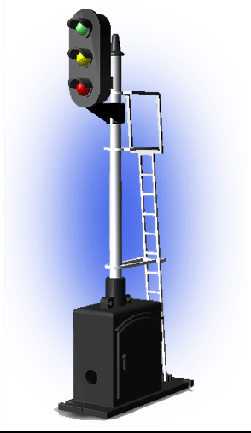
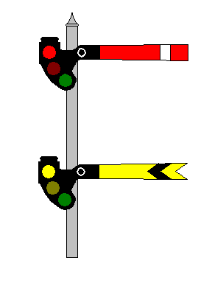
History & Evolution of Signal Systems
S&TC – 0
49 CFR 236.0
Notes:
History of railroad signaling is a story of innovation, technology, and an obsessive search for safety. This obsession began more than 150 years ago and continues unabated today. Over the years, signal engineers have used whatever technology was available to them the make America's railroads safer and more efficient. Safety and efficiency are the purposes for railroad signaling.

Slide 2
Learning Objectives
Recognize the background and continued development of signal and train control systems.
Understand the unchanging fundamental principles of railroad signaling.
Contrast older signal technology to the latest, more modern technology.
Recognize the importance of 49 CFR 236.0 to railroad operations.
Notes:
Recognize the history and development of modern signal and train control system and how signal systems evolved as new technologies became available.
Understand that while the technologies employed in railroad signaling have changed, the fundamental principles have remained the same by comparing and contrasting older technologies with the new.
Recognize how 49 CFR 236.0 determine the railroads’ method of operation and operating speeds.

Slide 3
CAUTION
The following presentation was developed to provide general information only. For detailed compliance information please refer to 49 CFR 236.0 – Rules, Standards and Instructions and the S&TC technical manual. It is recommended that each employee refer to appropriate manuals and regulations when dealing with any specific issue.
3
Notes:
When in doubt, go to the book!

Slide 4
Information
The FRA Rules, Standards, and Instructions are considered to be the minimum standard allowed for the installation, inspection, maintenance, and repair of signal and train control systems, devices, and appliances. Each railroad may adopt more stringent standards. Refer to your railroad’s signal standard and instruction manual for further guidance.

Slide 5
Early Railroad Operations
Early trains operated by a system called the Time Interval Rule.
Trains ran by strict schedules
Cumbersome, time consuming, exhausting
If one train was delayed waiting trains had to wait one hour.
Brakeman would walk 20 minutes out with a red flag.
The engineer would then move the train forward to the first brakeman and dispatch a second brakeman to walk another 20 minute ahead.
This process would be repeated until the train reached the next station.
Notes:
Trains operated according to a strict timetable, that is cannot leave a station until an appointed time and until any other trains they were to meet at that station have arrived. Rarely used as a block system, as if one train is delayed, all trains it is scheduled to meet are delayed. This can quickly lead to all trains on the railway being affected.

Slide 6
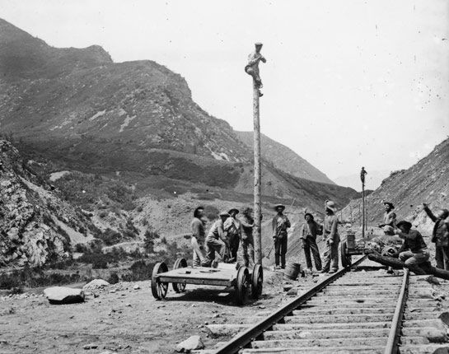
Telegraph on Early Railroads
1840s – Erie Railroad
begins installing telegraph.
1851 – Erie Railroad issues
first telegraphic train order.
1860s – Rapid expansion
of railroads is matched by
the expansion of the telegraph system.
1920 – Over 78,000 telegraphers working on American railroads.

Slide 7
First Telegraphic Train Order
To Agent and Operator at Goshen:
Hold the train for further orders.
Charles Minot, Superintendent
Superintendent Charles Minot of the Erie Railroad was on a train at Turner, New York waiting for a delayed eastbound train.
He wired Goshen, New York asking if the train had arrived yet.
Upon receiving a negative reply, he sent the following historic wire.
He then hand wrote the following order:
To Conductor and Engineer, Day Express:
Run to Goshen regardless of opposing train.
Charles Minot, Superintendent
Notes:
September 22, 1851, Superintendent Charles Minot issues the first telegraphic train order.

Slide 8
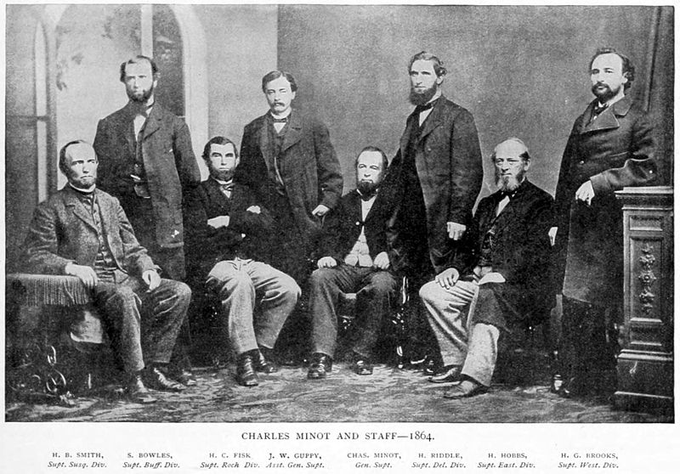
The Train Order Method of Train Operation was born on September 22, 1851
This Method of Operation is still used on some lines today.
Notes:
Popular on single track lines in North America up until the 1980s, Train Order operation was less a block system and more of a system of determining which trains would have the right of way when train movements would come into conflict. Trains would make use of a predetermined operating plan known as the timetable which made use of fixed passing locations often referred to as stations. Amendments to the operating plan would come from a train dispatcher in the form of train orders, transmitted to the trains via intermediaries known as agents or operators at train order stations.

Slide 9
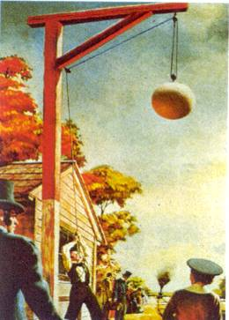
1830 – 1850’s
The first signals employed on an American railroad were a system of flags in the 1830s.
Railroads then developed a more effective system consisting of wooden balls hoisted up or down a pole to indicate train status.
Ball signals were first used to direct train movements in 1852, on the New York and New Haven Railroad.
Notes:
The first signals employed on an American railroad were a system of flags used on the Newcastle and Frenchtown Turnpike and Rail Road in the 1830s. The railroad then developed a more effective system consisting of wooden balls, painted red, white or black, and hoisted up or down a pole on a rope-and-pulley system. The initial use of these signals was merely to indicate the on-time status of trains, rather than to control train movements. The wooden balls were often configured with lanterns for nighttime use. Ball signals were first used to direct train movements in 1852, on the New York and New Haven Railroad.

Slide 10
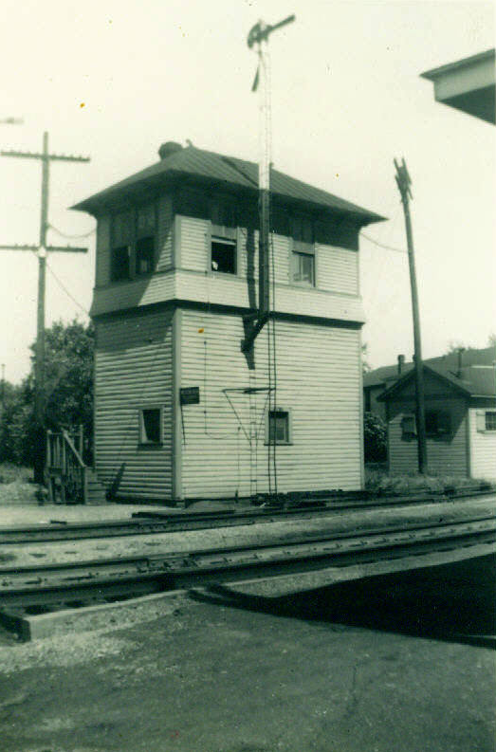
Manual Block Signal System - 1863
The first manual block system was implemented by the Pennsylvania Railroad in 1863.
This system required a railroad employee stationed at each signal to set the signals according to instructions received by telegraph from dispatchers.
Notes:
In a manual block system the line is divided into sections called blocks. At each point of division signalmen, in communication by telegraph, were stationed at block posts, with fixed signals to control the trains. When a train wished to enter a block, the signalman at its entrance communicated with the signalman at the exit of the block. If they agreed that the block was clear of trains, the signalman at the exit prevented any train from entering at that end, while the signalman at the entrance admitted the train, protecting it with a signal behind it. When the train reached the other end of the block, the signalman there advised the signalman at the entrance that the train had left the block, which was clear. The concept of trains operating via signal indication, in conjunction with train orders, was born.

Slide 11
Manual Block System
Association of American Railroads
A block signal system wherein the use of each block is governed by block signals controlled manually or by block-limit signals or both upon information by telephone or other means of communication.

Slide 12
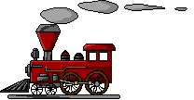
Manual Block Signal System - 1863
ALPHA
BRAVO
Notes:
As a train approaches Station Bravo the Bravo Signalman communicates with the Alpha Station Signalman to ensure that the block is clear. The Alpha Station Signalman sets the Alpha Signal to “STOP”, then communicates to the Bravo Station Signalman that the block is clear. The Bravo Station Signalman then sets the Bravo Signal to “Clear.” Once the train enters the block the Bravo Signalman sets the Bravo Signal to “STOP.”

Slide 13
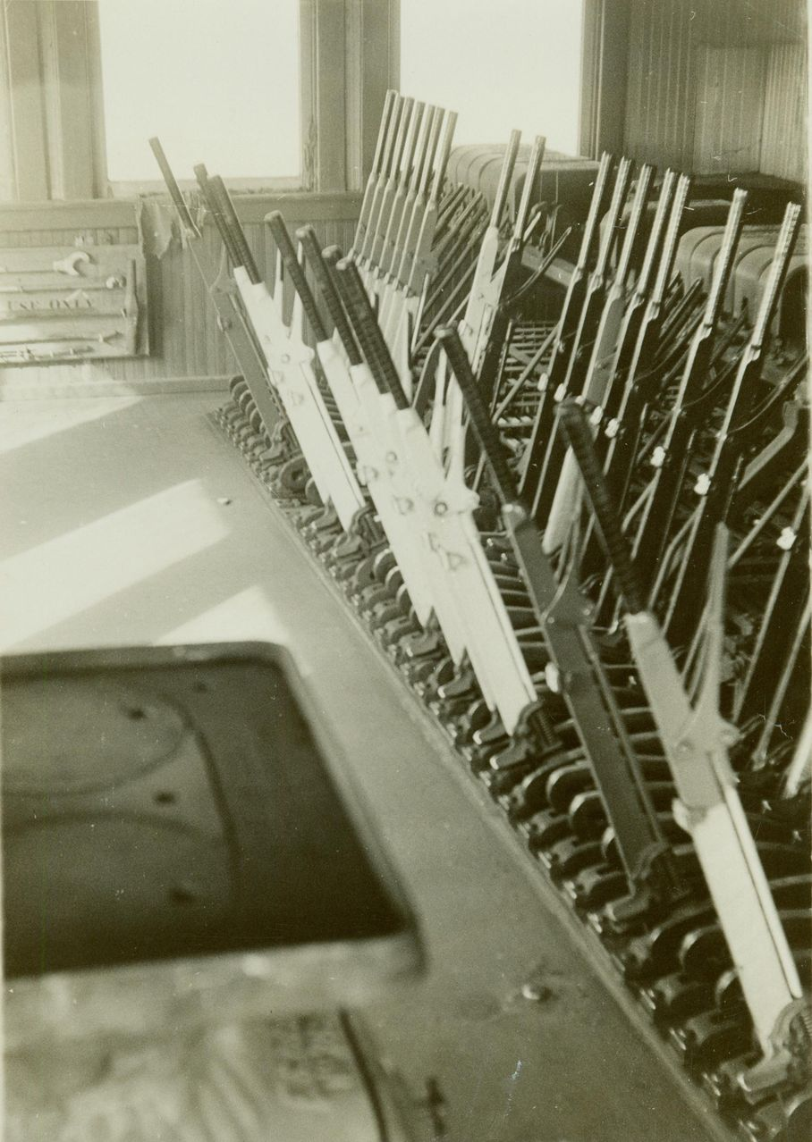
Interlocking Plant - 1870
Saxby and Farmer interlocking machine built in England and installed in Trenton, New Jersey.
An arrangement of signal apparatus that prevents conflicting movements through an arrangement of tracks such as junctions or crossings.
Notes:
The manual block signal system solved many of the safety problems related to operating trains between junctions, but problems still existed at junctions and crossings. American signal engineers looked to an English innovation to improve safety and efficiency at junctions. A London based company, Saxby and Farmer had invented the first interlocking machine.

Slide 14
Interlocking Definition
American Association of Railroads
An arrangement of signals and signal appliances so interconnected that their movements must succeed each other in proper sequence and for which interlocking rules are in effect. It may be operated manually or
Notes:
A minimal interlocking consists of signals, but usually includes additional appliances such as switches and derails, and may include crossings at grade and movable bridges. Some of the fundamental principles of interlocking include:
Signals may not be operated to permit conflicting train movements to take place at the same time.
Switches and other appliances in the route must be properly 'set' (in position) before a signal may allow train movements to enter that route.
Once a route is established and a train is given a signal to proceed over that route, all switches and other movable appliances in the route are locked in position until either
the train passes out of the portion of the route affected, or
the signal to proceed is withdrawn and sufficient time has passed to ensure that a train approaching that route has had opportunity to come to a stop before passing the signal.

Slide 15
1872
The electric track circuit was invented Dr. William Robinson.
Connected the train directly to the signal system.
Began movement toward automatic operation of the signal system.

Slide 16
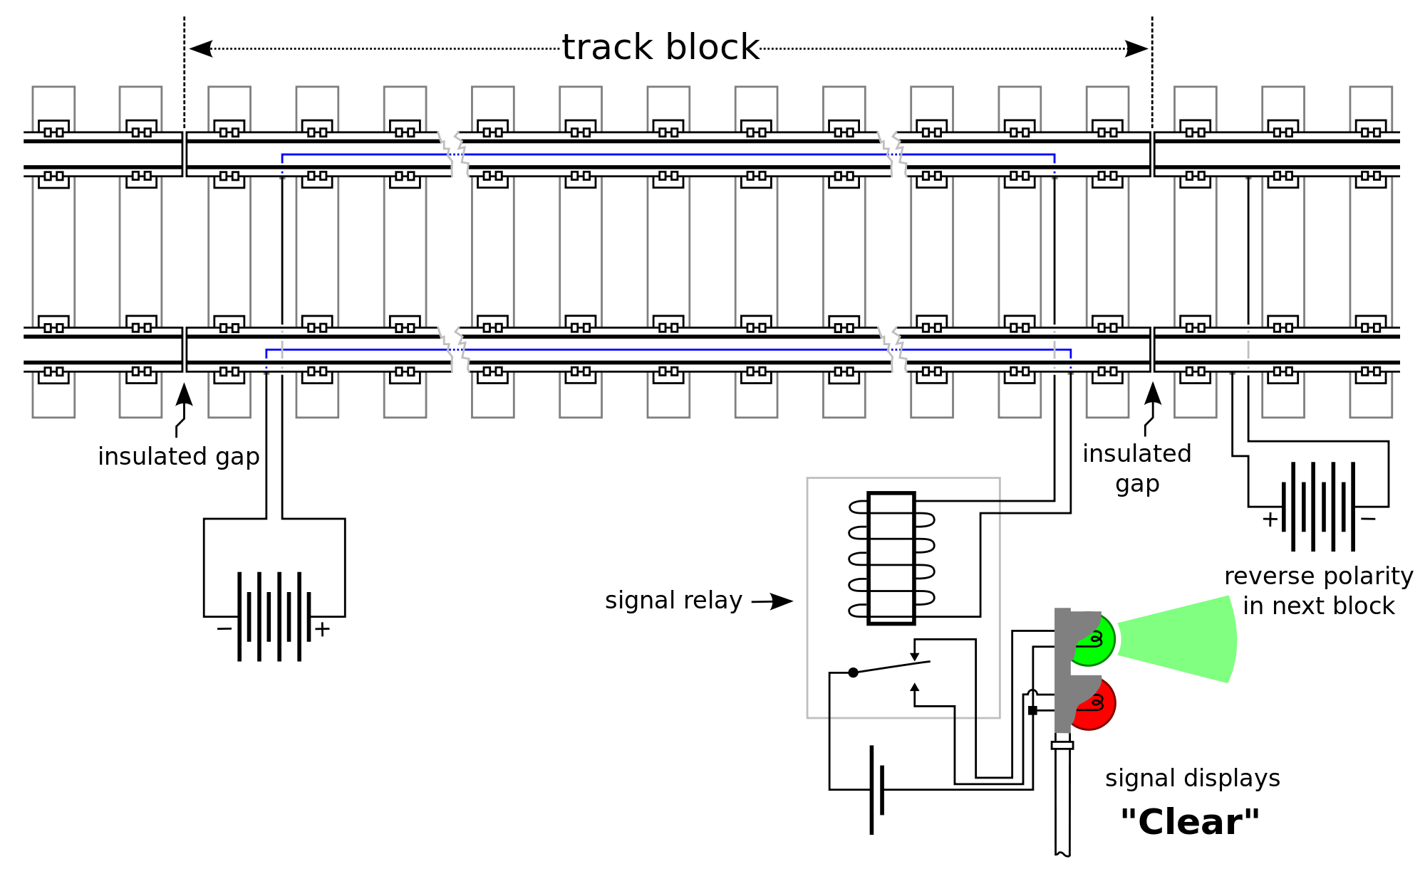
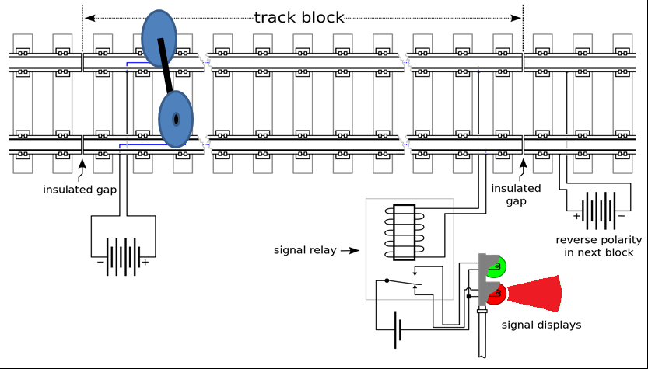
The Basic Track Circuit
A basic track circuit has power applied to each rail and a relay coil wired across them. When no train is present, the relay is energized by the current flowing from the power source through the rails. When a train is present, its axles short (shunt) the rails together; the current to the track relay coil drops, and it is de-energized. Circuits through the relay contacts therefore indicate whether or not the track is occupied.
“STOP”
Notes:
Each circuit detects a defined section of track, such as a block. These sections are separated by insulated joints, usually in both rails. To prevent one circuit from falsely powering another in the event of insulation failure, the electrical polarity is usually reversed from section to section. Circuits are powered at low voltages (1.5 to 12 V DC) to protect against line power failures. The relays and the power supply are attached to opposite ends of the section to prevent broken rails from electrically isolating part of the track from the circuit. A series resistor limits the current when the track circuit is short-circuited.
When a track circuit is in its normal state current flows from the battery to the relay, energizing its coils. This indicates to the signal system that the track circuit is unoccupied and that the rails are not broken, hence it is safe to proceed.
If the track circuit is occupied by a train the wheels will “shunt” the current away from the relay causing it to de-energize setting the signal to “Stop” indicating that the track is occupied and that it is unsafe to enter.

Slide 17
Track Circuit Definition
§ 236.726 Circuit, track.
An electrical circuit of which the rails of the track form a part.

Slide 18
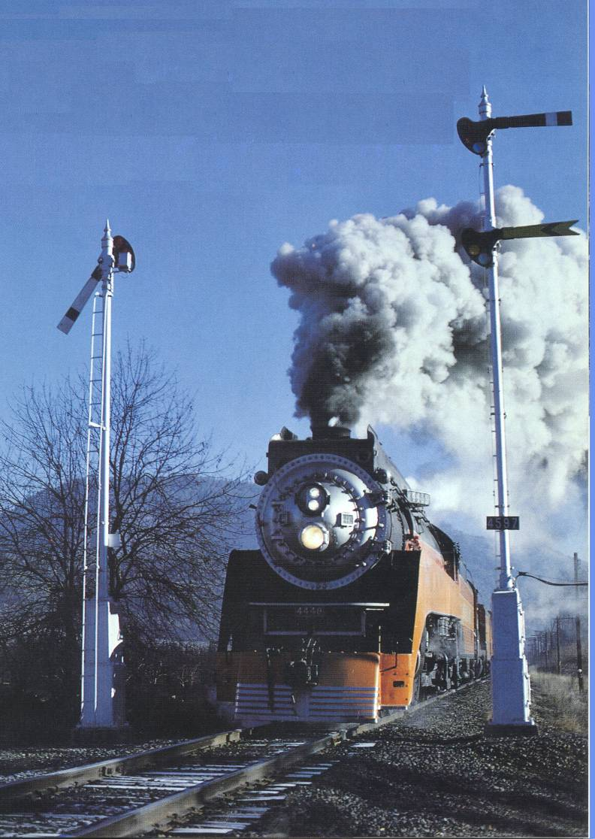
1900
Automatic signal systems utilizing the new electric track circuit and semaphore signals became widely popular.
Used to supplement the Train Order system increasing safety and efficiency.

Slide 19
Automatic Block Signal System Definition
Association of American Railroads
A block signal system where the use of each block is governed by an automatic block signal, cab signal, or both. A roadway signal operated either automatically or manually at the entrance to a block.

Slide 20
Automatic Block Signal System
A railroad signal system that consists of a series of signals that divide a railway line into a series of sections, or "blocks". ABS operation is designed to allow trains operating in the same direction to follow each other in a safe manner without risk of rear end collision. The introduction of ABS reduced railways' costs and increased their capacity. The automatic operation comes from the system's ability to detect whether blocks are occupied or otherwise obstructed, and to convey that information to approaching trains.
Notes:
By installing a series of track circuits between station the signal system now has the capability of monitoring track occupancy in the entire block between stations. This arrangement makes the communications between stations automatic, thereby relieving the block operator or block signalman from manually operating the signals.

Slide 21
Automatic Block Signal System
The simplest form of an Automatic Block Signal System.
Notes:
The simplest form of an Automatic Block Signal System uses track circuits to detect track occupancy and to automatically set the opposing block signal to “Stop.”

Slide 22
Automatic Block Signal System
Notes:
The manual block system provided safety for train movements between station, but was very inefficient as it only allowed one train at a time to occupy the block. The signal engineers of the day were able to improve operational efficiency by adding intermediate signals between stations to govern movement over each track circuit for train movements in the same direction.

Slide 23
Automatic Block Signal System
Notes:
The function of a basic Automatic Block Signal System (ABS) is to increase efficiency by allowing one train to follow another into and through a series of blocks between stations. ABS also provides limited protection from opposing trains, but the primary protection remains the train order.

Slide 24
Absolute Permissive Block Signal System
Notes:
An Absolute Permissive Block (APB) Signal System is a variation of ABS that features a “Tumble down” function for opposing train movements. When a train enters the block, not only does the opposing signal get set to “STOP”, but all the opposing signal to the next station get set to “STOP” also. This provides “absolute” protection from opposing trains while still permitting following trains to operate into the block.

Slide 25
Two Tracks of Signal Technology
Block Signals
Interlockings
Provided for safe train operation by establishing blocks of protection around the train.
Provided efficiency by allowing for following trains to operate in the same block, thereby increasing track capacity.
Provided for safe train operations at junctions and crossings.
Increased efficiency by allowing one person to control large and complex interchanges.
Notes:
By the mid-1920’s three technologies were merging to allow for a giant leap in railroad signaling and train operations. The well understood principles of block signaling and interlocking principles began to merge with the emerging science of electronic communications.

Slide 26
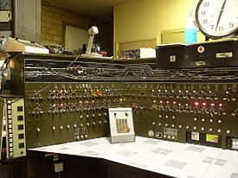
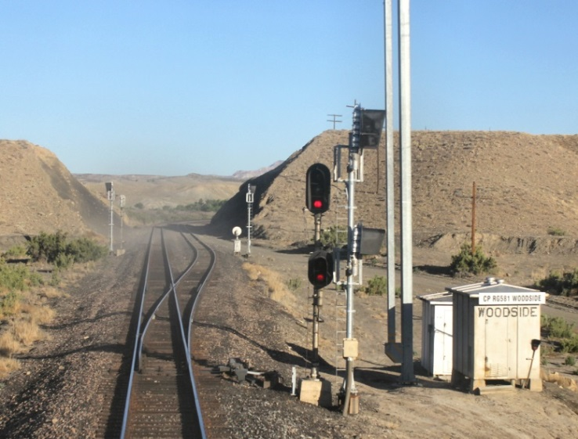
Traffic Control System - 1927
The first Traffic Control System (TCS) System was installed in 1927 on the New York Central Railroad between Stanley and Berwick, Ohio.
Combined an automatic block signal system with a series of manual interlocking plants.
Add a communications system.
Gave dispatcher control over train movements.
New method of operation by signal indication only.
Notes:
In 1927, the New York Central installed the first Traffic Control System (TCS). This system place a series of manually controlled interlocking plants within an automatic block territory. These manual interlocking plants were connected to a central office machine where a single dispatcher could control the entire territory. The signal system now became the method of train operations. General Railroad Signal Company installed this system and went on to market it a Centralized Traffic Control (CTC), but CTC is a Traffic control System.

Slide 27
Automatic Train Stop - 1901
Mechanical Automatic Train Stop (ATS) was first installed by the Boston Elevated Railroad and in the New York Subway System.
Popular on rapid transit and commuter railroad, but inadvertent activation made these systems impractical for long distance freight operations.
Notes:
Mechanical ATS was more popular on rapid transit systems and dedicated commuter rail than freight or long distance passenger lines due to a combination of the increased complexity found in mainline railroad operations, the risk of inadvertent activation by debris or other wayside appliances, and the danger of emergency brake applications at high speeds.
In 1910 the Pennsylvania and Long Island Rail Road installed a mechanical ATS system covering various lines to New York Penn Station using the trip value system which was designed to prevent inadvertent activations from debris.

Slide 28
Automatic Train Stop – 1920s
Electronic ATS was more reliable and had few inadvertent activations.
ATS became feasible for long distant freight railroads.
IIC issued an order requiring 49 railroads to install ATS on at least one of their passenger divisions.
Notes:
The General Railway Signal corporation introduced its Intermittent Inductive Automatic Train Stop system in the 1920s which made use of Inductive loops in a "shoe" mounted outside of the running rails. This system was also of the acknowledgment type. If a train passed a restrictive signal and the operator took no action within 5 seconds the system would stop the train. This system was installed by several railroads and continues to see service today. In September 1920, the Interstate Commerce Commission issued Order Number 13,514 requiring 49 railroads to install ATS on at least one of their passenger division.

Slide 29
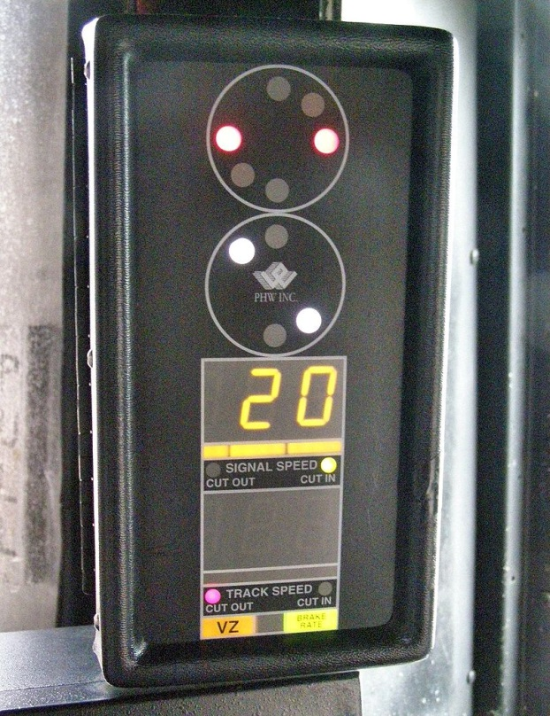
Automatic Cab Signal System
Provide signal indication in the locomotive cab for enhanced visibility.
Provides for automatic train stop if operator fails to take appropriate action.
Two main categories of ACS
Intermittent
Continuous
Notes:
The main purpose of a signal system is to enforce a safe separation between trains and to stop or slow trains in advance of a restrictive situation. The cab signal system is an improvement over the wayside signal system, where visual signals beside or above the right-of-way govern the movement of trains, as it provides the train operator with a continuous reminder of the last wayside signal or a continuous indication of the state of the track ahead.
All cab signaling systems must have a continuous in-cab indication to inform the driver of track condition ahead; however, these fall into two main categories. Intermittent cab signals are updated at discrete points along the rail line and between these points the display will reflect information from the last update. Continuous cab signals receive a continuous flow of information about the state of the track ahead and can have the cab indication change at any time to reflect any updates. The majority of cab signaling systems, including those that use coded track circuits, are continuous.

Slide 30
Automatic Train Control
Used in conjunction with ACS.
Primarily used in passenger and commuter service.
If operator fails to take action at a restricting signal the brakes will be applied until the target speed is achieved.
Notes:
Automatic Train Control (ATC) systems in the United States are almost always integrated with existing continuous cab signal systems. The ATC comes from electronics in the locomotive that implement some form of speed control based on the inputs of the cab signaling system. If the train speed exceeds the maximum speed allowed for that portion of track, an over-speed alarm sounds in the cab. If the engineer fails to reduce speed and/or make a brake application to reduce speed a penalty brake application is made automatically.
Due to the more sensitive handling and control issues with North American freight trains, ATC is almost exclusively applied to passenger locomotives in both inter-city and commuter service with freight trains making use of cab signals without speed control. Some high-volume passenger railroads such as Amtrak, Metro North and the Long Island Rail Road require the use of speed control on freight trains that run on all or part of their systems.

Slide 31
49 CFR 236.0 – Paragraph C
(1) Where passenger train speeds are 60 or more miles per hour, or freight train speeds are 50 or more miles per hour -
(i) A block signal system shall be installed; or
(ii) A manual block system shall be placed permanently in effect that shall conform to the following conditions:
A passenger train shall not be admitted to a block occupied by another train;
No train shall be admitted to a block occupied by a passenger train;
No train shall be admitted to a block occupied by an opposing train; and
A train (non-passenger) may be authorized to follow another train (non-passenger) into a block restricted speed.
(2) Where passenger train speed are 60 or more miles per hour, or freight train speeds are 50 or more miles per hour, a block signal system complying with the provisions of this part shall be installed, unless a PTC system is installed.
Paraphrased from the Regulation. Please see the rule for full text
Notes:
This rule requires that a block signal system complying with the RS&I or a manual block system complying with the provisions of this section be installed where passenger trains operate at 60 or more miles per hour or freight trains operate at 50 or more miles per hour. Further, an automatic train stop, train control, or cab signal system shall be installed where any train operates at 80 or more miles per hour.
This section details how a manual block system shall operate and requires that it be permanently in effect, i.e., all trains must be operated by manual block system rules.
A manual block system is a method of train operation by mandatory directives or voice rules, in non signaled territory (or against current of traffic), which authorizes movements between defined limits or blocks, and conforms with 236.0(c)(1),(2),(3),&(4).
The individual operating rules of a railroad will determine if the method of operation conforms to a manual block system.
Note that a methodology, such as the track warrant control rules of some carrier’s, which permit and establish yard limits within designated blocks; does not conform to the above manual block system, because trains are permitted to enter the main track within designated yard limit areas without direct authority or regard for block occupancy.

Slide 32
49 CFR 236.0 – Paragraph D
Where any train is permitted to operate at a speed of 80 or more miles per hour, an automatic cab signal, automatic train stop, or automatic train control system shall be installed, unless an FRA approved PTC system is installed.
(2) Where any train is permitted to operate at a speed of 80 or more miles per hour, a PTC system complying with the provisions of subpart I shall be installed and operational, unless FRA approval to continue to operate with an automatic cab signal, automatic train stop, or automatic train control system complying is approved.
Paraphrased from the Regulation. Please see the rule for full text
Notes:
(1) Prior to December 31, 2015, where any train is permitted to operate at a speed of 80 or more miles per hour, an automatic cab signal, automatic train stop, or automatic train control system complying with the provisions of this part shall be installed, unless an FRA approved PTC system meeting the requirements of this part for the subject speed and other operating conditions, is installed.
(2) On and after December 31, 2015, where any train is permitted to operate at a speed of 80 or more miles per hour, a PTC system complying with the provisions of subpart I shall be installed and operational, unless FRA approval to continue to operate with an automatic cab signal, automatic train stop, or automatic train control system complying with the provisions of this part has been justified to, and approved by, the Associate Administrator.
(3) Subpart H of this part sets forth requirements for voluntary installation of PTC systems, and subpart I of this part sets forth requirements for mandated installation of PTC systems, each under conditions specified in their respective subpart.
As you can see 49 CFR 236.0 ties the train speed to the minimum requirement of the method of train operation.

Slide 33
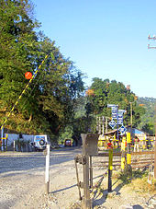
Warning Systems
Early concerns were for horse drawn vehicles and live stock.
Normal operation was by a flagman stationed near the crossing.
Notes:
Early level crossings had a flagman in a nearby booth who would, on the approach of a train, wave a red flag or lantern to stop all traffic and clear the tracks. Manual or electrical closable gates that barricaded the roadway were later introduced, intended to be a complete barrier against intrusion of any road traffic onto the railway. In the early days of the railways much road traffic was horse drawn or included livestock, requiring a full barrier crossing the entire width of the road. When opened to allow road users to cross the tracks, the gates were swung across the width of the railway, preventing any pedestrians or animals getting onto the tracks. The first US patent for such crossing gates was awarded on 1867.

Slide 34
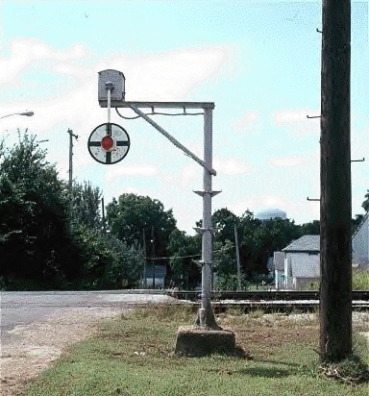
Early Systems - 1909
The first Highway Grade Crossing “Active” Warning Systems emulated the swinging lantern concept. Named the “Magnetic Flagman” this type of system was soon nick-named the “Wig-Wag”.
34
Notes:
Soon after the advent of the automobile, speeds were increasing and the popularity of enclosed cars made the concept of "stop, look, and listen" at railroad crossings difficult. Fatalities at crossings were increasing. Though the idea of automatic grade crossing protection was not new, no one had invented a fail-safe, universally recognized system. In those days, many crossings were protected by a watchman who warned of an oncoming train by swinging a red lantern in a side-to-side arc, used universally in the U.S. to signify "stop". It was presumed that a mechanical device that mimicked that movement would catch the eye of approaching motorists and give an unmistakable warning.

Slide 35
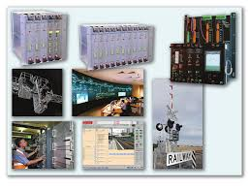
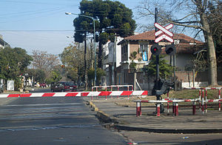
Today’s Systems
Notes:
Today’s systems are highly visible, utilizing diamond grade retro-reflective materials and multiple flashing lights to simulate the swinging of a lantern. They also use sophisticated control systems to ensure activation when necessary, but minimize the delay to the motorists.

Slide 36
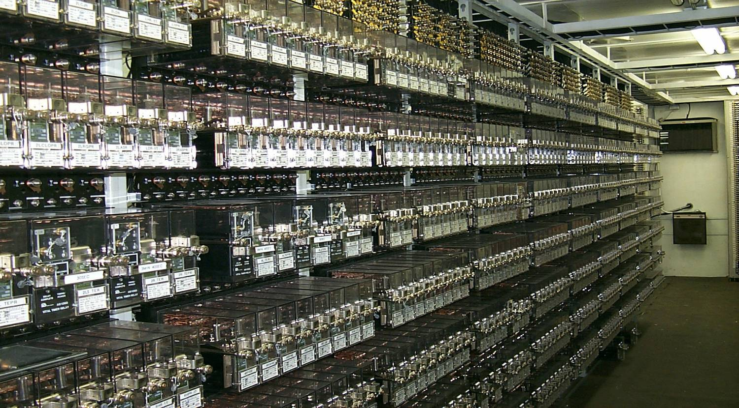
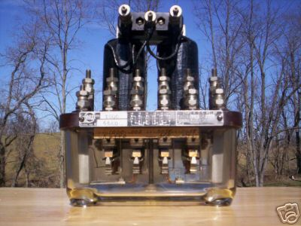
Railroad Logic of the Past
Notes:
Many of today’s signal systems still utilize shelf-mounted or plug-in relays. With proper care, inspection, testing, and maintenance these devices will provide many decades of service into the future.

Slide 37
Railroad Logic of Today
Notes:
As railroad signaling continues its evolution the skills needed to inspect, test, and maintain these systems are also changing. The systems are providing more information to aid in trouble-shooting and repairing the system is often as easy as changing a processor card. However,

Slide 38
System of the Past
Traffic Control System control panel.
Notes:
TCS control machines have evolved, but their primary functions have remained the same.
Initiate requests to the field (i.e., move a switch position, clear a signal, etc.).
Receive indications from the field (i.e., actual switch position, signal status, train location, etc.).
Display indication for the dispatcher.

Slide 39
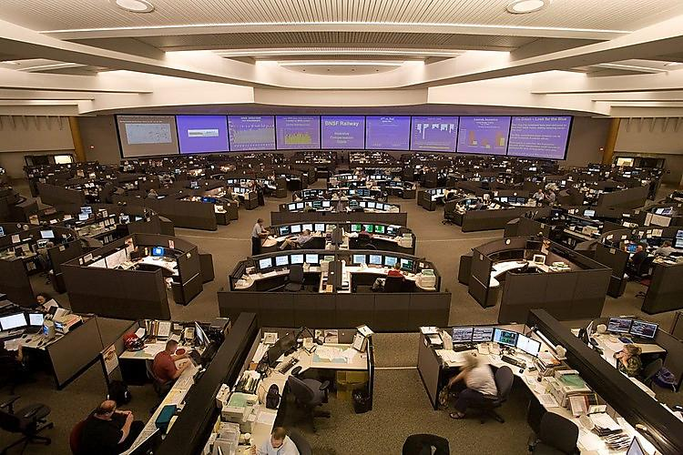
Today’s Systems
The installation of Traffic Control Systems has been very popular and these systems are now widely used on most major railroads.

Slide 40
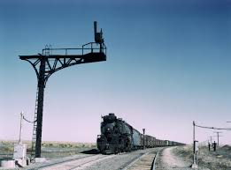
Signal of the Past
Some semaphore signals are still in use today.
Notes:
The signals of the past gave the engineer information about the track ahead and indicated what speed the train should travel.

Slide 41
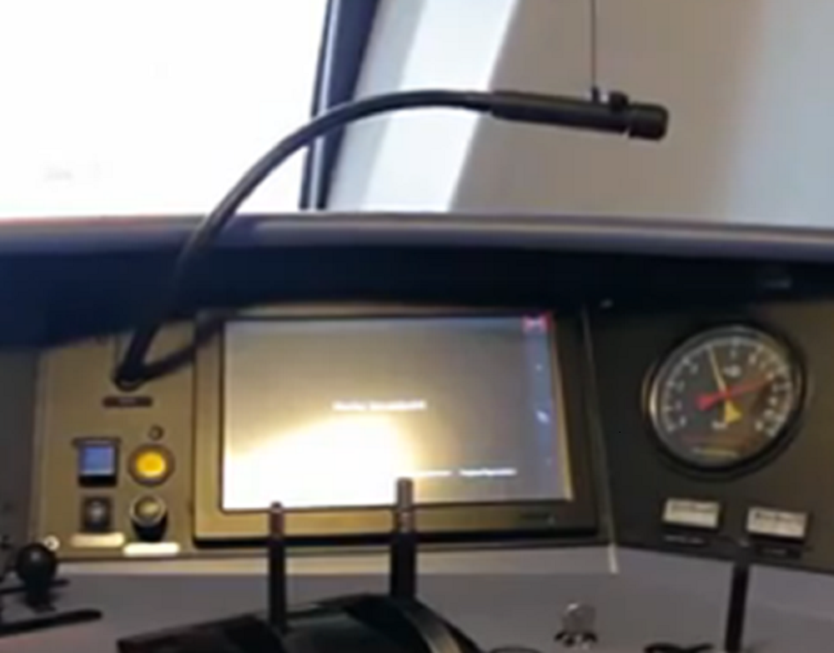
Today’s Information Display
Notes:
Today’s information displays give the engineer much more train handling information and will enforce restriction.

Slide 42
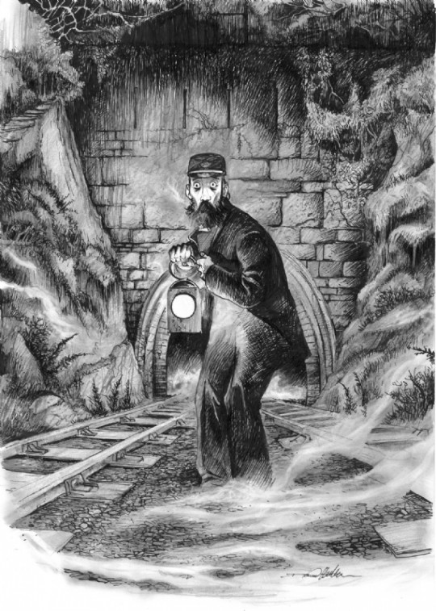
Modern Signaling
Exciting and growing discipline
Cutting edge technologies
Rich and honorable heritage
Noble goal- safe and efficient movement of trains
Notes:
As you can see modern railroad signaling is a exciting and growing discipline. Signalmen are is constant search for new technologies and new method to achieve the same goal as their predecessors – the safe and efficient movement of trains.

Slide 43
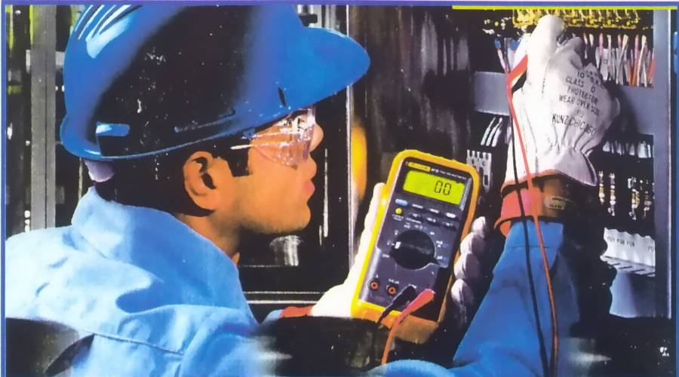
Today’s Systems
Today’s systems require some of the same testing procedures which signal maintenance personnel have been performing for over a century.
Notes:
Today it is more important than ever that the railroad hire and retain the finest signalmen possible. The signal discipline has evolved from dedicated flagmen work day and night in all types of weather, to pipe fitters and machinist assembling and maintaining intricate mechanical interlocking plants with hundreds of moving parts and thousands of feet of pipeline. With the advent of electricity, signalmen found another tool to use in search of safety. Signalmen with a vast understanding of electricity keep the railroads running for nearly a century before the next evolutionary change came to the industry. Having built the first computers back in the 1920s that stretch for miles along the railroad it was only natural that signalmen would embrace the microprocessor age.

Slide 44
Today’s Systems
In today’s systems, S&TC Personnel should be aware of the different technologies and systems in use and recognize the challenges encountered while testing, inspecting, and maintaining these systems.
A new approach and more planning may be needed to effectively test, inspect, and maintain some systems to ensure the safe and efficient movement of trains.
Notes:
As train control systems become more complex and many functions become transparent to inspecting, testing and maintaining personnel it becomes ever more critical that signalmen know and understand the fundamental principles around which the systems are designed. Regardless of the technology being used if a signalman know what the system is supposed to do and knows how to conduct performance tests on the system they will be successful.

Slide 45
The Signalman Axiom
“Remember, there are lives at stake in this business.”

Slide 46
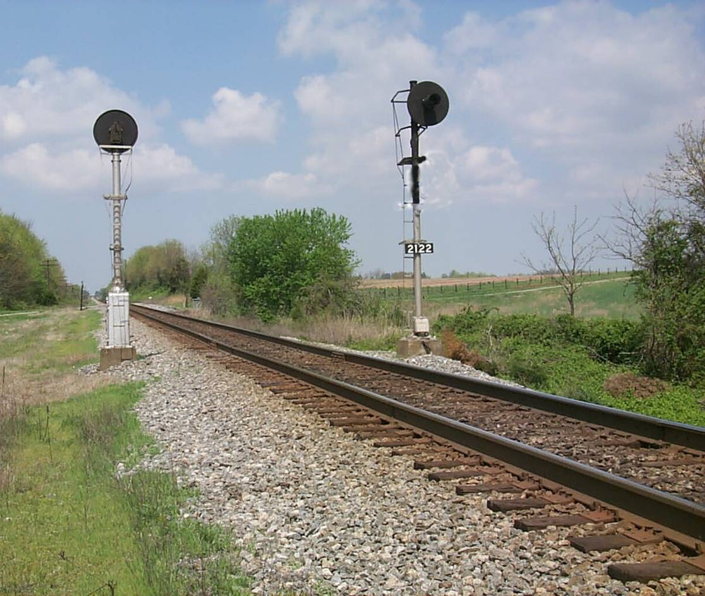
S&TC FUNDAMENTALS
Railroad Signal History and
49 CFR 236.0
The End
46

