Slide 1
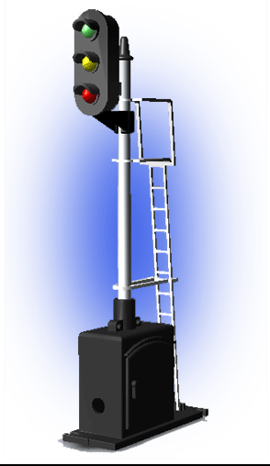
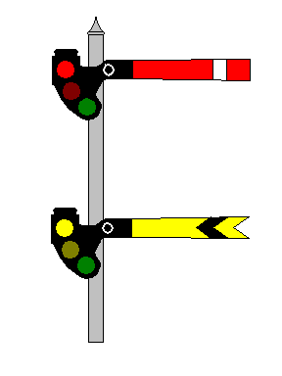
Signal and Train Control RULES, STANDARDS, AND INSTRUCTIONS (R,S&I)
STC – 1
All System
Subpart A
Notes:
Signal and Train Control - Rules, Standards, and Instructions (R,S&I) governing the installation, inspection, maintenance, and repair of signal and train control systems, devices, and appliances. – All Systems
All signal and train control systems must comply with all rules in 49 CFR 236, Subpart A.

Slide 2
Learning Objectives
Associate various regulations contained in 236 Subpart A, as they apply to S&TC systems, subsystems, and components.
Understand how to apply the R,S&I to everyday testing, inspection and maintenance of signal and train control systems, subsystems, and components.
2
Notes:
It is important that all S&TC personnel be able to associate the specific requirements of 49 CFR 236, Subpart A to the signal system, subsystem or component that they are responsible for installing, testing, inspecting, or maintaining in order to comply with the regulations. More importantly, S&TC personnel must be knowledgeable of these regulation to maintain the integrity and safe of these critical systems. Everyday people operate trains depending on these systems for their safety and well-being. Lives are at stake in this business and these regulation are the culmination of over 150 years of experience with signal systems.

Slide 3
CAUTION
The following presentation was developed to provide general information only. For detailed compliance information please refer to 49 CFR 236 – Rules, Standards and Instructions, Subpart A and the S&TC technical manual. It is recommended that each employee refer to appropriate manuals and regulations when dealing with any specific issue.
3
Notes:
When in doubt, go to the book!

Slide 4
Information
The FRA Rules, Standards, and Instructions are considered to be the minimum standard allowed for the installation, inspection, maintenance, and repair of signal and train control systems, devices, and appliances. Each railroad may adopt more stringent standards. Refer to your railroad’s signal standard and instruction manual for further guidance.
4

Slide 5

236.1 Plans, where kept.
As required for maintenance, plans shall be kept at all interlockings, automatic signals and controlled points.
5
Notes:
The term plans include circuit plans, location plans, and track profiles.
Where plans are kept may sound like a minor issue, but it is actually critical to safe operation of the signal system. Correct circuit plans assist in preventing connection errors when reconnecting wires that have been disarranged for testing or trouble shooting. They also provide a valuable job aid and guide in trouble shooting system faults.
While this rule only requires plans to be kept at interlockings, automatic signals and controlled points, it is an industry standard and highly recommended that plans be kept at all signal locations.

Slide 6
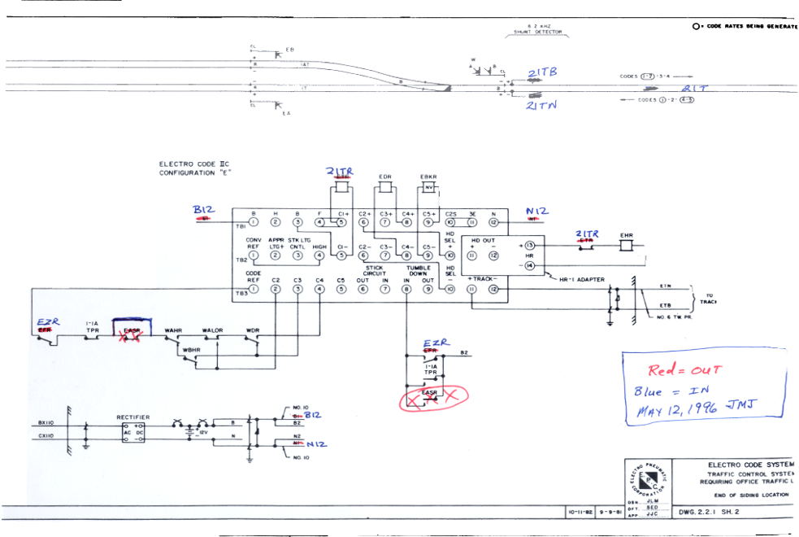
236.1 Plans, where kept.
Plans are required to be legible and correct.
6
Notes:
Plans are necessary for the installation, inspection, testing, maintenance, and repair of signal systems and are required to be correct and legible.
Track layout plan, circuit plan including circuits to approach signals, and locking sheet and dog chart where mechanical locking is used, must be kept at each interlocking.
Circuit plan including circuits to approach signals must be kept at each controlled point.
Circuit plans must be kept at all automatic signal in automatic block signal territory, traffic control territory, automatic train stop, train control, or signal territory in other systems such as spring switch protection, slide protection, etc.
Plans are required to be legible and correct. Plans that are torn, faded, or those having experienced more than one change in colored pencil are not considered to be legible and correct. Plans that have been modified with black or blue ink are considered as incorrect. The industry standard is that red pencil is to be used to mark circuits that have been, or will be removed and blue pencil will be used to indicate circuit the are to be, or have been installed.
Blue = in
Red = out
If more than one set of plans are at a location, they all must be legible and correct or the non-compliant sets must be corrected or removed.

Slide 7
236.2 Grounds.
Each circuit, the functioning of which affects the safety of train operations, shall be kept free of any ground or combination of grounds which will permit a flow of current equal to or in excess of 75 percent of the release value of any relay or other electromagnetic device in the circuit, except …
7
Notes:
Each circuit, the functioning of which affects the safety of train operations, shall be kept free of any ground or combination of grounds which will permit a flow of current equal to or in excess of 75 percent of the release value of any relay or other electromagnetic device in the circuit, except circuits which include any track rail and except the common return wires of single-wire, single-break, signal control circuits using a grounded common, and alternating current power distribution circuits which are grounded in the interest of safety.
Vital circuits shall be kept free of grounds equal to or in excess of 75% of the release value of relay or electromagnetic device in circuits. Track circuits, common return wires of single-wire, single-break signal control circuits grounded by design, and alternating current power distribution circuits grounded in the interest of safety are excluded.
Vital circuits designed to be ground free are required to be kept free of any ground current equal to or in excess of 75% of the release value of any relay or electromagnetic device in the circuit. There is no difference between an accidental or intentional ground.
Electronic devices designed to be ground free shall be kept free of grounds having a value that affects the proper operation of the device. (See FRA Technical Bulletin S-99-03)

Slide 8
236.2 Grounds.
Each circuit shall be kept free of any ground or combination of grounds.
Relay falsely
energized
Control
Relay
Battery
8
Notes:
The presents of grounds in signal circuit places the system at high risk. In this illustration the control relay is de-energized by its associated vital relay logic. If a ground exists in the system nothing changes. However, if a second ground appears it will complete the circuit between the battery and the relay, by passing the vital relay logic. This will cause the control relay to become energized, hence the system will respond inappropriately and possibly causing a false proceed aspect to be displayed.
Extreme care must be exercised when testing for grounds. Testing shall not be conducted while trains are approaching or passing, and the meter shall be watched at all times. If the meter indicates the energization of a relay, the meter shall be immediately disconnected. An unobserved meter must never be left connected to a vital circuit and ground.
Ground test shall be performed at every instrument case or house inspected. The preliminary test shall be with a voltmeter connected from line or track arrestor ground to a track circuit which will prove the meter is operating and the integrity of the ground circuit.
If a voltage ground is detected an ammeter must be used to determine the current value of the ground. Before using the ammeter precautions should be taken to ensure the safe movement of trains. This is important because when a person connects the ammeter between the grounded circuit and ground they are introducing a second ground to the system through the meter. Vital circuits can be bypassed through the meter.
AC power shall be interrupted during tests in order to check AC lighting circuits having DC stand by.
These requirements apply to highway-rail grade crossing warning devices, dragging equipment protection, slide detectors, etc., where signal control circuits are selected through relays energized by the power supply of such protection.
The railroad should take prompt action to correct a ground.

Slide 9
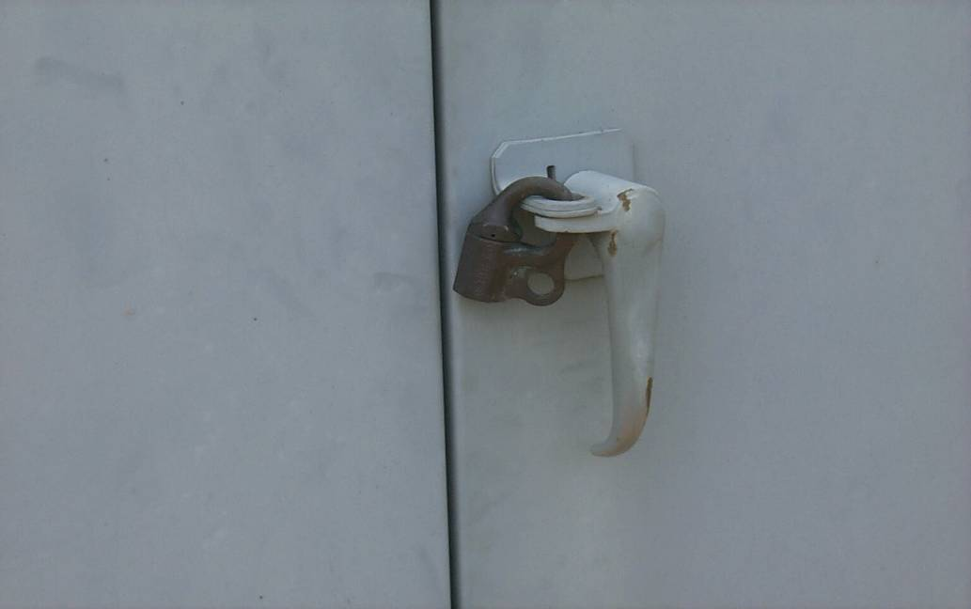
236.3 Locking of signal apparatus housings.
Signal apparatus housing shall be secured against unauthorized entry.
9
Notes:
Signal systems are viral to the safety of train operation, therefore all signal apparatus should be secured from persons who may want to steal or vandalize the equipment.

Slide 10
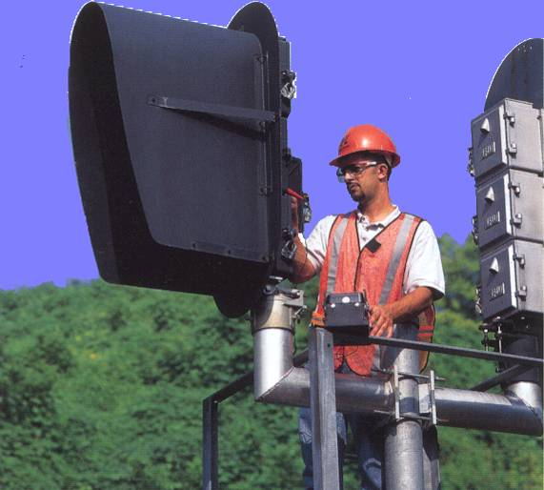
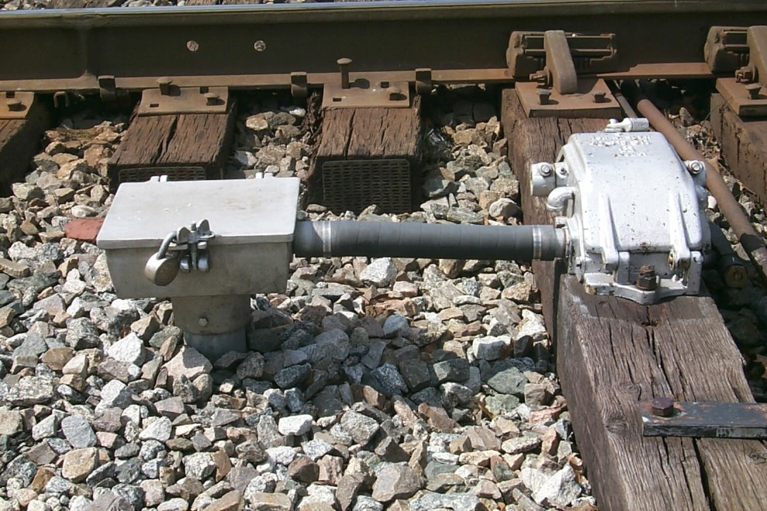
236.3 Locking of signal apparatus housings.
10
Notes:
Housings of signal apparatus must be secured to prevent unauthorized entry.
All outdoor housing of mechanical or power-operated devices used to operate signal or interlocked units must be kept locked, sealed, or secured. This includes signal cases, instrument cases, switch circuit controllers, facing-point locks, switch machines, junction or terminal boxes and battery boxes.
Power interlocking machine cabinets shall be locked or sealed to such extent that entry to or manipulation of the devices contained in the cabinet can only be accomplished by unlocking the lock or breaking the seal.
Time release and exposed electric locks must be locked or sealed.
Cabinets or cases containing apparatus designed to release locking in emergencies shall be locked or sealed.

Slide 11
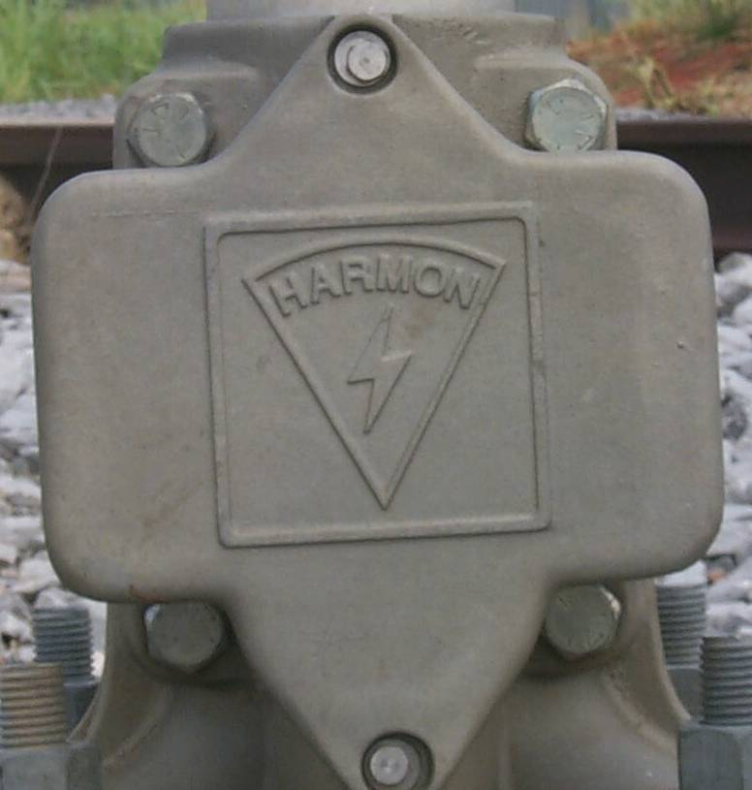
236.3 Locking of signal apparatus housings.
Wrench or nut locking with bell is acceptable.
11
Notes:
Wrench or nut-locking with bell is acceptable. In general terms, any locking device that requires a key or tool to unlock is an acceptable means of securing the housing.

Slide 12
236.4 Interference with normal functioning of device.
The normal functioning of any device shall not be interfered with in testing or otherwise without first taking measures to provide for safety of train operation which depends on normal functioning of such device.
12
Notes:
This rule is critical to the safe operation of trains. If a person interferes with the normal function of a device without first taking measures to provide for safe train operations it places people and equipment at high risk. Before any testing or maintenance activities are begun that may interfere with the normal function of the system, the system should be removed from service and measures taken to provide for the safe operation of trains through the system. Remember: what you do at one location may cause changes in the system miles away.

Slide 13
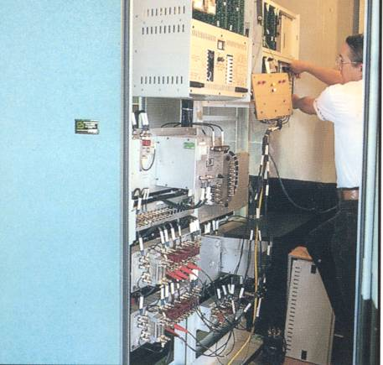
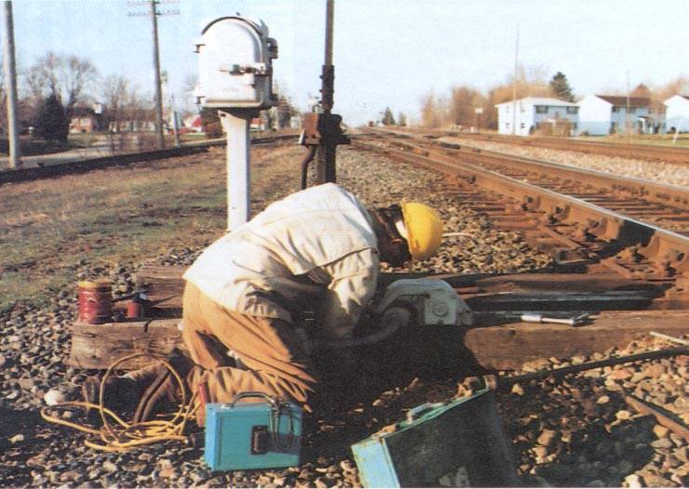
236.4 Interference with normal functioning of device.
13
Notes:
One of the most common examples of interference is the use of “jumper” wires while testing circuits. Using multiple jumper wires is a high risk activity. Jumper wire may be necessary for system testing, but they should be limited in number, brightly colored, and long enough to be easily seen. After the testing is complete all jumper wires should be accounted for before returning the system to service. There is no difference between accidental or intentional interference with respect to the enforcement of this rule by the Federal Railroad Administration.
Safety of train operation must be provided before interfering with the normal functioning of any device.
The intent of this rule is to insure carriers maintain the integrity of signal systems by prohibiting procedures or practices which defeat or nullify the minimum requirements of the RS&I.
Interference is any condition that circumvents, hinders, impedes, or diminishes whatsoever the intended protection of a device and may be accomplished by testing, installing, repairing, replacing, operating, or manipulating a signal component indicating or affecting the indication of safe passage for trains.
Tests of signal equipment should not be conducted until it has been ascertained no train movements will be affected. No test should be conducted during the passage of a train, Hi-rail vehicle or motor car. Testing may inadvertently cause switched, derails, or other devices to move.
Areas where interference can occur include all components, devices, mechanisms, or apparatus in vital circuits including shunt and fouling wires of switches and turnouts.
Examples of Interference
Unless measures are taken to provide safety of train operation, the following are some examples of interference with various types of equipment and procedures:
1. Testing such as falsely energizing relays, jumpering contacts, turning relays upside down; operating hand-operated switch, adjusting switch circuit controller or shunt fouling circuit, in advance of approaching train; operating power-operated switch without permission of dispatcher or operator; performing ground tests while train is approaching or moving over power-operated switch; defeating predetermined time interval of time release or time relay; and release of electric or mechanical locking.
2. Performing efficiency tests by removal of lamp bulbs that do not provide an approach aspect to the darkened signal; placing a shunt in advance of a signal after a train has passed its approach signal.
At interlockings, the unnecessary breaking of seals to force indications, defeat time, approach or route locking requirements.
Note: The procedure to move trains through interlockings under flag protection and appropriate rules is not considered interference.
4. Defeat of protective features to avoid train delay or to expedite train movements such as disconnecting shunt or fouling wires, turning relays upside down, jumpering contacts, falsely energizing relays or circuits, or releasing electrical locking.
The following will be considered interference under all circumstances:
Performing repairs and replacements of equipment or apparatus such as relays, cables, and conductors without proper testing afterwards; replacing rails in shunt fouling circuits leaving fouling wires and rail bonds broken and disconnected; replacing ties under switch machines or switch circuit controllers and leaving the circuit controller improperly adjusted; and leaving a switch in mid-stroke position.

Slide 14
236.5 Design of control circuits on closed circuit principle.
All control circuits the functioning of which affects safety of train operation shall be designed on the closed circuit principle, except circuits for roadway equipment of intermittent automatic train stop system.
14
Notes:
This rule requires that control circuits which affect the safety of train operation be designed on the closed circuit principle.
Excludes circuits for roadway equipment of intermittent automatic train-stop systems, shunt fouling circuits, and normally open track circuits on auxiliary tracks used to approach light wayside signals.
Includes all vital circuits and track circuits through which signal control circuits are selected.
Circuits should be so designed that failure of any part or component of the circuit will cause signals to display their most restrictive aspects.

Slide 15
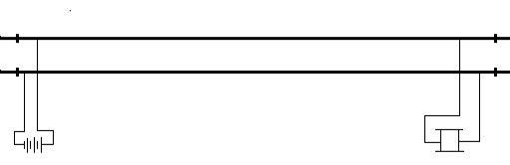
236.5 Design of control circuits on closed circuit principle.
A closed circuit is a normally energized electric circuit which, on being interrupted, de-energized, or shunted will cause the controlled function to assume its most restrictive state.
15
Notes:
All signal circuit should be designed, installed and maintained with the closed circuit principle, sometime referred to as the “Fail-Safe” principle.
An example of the close circuit principle is the basic track circuit. By placing the track relay as far a way from the battery as possible the relay will be de-energized if the battery goes dead, a wire or rail breaks, or if the two rails are shunted together.
A fail-safe is a device or practice that, in the event of a specific type of failure, inherently responds in a way that will cause no or minimal harm to other equipment, the environment or to people.
A system's being "fail-safe" means not that failure is impossible or improbable, but rather that the system's design prevents or mitigates unsafe consequences of the system's failure. That is, if and when a "fail-safe" system "fails", it is "safe" or at least no less safe than when it was operating correctly. This is sometimes referred to as system resiliency.

Slide 16
236.5 Design of control circuits on closed circuit principle.
16
Notes:
Since many types of failure are possible, it must be specified to what failure a component is fail safe. A system may be fail-safe in the event of a power outage (electrical failure), but may not be fail safe in the event of mechanical failures. For example, a semaphore arm may be fail-safe electrically because when energy is removed from its operating coil gravity will pull the arm down to the horizontal position indicating “Stop.” However, it is not fail-safe mechanically because a foreign object, ice, or snow may jam in in a more vertical position causing it to display a more permissive aspect.
In designing signal devices signal engineers have gone to great lengths to engineer the fail-safe principle into mechanical devices, but a completely fail-safe mechanical device is impossible and not required by the R,S&I. However, electric circuit can detect a mechanical failure and report it to the signal system. In the example of the stuck semaphore arm electrical contacts can determine that the semaphore arm has failed to fall to the proper position and report the event to the signal system.
Signal control and electric locking circuits are required to be selected through contacts of safety relays.
This rule does not prohibit the use of annunciating or indicating devices, but does prohibit selecting vital circuits through contacts operated by such devices.
Some examples of annunciating or indicating devices are:
a. Switch indicator
b. Block indicator
c. Cab indicator
d. Approach indicator
e. Track indicator
f. OSing device
g. Semaphore indicator
h. Manually-operated calling-on device.
Test such devices that are in non-compliance by manually moving indicator to energized position and observing if armature and contacts are actuated. If so, contacts of such devices may not be used in vital circuitry.

Slide 17

236.6 Hand-operated switch equipped with switch circuit controller.
17
Notes:
Switch circuit controllers are used at hand operated switches to detect the position of the switch points and supply that information to the signal system. They can be wired in an multitude of ways to accomplish various functions. Always check the circuit plans to understand how the circuit is supposed to function.

Slide 18
Switch Circuit Controller Definition
§ 236.732 Controller, circuit; switch.
A device for opening and closing electric circuits, operated by a rod connected to a switch, derail or movable-point frog.
18

Slide 19
236.6 Hand-operated switch equipped with switch circuit controller.
Hand-operated switch equipped with switch circuit controller connected to the point, or with facing-point lock and circuit controller, shall be so maintained that when point is open one-fourth inch or more on facing-point switch and three-eights inch or more on trailing-point switch, track or control circuits will be opened or shunted or both, and if equipped with facing-point lock with circuit controller, switch cannot be locked.
19
Notes:
This means that signal control or track shunting circuits that are controlled by a switch circuit control box connected to the point of a switch must be opened, shunted, or both if the switch point is open one-fourth inch or more for facing point switches and three-eights inch or more for trailing point switches.
Furthermore, if the switch is equipped with a facing-point lock the switch cannot be locked with a one-fourth inch obstruction in the points placed six inches from the switch point.

Slide 20
236.6 Hand-operated switch equipped with switch circuit controller.
On such hand-operated switch, switch circuit controllers, facing-point locks, switch-and-lock movements, and their connections shall be securely fastened in place, and contacts maintained with an opening of not less than one-sixteenth inch when open.
Note: It is not a compliance issue unless the contacts with an opening of less than one-sixteenth inch are normally open contacts.
20
Notes:
Loose hardware can make it almost impossible to properly adjust the contacts of wayside devices. For example, switch circuit controllers must be securely mounted to the tie and the rail must be securely mount to the tie in order for their relative positions to be accurately determined. If either the rail or the switch circuit controller are loose, or if the tie is deteriorated, the relative position between the switch point and the switch circuit controller may shift without the switch point being moved. More importantly, the switch point may move and the switch circuit controller may not detect the movement. Also, all rod connections should be tight and free from any movement as this too will make it difficult to maintain proper adjustment.

Slide 21
236.6 Hand-operated switch equipped with switch circuit controller.
Contacts which open during a switch obstruction test but are not visibly open one-sixteenth inch, are in compliance and not considered defective conditions.
Where switch circuit controller is connected to the point, the switch circuit controller shall be connected to the normally closed switch point. The utilization of a rigid front rod meets the requirement for being connected to the point.
21
Notes:
Contacts must open at least one-sixteenth inch when the contacts are fully open. Where switch circuit controller is connected to the point, the switch circuit controller shall be connected to the normally closed switch point.
It is important that the switch circuit controller be connected to the switch point over which train movements are governed by signal indications. This can be accomplish by directly connecting the switch circuit controller rod to the switch point, or if the switch is equipped with a solid front rod the switch circuit controller rod may be connected directly to the front rod.
Test should be made by placing appropriate gage between point and stock rail, six inches from the end of the point, and applying pressure against the gage until it cannot be removed.
Note: Where control circuits are opened through switch circuit controller or through switch repeating relay, it is not a requirement that shunt wires be provided or that shunt wires be doubled.
Note: This rule does not apply to power-operated switches, spring switches, or to the electric lock mechanisms on hand-operated switches.

Slide 22
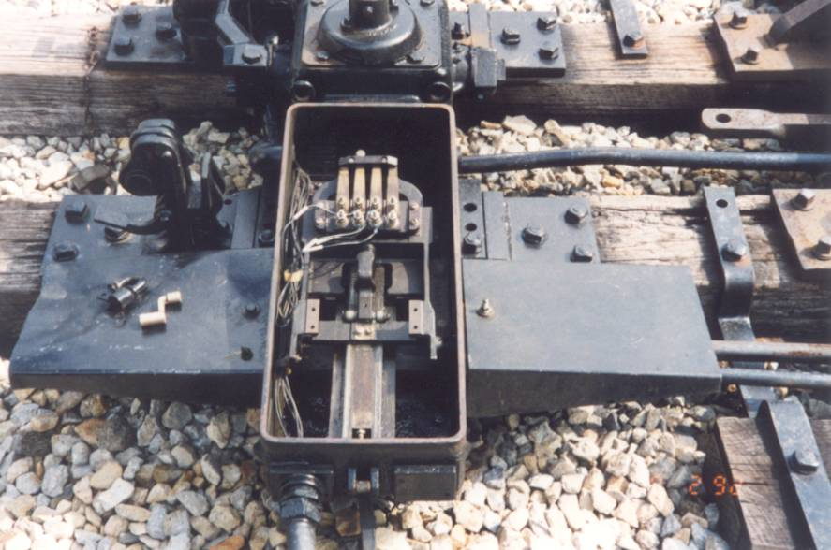
236.7 Circuit controller operated by switch-and-lock movement.
22
Notes:
A switch an lock movement is defined as any device, the complete movement of which performs the three operations of unlocking, operating, and locking a switch, movable point frog, or derail.

Slide 23
Switch and Lock Movement Definition
§ 236.775 Movement, switch-and-lock.
A device, the complete operation of which performs the three functions of unlocking, operating and locking a switch, movable-point frog or derail.
23

Slide 24
236.7 Circuit controller operated by switch-and-lock movement.
Circuit controller operated by switch-and-lock movement shall be maintained so that normally open contacts will remain closed and normally closed contacts will remain open until the switch is locked.
24
Notes:
Because switch and lock movements must complete all three functions of unlocking, operating, and locking a switch, movable point frog, or derail it must be designed, installed, and maintained in such a manner that its circuit controller will not indicate that the switch is in the proper position until the locking bar is in its fully lock position.
In other words, it is not enough for the device to move the switch points. Before the signal system considers the switch to be safe to traverse by a train the points have to be moved to the proper position and locked into place.
This rule applies to hand-operated, mechanical, or power-operated switch-and-lock movements including such machines as models M-22, M-23, 5, 55, T-20, etc. Before locking bar is completely withdrawn from lock rod, normally closed contacts must open and normally open contacts must close and remain so until locking bar has again engaged lock rod.

Slide 25
236.8 Operating characteristics of electromagnetic, electronic, or electrical apparatus.
Signal apparatus, the functioning of which affects the safety of train operation, shall be maintained in accordance with the limits within which the device is designed to operate.
25
Notes:
Operating characteristics of electromagnetic, electronic, or electrical apparatus in service must be in accordance with the limits within which it is designed to operate.
Rules 101, 102, 105, 106, 107, 108, 109, 551, 552, 588, and 589 address those devices so important to the safety of train operation that periodic tests are required to ascertain that operating characteristics remain unchanged.
This rule applies to all electromagnetic, electronic, or electrical devices used in or associated with vital circuitry or switch machine operation.

Slide 26
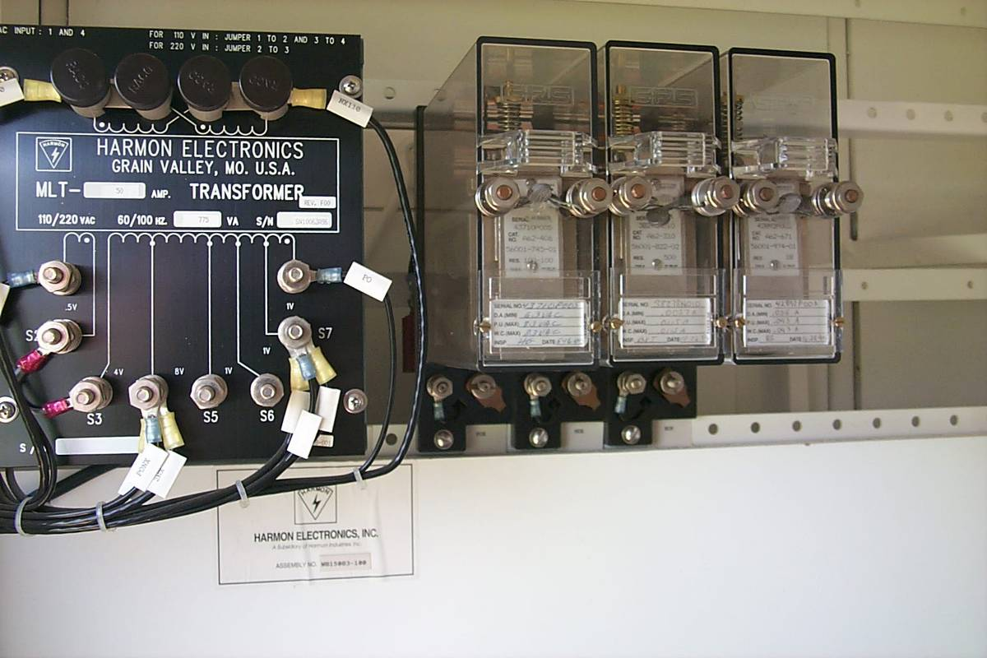
236.8 Operating characteristics of electromagnetic, electronic, or electrical apparatus.
26
Notes:
Each carrier should have specifications that determine the pick-up values, release values, working values, and condemning limits of these values for all electromagnetic, electronic, or electrical devices in use on its property. Some examples of deficient operating characteristics are:
a. Pick-up value too high.
b. Pick-up value too low.
c. Release value too high.
d. Release value too low.
The manufacturer’s specifications or carrier standards compatible with manufacturer specifications shall be used to determine these values.

Slide 27
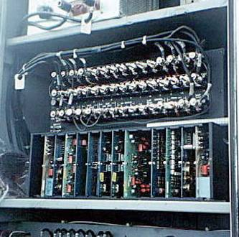
236.8 Operating characteristics of electromagnetic, electronic, or electrical apparatus.
27
Notes:
Some examples of electromagnetic devices covered by this rule not requiring periodic tests are:
a. Switch machine controllers.
b. Thermal relays of switch machine controllers.
c. Indicating magnets on interlocking machines.
d. Coils of forced drop electric locks.

Slide 28
236.9 Selection of circuits through indicating or annunciating instruments.
This rule prohibits selecting vital circuits through annunciating and/or indicating devices, such as;
Block indicator
Cab indicator
“OS”ing device
Test such devices by manually moving indicator armature to ensure vital circuits are not controlled by the movement of these devices.
28
Notes:
Vital relays and other signal devices are design to the highest practical standards of quality, whereas many indicating devices and annunciators are not. For this reason it is prohibited to select vital signal circuit through such devices. Signal control and electric locking circuits are required to be selected through contacts of safety (vital) relays.
This rule does not prohibit the use of annunciating or indicating devices, but does prohibit selecting vital circuits through contacts operated by such devices.
Some examples of annunciating or indicating devices are:
a. Switch indicator
b. Block indicator
c. Cab indicator
d. Approach indicator
e. Track indicator
f. OSing device
g. Semaphore indicator
h. Manually-operated calling-on device.
Test such devices that are in non-compliance by manually moving indicator to energized position and observing if armature and contacts are actuated. If so, contacts of such devices may not be used in vital circuitry.

Slide 29
Electric Switch Lock Definition
§ 236.758 Lock, electric, forced drop.
An electric lock in which the locking member is mechanically forced down to the locked position.
29

Slide 30
236.10 Electric locks, force drop type, where required.
This rule requires that electric locks applied to new installations and new electric locks applied to existing installations be of the forced-drop type.
Note: Applies to all electric locks installed after October 1, 1950.
30
Notes:
Non-force drop electric switch locks have been banned for over half a century. Unfortunately, due to the extreme ruggedness of signal equipment some still may be in service.
Force-drop electric switch lock are designed so that when the operating handle is move to the “locked” position the armature of the locking mechanism is force away from the magnetic coils and is mechanically held in the lock position to correspond with the operating handle.

Slide 31
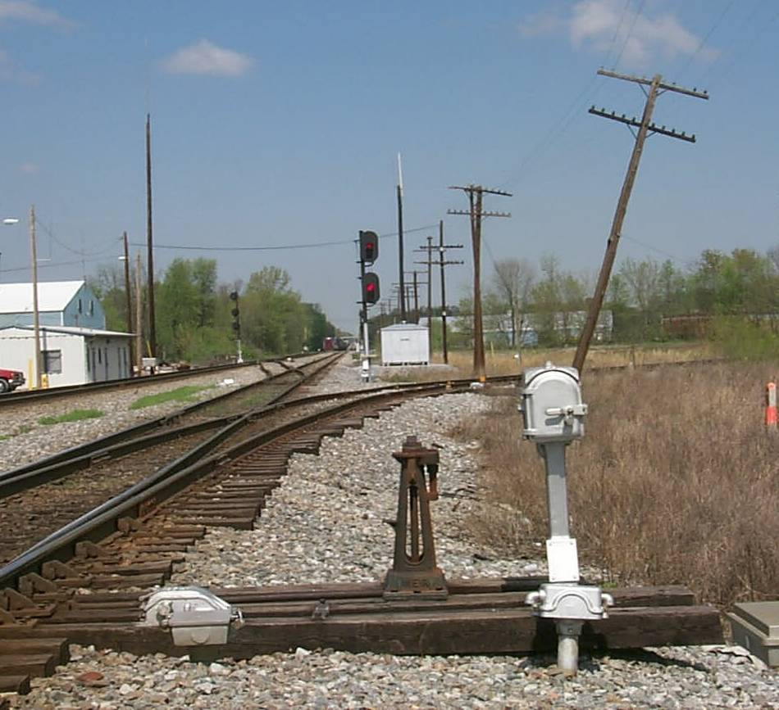
236.10 Electric locks, force drop type, where required.
31
Notes:
This rule requires that electric locks applied to new installations and new electric locks applied to existing installations be of the forced-drop type.
Applies to all electric locks installed after October 1, 1950, on new locations.
Applies to all electric locks on hand-operated switches and interlocking machines.
Tests should be made to determine that the locking dog is forced down into the locking sector. This test can be made by observing movement of the locking dog as the switch lock is locked in normal position.
Since most forced-drop type locks are spring loaded, they should be checked to determine that the spring is of sufficient strength so that normal operation does not release the locking dog unless the lock is energized.
A non-forced-drop electric lock may be removed from service, repaired and restored to service only when replacing another non-forced-drop type electric lock. It is highly recommended when removing a non-force-drop electric lock from service to replace it with a force-drop type lock.

Slide 32
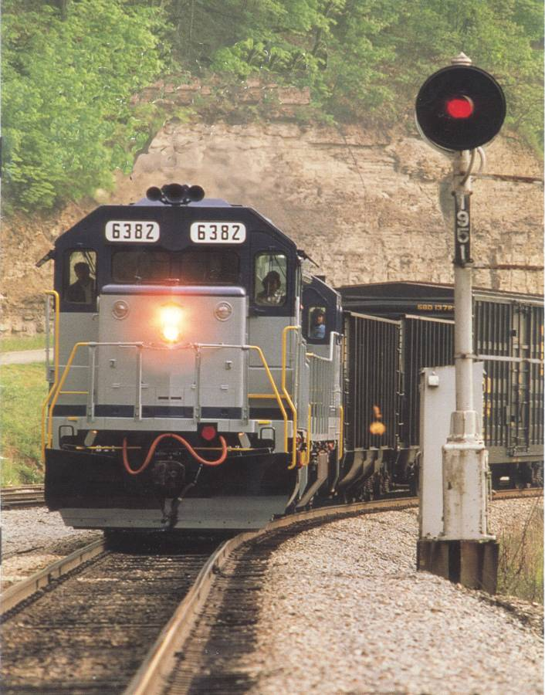
236.11 Adjustment, repair, or replacement of component
This rule requires any defective signal component or condition (which adversely affects the safety of train operation) be investigated and corrective action taken without undue delay.
32
Notes:
In order to preserve the integrity of the signal system it is important that any component that has failed to perform its intended function or any condition that adversely affects the safety of rail operations be investigated and corrected without undue delay. The Federal Railroad Administration defines “without undue delay” as before the next train movement, if the condition presents an adverse affect on safe train operations.
Often, the seriousness of the failure cannot be determined until it has been investigated. For example, a signal may be displaying a “Stop” indication. The railroad may have operating rules that allow trains to continue to operate passed that signal under the assumption that the signal is faulty. However, the signal may be at “Stop” because of a broken rail. The cause of the failure must be investigated “without undue delay.”
This rule requires the railroad to determine the cause of a signal aspect that is not in accordance with known operating conditions and requires that a failed signaling component which adversely affects safety of train operation be adjusted, repaired, or replaced without undue delay.
A signal aspect "not in correspondence with known operating conditions," means a signal aspect other than that intended by normal signal system operation.
Railroads are required to determine the cause of each "stop" or "stop and proceed" aspect resulting from an unknown condition. If that condition is the result of the failure of a signaling component and is a hazard to the safety of train operation, corrective action is required before the next train movement.

Slide 33
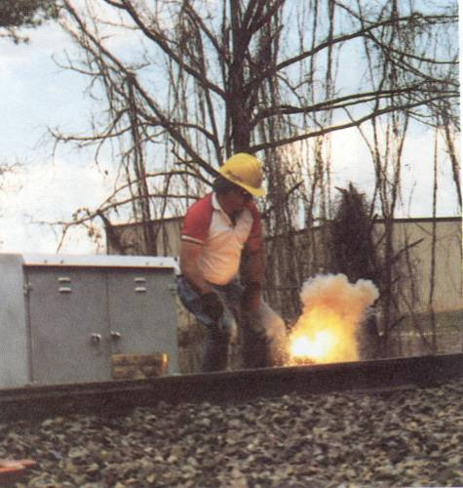
236.11 Adjustment, repair, or replacement of component
Some conditions which cause false restrictive indications may cause inconvenience to the railroad but do not necessarily pose a threat to safety of train movements.
33
Notes:
Conditions which cause false stop or false restrictive indications may cause inconvenience and additional expense to train movements. Examples of such conditions that do not necessarily pose a threat to safety of train operation are a burned out lamp, a broken track circuit connector, or a broken line wire. Under these condition, trains may continue to operate under the railroad operating rules as required by 49 CFR 236.0.

Slide 34
236.11 Adjustment, repair, or replacement of component
Applies to adjustable components which, when improperly adjusted, creates a safety hazard such as;
Circuit controller
Point detector
Lock rods
Timing relays
Track circuit values
34
Notes:
This rule applies to adjustable components which, when improperly adjusted, creates a safety hazard such as circuit controller, point detector and lock rod adjustments exceeding the requirements; insufficient predetermined time intervals; and excessive track circuit values.

Slide 35
236.11 Adjustment, repair, or replacement of component
Applies to components which, if not repaired, creates a safety hazard such as;
Grounded circuits
Insecure circuit controllers
Loose or insecure switch machines
Worn or defective lock rods
Worn or defective point detector rods
35
Notes:
This rule also applies to components which, if not repaired, creates a safety hazard such as grounded circuits; insecure circuit controllers, switch machines, pipeline carriers and cranks; and bent, worn, or insecure connecting rods, lock rods, and point detector rods.

Slide 36
236.11 Adjustment, repair, or replacement of component
Applies to components which, if not replaced, creates a safety hazard such as;
Broken connecting rods
Broken lock rods
Broken point detector rods
Broken fouling wires
Defective cables
Defective relays
36
Notes:
This rule applies to components which, if not replaced, creates a safety hazard such as broken connecting rod, lock rod, point detector rod, pipeline, or crank; broken fouling wires, shunt wires, and bond wires in fouling circuit; defective relays, cable, and conductors.
Note: Test equipment and instruments are excluded.

Slide 37
Switch Definitions
§ 236.822 Switch, spring.
A switch equipped with a spring device which forces the points to their original position after being trailed through and holds them under spring compression.
§ 236.818 Switch, facing point.
A switch, the points of which face traffic approaching in the direction for which the track is signaled.
§ 236.823 Switch, trailing point.
A switch, the points of which face away from traffic approaching in the direction for which the track is signaled.
37

Slide 38
236.12 Spring switch signal protection, where required.
This rule prescribes signal protection for spring switches in interlockings; and for spring switches installed after October 1, 1950, in automatic block signal, train stop, train control or cab signal territory where movements over the switch exceed 20 miles per hour.
38
Notes:
This rule prescribes signal protection for spring switches in interlockings and for spring switches installed after October 1, 1950, in automatic block signal, train stop, train control or cab signal territory where movements over the switch exceed 20 miles per hour.
This rule prescribes where spring switch protection is required, whereas Rules 236.13 and 236.14 prescribe how it will operate.
On all spring switches installed after October 1, 1950, in automatic block signal, train stop, train control, and cab signal territory where the speed exceeds 20 miles per hour, signal protection is required in the facing and both trailing routes.
Signal protection is required only with the current of traffic on track signaled for movement in one direction.
Signal protection is required for movements against the current of traffic from the reverse main of main tracks to a single main track.

Slide 39
236.13 Spring switch; selection of signal control circuits through circuit controller.
This rule requires that control circuits of signals governing facing movements over a main track spring switch be selected through the switch circuit controller or a relay repeating the position of such circuit controller.
This rule applies to interlockings, automatic block signal and other protective systems.
39
Notes:
This rule requires that control circuits of signals governing facing movements over a main track spring switch be selected through the switch circuit controller or a relay repeating the position of such circuit controller.
This rule applies to interlockings, automatic block signal, and other protective systems.
Note: Rules 236.303 and 236.342 apply to spring switches in interlocking and traffic control systems.
This rule requires point protection for facing movements over spring switch. Trailing point protection is not required.
Control circuits for facing movements must be selected through either switch circuit controller or track relay where switch shunting circuit is used.
This rule applies to spring switches provided with signal protection in non-signaled territory. It does not require such protection be provided, but if protection is provided, it must meet these requirements.
Test of spring switch shall be made by placing a one-fourth inch gage six inches from the end of the switch point on either the normal or reverse side and then placing the spring switch throw lever in either the full normal or reverse position as appropriate.

Slide 40
236.14 Spring switch signal protecting; requirements.
This rule prescribes how spring switch signal protection shall operate in automatic block signal territory when it governs movements with the current of traffic from a siding to main track signaled for movements in one direction; from a main track to another main track operating against the current of traffic, or when operating from a main track to a siding signal in both directions.
40
Notes:
This rule prescribes how spring switch signal protection required by Rule 236.12 shall operate in automatic block signal territory when it
governs movements with the current of traffic from a siding to main track signaled for movements in one direction;
governs movements from a siding to a main track signaled for movements in either direction;
governs movements from the end of double track territory signaled for movements in one direction with the current of traffic to single track territory.
It permits the use of approach or time locking an applies to automatic block signal territory only.
Paragraph (a) sets forth the requirements for signals governing movements from siding to main track signaled for movements with the current of traffic.
Paragraph (b) sets forth the requirements for signals governing movements against the current of traffic from the reverse main of main tracks to single track or from siding to main track signaled for movements in either direction when block into which signal governs is occupied by preceding trains or by opposing trains.
Paragraph (c) sets forth the requirements for signals governing movements against the current of traffic from the reverse main of main tracks to single track or from siding to main track signaled for movements in either direction when a train is approaching the switch within 1,500 feet in approach of the approach signal located stopping distance from the main track signal governing trailing movements over the spring switch.

Slide 41
236.15 Timetable instructions.
Automatic block, traffic control, train stop, train control, and cab signal territory shall be designated in timetable instructions.
41
Notes:
This rule requires automatic block, traffic control, train stop, train control, and cab signal territories to be designated in timetable instructions.
They may be published in either timetable or special instructions in any manner the railroad chooses.
Note: Interlockings are not required to be so designated.

Slide 42
236.16 Electric lock, main track releasing circuit.
When an electric lock releasing circuit is provided on the main track to permit a train or an engine to diverge from the main track without time delay, the circuit shall be of such length to permit occupancy of the circuit to be seen by a crew member stationed at the switch…
42
Notes:
An electric lock main track release circuit is primarily used to allow for a train on the main track to enter the side track while the main track is occupied without running the time delay required by time locking.
This rule sets forth the requirements for main track releasing circuit for electric lock on hand-operated switch.
This rule does not require that a main track quick release circuit be installed at electrically locked switches. However, where such circuits are installed, the rule prohibits the electric lock releasing circuit on the main track from being of such length that distance or curvature of track will prevent a crew member standing at the switch from observing a train or car occupying the releasing circuit.

Slide 43
236.16 Electric lock, main track releasing circuit.
The rule also requires that where the electric lock releasing circuit extends into the fouling section of turnout, train shall be prevented from occupying the fouling section by pipe-connected or independently operated, electrically locked derail at the clearance point.
43
Notes:
The rule also requires that where the electric lock releasing circuit extends into the fouling section of turnout, train shall be prevented from occupying the fouling section by pipe-connected or independently operated, electrically locked derail at the clearance point.
The releasing circuit shall be considered as extending into the fouling section if it extends further than the heel of the switch points.
Note: The provisions of Section 236.205(d) are applicable to the relay utilized to provide quick release as it is considered a “track circuit relay”. If that relay is in its state of allowing quick release (i.e., normally energized relay being de-energized or, normally de-energized relay being energized), it shall effect the opening of the control circuits governing signals over the switch in either direction.

Slide 44
236.17 Pipe for operating connections; requirements.
This rule prescribes steel or wrought-iron pipe one inch or larger for operating connections of pipe-connected appliances, with each joint fully screwed into coupling with each end of pipe secured by two rivets. Pipe shall be supported on carriers not more than 8 feet apart on tangent and curves of less than 2 degrees and not more than 7 feet apart on curves of more than 2 degrees.
44
Notes:
While there are but a few mechanical interlocking using pipelines left in the country, this rule applies to pipeline connections in any signal system. The purpose of this rule is to ensure that pipelines controlling switches, signal, derails, and other movable devices are:
Made of the proper material
Connected properly
Supported adequately to prevent binding
Properly compensated for changes on temperature
Assembled in such a manner that component pieces do not interfere with each other.
This rule prescribes steel or wrought-iron pipe one inch or larger for operating connections of pipe-connected appliances, with each joint fully screwed into coupling with each end of pipe secured by two rivets. Pipe shall be supported on carriers not more than 8 feet apart on tangent and curves of less than 2 degrees and not more than 7 feet apart on curves of more than 2 degrees. Pipeline shall be properly aligned and compensated and couplings shall not foul carriers. Up-and-down rods of mechanically operated signals may be three-fourths inch pipe or solid rod.
Steel or wrought-iron pipe prescribed by this rule is one-inch nominal inside diameter pipe, or 1.315 inch actual outside diameter pipe. Three-fourths inch pipe measures 1.05 inch actual outside diameter.
Pipelines should be operated and carefully observed for bowing when pipe is under compression. The pipeline shall be so installed that when a device is obstructed, the pipeline shall be prevented from bowing enough to permit latching of lever or full drive of power operated machine.
Carriers must be complete and properly assembled and spacing strictly adhered to. Pipeline must be kept in proper alinement and carrier foundations must be secure and permit no movement when pipeline is operated.
Bent or damaged pipe is prohibited.
This rule does not apply to pipeline used as “helper rods” associated with power-operated switch machines.

Slide 45
236.18 Software Management Control Plans.
This rule requires railroads to have a written plan in place known as the “SMCP.”
“Software management control plan” means a plan designed to ensure that the proper and intended software version for each specific site and location is documented (mapped) and maintained through the life-cycle of the system.
45
Notes:
This rule requires each railroad develop and adopt a software management control plan for existing processor-based signal and train control systems. Each railroad must develop and adopt a software management control plan on or before December 6, 2005. Each railroad commencing operations after June 6, 2005, is required to adopt a software management control plan prior to commencing operations.
Each railroad is then required to have its software management control plan fully implemented no later than 30 months after its adoption. The deadline for implementation is June 6, 2008.
“Software management control plan” means a plan designed to ensure that the proper and intended software version for each specific site and location is documented (mapped) and maintained through the life-cycle of the system.

Slide 46
236.18 Software Management Control Plans.
The plan must further describe how the proper software configuration is to be identified and confirmed in the event of replacement, modification, or disarrangement of any part of the system.
46
Notes:
The plan must further describe how the proper software configuration is to be identified and confirmed in the event of replacement, modification, or disarrangement of any part of the system. The requirements of this section apply to all software of processor-based signal and train control equipment in service on June 6, 2005. The requirements do not apply to hardware except to a limited degree (disarrangement of hardware should be considered only for those occurrences of natural disasters (e.g., lightning, floods, etc.) or accidents (e.g., fires, derailments, automobiles that strike instrument housings, etc.) that destroy or damage equipment locations to the extent it requires replacement of processor-based equipment).
Products subject to the provisions contained in Part 236, Subpart H, are required to be developed, installed, implemented, and maintained in strict accordance with a configuration management control plan contained in an Federal Railroad Administration approved Product Safety Plan (PSP). Configuration management is a process to ensure all documentation which describes a system and its various components are current and reflect the actual functional and physical characteristics (configuration) of the system throughout its life-cycle. Software configuration control ensures that any software revision (e.g., addition, modification, or deletion) is prepared, authorized, receipt acknowledged, and placed in service in accordance with established procedures. FRA defines a full “configuration management control plan” to mean a plan designed to ensure that the proper and intended product configuration, including the hardware components and software version, is documented and maintained through the life-cycle of the products in use. The requirements of this section do not apply to configuration management required within a PSP although, a railroad may combine its software management control plan with the configuration management control plan for products a railroad may elect to be made subject to Subpart H.

Slide 47
236.18 Software Management Control Plans.
There’s usually two parts to an SMCP.
The overall written plan describing version control, chain of custody, how to document revisions, and etc.
The actual line item listing of each location of software, which usually also contains the revision level info, chassis ID, checksum, CRC, and etc.
47
Notes:
A software management control plan is an inventory of software at each equipment location of a signal or train control system which includes each wayside location, each rail-highway grade crossing that provides safety-critical data to a signal or train control system, onboard each equipped locomotive, and at each departure test point. The plan must reflect the existing software, software changes resulting from modifications, upgrades in software, upgrades in hardware that require new or modified software, and changes in operating conditions such as removal or addition of switches or signals, respacing, and increased speeds.
The plan should be updated to reflect each change and provide traceability to previous versions of software. S&TC personnel should be able to determine from the software management control plan precisely what software is installed at each location.
A software management control plan will track the version of software that should be and is in use in all equipment locations of a signal and train control system. The plan should identify and document for each equipment location devices that contain software. FRA is not requiring railroads to track changes deeper than that at the PROM (PROMS, EPROMS, EEPROMS, etc.) level. Accordingly, circuit boards with embedded memory and programmable memory devices should be identified in the plan. The plan should identify the name of the executive or application software, software version number, software revision number, date of software revision, and a description of the software cyclic redundancy check. In addition, the location of each spare PROM and circuit board with embedded memory should be identified. The installation of a spare PROM or circuit board with embedded memory and the disposition of each shall be recorded in the software management control plan. The software management control plan should stipulate that when testing or otherwise, no PROM or circuit board with embedded memory may be replaced with another until it has been verified the replacement is correct.
A software management control plan must require the software to be maintained as specified, i.e., software shall be maintained strictly as required by design. The plan should require revisions (additions, modifications and deletions) to a processor-based equipment be made only upon written approval of the railroad’s designated responsible officer or his/her designated representative. Each revision of the software shall be supported by documentation which includes and originates from a change request initiated by the railroad or the vendor and be attached to the revision document. Software revision control shall require documentation that describes the reason for making the change and a description of the change, the supporting hardware and compatible interfaces. Each software revision shall contain documentation that describes the functional description, change summary, and compatibility summary to ensure the revision meets the railroad’s requirements. The documentation for each revision shall contain instructions for verifying and field testing any change not covered in the railroad’s rules, standards and procedures that govern installation, maintenance and testing of processor-based equipment. Unless specifically identified otherwise in the documentation, each revision shall be installed and tested in accordance with the railroad’s rules, standards, and procedures.
The software management control plan should specify that a safety-critical software upgrade, patch, or revision from a supplier, must be installed without undue delay. The plan should identify interim steps to be taken to assure safety of train operations and the motoring public until the safety-critical upgrade, patch, or revision has been installed.
Upon completion of each revision, the software management control plan shall be updated to reflect the change, including software revision number, version number, and date and time installed, and name of individual performing the installation. A record of the revision installation shall be submitted to the responsible railroad official or his/her designated representative, to document that the revision has been installed. The results of tests validating each revision should be included and must be recorded and made part of the software management control plan record.
The software management control plan is required to be maintained on file at a designated railroad office, or offices, and available for review or replication by FRA Inspectors or FRA-certified State Inspectors. (See FRA Technical Bulletin S-06-01 and S-07-01)

Slide 48
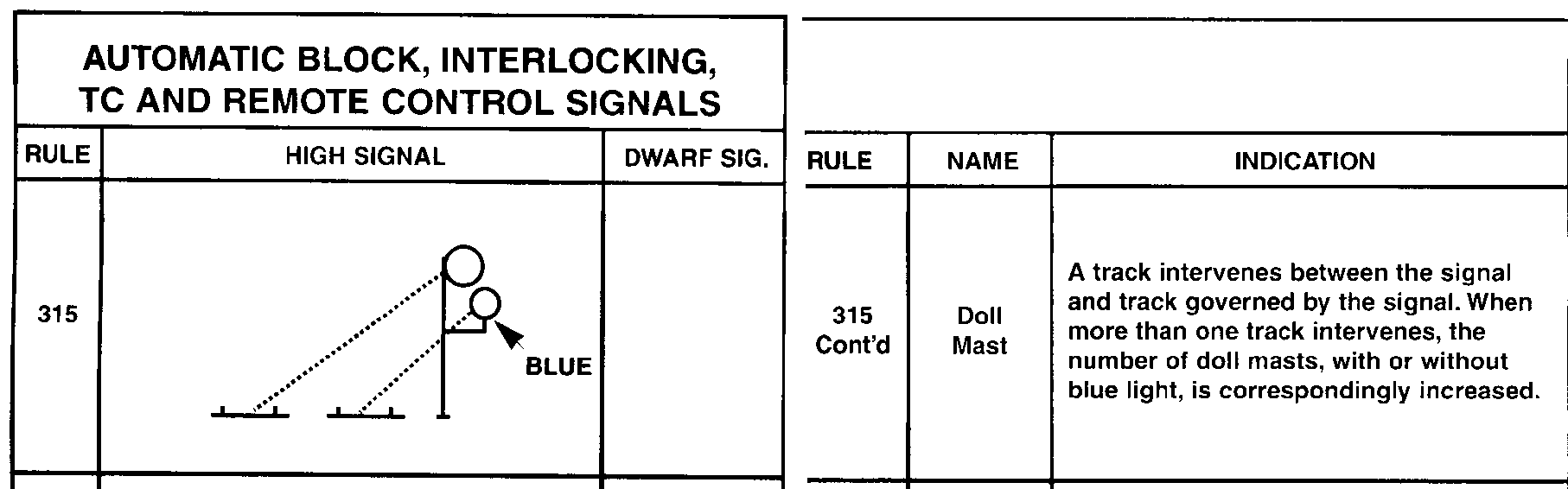
236.21 Location of roadway signals.
Each roadway signal shall be positioned and aligned so that its aspects can be clearly associated with the track it governs.
48
Notes:
This rules requires that each signal be positioned and aligned so that the aspect it displays is clearly associated with the track it governs.
Signal personnel must be alert for installation where it is possible to mistake the aspect of one signal for that of another.

Slide 49
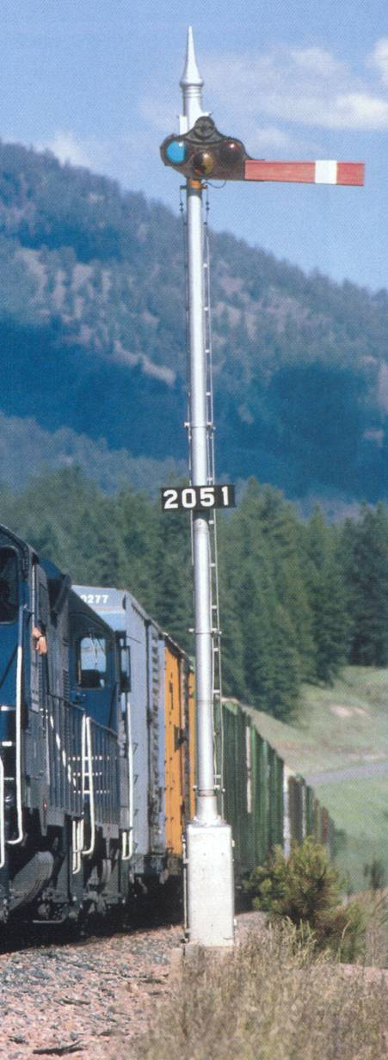
236.22 Semaphore signal arm; clearance to other objects.
At least one‑half inch clearance shall be provided between semaphore signal arm, and any object that may interfere with its operation
49
Notes:
This rule requires one-half inch clearance between a semaphore arm and any object which may interfere with its operation.
Operational test of semaphore signal should be made to insure any object, including light unit, clears arm, and spectacle at least one-half inch throughout its arc of travel.

Slide 50
Semaphore Arm Definition
§ 236.702 Arm, semaphore.
The part of a semaphore signal displaying an aspect. It consists of a blade fastened to a spectacle.

Slide 51
236.23 Aspects and indications
This rule prescribes how aspects will be shown, that each aspect will be named and indicate action to be taken and the fundamental indications of the aspects.
Applies to all systems. Each aspect and indication is required to be defined in railroad’s rule book or special instructions.
51
Notes:
This rule prescribes how aspects shall be shown, that each aspect shall be named and indicate action to be taken and the fundamental indications of the aspects.
It provides that signals may be qualified and prohibits the use of reflector lenses or buttons or other devices depending upon reflected light for visibility in lieu of signal aspects. It prescribes that the names, indications, and aspects be defined in the railroad's operating rule books or special instructions.
Applies to all system. Each aspect and indication is required to be defined in railroad's rule book or special instructions.
Use of single white light is prohibited except for indicators of protective devices such as hotbox or dragging equipment detectors and for use as a qualifying appurtenance.
It is permissible for railroads to qualify red aspect to permit its use to indicate "Proceed at Restricted Speed" without requiring stop (see Rule 236.204). Such signals are generally used in mountain grade territory where it may be difficult to restart a train once it has made a complete stop. Yellow or lunar aspect must be used to approach such signals.
The absence of a semaphore arm on a semaphore signal is an imperfectly displayed signal and does not meet these requirements.
Fixed signal aspects, without lights or which depend for visibility upon a reflected light from an external source, is in violation of this part for night train operation.
The rule prohibits future installation of reflective devices in lieu of signal aspects such as the yellow triangle that will permit a higher speed when certain aspects are displayed.
The failure of a lamp in a light signal, a false restrictive position of a semaphore arm or the absence of a qualifying appurtenance shall not cause a signal to display a more favorable aspect than intended. (See FRA Technical Bulletin S-99-01)

Slide 52
Aspect and Indication Definitions
§ 236.703 Aspect.
The appearance of a roadway signal conveying an indication as viewed from the direction of an approaching train; the appearance of a cab signal conveying an indication as viewed by an observer in the cab.
§ 236.749 Indication.
The information conveyed by the aspect of a signal.
52

Slide 53
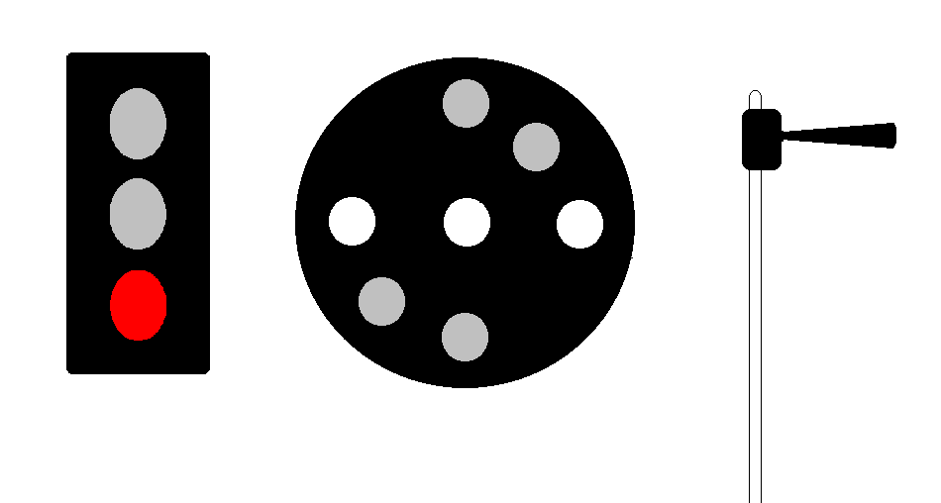
236.23 Aspects and indications
Aspect = Red, Name = Stop, Indication = Stop
53
Notes:
A red light, a series of horizontal lights or a semaphore blade in a horizontal position shall be used to indicate stop.

Slide 54
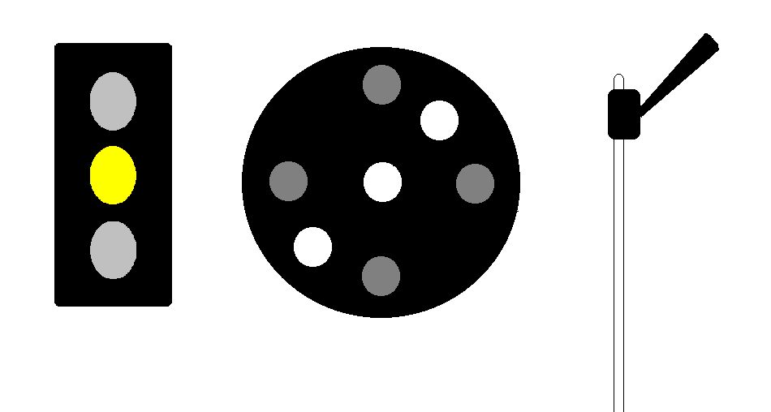
236.23 Aspects and indications
Aspect = Yellow, Name = Approach,
Indication = Approach next signal prepared to stop
54
Notes:
A yellow light, a lunar light, or a series of lights or a semaphore blade in the upper or lower quadrant at an angle of approximately 45 degrees to the vertical, shall be used to indicate that speed is to be restricted and stop may be required.

Slide 55
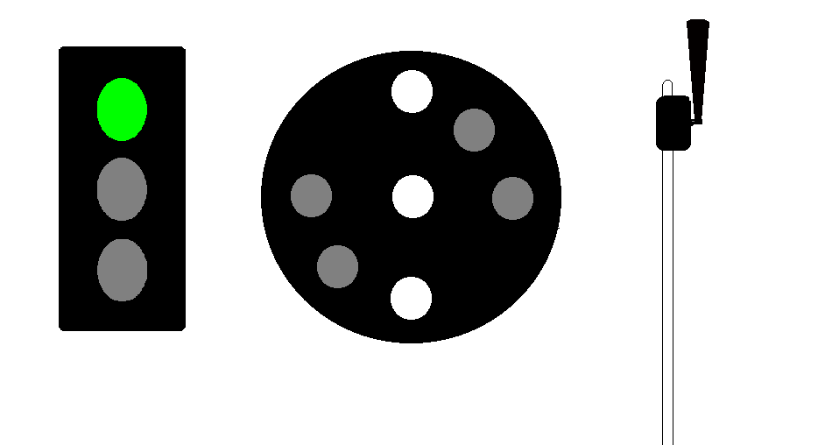
236.23 Aspects and indications
Aspect = Green, Name = Clear, Indication = Proceed
55
Notes:
A green light, a series of vertical lights, or a semaphore blade in a vertical position in the upper quadrant or 60° or 90° in the lower quadrant shall be used to indicate proceed at authorized speed.

Slide 56
236.24 Spacing of roadway signals.
Each roadway signal shall be located with respect to the next signal or signals in advance which govern train movements in the same direction so that the indication of a signal displaying a restrictive aspect can be complied with by means of a brake application, other than an emergency application…
56
Notes:
This rule requires signals to be adequately spaced to provide proper distances for reducing speeds or stopping by use of other than an emergency brake application before reaching the point where reduced speed or stopping is required.
This rule also requires that in ACS, ATC and ATS territory, these braking distances be adequate to compensate for the 8 second delay time which is designed into almost all ACS, ATC and ATS systems. Section 236.563 states in part, “. . . and the spacing of signals to meet the requirements of 236.24 shall take into consideration the delay time.” Thus, the proper spacing of signals must also include the spacing of code change points so that a train may comply with the indications of a cab signal, train stop or train control system without using an emergency brake application before reaching the point where reduced speed or a stop is required.
The railroad's braking distance charts shall be used to determine proper spacing. In event a railroad does not have a braking distance chart, braking tests may be required at suspected locations.

Slide 57
Stopping (Braking) Distance Definition
§ 236.741 Distance, stopping.
The maximum distance on any portion of any railroad which any train operating on such portion of railroad at its maximum authorized speed, will travel during a full service application of the brakes, between the point where such application is initiated and the point where the train comes to a stop.
57

Slide 58
236.26 Buffing device, maintenance.
Buffing device shall be maintained so as not to cause the signal to display a less restrictive aspect than intended.
Note: Applies to semaphore signals only.
58
Notes:
This rule requires that buffing device be so maintained that it cannot cause a signal to display a less restrictive aspect than intended.
Operational test should be made to observe that oil or air buffers operate properly.
In the event the buffing device causes a signal to display a less restrictive aspect than intended, a false proceed report shall be filed with the FRA.

Slide 59
Track Circuits

Slide 60
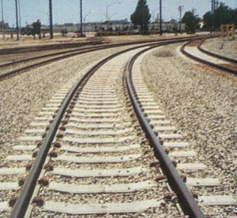
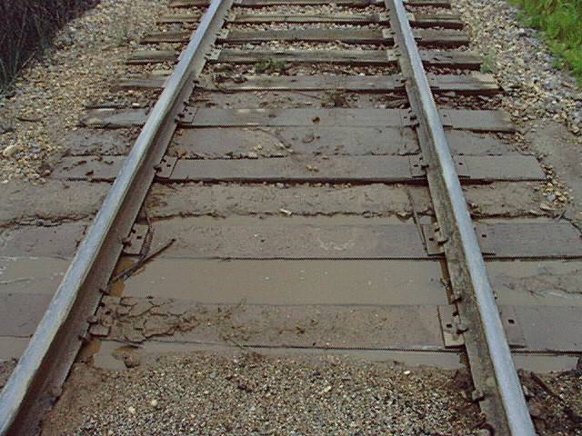
236.51 Track circuit requirements.
60
Notes:
Track circuits are the critical link between the signal system and the moving train. The proper installation, adjustment, and maintenance is crucial to proper operation of the entire system.

Slide 61
236.51 Track circuit requirements.
Track relay controlling home signals shall be in de-energized position, or device that functions as a track relay controlling home signals shall be in its most restrictive state, and the track circuit of an automatic train stop, train control, or cab signal system shall be de-energized in the rear of the point where any of the following conditions exist…
61
Notes:
This rule is the standard by which all track circuits which control home signals or locking circuits shall be designed and installed. This rule is not applicable to track circuits which do not affect the safety of train operation.
Applies to all types of track circuits which control home signals or locking circuits. Does not apply to track circuits that do not affect safety of train operation such as annunciator circuits or approach lighting circuits on non-signaled sidings.
Automatic train stop, train control, and cab signal systems track circuits required to be de-energized under this rule include those superimposed on track circuits of the conjunctive system.
Maximum authorized speed through a turnout equipped with shunt fouling circuit is 45 mph.

Slide 62
236.51 Track circuit requirements.
Track relay shall be de-energized or device that functions as a track relay shall be in its most restrictive state when a rail is broken or a rail or switch frog is removed; when any part of the track circuit or fouling section is occupied by a train, locomotive or car; and…
62
Notes:
Track relay shall be de-energized or device that functions as a track relay shall be in its most restrictive state when a rail is broken or a rail or switch frog is removed; when any part of the track circuit or fouling section is occupied by a train, locomotive or car; and, where switch shunting circuit is used, when switch is not in proper position, facing point lock is not locked, or independently operated derail is not in derailing position.

Slide 63
236.51 Track circuit requirements.
Track relay shall be de-energized or device that functions as a track relay shall be in its most restrictive state when a rail is broken or a rail or switch frog is removed;
63
Notes:
Track circuits are required to provide broken rail protection, with a few exceptions.
It is not a violation of this rule if the track relay is not de-energized or the device that functions as a track relay is not in its most restrictive state when a rail is broken or removed in a shunt fouling circuit; when a break occurs between the end of a rail and track circuit connector, within the limits of a rail-joint bond appliance, or other protective device; as a result of leakage current or foreign current in the rear of a point where a break occurs; or as a result of sand, rust, dirt, grease, or foreign matter preventing shunting.
Where sand, rust, dirt, grease, or other foreign matter is known to prevent, or possibly prevent, effective shunting, the carrier is required to take adequate measures to safeguard safety of train operation.
Track relay must be in de-energized position or device that functions as a track relay must be in its most restrictive state when a rail is removed.
Non-shunting sections caused by insulated rail joint stagger on short track circuits and in connection with crossing frogs are one of the most overlooked variances with this rule. Staggered insulated rail joints in excess of five (5) feet create the possibility of cars or locomotives occupying part of a track circuit undetected.

Slide 64
236.52 Relayed cut section.
Where relayed cut‑section is used in territory where non-coded direct‑current track circuits are in use the energy circuit to the adjoining track shall be open and the track circuit shunted when the track relay at such cut‑section is in de-energized position.
64
Notes:
A cut section refers to an arrange where a block section is too long to maintain a single track circuit due to current leakage through ties and ballast. In such cases the block is divided into sections called cut sections. If the section does not reach to the signal it may be repeated through adjacent sections by a track relay. These sections are referred to as relayed cut sections. This rule requires that where energy of non-coded direct-current track circuit is supplied through contacts of adjoining non-coded track relay, energy circuit shall be opened and track circuit shunted when relay is de-energized.
This rule applies at relayed cut-section of non-coded direct-current track circuit only, including polar, neutral or biased relays.

Slide 65
Relayed Cut-section Definition
§ 236.737 Cut-section, relayed.
A cut-section where the energy for one track circuit is supplied through front contacts or through front and polar contacts of the track relay for the adjoining track circuit.
65

Slide 66
236.52 Relayed cut section.
Switch is open shunting Track 1
Resulting in Track 6 De-energizing
System in the “Normal” state
and switch is closed
Track 6
Track 5
Track 4
Track 3
Track 2
Track 1
Relay-cut Sections relay information about the system through
Track circuits over distances longer than a single track circuit.
Track circuit battery leads must not only be opened,
but shunted as well.
66
Notes:
The purpose of relayed cut section is to transmit information regarding the system status through track circuits over distances that are longer than any individual track circuit. This could be accomplished by simply opening the track circuit battery leads through the previous track circuits relay.
However, some railroad cross ties that are treated with preservatives can act as a battery when interacting with chemicals in the ballast. To prevent these natural batteries from falsely energizing the track relay this rule requires that the track lead be shunted.

Slide 67
236.53 Track circuit feed at grade crossing.
At grade crossing with an electric railroad where foreign current is present, the electric energy for non-coded direct current track circuit shall feed away from the crossing.
67
Notes:
At crossing-at-grade of a non-electrified railroad using non-coded direct-current track circuits with electrified railroad, this rule requires the battery end of direct-current track circuit be located at the crossing. The purpose of this rule is to place the non-coded direct current relay as far from the potential source of foreign current as possible.
This rule is not applicable unless foreign current is proven to be present.

Slide 68
236.54 Minimum length of track circuit.
When a track circuit shorter than maximum inner wheelbase of any locomotive or car operated over such track circuit is used for control of signaling facilities, other means shall be used to provide the equivalent of track circuit protection.
68
Notes:
The purpose of this rule is to prevent the possibility of a locomotive or car from bridging a track circuit and causing the signal system to respond inappropriately.
Track circuits shorter than the inner wheelbase of any car or locomotive operating over the track are prohibited unless supplemented with other protective devices or circuits that provide protection equivalent to a track circuit.
This rule is applicable to all track circuits which control home signals or electric locking circuits. The rule does not apply to track circuits used exclusively for approach lighting circuits on sidings or auxiliary tracks or to annunciator circuits or other non-vital type track circuits.

Slide 69
236.55 Dead section; maximum length.
Where dead section exceeds 35 feet, a special circuit shall be installed. Where shortest outer wheelbase of a locomotive operating over such dead section is less than 35 feet, the maximum length of the dead section shall not exceed the length of the outer wheelbase of such locomotive unless special circuit is used.
69
Notes:
This rule prohibits the use of dead section longer than the shortest outer wheel base of a carrier's locomotive but in no case longer than 35 feet without protecting it with a special circuit. The purpose of this rule is to ensure that a locomotive cannot be placed in a dead section and remain undetected by the signal system.
This rule applies to the outer wheelbase of locomotives only and does not apply to cars.
Trap circuits are more commonly used to protect dead sections; however, directional stick circuits fall into the category of special circuits.

Slide 70
Dead Section Definition
§ 236.798 Section, dead.
A section of track, either within a track circuit or between two track circuits, the rails of which are not part of a track circuit.
70

Slide 71
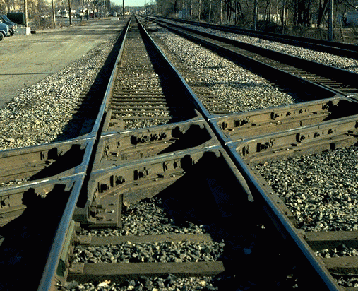
236.55 Dead section; maximum length.
This rule prohibits the use of dead section longer than the shortest outer wheelbase of carrier’s locomotive but in no case longer than 35 feet.
71
213TSSLO
V9.0
154
Notes:
This rule prohibits the use of dead section longer than the shortest outer wheel base of a carrier's locomotive but in no case longer than 35 feet without protecting it with a special circuit.
This rule applies to the outer wheelbase of locomotives only and does not apply to cars.
Trap circuits are more commonly used to protect dead sections; however, directional stick circuits fall into the category of special circuits.
Presence detector or other such devices satisfy the requirement of this part.
This rule is not applicable to non-shunting section caused by the stagger of insulated rail joints. Rule 236.51 applies to situations where stagger insulated rail joints permit cars to span a live rail of the track circuit.

Slide 72
236.56 Shunting sensitivity.
This requirement applies to any type track circuit of which the rails form a part of the circuit and used for controlling signal aspects or electric locking. Does not apply to approach lighting circuits on non-signaled track, annunciator circuits, etc.
The most difficult time to shunt a track circuit is when the ballast is dry or frozen.
72
Notes:
This rule requires that track circuit controlling signal aspects or electric locking shall be maintained so that when a shunt of 0.06 ohm resistance is connected across the rails of the track circuit at any location in the circuit, including shunt fouling section, the track relay shall assume the de-energized position or if an electronic device is used in lieu of a track relay, such electronic device shall assume its most restrictive state.
This requirement applies to any type track circuit of which the rails form a part of the circuit and used for controlling signal aspects or electric locking. Does not apply to approach lighting circuits on non-signaled track, annunciator circuits, etc.
The most difficult time to shunt a track circuit is when the ballast is dry or frozen.
Car frame type track circuit must comply with this section.
Each turnout has three fouling sections which should be tested.
Most restrictive state is defined in 236.813a as the mode of an electronic device that is equivalent to a track relay in its de-energized position. Regardless of the type of track circuit, this rule requires that signals governing movements over the track circuit must display their most restrictive aspects when the track circuit is shunted with a resistance of 0.06 ohms.
Note: The battery end rheostat is used to adjust the track circuit operating voltage. The relay end rheostat is used to adjust the shunting sensitivity of the track circuit.

Slide 73
236.57 Shunt and fouling wires.
Each track circuit controlling home signal or approach locking shall be so maintained that track relay is in de-energized position, or device that functions as a track relay shall be in its most restrictive state if, when track circuit is dry, a shunt of 0.06 ohm resistance is connected across the track rails of the circuit, including fouling sections of turnouts.
73
Notes:
Shunt fouling circuits are not designed or install using the “closed loop” principle, hence they must desire special attention. The special attention they receive is the principle of redundancy. Therefore, each wire component of the circuit must be composed of two discrete conductors.
Shunt wires and fouling wires are each required to be of sufficient conductivity and maintained in such condition that the track relay will be de-energized when the track circuit is shunted. Two completely separate conductors are required, except where switch circuit controller is used to both open control circuits and shunt the track circuit.
This rule prohibits the installation of a single duplex wire with single plug as fouling or shunt wires. The single plug constitutes a single conductor. Existing installations having single duplex wires with single plug for shunt or fouling wires may be continued in use until such time as they require repair or replacement. The use of two duplex wires with single plug is acceptable.
A conductor consisting of many small strands, such as that with the trade name "Bondstrand," can be only considered as a single conductor.

Slide 74
236.57 Shunt and fouling wires.
Two fouling wires are required at the heel of the reverse switch point, and toe and heel of the switch frog, and between the outer rails of the main track and turnout.
Shunt wires to switch circuit controller shall consist of two separate conductors connected to each rail and extending to the terminals of switch circuit controller.
74
Notes:
Two fouling wires are required at the heel of the reverse switch point, and toe and heel of the switch frog, and between the outer rails of the main track and turnout.
Shunt wires to switch circuit controller shall consist of two separate conductors connected to each rail and extending to the terminals of switch circuit controller.
Note that the points of connection to the main or signaled track rail of the two separate conductors of fouling wires, and/or shunt fouling wires if strapped together in the switch circuit controller, must not be “excessively” spaced apart from one another. This condition results, or may result, in a loss of broken rail protection necessitated by Section 236.51 that is equivalent to the length of the spacing between the points of connection of the wires.
Note: This rule is not applicable to rail joint bonds in fouling section.

Slide 75
236.58 Turnout, fouling section.
Rail joints within the fouling section shall be bonded, and fouling section shall extend at least to a point where sufficient tract centers and allowance for maximum car overhang and width will prevent interference with train, locomotive, or car movement on the adjacent track.
75
Notes:
The fouling section of each turnout is required to be bonded and to extend at least to the clearance point.
This rule requires that the fouling section of each turnout shall extend at least to a point on the turnout where a standing standard sized car or locomotive will clear a movement of other standard sized car or locomotive on the main track, under all circumstances, including with consideration of such as overhang of cars, track curvature, etc.
This rule requires that each rail joint in the fouling section be bonded. The rule does not require double bonding of the rail joints. However, double bonding within the fouling section is recommended.

Slide 76
Shunt Fouling Circuit Definition
§ 236.724 Circuit, shunt fouling.
The track circuit in the fouling section of a turnout, connected in multiple with the track circuit in the main track.

Slide 77
236.59 Insulated rail joints.
Insulated rail joints shall be maintained in condition to prevent sufficient track circuit current from flowing between the rails separated by the insulation to cause a failure of any track circuit involved.
77
Notes:
Insulated rail joints are required to be maintained in such condition as to prevent energy from flowing between adjoining track circuits.
Applies to all insulated rail joints in all systems.
An insulated rail joint is considered defective when tests prove insulation is worn, deteriorated, or otherwise bypassed so as to conduct sufficient current between adjoining track circuits to cause track circuit failure.
The breakdown of insulation in a single insulated rail joint is considered a failure of a track circuit even though the insulated rail joint on the other rail is in good condition.

Slide 78
Insulated Joint Definition
§ 236.752 Joint, rail, insulated.
A joint in which electrical insulation is provided between adjoining rails.

Slide 79
236.60 Switch shunting circuit; use restricted.
This rule prohibits the installation of switch shunting circuit except where track or control circuit is also opened through the switch circuit controller.
This rule prohibits the use of a switch shunting circuit as the only method of protection. The rule permits the use of a circuit to shunt the track circuit only if the circuit controller also opens the track circuit or a signal control circuit.
79
Notes:
This rule prohibits the installation of switch shunting circuit except where track or control circuit is also opened through the switch circuit controller.
This rule applies to all systems including signal arrangements such as tunnel protection, slide detector, or high water detector.
This rule prohibits the use of a switch shunting circuit as the only method of protection. The rule permits the use of a circuit to shunt the track circuit only if the circuit controller also opens the track circuit or a signal control circuit.
This rule permits the continued use of existing installations of switch shunting circuits.
The rule applies to all new switch locations in revenue service. The FRA has defined a new switch as:
An additional switch installed in a system existing on February 27, 1984;
All switches of each system installed after February 26, 1984; and
A switch installed as the result of the shortening or lengthening of a siding or other auxiliary track except when such switch is moved for routine track maintenance (including rail relay) or the angle of the switch frog is changed as the result of a change in carrier track standards.

Slide 80
Wires and Cables

Slide 81
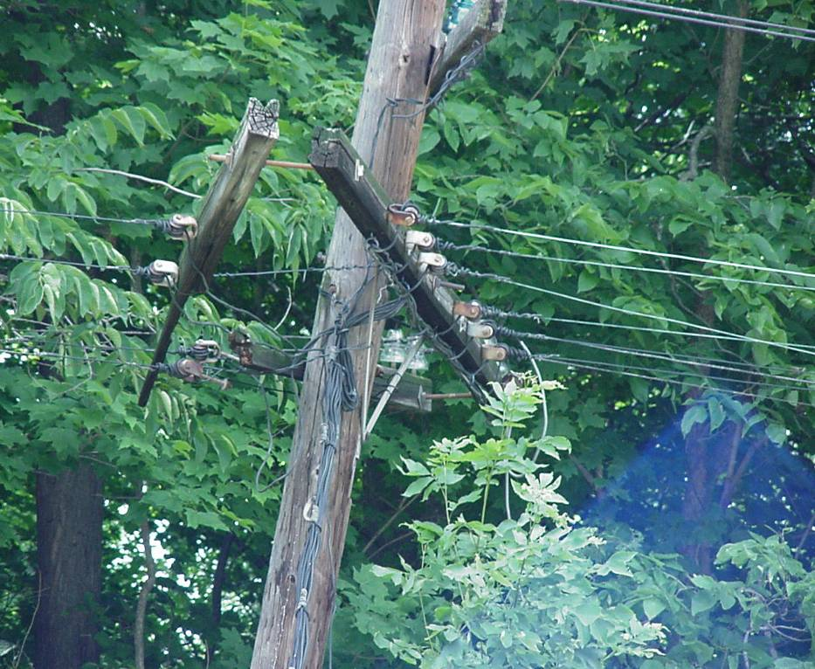
236.71 Signal wires on pole line and aerial cable.
Signal wire on pole line shall be securely tied in on insulator properly fastened to crossarm or bracket supported by pole or other support. Signal wire shall not interfere with, or be interfered by, other wires on the pole line. Aerial cable shall be supported by messenger.
.
81
Notes:
Signal wires carried on pole lines are required to be securely fastened to insulators. Cable used aerially is required to be supported by messenger cable.
The intent of this rule is that all signal wires, including A.C. power supply carried on pole line, are required to be tied in on insulators that are securely fastened to a crossarm or bracket attached to a pole or fixture. Signal wire is required to be maintained clear of all other wires.
Particular attention should be given to vertical runs of cable. These are frequently found tied off at the top of the run at which point the entire weight of the cable is self-supported. The cable is required to be supported throughout by messenger.

Slide 82
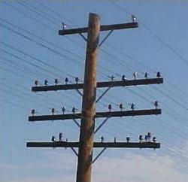
236.73 Open-wire transmission line; clearance to other circuits.
This rule requires that open-wire transmission lines of 750 volts or more be placed at least four feet above the nearest crossarm carrying signal or communication wires.
82
Notes:
The purpose of this rule is to ensure that high voltage transmission lines do not interfere with signal wires and to provide safe separation for signalmen working on open lines. This rule requires that open-wire transmission lines of 750 volts or more be placed at least four feet above the nearest crossarm carrying signal or communication wires.
Applies where power of 750 volts or more is transmitted by open-wire line.

Slide 83
Open Line Wire Definition
§ 236.754 Line, open wire.
An overhead wire line consisting of single conductors as opposed to multiple-conductor cables.

Slide 84
236.74 Protection of insulated wire; splice in underground cable.
Insulated wire must be placed in wire runs, strung on pole line, or messenger, or buried in a manner that it cannot be damaged.
No insulated wire or conductor should be punctured for test proposes.
This rule does not permit temporary installation of cable or wires on top of the ground.
84
Notes:
This rule requires insulated wire be protected from mechanical injury. It prohibits puncturing insulation for test purposes and requires that splice in underground wire have insulation resistance at least that of the wire spliced.
Insulated wire shall be placed in wire runs, strung on pole line, or messenger, or buried in a manner that it cannot be damaged by the operation of apparatus, vehicles, tools, workmen, or by closing doors.
No insulated wire or conductor, whether in housing or outside, should be punctured for test proposes.
This rule does not permit temporary installation of cable or wires on top of the ground.

Slide 85
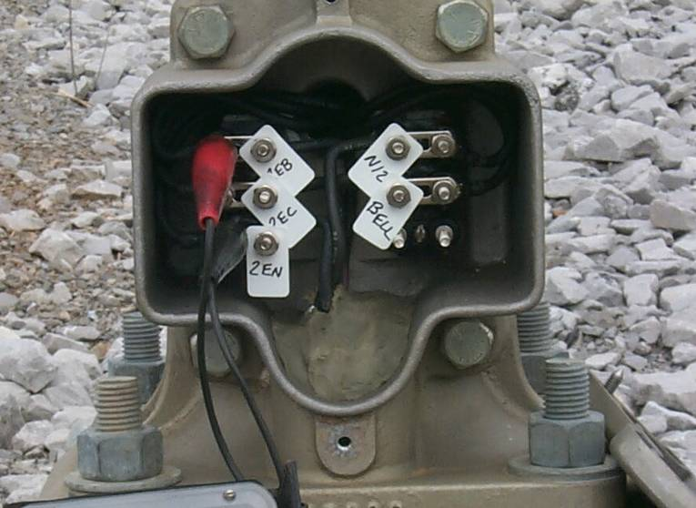
236.76 Tagging of wires and interference of wires or tags with signal apparatus.
Each wire shall be tagged
or otherwise so marked
that it can be identified at
each terminal. Tags and
other marks of identification
shall be made of insulating material and so arranged that tags and wires do not interfere with moving parts of apparatus.
85
Notes:
Each wire is required to be tagged or otherwise marked so it can be identified at each terminal. Nomenclature shall correspond to that of the circuit plan. Tags or other marks of identification are required to be made of insulating material and wires and tags are prohibited from interfering with moving parts of signal apparatus.

Slide 86
Inspections and Tests

Slide 87
236.101 through 236.110 Inspections and Tests; All Systems
236.101 through 236.109 are rules which prescribe certain tests and inspections be performed by the railroad to ensure signal apparatus and/or equipment is in condition to perform it’s intended function. These rules also list the frequency at which these tests shall be performed.
87
Notes:
Refer to the on-the-job training manual for the Task, Condition, and Standard for accomplishing these tests.

Slide 88
236.101 Purpose of inspections and tests; removal from service of relay failing to meet test requirements.
The following inspections and tests shall be made in accordance with specifications of the carrier, subject to approval of the FRA, to determine if the apparatus and/or equipment is maintained in condition to perform its intended function. Electronic device, relay, or other electromagnetic device which fails to meet the requirements of specified tests shall be removed from service, and shall not be restored to service until its operating characteristics are in accordance with the limits within which such device or relay is designed to operate.
88
Notes:
This rule prescribes certain inspections and tests of vital importance be made. The inspections and tests must be performed in accordance with the railroad’s specifications which are subject to FRA approval. Electronic device, relay or other electromagnetic device which fails to meet requirement of specified tests must be removed from service and not restored to service until its operating characteristics are within the limits prescribed by the manufacturer.
Applies to all systems. (See Technical Bulletin S-04-01)

Slide 89
236.101 Purpose of inspections and tests; removal from service of relay failing to meet test requirements.
Purpose of inspections and tests is to determine if operating characteristics of relays, electronic apparatus and electromagnetic devices are within specified values and that apparatus and equipment is being maintained in condition to assure safety of train operation.
89
Notes:
The purpose of inspections and tests is to determine if operating characteristics of relays, electronic apparatus and electromagnetic devices are within specified values and that apparatus and equipment is being maintained in condition to assure safety of train operation.

Slide 90
236.102 Semaphore or searchlight signal mechanism.
a) Semaphore signal mechanism shall be inspected at least once every six months, and tests of the operating characteristics of all parts shall be made at least once every two years.
(b) Searchlight signal mechanism shall be inspected, and the mechanical movement shall be observed while operating the mechanism to all positions, at least once every six months. Tests of the operating characteristics shall be made at least once every two years.
90
Notes:
This rule requires a visual inspection of semaphore and searchlight signal mechanism at least once every six months. Tests of the operating characteristics are required to be made every two years.
The searchlight signal mechanism observation of the operating mechanism can be accomplished by placing a lantern battery across the control terminals of the mechanism and observing its movement; then reversing the battery to observe the mechanisms movement to the opposite position; remove the battery and observe the mechanism return to its neutral position.
Testing of the operational characteristics of a searchlight mechanism or semaphore requires specialized training and equipment.

Slide 91
236.102 Semaphore or searchlight signal mechanism.
Applies to all semaphore and searchlight type signal mechanisms. Record of six-month inspection is not required. The rule requires the observation of the searchlight mechanism while it is operated to all positions during the six-month inspection.
Tests of operating characteristics include pick-up, release, and working values. They may be recorded in either voltage or current values.
91
Notes:
Applies to all semaphore and searchlight type signal mechanisms. Record of six-month inspection is not required. The rule requires the observation of the searchlight mechanism while it is operated to all positions during the six-month inspection.
Tests of operating characteristics include pick-up, release, and working values. They may be recorded in either voltage or current values.

Slide 92
236.103 Switch circuit controller or point detector.
Switch circuit controller, circuit controller, or point detector operated by hand-operated switch or by power-operated or mechanically-operated switch-and-lock movement shall be inspected and tested at least once every three months.
92
Notes:
Switch circuit controllers and point detectors are required to be inspected and tested at least once every three months. Many railroads requires this test to be performed monthly.
Applies to all switch circuit controllers and point detectors in all systems required by Rules 236.6, 236.13, 236.51, 236.57, 236.202, 236.203, 236.334 and 236.342.
Inspection should determine general condition, such as extent of wear of bearings and connections, secure fastening, condition of contacts and shunt wires, wiring, gaskets, etc. in compliance with these rules.
Test should be made with gage placed between the stock rail and the switch point, six inches from the end of switch point, to determine proper adjustment and operation.
This rule is not applicable to a switch that is removed from revenue service and is effectively spiked, clamped, or blocked in proper position. Inspectors should be aware of carrier’s procedure for removal of switches from service.

Slide 93

236.104 Shunt fouling circuit.
Shunt fouling circuit shall be inspected and tested at least once every three months.
The track circuit in the fouling section of a turnout, connected in multiple with the track circuit in the main track.
93
Notes:
Because the shunt fouling section is in multiple (parallel) with the main track circuit it is not part of a closed loop and is not fail safe. Therefore they require special attention. There is no way to build redundancy into the circuit, so performance testing is the only other option. A shunt fouling circuit is required to be inspected and tested at least once every three months. Because of the critical nature of this circuit many railroads require this test monthly.
Applies to all shunt fouling circuits in all systems.
Inspection should determine bonds and fouling wires are applied in compliance with Rules 236.51, 236.56, 236.57, and 236.58 at the proper places, intact and in good condition.
Test should be made at clearance point and on both sides of insulated rail joints between points and frog by connecting 0.06 ohm shunt across rails and determining if the associated track relay is in de-energized position, or the device that functions as a track relay is in its most restrictive condition.
A switch removed from revenue service does not eliminate the requirements of this rule.

Slide 94
236.104 Shunt fouling circuit.
Test should be made at clearance point and on both sides of insulated rail joints between points and frog by connecting 0.06 ohm shunt across rails and determining if the associated track relay is in de-energized position, or the device that functions as a track relay is in its most restrictive condition.
1
3
2
94
Notes:
Applies to all shunt fouling circuits in all systems.
Inspection should determine bonds and fouling wires are applied in compliance with Rules 236.51, 236.56, 236.57, and 236.58 at the proper places, intact and in good condition.
Test should be made at clearance point and on both sides of insulated rail joints between points and frog by connecting 0.06 ohm shunt across rails and determining if the associated track relay is in de-energized position, or the device that functions as a track relay is in its most restrictive condition.

Slide 95
236.105 Electric lock.
Electric lock, except forced‑drop type, shall be tested at least once every two years.
.
95
Notes:
This rule requires that electric locks be tested once every two years. It excludes forced drop type electric locks.
Applies to all systems and interlocking machines.
Locks failing to meet test requirements must be replaced. Electric locks of the non-forced drop type may be removed from service, repaired, and replaced in service.
Tests of operating characteristics include pick-up, release, and working values. They may be recorded in either voltage or current values.

Slide 96
236.106 Relays.
Each relay, the functioning of which affects the safety of train operations, shall be tested at least once every four years except:
(a) Alternating current centrifugal type relay shall be tested at least once every 12 months;
(b) Alternating current vane type relay and direct current polar type relay shall be tested at least once every 2 years; and
(c) Relay with soft iron magnetic structure shall be tested at least once every 2 years.
96
Notes:
This rule requires that each relay used in vital circuits of wayside equipment be tested at intervals prescribed for its type of design.
Applies to relays used in vital circuits of wayside equipment in all systems.
Each relay is required to be tested at least once every four years except:
Centrifugal relays shall be tested at least once every 12 months.
Vane relays and D.C. polar relays shall be tested at least once every two years.
Relays with soft iron magnetic structure which tends to become permanently magnetized, shall be tested at least once every two years.

Slide 97
236.106 Relays.
Applies to relays used in vital circuits of wayside equipment in all systems.
This rule is applicable only to relays in service. A new relay placed in service shall be tested at intervals prescribed for its type of design. A shopped relay, after being tested or repaired in the shop, is not considered in service until it is installed within a signal system.
97
Notes:
This rule is applicable only to relays in service. A new relay placed in service shall be tested at intervals prescribed for its type of design. A shopped relay, after being tested or repaired in the shop, is not considered in service until it is installed within a signal system.

Slide 98
236.106 Relays.
A relay that has broken glass, high resistance contacts, burnt contacts, burnt ribbons, broken or bent contacts, improperly installed ribbons, or evidence of moisture or other foreign matter inside its housing is not properly maintained and is prohibited.
98
Notes:
A relay that has broken glass, high resistance contacts, burnt contacts, burnt ribbons, broken or bent contacts, improperly installed ribbons, or evidence of moisture or other foreign matter inside its housing is not properly maintained and is prohibited.
Tests of operating characteristics include pick-up, release, and working values. They may be recorded in either voltage or current values.

Slide 99
236.107 Ground tests.
(a) Except as provided in paragraph (b) of this section, a test for grounds on each energy bus furnishing power to circuits, the functioning of which affects the safety of train operation, shall be made when such energy bus is placed in service, and shall be made at least once every three months thereafter.
99
Notes:
This rule requires a test for grounds on vital circuitry be made when placed in service and at least once every three months thereafter. The performance standard for this test can be found in 49 CFR 236.2.
This test shall be made at energy buses supplying power to signal control circuits. Use of an appropriate external battery source is an acceptable means of testing.
Test shall be made by measuring the voltage potential between each energy bus and ground. If a voltage potential is detected between energy bus and ground, a current reading shall be taken to determine whether the ground is in excess of that permitted by Rule 236.2. In no case shall a current reading be taken when a train is closely approaching or passing, or a meter connected between an energy bus and ground be left unattended.
The ground test should also be applied to each output circuit of those electronic devices installed to provide one or more individual isolated power supplies from a single common storage battery or power supply. (See FRA Technical Bulletin S-99-03)

Slide 100
236.107 Ground tests.
(b) The provisions of this rule shall not apply to track circuit wires, common return wires of grounded common single‑break circuits, or alternating current power distribution circuits grounded in the interest of safety.
100
Notes:
The test is not required to be made on track circuit wires, AC distribution circuits grounded in the interest of safety or common return wires of grounded common single break circuits.

Slide 101
236.108 Insulation resistance tests, wires in trunking and cables.
(a) Insulation resistance of wires and cables, except wires connected directly to track rails, shall be tested when wires, cables, and insulation are dry. Insulation resistance tests shall be made between all conductors and ground, and between conductors in each multiple conductor cable, and between conductors in trunking, when wires or cables are installed and at least once every ten years thereafter
101
Notes:
This rule requires tests of insulation resistance of wires in trunking and cable be made when installed and at least once every ten years thereafter.
Insulation resistance tests of each wire within trunking or within a cable must be tested to ground and tested against all other wires within the trunking or cable.
Single-conductor wire buried underground shall be tested to ground, but is not required to be tested against all other wires in the cable run.
This rule applies to conductors and cables used for signal power.
Track wires, line wires and case wiring are excluded from the requirements of this rule.
Where a conductor is found with insulation resistance of less than 500,000 ohms, prompt action is required for repair or replacement of the defective wire or cable. Until repair or replacement, insulation resistance tests must be made annually. The reason for this provision is to allow lead time for acquisition of new cable or scheduling of manpower. However, if material and manpower are available to effect repairs or replacement, corrective action shall be taken immediately.
Where a conductor is found with insulation resistance of less than 200,000 ohms, it shall be either repaired or removed from service.

Slide 102
Trunking Definition
§ 236.835 Trunking.
A casing used to protect electrical conductors.

Slide 103
236.108 Insulation resistance tests, wires in trunking and cables.
(b) Then insulation resistance of wire or cable is found to be less than 500,000 ohms, prompt action shall be taken to repair or replace the defective wire or cable and until such defective wire or cable is replaced, insulation resistance test shall be made annually.
(c) In no case shall a circuit be permitted to function on a conductor having an insulation resistance to ground or between conductors of less than 200,000 ohms during the period required for repair or replacement.
103
Notes:
Conductors having insulation resistance of less than 500,000 ohm shall be tested annually.
In no case shall a conductor with insulation resistance of less than 200,000 ohms be left in service.
Tests must be made when wires, cables, and insulation are dry. However, wet conditions do not under any circumstances provide relief from Section 236.2.

Slide 104
236.109 Time releases, timing relays and timing devices.
Time releases, timing relays and timing devices shall be tested at least once every twelve months. The timing shall be maintained at not less than 90 percent of the predetermined time interval, which shall be shown on the plans or marked on the time release, timing relay, or timing device.
104
Notes:
This test requires that time releases, time relays, and timing devices be tested once every twelve months, and that timing be maintained at not less than 90% of the predetermined time interval, which shall be shown on the plans or marked on the time release, time relay, or timing device.
Applies to all systems. Tests should not be conducted while rail traffic is approaching or within any route involved in the test.
This test is required to determine the length of time that a time release, time relay, or timing device must run before the locking is released.
Test shall be conducted by starting time release, time relay or timing device and checking the length of time from the instant the device is started or from the opening of check contact (if used) until release of lever lock or energization of electric stick locking relay.
Releasing time must not be less than 90% of that shown. It may be any amount of time over the predetermined time. Predetermined time interval must be shown on plans or marked on the time release or relay.

Slide 105
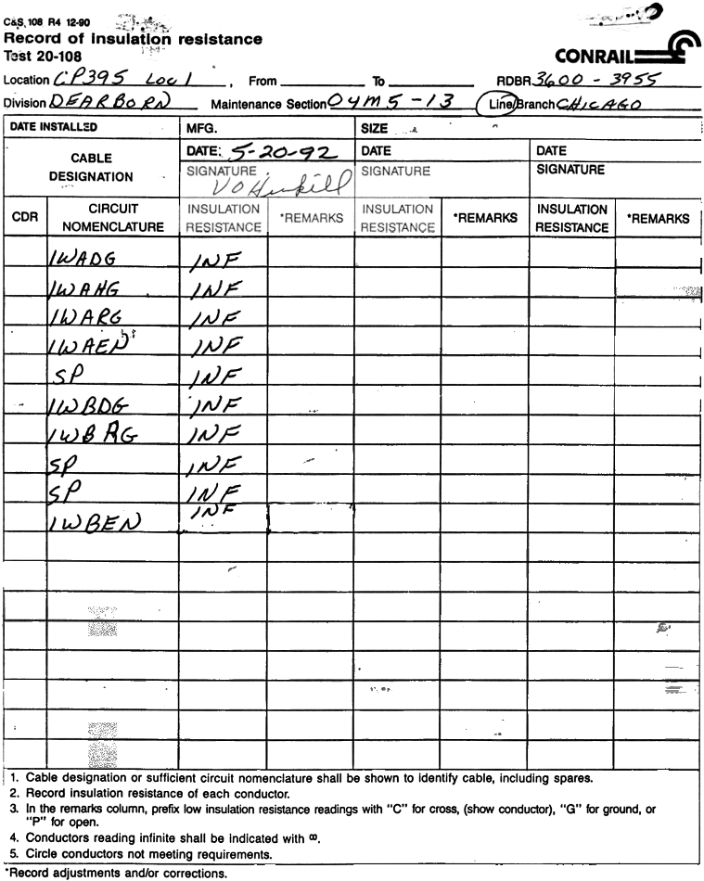
236.110 Results of tests.
236.110 prescribes how the results of each test and inspection shall be recorded, retained and where filed.
105
Notes:
This rule requires that the results of vital tests be recorded and filed in the office of the responsible division officer. It specifies those results to be recorded, prescribes the general format to be used, and requires that the recording be signed by the employee making the test, or electronically coded or identified by number of the automated test equipment used (where applicable).

Slide 106
236.110 Results of tests.
Results of tests made in compliance with § 236.102 to 236.109, inclusive; 236.376 to 236.387, inclusive; 236.576; 236.577; 236.586 to 236.589, inclusive; and 236.917(a) must be recorded on preprinted forms provided by the railroad or by electronic means.
106
Notes:
The result of each required test must be recorded on preprinted or computerized form designed for that purpose or by electronic means, subject to approval by the FRA Associate Administrator for Safety. Results of tests recorded on other than as prescribed above is prohibited.

Slide 107
236.110 Results of tests.
These records must show the name of the railroad, place and date, equipment tested, results of tests, repairs, replacements, adjustments made, and condition in which the apparatus was left. Each record must be:
107
Notes:
The form must show name of carrier, place, date, equipment tested, results of tests, repairs, replacements, adjustments, condition in which apparatus was left.

Slide 108
236.110 Results of tests.
(1) Signed by the employee making the test, or electronically coded or identified by number of the automated test equipment (where applicable);
(2) Unless otherwise noted, filed in the office of a supervisory official having jurisdiction; and
(3) Available for inspection and replication by FRA and FRA-certified State inspectors.
108
Notes:
The record must include the signature of employee making the test or electronically coded or identified by a unique number of the automated test equipment used (where applicable). This required information may be shown in any order the carrier chooses and forms may provide for several tests. Equipment tested refers to each piece of equipment tested in compliance with sections 236.102 to 236.109, inclusive; 236.376 to 236.387, inclusive; 236.576; 236.577; and 236.586 to 236.589 inclusive; and 236.917(a).
Each test record required by this rule shall be filed in the office of a supervisory official having jurisdiction. The divisional officer may be an assistant signal supervisor, signal supervisor, or any other divisional officer. ATC, ATS and ACS test records shall be kept at the locomotive office nearest the test point locations.
Except for the results of tests made in compliance with sections 236.587 and 236.917(a), all such records of tests shall be kept on file until the next record of the same tests are made and put on file. The records of tests made at intervals of less than one year shall be retained for at least one year.

Slide 109
236.110 Results of tests.
(b) Results of tests made in compliance with § 236.587 must be retained for 92 days.
(c) Results of tests made in compliance with § 236.917(a) must be retained as follows:
109
Notes:
The records of results of tests made in compliance with section 236.587 shall be kept on file for at least 92 days.
The records of results of tests made in compliance with section 236.917(a) must be retained as follows:
(1) Results of tests that pertain to installation or modification must be retained for the life-cycle of the equipment tested and may be kept in any office designated by the railroad; and
(2) Results of periodic tests required for maintenance or repair of the equipment tested must be retained until the next record is filed but in no case less than one year.
FRA is requiring that railroads adopting electronic means of recording results of test first obtain FRA’s approval through an application process. Requiring FRA approval will establish a process whereby FRA can ensure all the proper information (prescribed in paragraph (a)) is recorded. FRA will also be able to determine where and how the electronic records will be available for inspection. FRA notes that if tests are performed by Automatic Test Equipment (ATE), the test equipment shall be identified by a unique number, and the test record must reflect that number.
Electronic or automated tracking systems used to meet the requirements contained in paragraph (a) of this section must be capable of being reviewed and monitored by FRA at any time to ensure the integrity of the system. FRA's Associate Administrator for Safety may prohibit or revoke a railroad's authority to utilize an electronic or automated tracking system in lieu of preprinted forms if FRA finds that the electronic or automated tracking system is not properly secured, is inaccessible to FRA, FRA-certified State inspectors, or railroad employees requiring access to discharge their assigned duties, or fails to adequately track and monitor the equipment. The Associate Administrator for Safety will provide the affected railroad with a written statement of the basis for his or her decision prohibiting or revoking the railroad from utilizing an electronic or automated tracking system. (See Technical Bulletin S-96-05)

Slide 110
236.110 Results of tests.
(1) Results of tests that pertain to installation or modification must be retained for the life-cycle of the equipment tested and may be kept in any office designated by the railroad; and
(2) Results of periodic tests required for maintenance or repair of the equipment tested must be retained until the next record is filed but in no case less than one year.
110
Notes:
The records of results of tests made in compliance with section 236.917(a) must be retained as follows:
(1) Results of tests that pertain to installation or modification must be retained for the life-cycle of the equipment tested and may be kept in any office designated by the railroad; and
(2) Results of periodic tests required for maintenance or repair of the equipment tested must be retained until the next record is filed but in no case less than one year.

Slide 111
236.110 Results of tests.
(d) Results of all other tests listed in this section must be retained until the next record is filed but in no case less than one year.
111

Slide 112
236.110 Results of tests.
(e) Electronic or automated tracking systems used to meet the requirements contained in paragraph (a) of this section must be capable of being reviewed and monitored by FRA at any time to ensure the integrity of the system. FRA's Associate Administrator for Safety may prohibit or revoke a railroad's authority to utilize an electronic or automated tracking system in lieu of preprinted forms if FRA finds that the electronic or automated tracking system is not properly secured, ….
112
Notes:
FRA is requiring that railroads adopting electronic means of recording results of test first obtain FRA’s approval through an application process. Requiring FRA approval will establish a process whereby FRA can ensure all the proper information (prescribed in paragraph (a)) is recorded. FRA will also be able to determine where and how the electronic records will be available for inspection. FRA notes that if tests are performed by Automatic Test Equipment (ATE), the test equipment shall be identified by a unique number, and the test record must reflect that number.
Electronic or automated tracking systems used to meet the requirements contained in paragraph (a) of this section must be capable of being reviewed and monitored by FRA at any time to ensure the integrity of the system. FRA's Associate Administrator for Safety may prohibit or revoke a railroad's authority to utilize an electronic or automated tracking system in lieu of preprinted forms if FRA finds that the electronic or automated tracking system is not properly secured,

Slide 113
236.110 Results of tests.
…. is inaccessible to FRA, FRA-certified State inspectors, or railroad employees requiring access to discharge their assigned duties, or fails to adequately track and monitor the equipment.
The Associate Administrator for Safety will provide the affected railroad with a written statement of the basis for his or her decision prohibiting or revoking the railroad from utilizing an electronic or automated tracking system.
113
Notes:
is inaccessible to FRA, FRA-certified State inspectors, or railroad employees requiring access to discharge their assigned duties, or fails to adequately track and monitor the equipment. The Associate Administrator for Safety will provide the affected railroad with a written statement of the basis for his or her decision prohibiting or revoking the railroad from utilizing an electronic or automated tracking system.

Slide 114
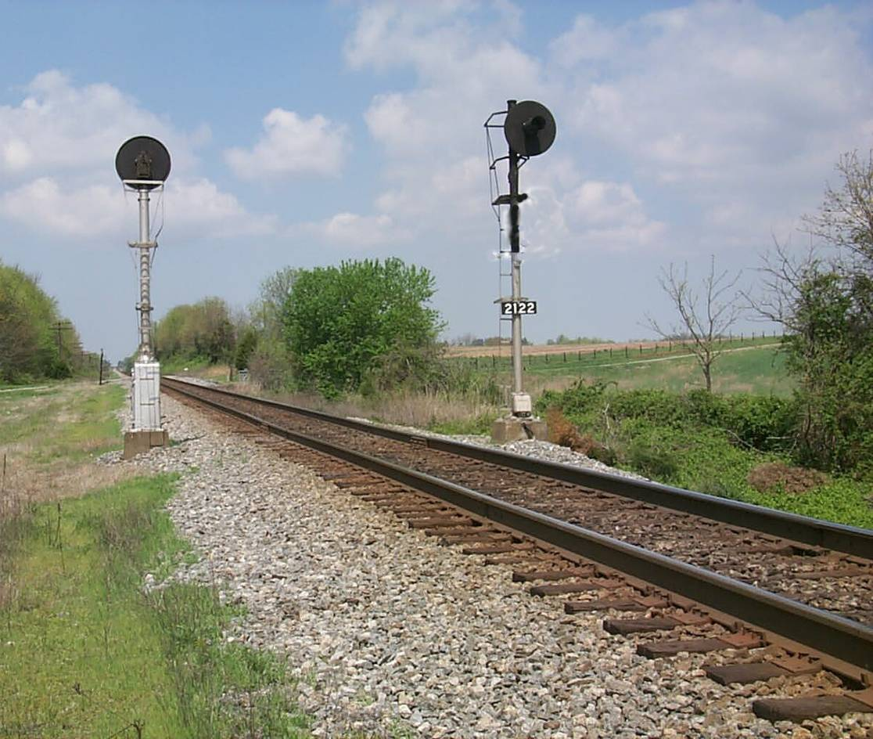
S&TC FUNDAMENTALS
49 CFR 236
Subpart A
All Systems
The End
114

