Slide 1
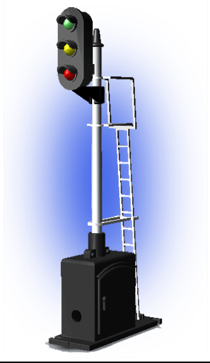
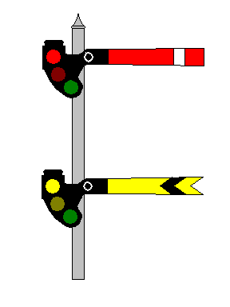
Signal and Train Control
RULES, STANDARDS, AND INSTRUCTIONS (R,S&I)
STC – 3a
Movable Bridges
Subpart C
Notes:
Movable bridges are an integral part of the U.S. transportation system having been developed in concert with the development of the railroad network. Movable bridges have proven to be an economical solution to the problem of how to carry rail line across an active waterway. One could consider a movable bridge as a intermodal manual interlocking plant. In fact, that is what they are and must be designed, installed, tested, and maintained according to Federal regulations.
While railroad bridges are engineered to handle heavy loads and are therefore very heavy, the positioning of the bridge is held to tight tolerances.

Slide 2
Learning Objectives
Understand that movable railroad bridges are interlockings and the requirements of 49 CFR 236.312 in the design standards of these bridges.
Understand the requirements of 49 CFR 236.387 for maintaining and testing movable bridge installations.

Slide 3
CAUTION
The following presentation was developed to provide general information only. For detailed compliance information please refer to 49 CFR 236 – Rules, Standards and Instructions, Subpart C, 236.312, 236.387, and the S&TC technical manual. It is recommended that each employee refer to appropriate manuals and regulations when dealing with any specific issue.
3
Notes:
When in doubt, go to the book!

Slide 4
Information
The FRA Rules, Standards, and Instructions are considered to be the minimum standard allowed for the installation, inspection, maintenance, and repair of signal and train control systems, devices, and appliances. Each railroad may adopt more stringent standards. Refer to your railroad’s signal standard and instruction manual for further guidance.

Slide 5
Movable Bridges and Interlocking
Types of movable bridges:
Bascule
Lift
Swing
For a proceed aspect the bridge must be:
Seated and locked
Surface and alignment
Derails down (if applicable)
Notes:
There are various types of movable bridges, but most fall into three categories of spans: bascule, lift and swing. Regardless of the type of bridge, the sequence of operation for rail traffic is as follows:
The bridge must be seated, then locked.
The movable rails must be determined to be in proper surface and alinement with the rails on the abutment or fixed span.
Derails, if any, must be placed in non-derailing position.
Interlocked signal may then be operated to display proceed aspect.
For water traffic the sequence of operation is precisely the opposite.
All signals must be at STOP.
Derails, if any, must be in derailing position.
Movement of rails and bridge structure must be completed to the open position.
Water traffic may then be cleared to proceed through bridge area.

Slide 6

Types of Bridges
Bascule
Lift
Swing
Notes:
A bascule bridge (sometimes referred to as a drawbridge) is a movable bridge with a counterweight that continuously balances a span, or "leaf", throughout its upward swing to provide clearance for boat traffic. It may be single or double leafed.
The name comes from the French term for balance scale, which employs the same principle. Bascule bridges are the most common type of movable span because they open quickly and require relatively little energy to operate, while providing the possibility for unlimited vertical clearance for marine traffic.

Slide 7
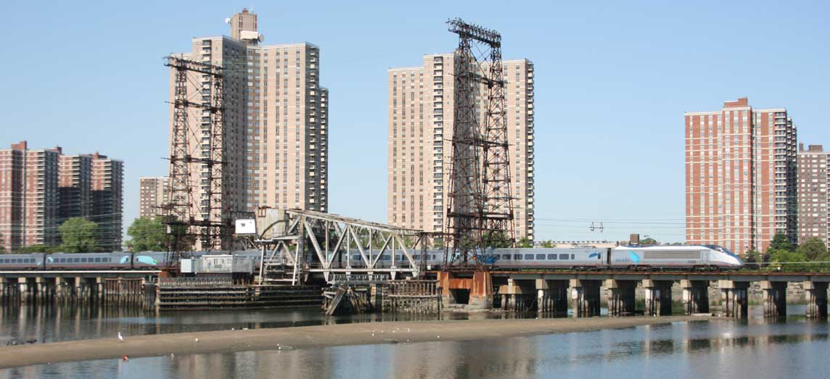
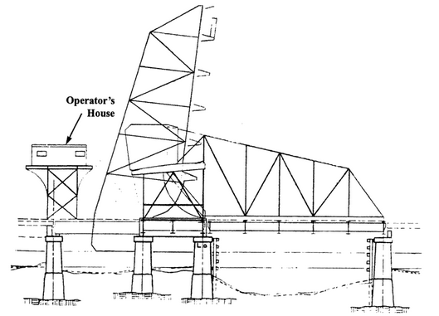
Bascule Bridges
Penham Bay Bascule Bridge – New York
Built in 1907
Notes:
The Pelham Bay Bridge in New York is a typical single-leaf Scherzer bascule railroad bridge. The design was developed by William Scherzer in 1893 and is simple and widely used. The Pelham Bay Bridge is of through truss design with a span of 81 feet 7 inches. Railroad bascule bridges are always single span as the heavy dynamic loads associated with heavy rail weight preclude a joint at midspan.

Slide 8
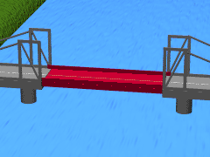
Types of Bridges
Bascule
Lift
Swing
Notes:
A vertical-lift bridge or just lift bridge is a type of movable bridge in which a span rises vertically while remaining parallel with the deck.
The vertical lift offers several benefits over other movable bridges such as the bascule and swing span bridges. Generally speaking they cost less to build for longer movable spans. The counterweights in a vertical lift are only required to be equal to the weight of the deck, whereas bascule bridge counterweights must weigh several times as much as the span being lifted. As a result, heavier materials can be used in the deck, and so this type of bridge is especially suited for heavy railroad use.

Slide 9
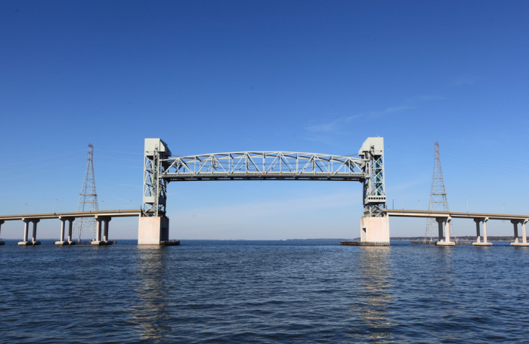
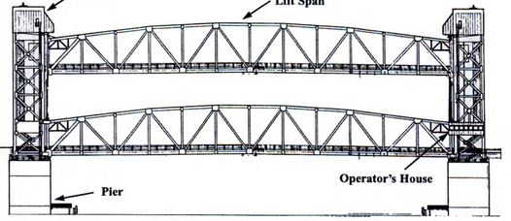
Lift bridges
James River Lift Bridge
Notes:
The biggest disadvantage to the vertical-lift bridge (in comparison with many other designs) is the height restriction for vessels passing under it. This is a result of the deck remaining suspended above the passageway.

Slide 10
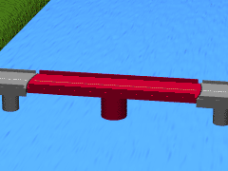
Types of Bridges
Bascule
Lift
Swing
Notes:
A swing bridge is a movable bridge that has as its primary structural support a vertical locating pin and support ring, usually at or near to its center of gravity, about which the turning span can then pivot horizontally. Small swing bridges as found over canals may be pivoted only at one end, opening as would a gate, but require substantial underground structure to support the pivot.
In its closed position, a swing bridge carrying a railroad over a river or canal, for example, allows traffic to cross. When a water vessel needs to pass the bridge, railroad traffic is stopped (usually by interlocked signals), and then motors rotate the bridge horizontally about its pivot point. The typical swing bridge will rotate approximately 90 degrees, or one-quarter turn; however, a bridge which intersects the navigation channel at an oblique angle may be built to rotate at whatever degree is necessary in order to clear the channel.

Slide 11
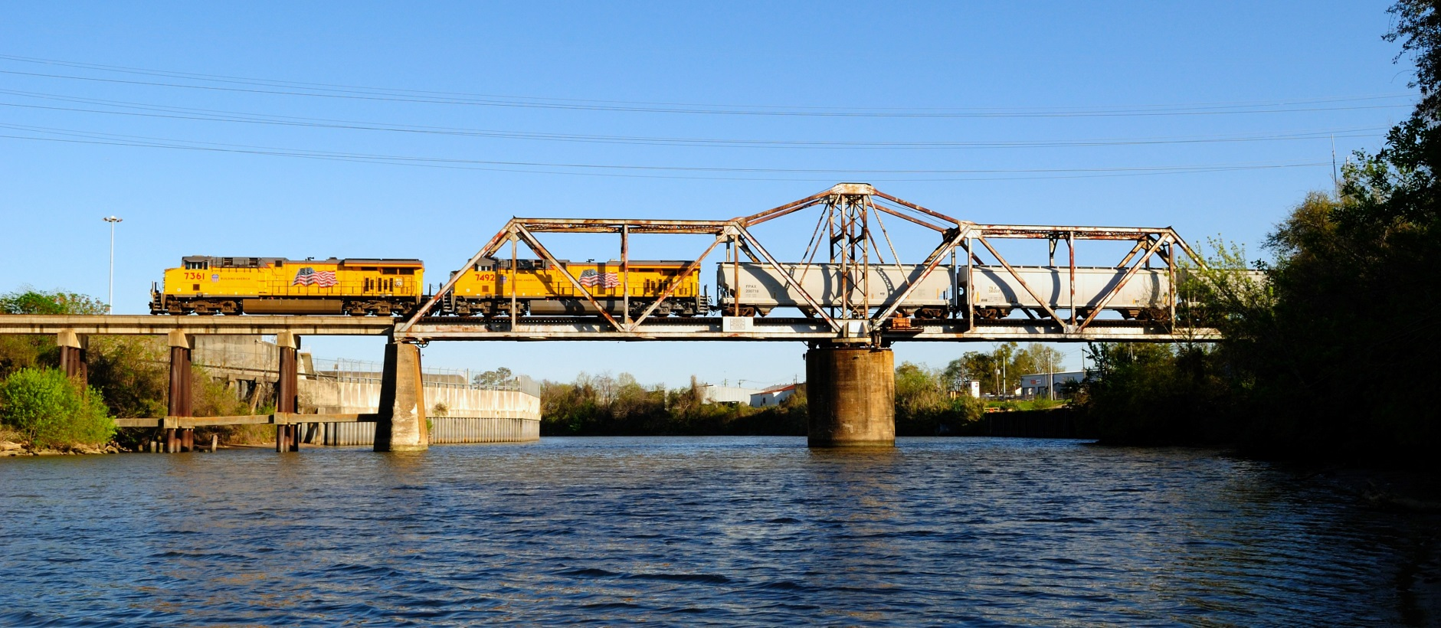
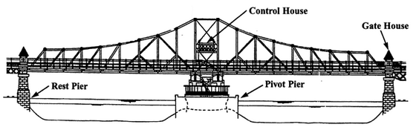
Swing Bridges
Swing Bridge – Union Pacific
Notes:
Swing spans movable bridges are widely used by railroads. However, they only allow a limited opening and the center pivot pier is often viewed as a significant impediment to water navigation. The pivot pier could also require an elaborate, difficult to maintain, and expensive fender system.

Slide 12
236.312 Movable bridge, interlocking of signal appliances with bridge devices.
= Test Point
Movable Rails
Wedges or Rollers
Notes:
This rule requires that interlocking of movable bridge be so interconnected with bridge devices that bridge must be properly locked and track properly aligned before a signal governing movements over the bridge can display an aspect to proceed.

Slide 13
Bascule Bridge
= Test Point
Hinged End
Notes:
Bascule spans require bridge locking devices that can drive locking members between the movable span and abutment or fixed span only when the bridge is properly seated. Only the lift end of bascule spans must be locked. When the locking members are within one inch of being fully driven, the bridge is considered to be properly locked. Bridge locks are not designed to hold the movable span down, but to determine that the bridge is properly seated. The movable rails of bascule frequently correctly aligned before the bridge seats, hence the need of bridge locks.
Rails which slide or lower to butt with those of the abutment or fixed span, or risers that slide into position in the movable joint must be locked in proper alinement.
Conley frogs are designed to be self aligning and are not required to be locked or electrically checked for alinement. They are required to be checked for surface.
All movable joints are required to be locked or electrically determined to be in proper surface except for those on the hinged end of bascule bridges. If surface is checked electrically, closely inspect plungers and mechanical connections for binding.
Movable joints are "soft" joints. The three-eighths inch requirement of this rule was not revised by the Track Safety Standards and movable joints are not required to be maintained to meet these standards.
At automatic and remote-controlled movable bridge interlockings, those devices used to detect and govern movement of water traffic such as audible devices, signal aspects and electric eyes are considered interlocking appliances and must operate in their proper sequence and perform their intended function.
All the rules of Subpart C are applicable to interlocked drawbridges.
Test of bridge locking is determined by withdrawing locking member or wedge more than one inch and determining whether or not control circuits are opened.
Test of movable rails for alinement is made by measuring the difference in aligned rails. Slide and lift rails should also be tested by manually applying lateral force to the movable rails.
Test of movable rails for surface should be made by placing a one-half inch obstruction on each rail seat and determining whether or not rail can be locked or, if electrically checked, whether or not circuit controller contacts are opened.
The RS&I does not define bridge locking, therefore it is permissible for the carrier to utilize any type of bridge locking they desire. The only requirement for the bridge lock is that the movable span must be locked with the fixed span.
Where an emergency release is provided at bridge locking, it is required to be kept locked or sealed to prevent the emergency release from being used for routine day to day operation. Operation of the emergency release shall not defeat the time or approach locking circuits.

Slide 14
Lift Span
= Test Point
Notes:
Lift spans require bridge locking devices that can drive locking members between the movable span and abutment or fixed span only when the bridge is properly seated. Locking devices are required on both ends of lift spans. When the locking members are within one inch of being fully driven, the bridge is considered to be properly locked. Bridge locks are not designed to hold the movable span down, but to determine that the bridge is properly seated. The movable rails of lift bridges frequently correctly aligned before the bridge seats, hence the need of bridge locks.
Rails which slide or lower to butt with those of the abutment or fixed span, or risers that slide into position in the movable joint must be locked in proper alinement.
Conley frogs are designed to be self aligning and are not required to be locked or electrically checked for alinement. They are required to be checked for surface.
All movable joints are required to be locked or electrically determined to be in proper surface except for those on the hinged end of bascule bridges. If surface is checked electrically, closely inspect plungers and mechanical connections for binding.
Movable joints are "soft" joints. The three-eighths inch requirement of this rule was not revised by the Track Safety Standards and movable joints are not required to be maintained to meet these standards.
At automatic and remote-controlled movable bridge interlockings, those devices used to detect and govern movement of water traffic such as audible devices, signal aspects and electric eyes are considered interlocking appliances and must operate in their proper sequence and perform their intended function.
All the rules of Subpart C are applicable to interlocked drawbridges.
Test of bridge locking is determined by withdrawing locking member or wedge more than one inch and determining whether or not control circuits are opened.
Test of movable rails for alinement is made by measuring the difference in aligned rails. Slide and lift rails should also be tested by manually applying lateral force to the movable rails.
Test of movable rails for surface should be made by placing a one-half inch obstruction on each rail seat and determining whether or not rail can be locked or, if electrically checked, whether or not circuit controller contacts are opened.
The RS&I does not define bridge locking, therefore it is permissible for the carrier to utilize any type of bridge locking they desire. The only requirement for the bridge lock is that the movable span must be locked with the fixed span.
Where an emergency release is provided at bridge locking, it is required to be kept locked or sealed to prevent the emergency release from being used for routine day to day operation. Operation of the emergency release shall not defeat the time or approach locking circuits.

Slide 15
Swing Bridge
= Test Point
Movable Rails
Wedges or Rollers
Notes:
Swing spans are properly seated when the wedges are driven to lift the span off the center pier. Consider swing spans locked when the wedges are within one inch of being fully driven. The latches of swing spans are not bridge locking members, but are provided to stop swing bridges in proper alinement as it is being closed.
Rails which slide or lower to butt with those of the abutment or fixed span, or risers that slide into position in the movable joint must be locked in proper alinement.
Conley frogs are designed to be self aligning and are not required to be locked or electrically checked for alinement. They are required to be checked for surface.
All movable joints are required to be locked or electrically determined to be in proper surface except for those on the hinged end of bascule bridges. If surface is checked electrically, closely inspect plungers and mechanical connections for binding.
Movable joints are "soft" joints. The three-eighths inch requirement of this rule was not revised by the Track Safety Standards and movable joints are not required to be maintained to meet these standards.
At automatic and remote-controlled movable bridge interlockings, those devices used to detect and govern movement of water traffic such as audible devices, signal aspects and electric eyes are considered interlocking appliances and must operate in their proper sequence and perform their intended function.
All the rules of Subpart C are applicable to interlocked drawbridges.
Test of bridge locking is determined by withdrawing locking member or wedge more than one inch and determining whether or not control circuits are opened.
Test of movable rails for alinement is made by measuring the difference in aligned rails. Slide and lift rails should also be tested by manually applying lateral force to the movable rails.
Test of movable rails for surface should be made by placing a one-half inch obstruction on each rail seat and determining whether or not rail can be locked or, if electrically checked, whether or not circuit controller contacts are opened.
The RS&I does not define bridge locking, therefore it is permissible for the carrier to utilize any type of bridge locking they desire. The only requirement for the bridge lock is that the movable span must be locked with the fixed span.
Where an emergency release is provided at bridge locking, it is required to be kept locked or sealed to prevent the emergency release from being used for routine day to day operation. Operation of the emergency release shall not defeat the time or approach locking circuits. (See Technical Bulletin S-05-01)

Slide 16
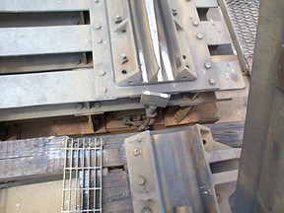
FRA Movable Bridge
Correct Surface and Seated
Notes:
Signal governing movements over movable bridge protected by interlocking must not display aspect to proceed with the track rail on the movable span more than three-eights inch from correct surface with the rail seating device on the bridge abutment or fixed span.

Slide 17
Movable Bridge
Inspection Procedures
When checking for correct surface, the most critical area is that area where the train wheels transition from the fixed rails to the movable rails.
Surface checks should be made by placing the appropriate gage in close proximity to this critical area.

Slide 18
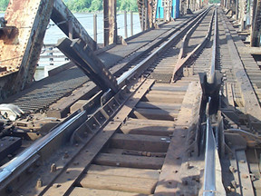
Movable Bridge
Correct Alignment
Notes:
Signal governing movements over movable bridge protected by interlocking can must not display aspect to proceed with the track rail on the movable span more than three-eighths inch from correct alinement with the rail seating device on the bridge abutment or fixed span.

Slide 19
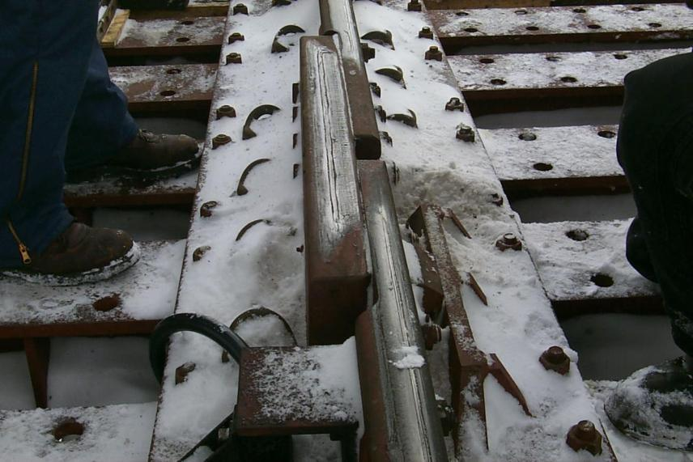
Movable Bridge
Inspection Procedures
Notes:
Slide and lift rails should be inspected for both surface and alignment. Closely inspect the movable rails with fixed rails and ensure alignment of rails which move laterally in excess of 3/8 inch.

Slide 20
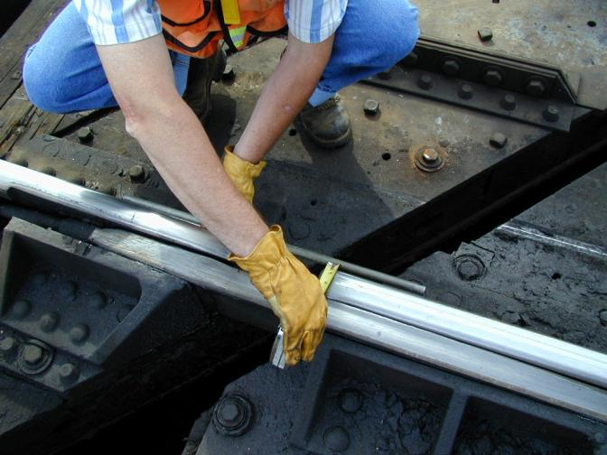
FRA Movable Bridge
Inspection Procedures
Notes:
Bridges which are equipped with easer bars that align and laterally support rails should be tested with a straight edge applied to the running side (or inside gage portion) of the rail. Rails should not exceed “misalignment” by more than 3/8 inch. (236.312.04)

Slide 21
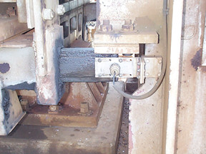
FRA Movable Bridge
Inspection Procedures
Notes:
On lift and bascule bridges the locking test is usually accomplished by the movement of the locking member, and ensure that bridge locking circuit assumes it’s most restrictive state when the locking member is withdrawn in excess of one inch. Sometimes it is beneficial to place a mark on some part of the bridge structure or locking apparatus which will depict when the locking member travels one inch.

Slide 22
Swing Bridge
= Test Point
Movable Rails
Wedges or Rollers
Notes:
On swing bridges, consider bridge locked when wedges or rollers are within one inch of being fully driven. The locking test is usually performed by incrementally withdrawing wedges or rollers and measuring the distance the wedge or roller has traveled. Test to ensure that bridge locking circuit assumes it’s most restrictive state when wedges or rollers have been withdrawn in excess of one inch.

Slide 23
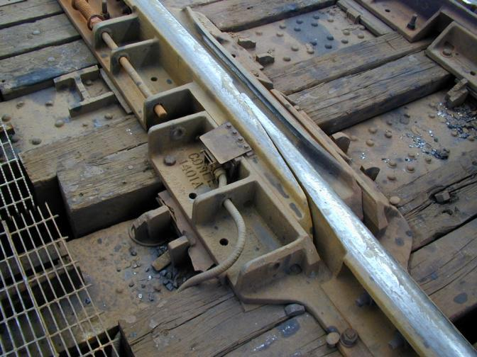
Movable Bridge
Proximity switch being used to monitor correct surface.
Notes:
Some bridges may be equipped with “non-conventional” sensor type components which indicate locking, surface, and alignment. These devices are acceptable as long as they function in a “fail-safe” manner and the design includes software checks or some other type of “fail-safe” circuit design.

Slide 24
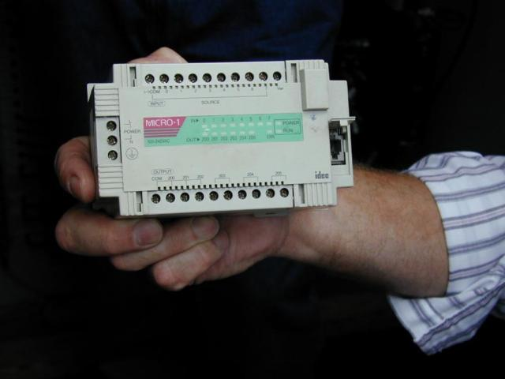
Movable Bridge
Programmable Logic controller used in connection with proximity switches, micro-switches, to ensure vitality
Notes:
These devices should be tested in the same manner as other conventional signal components. Be sure to perform adequate tests to ensure that these devices are operating in proper sequence and are installed to adequately perform their intended function.

Slide 25
Movable Bridge Inspection Records
When inspecting and testing movable bridges it is recommended that the railroad record and maintain inspection data in greater detail than is required by 49 CFR 236.110. These detailed record can be compared over time to determine trend or significant changes in the bridge structure and mechanism.

Slide 26
236.387 Movable Bridge Locking.
Movable bridge locking shall be tested once each year.
Application:
Applies to movable bridge interlockings. Test shall be made by displacing bridge locking members more than one inch from their proper position and determine that signals cannot be cleared to authorize movement over the movable bridge.
Notes:
This rule requires movable bridge locking to be tested at least once a year.
Applies to movable bridge interlockings. Test shall be made by displacing bridge locking members more than one inch from their proper position and determine that signals cannot be cleared to authorize movement over the movable bridge.
When movable bridge is equipped with circuit controllers with or without mechanical rail locks, movable rails shall be displaced more than 3/8 inch from their correct surface or alignment with adjacent fixed rail by an obstruction. With the movable rail thus displaced, the rail lock should not lock up and if rail lock is not provided, signals cannot be cleared to authorize movement over the movable bridge.
This test should be made for each rail lock or circuit controller on the bridge that checks for correct rail alinement or surface.
Check operation of all circuit controllers connected to the wedges, latches, rail locks, etc., to see that contacts make or break when corresponding functions are in their proper position.

Slide 27

S&TC FUNDAMENTALS
49 CFR 236
Subpart C
Movable Bridges
The End
27

